Slide 1
The Growing Threat of Antibiotic Resistance in Post-Acute Care
Jennifer Han, MD, MSCE
Assistant Professor of Medicine and Epidemiology
Division of Infectious Diseases
Associate Healthcare Epidemiologist
Hospital of the University of Pennsylvania
November 17th, 2016

Slide 2
Disclosures
None to report

Slide 3
Pa. woman first in U.S. diagnosed with new
drug-resistant superbug
Are we headed for an antibiotic apocalypse? Deadly superbugs
Deadly 'superbugs' invade U.S. health care facilities
DEADLY BACTERIA THAT DEFY DRUGS OF LAST RESORT
‘Nightmare’ bacteria on warpath

Slide 4
Objectives
Discuss the increasing importance of post-acute care facilities in healthcare delivery
Describe the epidemiology of multidrug-resistant organisms (MDROs) in post-acute care facilities
MRSA
Clostridium difficile
Multidrug-resistant gram-negative bacteria
Carbapenem-resistant Enterobacteriaceae
Discuss interventions and future directions for preventing the emergence of MDROs in long-term care settings

Slide 5
Antibiotic resistance in the 21st century:
“no institution is an island”
Antibiotic Resistance
Long term acute care hospital
Adapted from Jarvis WR, Emerg Infect Dis 2001;7:170.

Slide 6
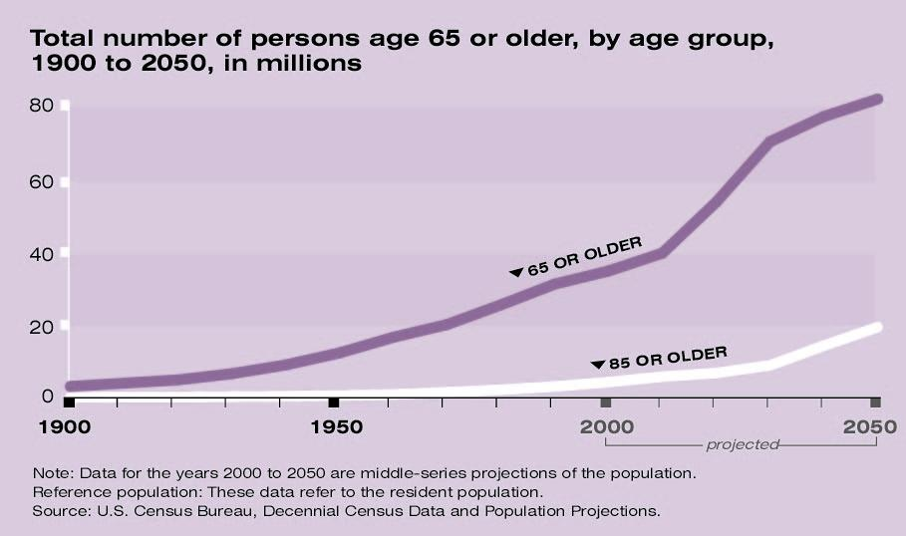
Changes in the aging population
2012: ~12% of population
2030: ~23% of population
~13% of population worldwide

Slide 7
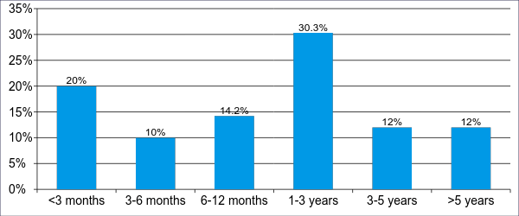
What is a long-term care facility?
Residential setting for individuals with functional disabilities
Nursing homes, skilled nursing facilities (SNFs), VA Community Living Centers (CLCs)
~70% of people ≥ 65 years will require some long-term care services
Department of Health and Human Services
CMS Nursing Home Compendium, 2013

Slide 8
Antibiotic resistance in nursing homes
Facility characteristics
∙ Prolonged LOS
∙ Transfers
∙ Interaction with other residents and staff
Resident characteristics
Practices
∙ Aging
∙ Immune senescence
∙ Comorbidities
∙ Functional disability
∙ Indwelling devices
∙ Antibiotic use
∙ Infection prevention practices and resources
Colonization/
infection with MDROs
Mody L. Clin Infect Dis 2011;52.
Van Buul L. J Amer Med Dir Assoc 2012;568.
.

Slide 9
The nursing home population
Characteristic
Age ≥ 65 years | 85%
Number of ADL impairments 4-5 | 62%
Cognitive impairment Moderate Severe | 26% 38%
Incontinence | 36%
Stage ≥2 pressure ulcers | 6%
Department of Health and Human Services
CMS Nursing Home Compendium, 2013

Slide 10
Antibiotic resistance in nursing homes
Facility characteristics
∙ Prolonged LOS
∙ Transfers
∙ Interaction with other residents and staff
Resident characteristics
Practices
∙ Aging
∙ Immune senescence
∙ Comorbidities
∙ Functional disability
∙ Indwelling devices
∙ Antibiotic use
∙ Infection prevention practices and resources
Colonization/
infection with MDROs
Mody L. Clin Infect Dis 2011;52.
Van Buul L. J Amer Med Dir Assoc 2012;568.
.

Slide 11
Antibiotic resistance in nursing homes
Facility characteristics
∙ Prolonged LOS
∙ Transfers
∙ Interaction with other residents and staff
Resident characteristics
Practices
∙ Aging
∙ Immune senescence
∙ Comorbidities
∙ Functional disability
∙ Indwelling devices
∙ Antibiotic use
∙ Infection prevention practices and resources
Colonization/
infection with MDROs
1. Mody L. CID 2011;52.
2. Van Buul L. JAMDA 2012;568.
.

Slide 12
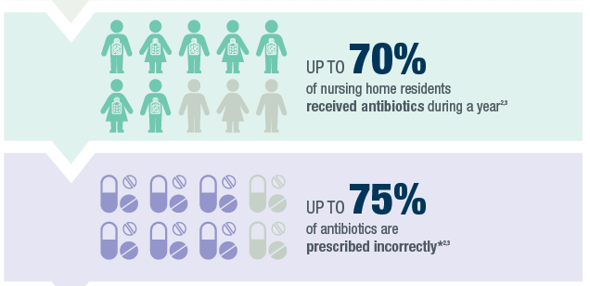

Slide 13
What is an LTACH?
Hospital Length of Stay
• 1975 = 11.4 days
• 2004 = 6.5 days
• 2006 - 2011 = 4.8 days
Require hospitalization for ≥ 25 days (CMS)
Complex medical conditions → 90% had LOS in hospital of ≥14 days
Acuity of care meets acute care hospital requirements
Licensed and credentialed under same criteria as short-term acute care hospitals
1980s: LTACHs
National Center for Health Statistics. Summary Health Statistics
for the US Population: National Health Interview Survey, 2008
Healthcare Cost and Utilization Project.

Slide 14
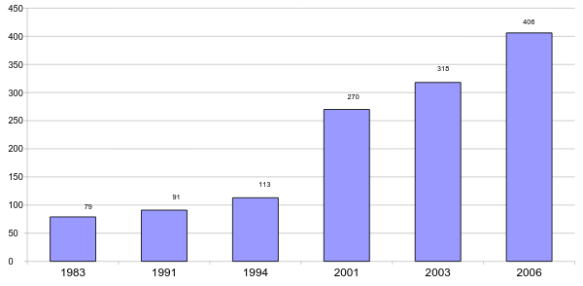
LTACH Growth
Currently ~450 in the U.S.
Moratorium expires September 2017
Centers for Medicare and Medicaid Services, 2008

Slide 15
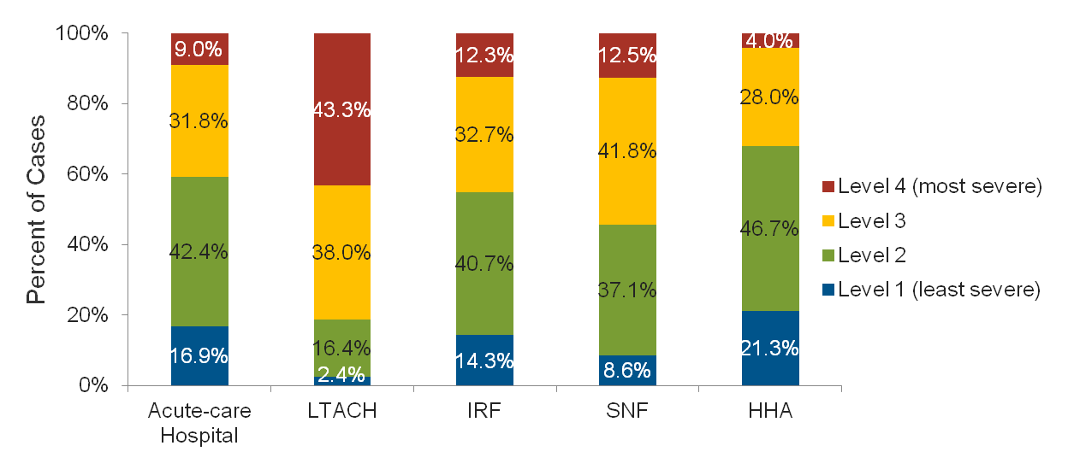
Patient severity of illness varies by healthcare setting
~40% of discharges to LTACHs → chronic mechanical ventilation
Medicare Payment Advisory Commission. (2010). March Report to the Congress: Long-term Care Hospital Services. Washington, DC.
The Moran Company. Analysis of 2008 Medicare acute-care hospital data sorted by APR-DRG group.

Slide 16
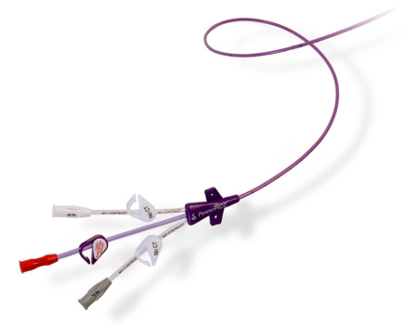
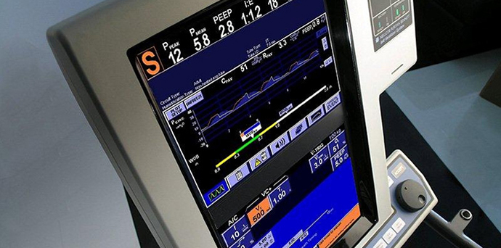
LTACHs: the “Perfect Storm” for emergence of antibiotic resistance
Complex patient population with average LOS >25 days
Device utilization high
Up to ~75% central venous catheter use
Rate of antibiotic use high
Use of broad-spectrum antibiotics higher than 50th-75th percentile of ICU use
Logistics of isolation and cohorting
Gould, et al Infect Control Hosp Epidemiol 2006;27.
Furuno, et al. Am J Infect Control 2008;36.
Munoz-Price. Clin Infect Dis 2009;49.

Slide 17
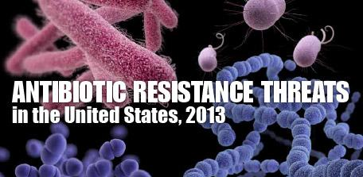
CRE
C. difficile
“…require urgent public health attention to identify infections and to limit transmission.”
MRSA

Slide 18
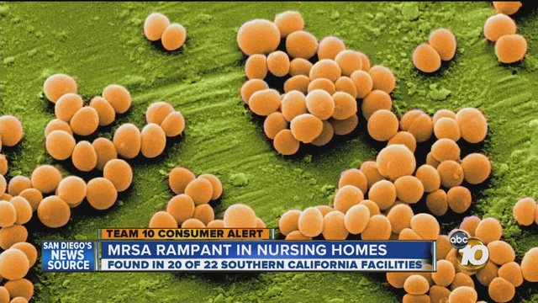
Epidemiology of MRSA in nursing homes

Slide 19
The epidemiology of MRSA in nursing homes
Burden in NHs significantly less well-studied than in acute care hospitals → less standardized infection prevention policies
Prevalence of colonization: ~25-50%
Residents with indwelling devices: ~75%
Acute care hospitals: 6-12%; ICUs: 7-24%
Highly dependent on local prevalence and importation pressure
Risk factors for MRSA colonization
Older age ∙ Poor functional status
Prior antibiotic therapy ∙ Indwelling devices
Low nursing : bed ratio ∙ ↓ social engagement levels
Environmental contamination of common areas
Stone N. Infect Control Hosp Epidemiol 2008;29.
Mody L. Clin Infect Dis 2008;46.
Manzur A. Clin Microbiol Infect 2009;15(Suppl).
Reynolds C. Infect Control Hosp Epidemiol 2011;32
Murphy C. BMC Infect Dis 2012;12..

Slide 20
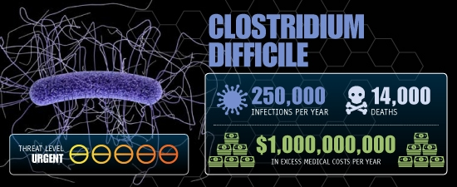
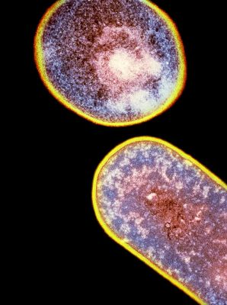
Clostridium difficile in nursing homes
C. diff no longer just a hospital superbug

Slide 21
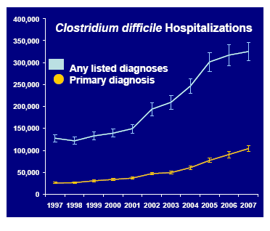
National Estimates of U.S. Short-Stay Hospital Discharges with C. difficile
Campbell et al. Infect Control Hosp Epidemiol 2009:30.

Slide 22
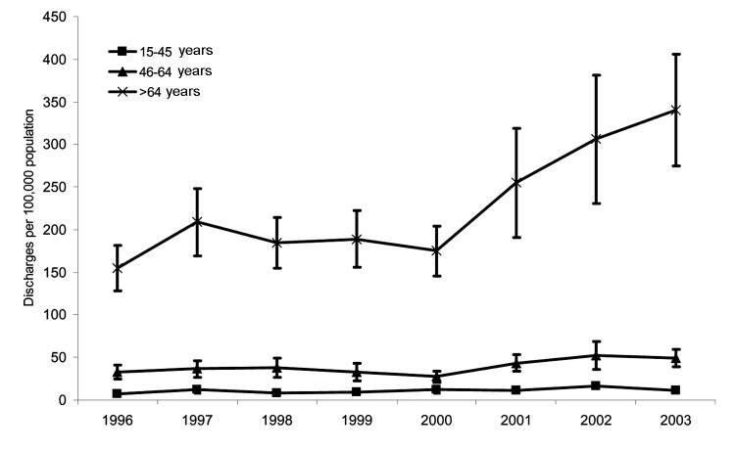
National Estimates of U.S. Short-Stay Hospital
Discharges with C. difficile by Age
McDonald LC, et al. Emerg Infect Dis. 2006;12(3):409-15

Slide 23
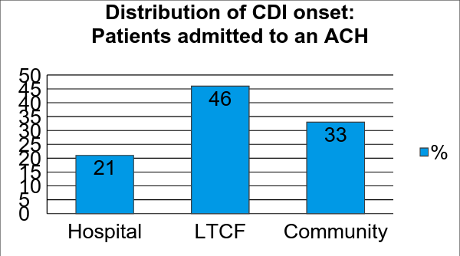
Changing epidemiology of C. difficile in nursing homes
400 cases of CDI, 2005 - 2010
>300,000 cases/year
$2.2 billion in excess costs
16,500 deaths/year
Garg S, et al. Dig Dis Sci 2013;58
Dubberke et al. Emerg Infect Dis. 2008;14.
Dubberke et al. Clin Infect Dis. 2008;46.
.

Slide 24
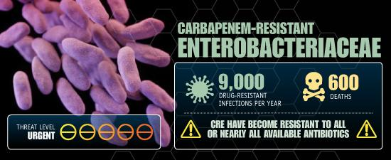
Carbapenem-resistant Enterobacteriaceae

Slide 25
2001
Adapted from CDC.gov

Slide 26
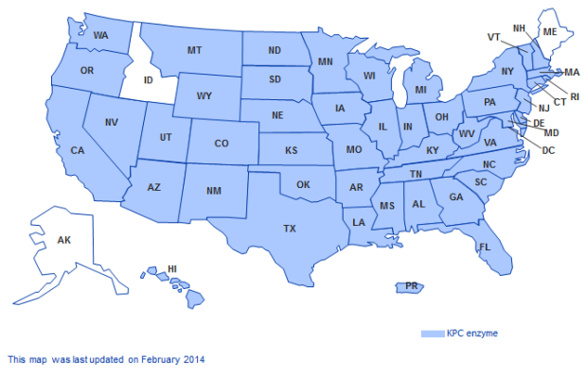
Geographical Distribution of KPC-Producing Organisms
2014
Adapted from CDC.gov

Slide 27
Carbapenem-Resistant Enterobacteriaceae (CRE) a major therapeutic challenge
Antimicrobial agent | Interpretation |  | Antimicrobial agent | Interpretation
Amikacin | I |  | Ertapenem | R
Amox/clav | R |  | Gentamicin | R
Ampicillin | R |  | Imipenem | R
Aztreonam | R |  | Meropenem | R
Cefazolin | R |  | Gentamicin | R
Cefpodoxime | R |  | Tobramycin | R
Cefotaxime | R |  | TMP-SMX | R
Cetotetan | R
Ceftriaxone | R
Ceftazidime | R |  | Polymyxin B | ≤ 2 μg/mL
Cefepime | R |  | Colistin | ≤ 2 μg/mL
Ciprofloxacin | R |  | Tigecycline | ≤ 2 μg/mL

Slide 28
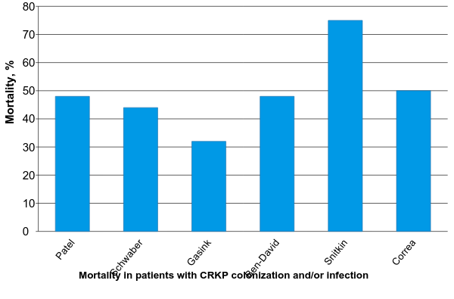
Carbapenem resistant K. pneumoniae (CRKP): clinical outcomes in acute care hospitals

Slide 29
Prevalence of carbapenem-resistant Enterobacteriaceae in acute care hospitals versus LTACHs
U.S. surveillance of healthcare-associated infections
National Healthcare Safety Network (NHSN)
Facility type | Number of facilities with CRE from a CAUTI or CLABSI (2012) | Total facilities performing CAUTI or CLABSI surveillance (2012) | (%)
Acute care hospitals | 145 | 3,716 | (3.9)
LTACHs | 36 | 202 | (17.8)

Slide 30
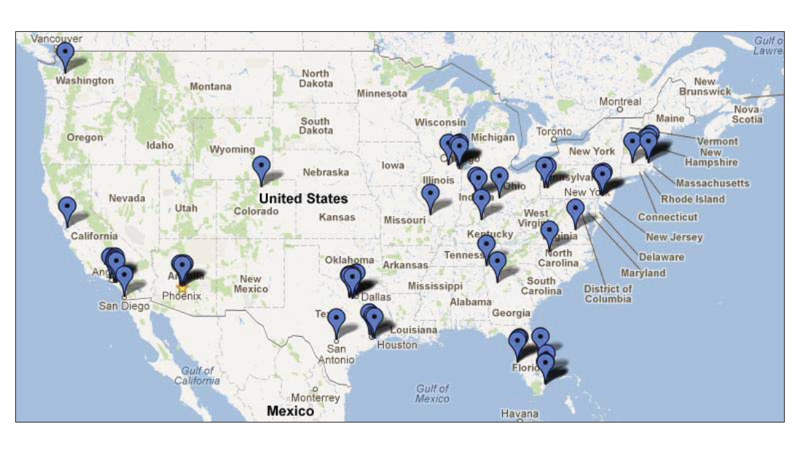

Slide 31
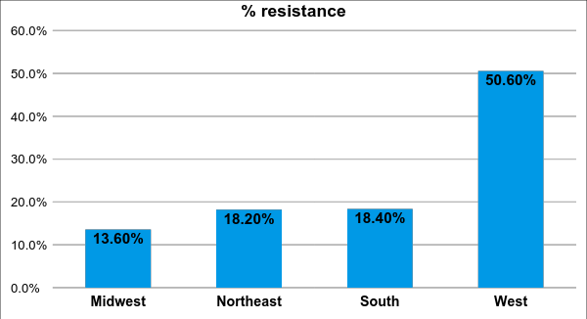
FY2013 snapshot
LTACHs as a large, potentially unrecognized reservoir of CRE

Slide 32
Interventions and future directions for prevention of MDROs in long-term care settings
Studies characterizing MDROs in nursing homes and LTACHs
Systematic surveillance
Epidemiologic risk factors, outcomes
Infection prevention practices targeted towards the nursing home setting
Antibiotic stewardship in long-term care
Improved interfacility communication/collaboration
Regional surveillance networks
Standardized communication on transfers

Slide 33
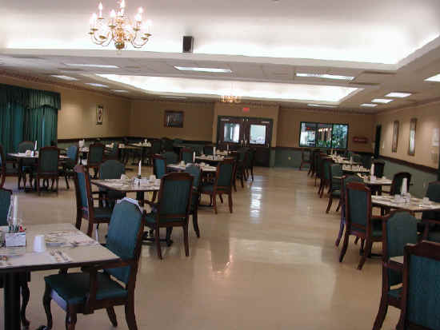
Nursing homes: infection prevention considerations
Residential setting
Relative lack of private rooms
No in-house reference laboratory
Promotion of socialization
Group activities: dining, recreation, PT/OT
Limited resources and personnel for IPC programs → 37% of NHs received an IPC-related deficiency citation
CMS “Reform Requirements for Long-Term Care Facilities” → IPC program within quality assurance and performance improvement (QAPI) program
Requirement that facilities have a designated IPC officer for whom overseeing the IPC program is his or her major responsibility
Specialized training in infection prevention
Cohen C, et al. Infect Control Hosp Epidemiol 2015.

Slide 34
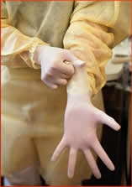
Nursing home IPC: contact precautions?
MRSA colonization as prime example
Potential significant contamination of gowns
(up to 24%) and gloves (37%) with typical activities
Precautions for infection versus colonization?
↓ HCW contact, ↑ depression, falls, delirium
“I’ve been through some very, very serious life and death situations…I have a lot of chronic problems that are difficult to treat. Like my osteomyelitis, it almost killed me, it really did. I am a walking, talking survivor. I am concerned about MRSA, and despite being in and out of facilities for 15 years…I have remained MRSA-free and I want to stay that way. Because I don’t need that [MRSA] on top of all the other things I have going on.”
“This is my home and it scares me to see people wearing these yellow coverings and gloves. I feel like a pariah sometimes, and people don’t want to be associated with me. It makes me worry about my friends and getting on with my social activities.”
Roghmann MC, et al. Infect Control Hosp Epidemiol 2015;36
Morgan D, et al. Am J Infect Control 2009;37.

Slide 35
Interventions and future directions for prevention of MDROs in long-term care settings
Studies characterizing MDROs in nursing homes and LTACHs
Systematic surveillance
Epidemiologic risk factors, outcomes
Infection prevention practices targeted towards the nursing home setting
Antibiotic stewardship in long-term care
Improved interfacility communication/collaboration
Regional surveillance networks
Standardized communication on transfers

Slide 36
Antibiotic stewardship in nursing homes
Leadership commitment
Accountability
Drug expertise
Action to implement policies/practices
Tracking measures
Reporting data
Education
Considerations: staffing, expertise, data collection
CMS finalized proposal → requirement for NHs to have antibiotic stewardship program
2014 survey of 175 PA LTCFs – only ~37% had an antibiotic stewardship program in place
Pennsylvania Patient Safety Authority, LTCF and acute care hospital survey, 2014.

Slide 37
Interventions and future directions for prevention of MDROs in long-term care settings
Studies characterizing MDROs in nursing homes and LTACHs
Systematic surveillance
Epidemiologic risk factors, outcomes
Infection prevention practices targeted towards the nursing home setting
Antibiotic stewardship in long-term care
Improved interfacility communication/collaboration
Regional surveillance networks
Standardized communication on transfers

Slide 38
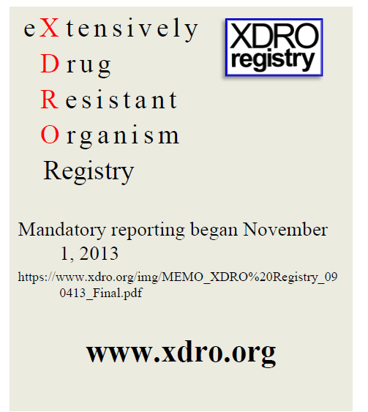
1st year: 1,557 CRE reports
→ 115 acute care hospitals
→ 5 LTACHs
→ 46 long-term care facilities
Infection Prevention Symposium: Antimicrobial Stewardship and Carbapenem-Resistant Enterobacteriaceae (CRE)

Slide 39
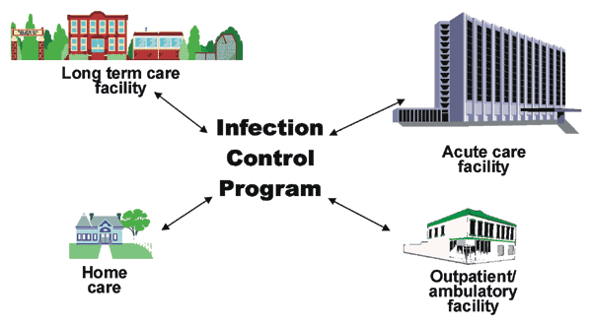
Summary
Increasing importance of post-acute care facilities in healthcare delivery
These facilities can serve as reservoirs of major MDROs
MRSA, C. difficile, CRE
Interventions and future research needed on ↓emergence of MDROs adapted to these settings
What works?
Long term acute care hospital

Slide 40
Thank you!
jennifer.han@uphs.upenn.edu

