Slide 1
Dementia in Patients with Intellectual Disabilities
Mary Ann Forciea MD
Seth Keller MD, Matthew Janicki MD
Dec 12 2014
Sponsored by GEC

Slide 2
Audience Response #1
In my practice, I have evaluated patients with Intellectual Disabilities for possible dementia
A Yes
B No

Slide 3
Practice Site
A Office Based
B Nursing Home
C Home Care
D PACE/LIFE
E Hospital
F Other

Slide 4
Audience Response #2
In my practice, I provide ongoing care for patients with Intellectual Disabilities and Dementia
A Yes
B No

Slide 5
Practice Site
A Office Based
B Nursing Home
C Home Care
D PACE/LIFE
E Other

Slide 6
Background
In guidelines for care of ID patients with decline in function
Referral for “Geriatric Assessment”
Are we prepared to evaluate patients with Intellectual Disabilities for dementia?

Slide 7
Intellectual Disability Definition AAIDD
Intellectual disability is a disability characterized by significant limitations in both intellectual functioning and in adaptive behavior, which covers many everyday social and practical skills. This disability originates before the age of 18.
Intellectual functioning—also called intelligence—refers to general mental capacity, such as learning, reasoning, problem solving, and so on.
IQ <70
Adaptive behavior is the collection of conceptional, social, and practical skills that are learned and performed by people in their everyday lives.
Conceptual skills—language and literacy; money, time, and number concepts; and self-direction.
Social skills—interpersonal skills, social responsibility, self-esteem, gullibility, naïveté (i.e., wariness), social problem solving, and the ability to follow rules/obey laws and to avoid being victimized.
Practical skills—activities of daily living (personal care), occupational skills, healthcare, travel/transportation, schedules/routines, safety, use of money, use of the telephone.

Slide 8
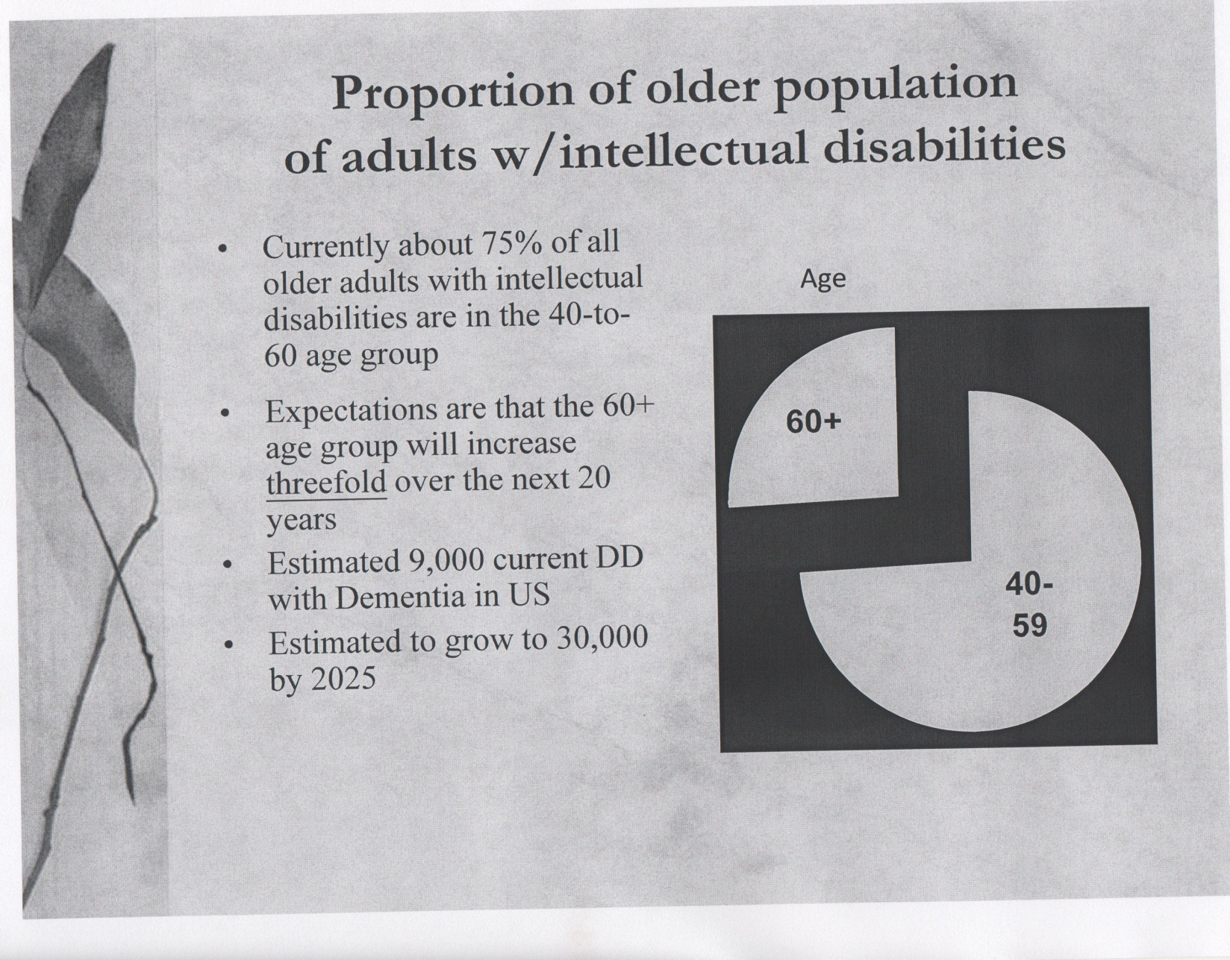

Slide 11
ARS #3 Adults with Down Syndrome make up what proportion of the ID community?
A 2%
B 10%
C 20%
D 40%
E 60%
Notes:
10-12% if adult ID population have DS

Slide 12
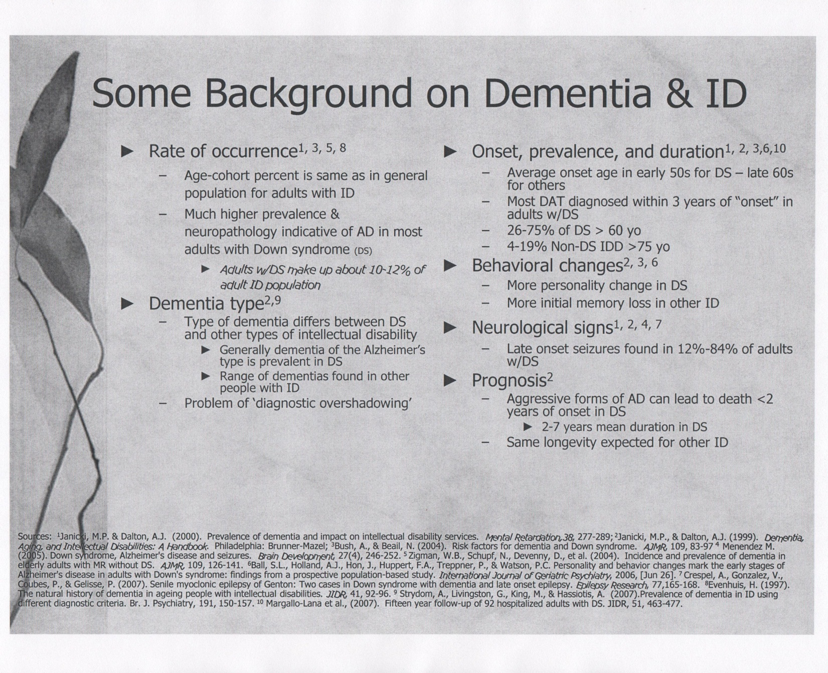

Slide 14
Similarities
AD/ID with AD

Slide 15
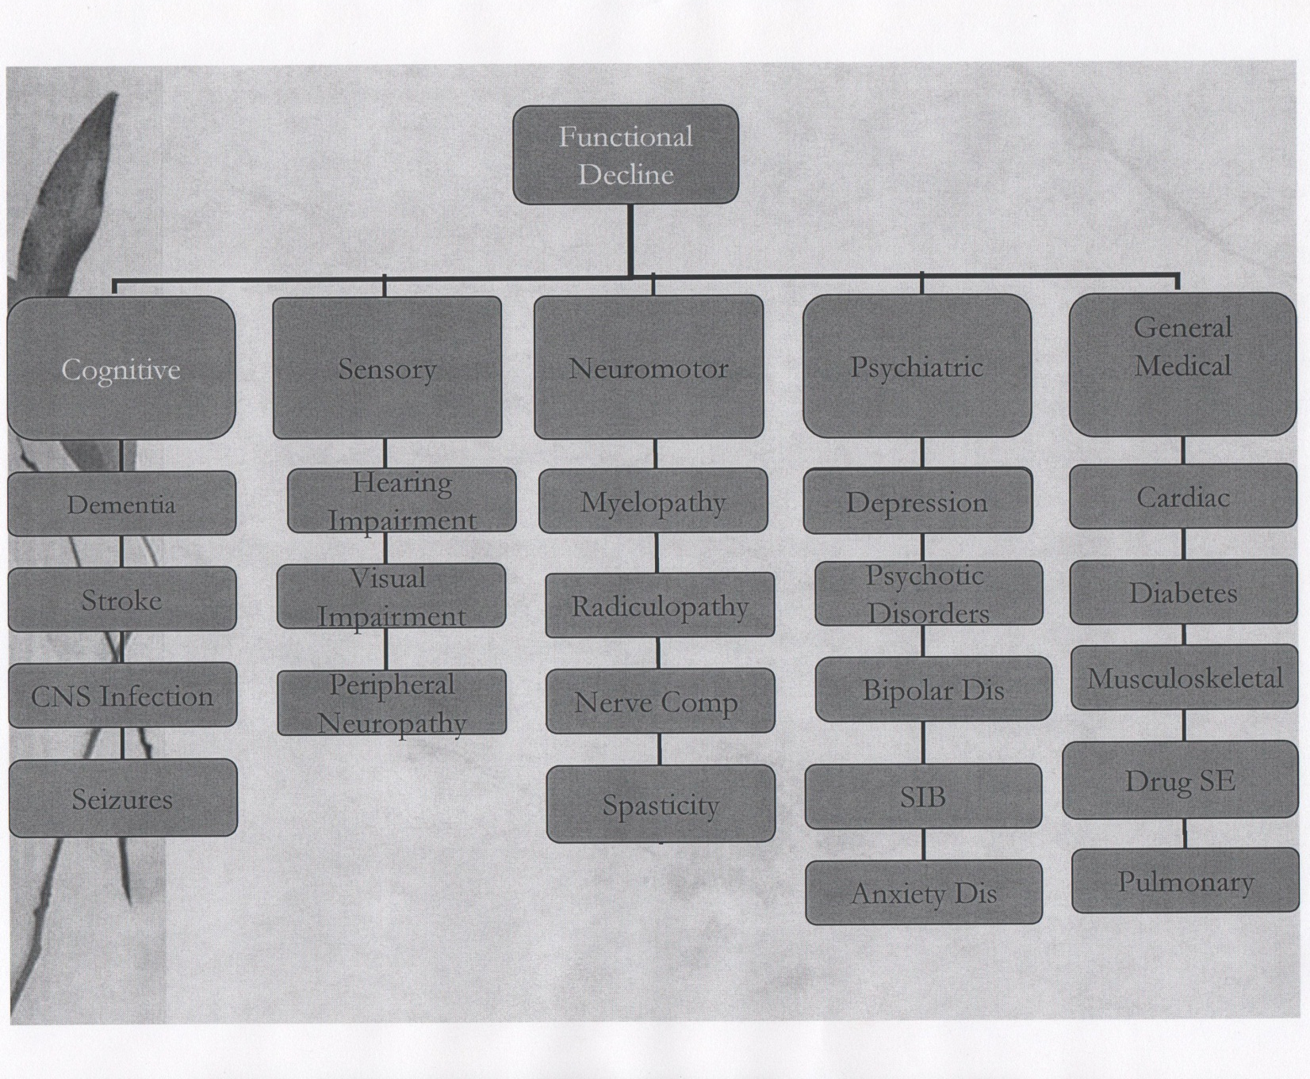

Slide 16
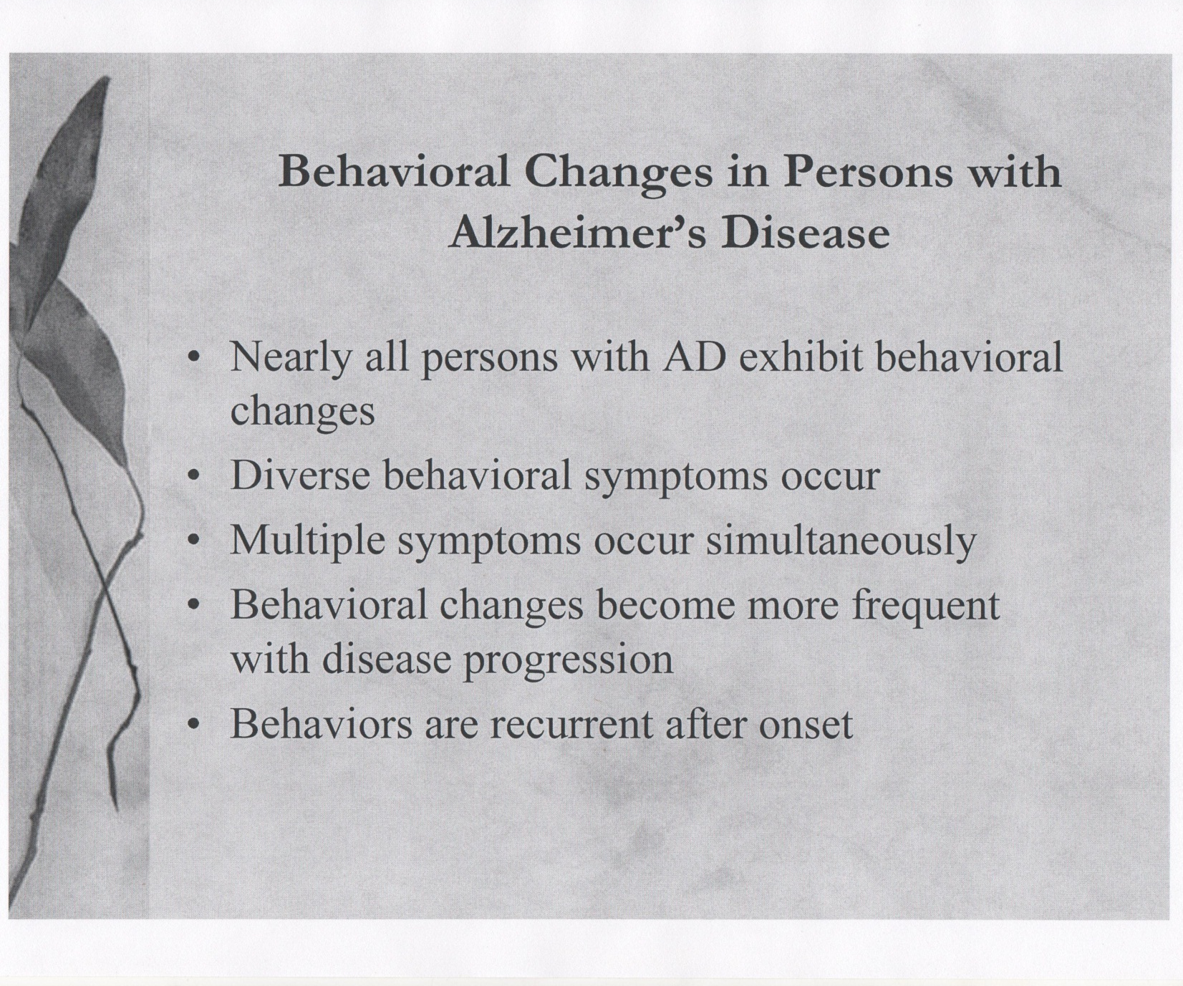

Slide 18
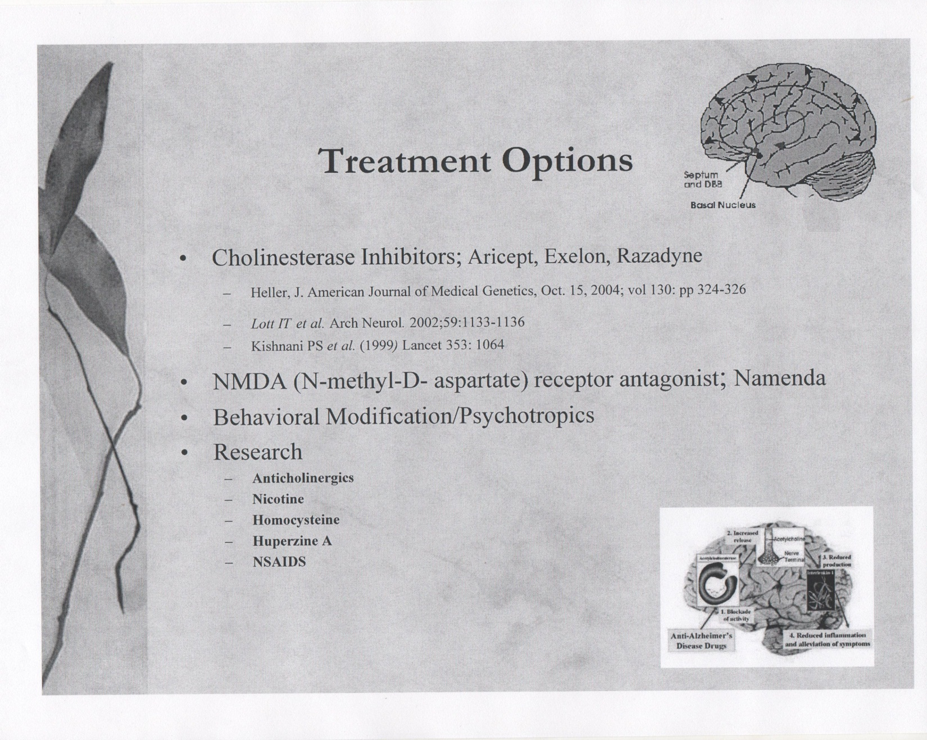

Slide 19
Differences
AD/ID with AD

Slide 22
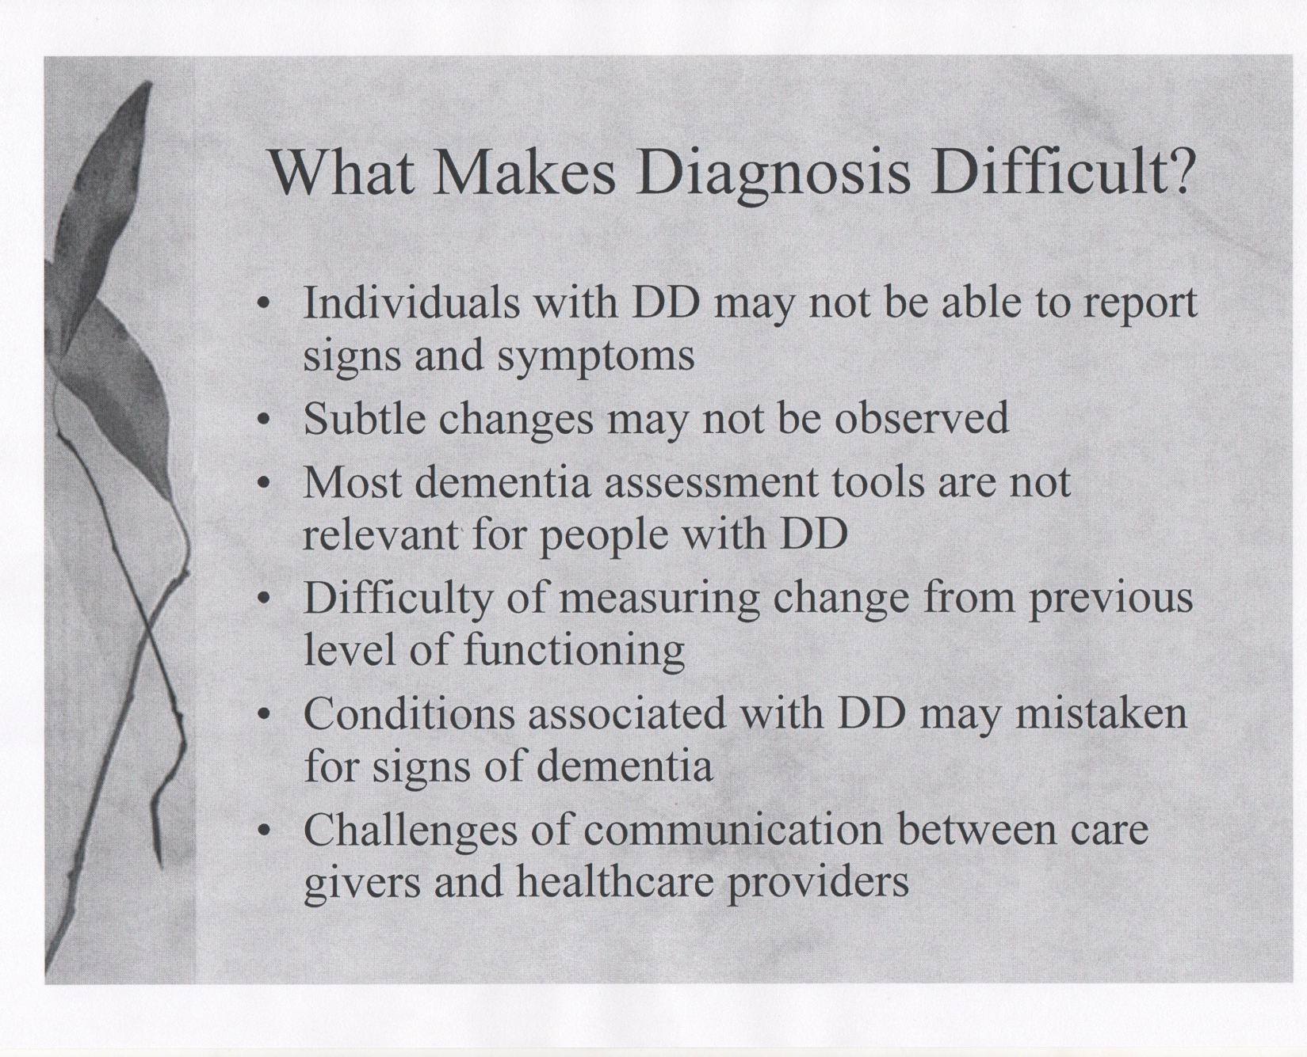

Slide 23
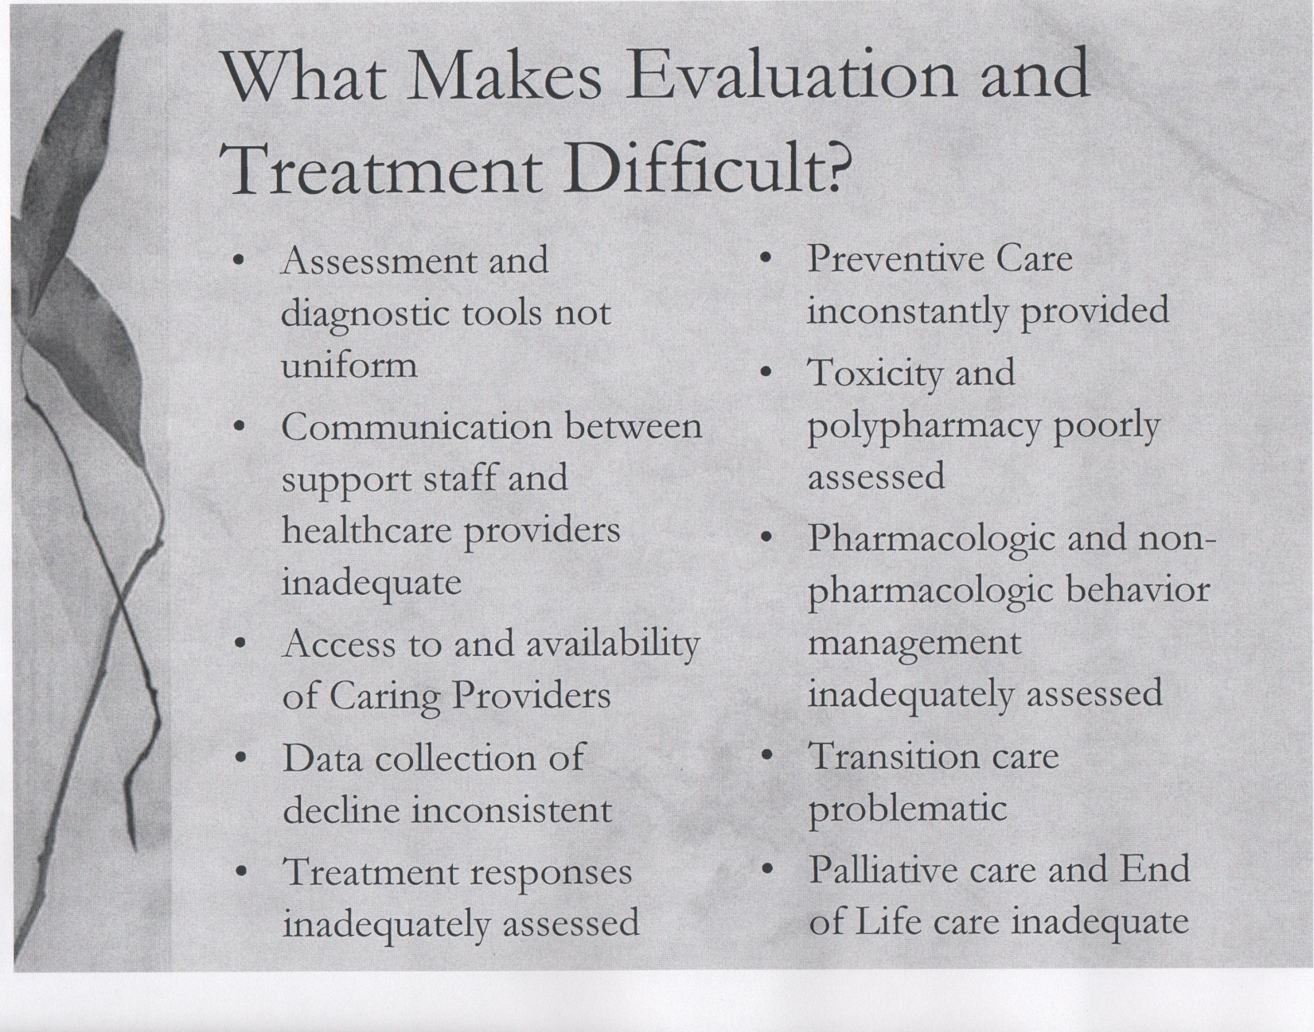

Slide 24
Making the Diagnosis of Dementia
Expert panel
Goals
Instrument

Slide 25
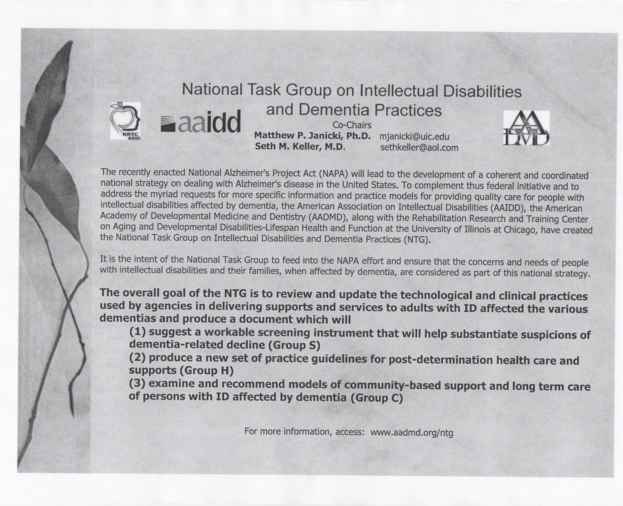

Slide 26
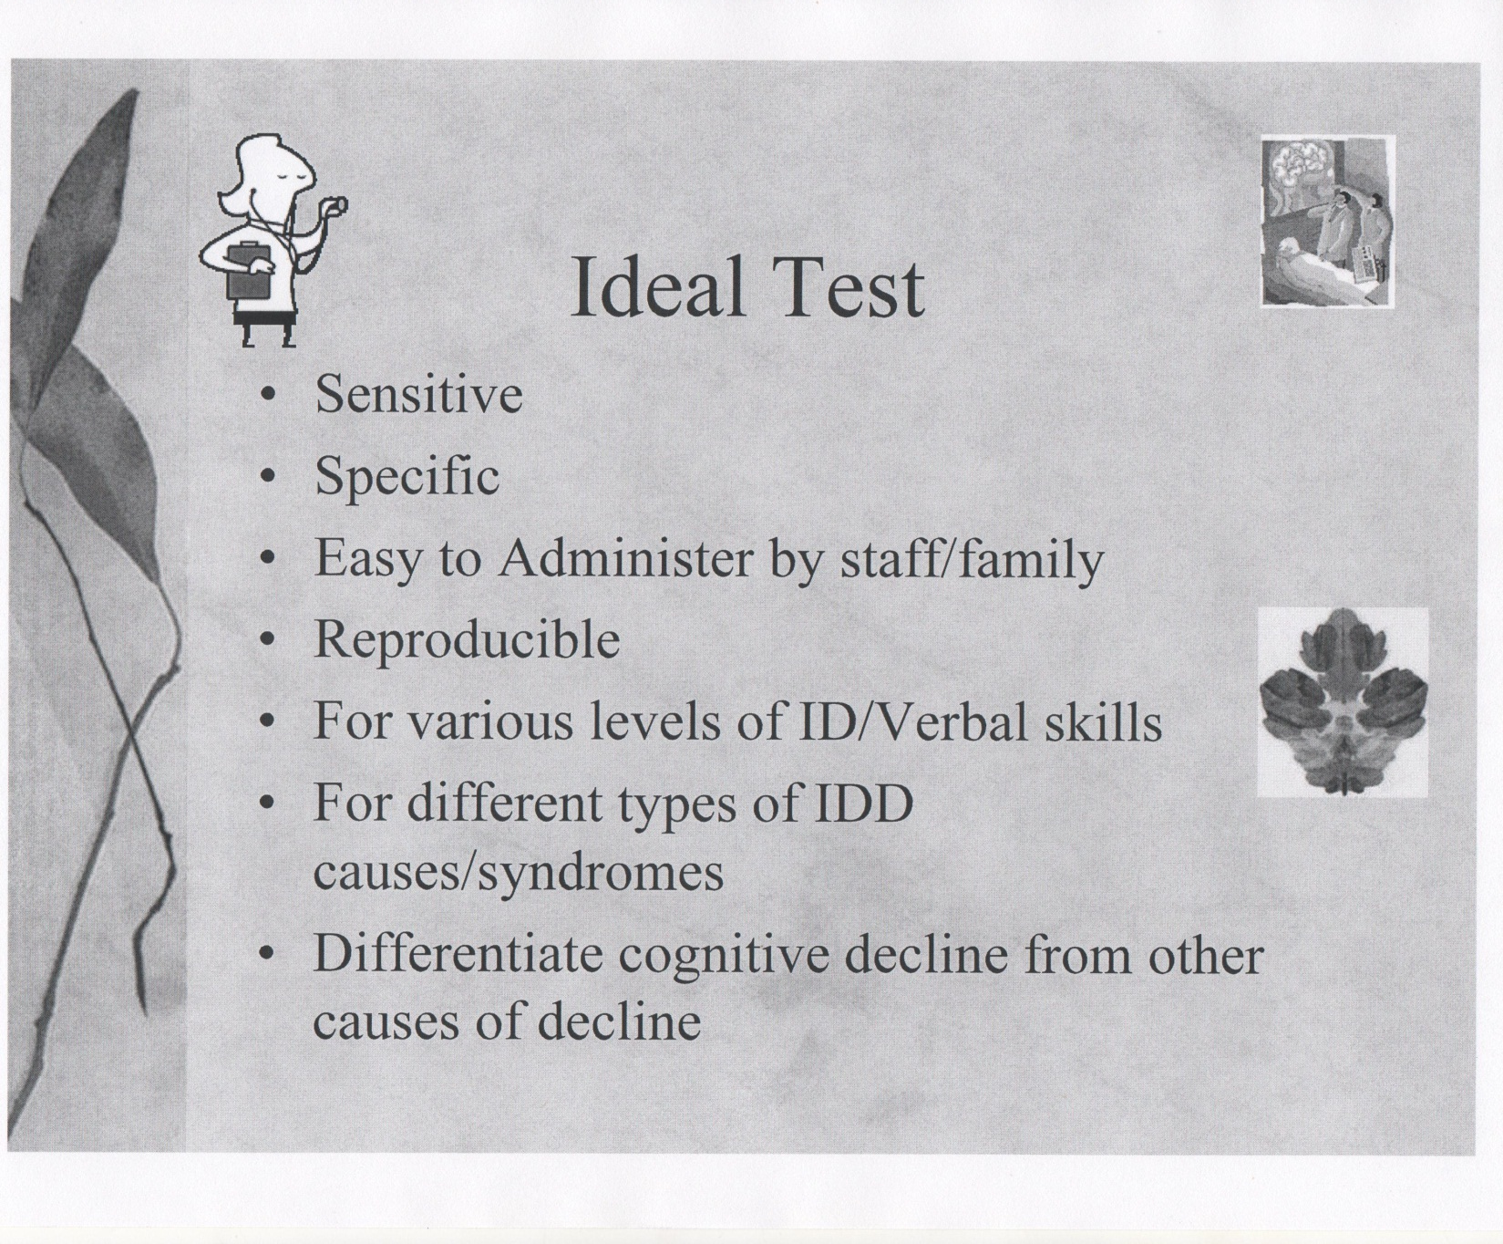

Slide 27
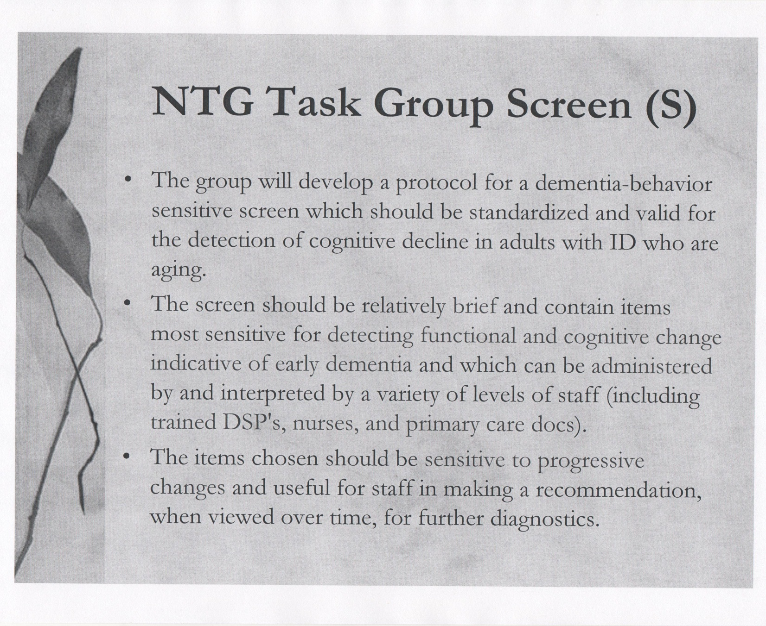

Slide 28
Treatment considerations
Rapid progression in DS
High frequency of seizures
Communication challenges
Aging caregivers
Site of care concerns

Slide 31
