Slide 1

Obesity and Continence Care in Nursing Home Residents
Christine Bradway, PhD, RN, FAAN
cwb@nursing.upenn.edu
Geriatric Medicine Grand Rounds
January 10, 2014

Slide 2
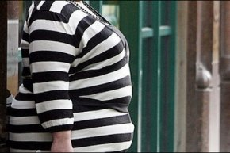
Objectives
1. Describe the demographics and consequences of obesity and UI
2. Examine selected research regarding obesity and continence care in nursing home residents
3. Suggest future practice
and research needs

Slide 3
How Is Obesity Defined?

Slide 4
Weight Classification by Body Mass Index* *NIH, 2000
Classifications | Body Mass Index (kg/m2)
Underweight | < 18.5
Normal | 18.5-24.9
Overweight | 25-29.9
Obesity Class I Class II | 30-34.9 35-39.9
Extreme/Severe Obesity Class III | > 40

Slide 5
Obesity and UI: Epidemiology**
UI affects 50% of middle-aged/older women
Obesity in the US:
  33% of adult population obese; increasing by 6%/year
  Severe obesity present equally in women and men
  Women represent > 75% seeking treatment
Older Adults
  39% overweight; 20% obese
Most research focused on women
  > 50% US women overweight/obese
  1/3 UK women overweight; ¼ obese

Slide 6
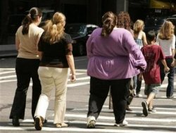
BMI and Type of UI in Women**
Clear dose-response effect: Increased weight=increased UI
  2X-4-5X increased risk (odds ratio)
Stress UI
  BMI >35: 2X risk any UI; 3.1X risk severe UI
  BMI >40: 2.2X risk any UI; 4.1X risk severe UI
Urge UI
  BMI >35: 1.4X risk any UI; 2.5X risk severe UI
  BMI >40: 1.9X risk any UI; 3.9X risk severe UI
Mixed UI
  BMI >35: 3.6X risk any UI; 5.5X risk severe UI
  BMI >40: 3.9X risk any UI; 6X risk severe UI

Slide 7
Obesity and UI: Impact of Age**
Notes:
BMI/Odds ratio: Age Small increase in risk for UI by increasing age, and with greater BMI.
Young=18-23
Middle Age= 45-50
Older=70-75

Slide 8
Epidemiology: Summary
Overweight/obesity important UI risk factors
  Each 5-unit increase in weight associated with 20-70% increase in risk of daily UI
Obesity strong risk factor
UI in women associated with higher BMI
Most studies: stronger association for stress/mixed UI than urge/OAB
Little known about impact of body fat distribution
  Nurse’s Health Study data

Slide 9
Obesity and UI: What Causes It?
Added weight?
  Long term impact of obesity on pelvic floor¹
  Increased intra-abdominal pressure? ²
Age/Chronicity of condition ?
  Risk of stress UI greater in women obese for > 30 years¹
  Other factors?³
Additional research necessary

Slide 10
Obesity and UI: Consequences
Obesity alone:
  Decreased function
  Increased risk NH placement
  Increased mortality and morbidity
  UI, FI, POP
  Obesity and UI:
    Pressure ulcers, skin infections, indwelling urinary catheter
    Decreased QOL; need for more research re: impact

Slide 11
Obesity and UI: Assessment/Evaluation
History
  Identify UI or other urologic issues
  Thorough, and inclusive of weight history
Physical Examination
Diagnostic Tests
Determine plan for treatment/management

Slide 12
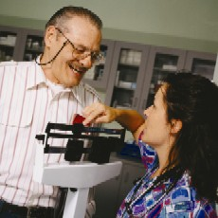

Physical Examination
Calculate BMI
Abdominal: identify bladder fullness, tenderness, masses
Genital: irritation, lesions, d/c, atrophic vaginitis, POP, vaginal muscle strength
Rectal: tone, nerve innervation, muscle strength, constipation, BPH
Skin

Slide 13
Diagnostic Tests
U/A and urine culture
Labs: ???
  electrolytes
  BUN, creat
  thyroid function
  glucose
PVR: ? By ultrasound or straight catheter

Slide 14
Diagnostic Tests: Urodynamic Studies (UDS)
Many studies of obesity and UI do not publish UDS results
Sugerman, et al and Noblett, et al
  Elevated P_{abd} and P_{ves} in patients with increased abdominal diameter and BMI
Dietel, et al and Bump, et al
  For patients with significant weight loss: improvements in stress UI, decreased P_{ves,} cough pressure transmission and urethral mobility

Slide 15
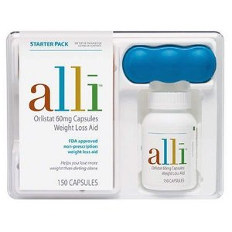
Obesity and UI: Non-Surgical Management
Weight Loss:
  Subak, et al, 2005
  Subak, Wing, et al 2009
  Auwad, et al, 2008

Slide 16
Obesity and UI: Non-Surgical Urologic Treatments
PME/Behavioral UI Therapies?
  Subak, Wing, et al 2009: Educational booklet w/basic UI, PME, urge-control info.
    Found no evidence for effect of PME
Medications
  Antimuscarinic agents: Chancellor, et al (2010)
Notes:
Medications: 60mg Trospium Chloride XL: safe to use in obese, effective, but study has limitations.

Slide 17
Obesity and UI: Surgical Treatment
For UI:
  Concerns about safety/feasibility of surgery
  Some evidence re: TVT
  Treatment of FI and POP
For obesity:
  Reviews of bariatric surgical procedures
    Hunskaar, 2008; Subak, et al 2009
  Burgio, et al, 2007

Slide 18
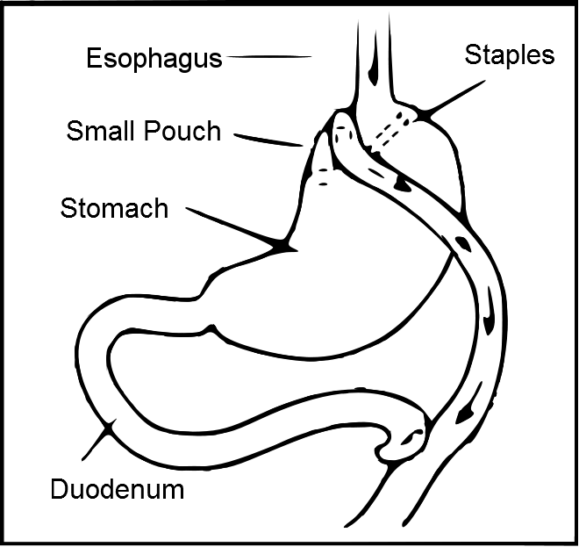
Roux-en-Y Gastric Bypass
Notes:
Burgio, et al (2007). All subjects underwent laparoscopic Roux-en-Y.
101 women with BMI of 40 or more.
Prevalence of UI and FI decreased post-op. Improvements are attributable to weight loss.

Slide 19
Weight Loss Surgery in Morbidly Obese Women**
Notes:
Burgio, et al, 2007: Percent of women (e.g., 20% change in those with BMI change of <16; 33% change in those with BMI change of 16-18, etc. ) with resolution of UI by magnitude of change in BMI.

Slide 20
Obesity and UI in Long-Term Care
Obesity in Older Individuals
Obesity and Continence Care
1992-2002: % newly admitted obese residents increased from 15% to > 25%.
30% of those with BMI of >35.0 were < 65
77% female
13.4% non-Hispanic black
Rogers, et al, 2008: NH residents weighing >250 pounds at admission were 2X as likely to have an indwelling catheter as those < 250 pounds
Bradway, et al: 2010
Felix, et al: 2009
Felix, et al: 2013
Bradway, et al: 2013
Notes:
Bradway, et al, 2013: mention work on transitional care

Slide 21
Continence Care for Obese NH Residents*: Methods
Qualitative descriptive design
Medical record review
Interviews of nurses caring for obese residents
Interviews of obese residents
Direct observation of care between nursing staff and obese residents

Slide 22
Description of the Sample
Characteristic | Resident Participants (N=5)
Mean Age (years) | 65 (range=47-75)
Race | African American=1 White=4
Female Sex | n=3
Mean Weight (pounds) | 323 (range=273-428)
Mean Body Mass Index | 53 (range-50-57)
Urinary Incontinence | n=3* Functional=3 Urge=1 Urinary Retention=1
Fecal Incontinence | n=3*
Strategies for Managing UI | Anticholinergic Medication n=1 Pads/products n=3 Indwelling urinary catheter n=1

Slide 23

Findings
Three primary themes
From interview and observational data:
  Obese and Incontinent Day to Day
  Fitting In the Environment
  “It’s Rough…But We Want to Do It”

Slide 24
Dealing with Continence and Incontinence
Indwelling Catheters
Complex Schedules
“I had one [an indwelling urinary catheter] when I first came here. After about a month, it was removed. I asked them to replace it, but was told they were not allowed to do that…I think it helped keep me dry. Even if [I get the urge]…call the nurse, they might not get here in time, and then I get wet…”
“[The NAs] need a Hoyer lift to get me out of bed because I can’t bear weight. I can’t use a toilet or bedside commode, so I wear a diaper. I’m out of bed from 11AM-7PM and don’t go the bathroom in-between. The diaper gets wet. I could ask to go to bed at 4PM [and probably not be as wet or maybe even stay dry] but I want to stay up until 7PM…it’s a choice I make.”
Notes:
One of the sub-themes for Obese and Incontinent Day to Day was: Dealing with Continence and Incontinence.

Slide 25
Fitting in the Environment
Tight spaces
Working with equipment and products
Fitting in

Slide 26
Working with Equipment and Products
[It would be] “nice to have a shower stretcher that fits the patients better, but if they [facility] got it, it would not fit through the doorway to the patient’s room or the doorway to the shower.” (Nurse participant #3)
“diapers are scratchy, especially if you are overweight…if the diaper does not fit the tabs end up not being closed, then the tabs lay against the skin and rub the area. They stick to you…those plastic tabs are sharp!”

Slide 27
“It’s Rough…But We Want to Do It”
Time and staffing
Physically exhausting and challenging care
Caregiving with respect and dignity

Slide 28
Physically Exhausting and Challenging Care
“It’s really rough. It’s hard on us. It takes a couple people [and] sometimes it is too much”
[The] “wear and tear on your body [is] not discussed…We hear about good body mechanics, and we DO that, but when you are moving a very large person, EVEN WITH good mechanics, your shoulders hurt when you get home, just from the extra pushing with your body.”
“Your hand is in pain when you have to hold up that belly and then try to wash.”

Slide 29
Study Discussion/Conclusions
Pilot study with small sample size
First study to observe and interview residents and staff re: continence and obesity
Obese residents younger and heavier than “typical” LTC resident
At high risk for incontinence and containment problems
Need for evidence re: use of indwelling urinary catheters
Products, supplies, and equipment impact continence care
Residents and staff acknowledge environmental issues and physical burden

Slide 30
Case Study*
72 y.o. male, BMI 50.2
Incontinent of bowel and bladder
2-3 certified nurse assistants to bathe/shower
105 minutes
  Vs. 45 minutes for non-obese patient**
  * Felix, et al, 2009
  Rose, et al, 2007; Bradway & Felix, under review
Notes:
We were also able to examine extensive documentation of one episode of bathing and continence care for one NH resident and compare it with existing literature (for bariatric surgical patients).

Slide 31
Effect of Weight on IDUC Use Among LTC Facility Residents*: Methods
Longitudinal cohort design
Medical record review
  All federally certified LTC facilities in Arkansas
  MDS data from all older adults admitted during quarter one in 2008 (N=3,879)
  All 4 quarters during a one year period examined
Descriptive stats to characterize LTC residents
Generalized estimating equation (GEE) model to examine effect of obesity on indwelling urinary catheter use over time

Slide 32
Description of the Sample
Characteristic | Resident Participants (N=3,879)
Mean Age (SD) | 84.1 (8.4)
*African American | 10.2% (N=393)
*Female Sex | 66.9% (N=2593)
Underweight (BMI <18.5) | 9% (N=346)
Normal weight (BMI 18.5-24.9) | 43.5% (N=1673)
Overweight (BMI 25-29.9) | 27.8% (N=1067)
Obesity (BMI 30-34.9) | 11.89% (N=456)
Severe obesity (BMI > 35) | 7.9% (N=302)
Notes:
Average BMI=25.8; at admission, almost 20% of residents were categorized as obese (BMI > 30)
*At admission, 24.2% of AA were obese compared with 19.2% Caucasians (p=0.02); 22.7% females obese compared to 15.7% males (P< 0.00001)
ADL score, cognitive status, number of beds, staff not retained in final model b/c they were not significant and did not contribute to the model

Slide 33
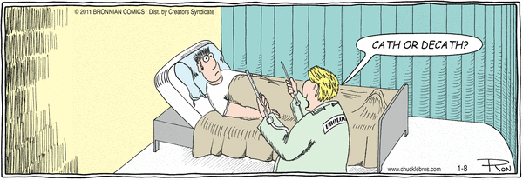
Results: At Admission
Prevalence rate of IDUC: 16.8%; decreased to 4.1% by 4th quarter
Obese had higher prevalence of IDUC than non-obese (19.4% vs 16.2%; p=0.034); borderline significance at 2nd quarter (p=0.09); no difference in 3rd and 4th quarters

Slide 34
Results: GEE Model
Obese residents (BMI 30-34.9) had increased odds (OR=1.69) of having IDUC; not statistically significant (p=0.40)
Only significant association was re: time
  Over time, likelihood of IDUC was significantly lower (p=0.04)
Trends:
  Females less likely (OR=0.67; p=0.09) to have IDUC than males
  AA more likely (OR=1.6; p=0.08) to have IDUC than Caucasians

Slide 35
Discussion/Summary Felix, et al, 2013
Higher than national quality benchmark rate at admission for IDUC use in all residents as well as obese residents
Substantial decrease in IDUC use within one year
Obesity did not increase risk of IDUC use, except at admission
Need for additional examination of race and gender

Slide 36
Implications for Practice and Research
Indwelling catheter use
Use of anticholinergic medications
Incorporation of behavioral strategies
Dually incontinent residents
Time, effort, and costs of care
Prevention strategies
Urologic specialists must partner with
other providers/specialties

Slide 37
Summary and Conclusions
Obesity is a strong, independent risk factor for UI
The exact mechanism is unknown
Need evidence re: appropriate assessment
Conservative and surgical weight loss should be considered in obese women with UI
The NH environment is an area in need of additional research

Slide 38
References
Auwad, W., et al. (2008). Moderate weight loss in obese women with UI: A prospective longitudinal study. International Urogynecology Journal, 19, 1251-1259.
Bradway, C., et al. (2010). Continence care for obese nursing home residents. Urologic Nursing, 30, 121-129.
Bradway, C., et al. (2013). Case study: Transitional care for a patient with benign prostatic hyperplasia and recurrent urinary tract infections. Urologic Nursing, 33, 177-179, 200.
Bump, R.C., et al. (1992). Obesity and lower urinary tract function in women: effect of surgically induced weight loss. American Journal of Obstetrics & Gynecology, 167, 392–7.
Burgio, K, et al. (2007). Changes in urinary and fecal incontinence symptoms with weight loss surgery in morbidly obese women. Obstetrics & Gynecology, 110, 1034-1040.
Chancellor, M.B., et al (2010). Obesity is associated with a more severe overactive bladder disease state that is effectively treated with once-daily administration of trospium chloride extended release. Neurourology & Urodynamics, 29, 551-54.

Slide 39
References
Chiarelli, P., et al. (2009). Leaking urine: Prevalence and associated factors in Australian women. Neurology & Urodynamics, 18, 567-77.
Deitel , M., et al. (1988). Gynecologic-obstetric changes after loss of massive excess weight following bariatric surgery. Journal of the American College of Nutrition, 7, 147-53.
Felix, H.C., et al. (2009). Staff time and estimated labor costs to bathe obese nursing home residents: A case report. Obesity and Nursing Home Working Paper Series No 1. Available at Social Science Research Network: http://ssrn.com/abstract=1492703
Felix, H.C., et al. (2013). Effect of weight on indwelling catheter use among long-term care facility residents. Urologic Nursing, 33, 194-200.
Greer, W.J., et al. (2008). Obesity and pelvic floor disorders. Obstetrics & Gynecology, 112, 341-348.

Slide 40
References
Hannestad, et al (2003). Are smoking and other lifestyle factors associated with female UI? The Norwegian EPINCOT study. British Journal of Obstetrics & Gynecology, 110, 247-254.
Hunskaar, S. (2008). A systematic review of overweight and obesity as risk factors and targets for clinical intervention for UI in women. Neuourology & Urodynamics, 27, 749-757.
Noblett , K.L., et al. (1997). The relationship of body mass index to intra-abdominal pressure as measured by multichannel cystometry. International Urogynecology Journal of Pelvic Floor Dysfunction, 8, 323–6.
Rose M, et al. (2007). A comparison of nurse staffing requirements for the care of morbidly obese and non-obese patients in the acute care setting. Bariatric Nursing and Surgical Patient Care, 2(1):53-56.
Subak, L.L., et al, (2005). Weight loss: A novel and effective treatment for UI. The Journal of Urology, 174, 190-195.
Subak, et al. (2009). Obesity and UI: Epidemiology and clinical research update. The Journal of Urology, 182, S2-7.
Subak, L.L., Wing, R., et al. (2009). Weight loss to treat UI in overweigh and obese women. NEJM, 360, 481-490.
Sugerman, H., et al, (1997). Intra-abdominal pressure, sagittal abdominal diameter and obesity comorbidity. Journal of Internal Medicine, 241, 71–9.

