Slide 1
iLab Introduction Internal User Guide Rodent Metabolic Phenotyping Core Perelman School of Medicine Link: https://med-upenn.corefacilities.org/service_center/show_external/5249

Slide 2
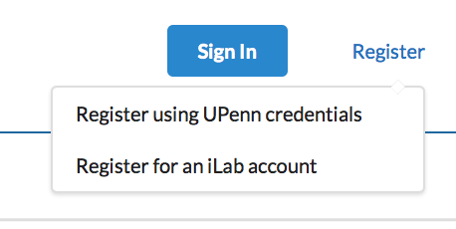
The opening page for iLab gives you the option to sign in or register as a new user.
To register as a new user, please click the “Register” button – the following dropdown menu will become available.
Select the “Register using UPenn Credentials” button and follow all instructions.

Slide 3
New User Registration
IMPORTANT STEPS FOR REGISTERING
AS A NEW USER
iLab will ask which PI’s lab you belong to.
You will need to have funds allocated to you to request services.
Ask your PI or BA to assign fund accounts to you in CAMS.
CAMS assignments are copied into iLab overnight.

Slide 4
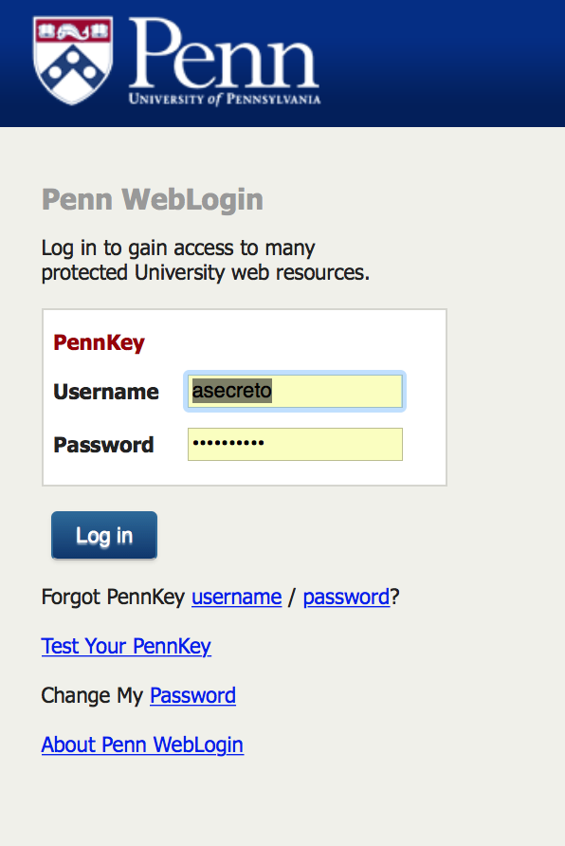
Registered User Sign In
To sign into the iLab system, please use your UPenn credentials.
UPenn credentials are your PennKey Name and Password.

Slide 5
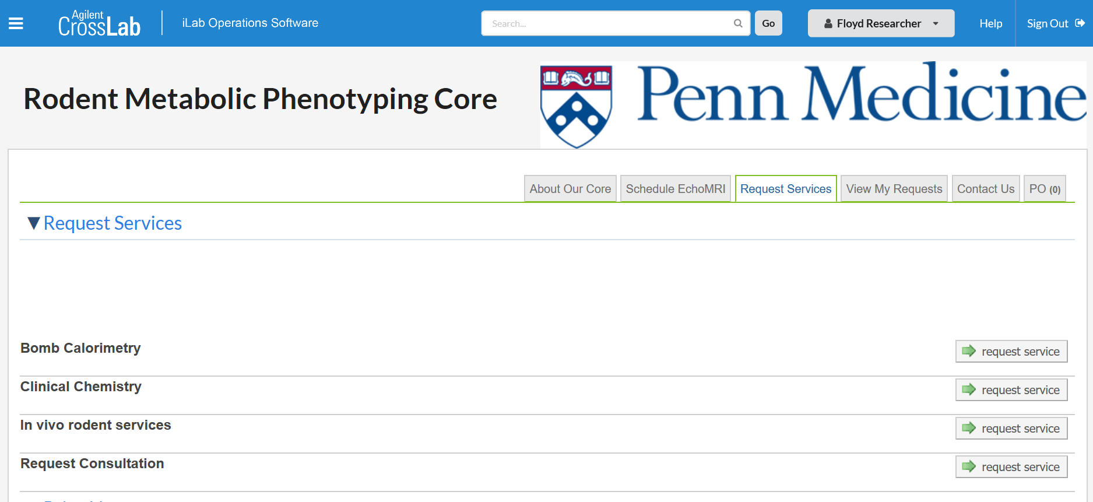
After signing in,
select the tab to request services then click the request service button for your selected category.

Slide 6
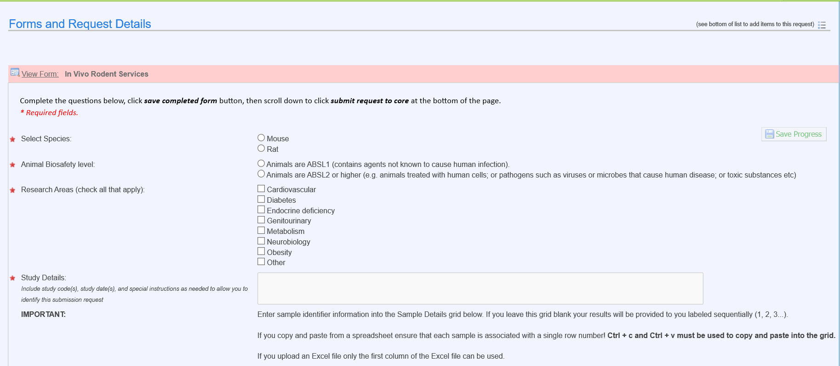
There are 3 sections to Request Services
SECTION 1: Forms and Request Details:
Complete all required fields - (they’re identified with a red star).
Save the Section 1 form.

Slide 7
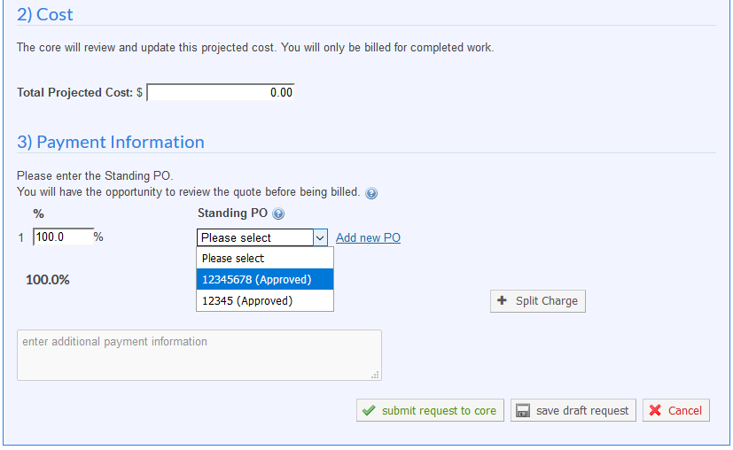
There are 3 sections to Request a Service
The core will complete Section 2 and send you a quote with the final price for your approval.
SECTION 3:
Use the drop-down arrow to choose a fund for payment.
Submit your request to the core.

Slide 8
Scheduling EchoMRI: Accessible to trained EchoMRI Users Only
Click on Schedule EchoMRI tab
1) Click on EchoMRI to book use of EchoMRI as a “trained user.”
2) If not a “trained user”, you will need to complete a one-time EchoMRI training session which can be requested under the Request Services tab.

Slide 9
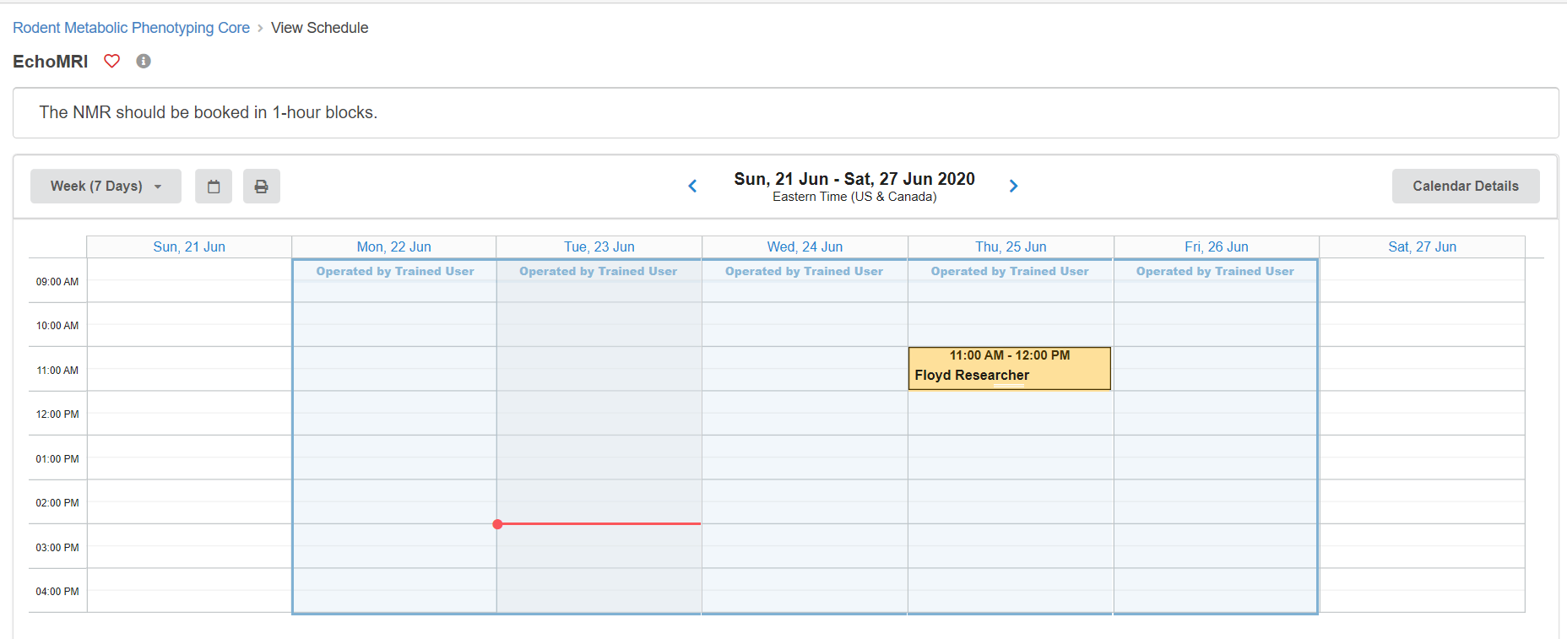
Scheduling EchoMRI: Accessible to trained EchoMRI Users Only
Click on Calender to reserve 1-hour time blocks.
1) When scheduling the EchoMRI, you can only create reservations in the future. You cannot create a reservation with a start time within 24 hours of the current time.
2) If you cancel the booking with a less than 24-hour notice, you will automatically be charged for the service.

Slide 10
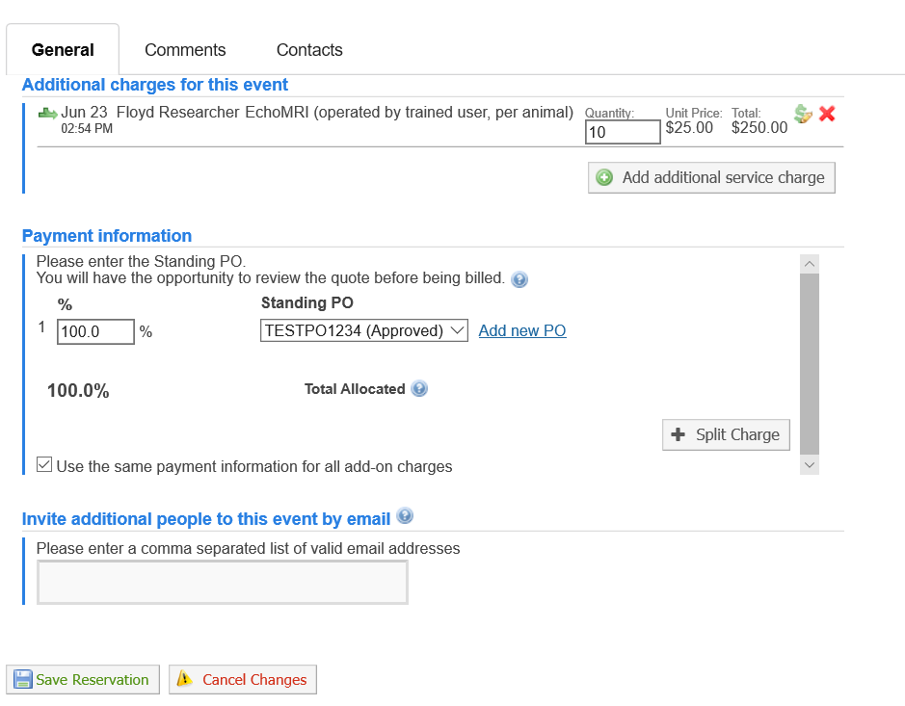
Scheduling EchoMRI: Accessible to trained EchoMRI Users Only
Fill out the form that automatically populates after reserving a time block:
Enter quantity of animals
Enter fund account number.
Click on Save Reservation.

Slide 11
iLab access issues
If you are unable to access iLab:
Make sure you are a registered user of the iLab system
Please send an e-mail to ilab-support@agilent.com describing your issue. iLab staff responds quickly to support requests.
iLab can help with funding source issues AFTER your BA has added you to funding sources in CAMS.

Slide 12
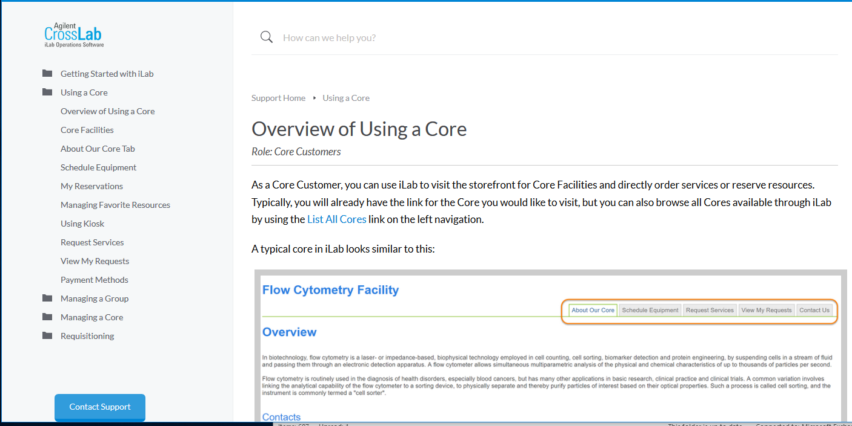
Additional Resources
iLab documentation:
https://help.ilab.agilent.com/37179-using-a-core/264646-using-a-core-overview
Screen by screen help, with a direct link to iLab support
Resources also available at Penn Medicine’s iLab website: https://www.med.upenn.edu/pmacs/iLab.html

