Slide 1
Center for Evidence Based Practice
PennPathways
6/17/2022

Slide 2
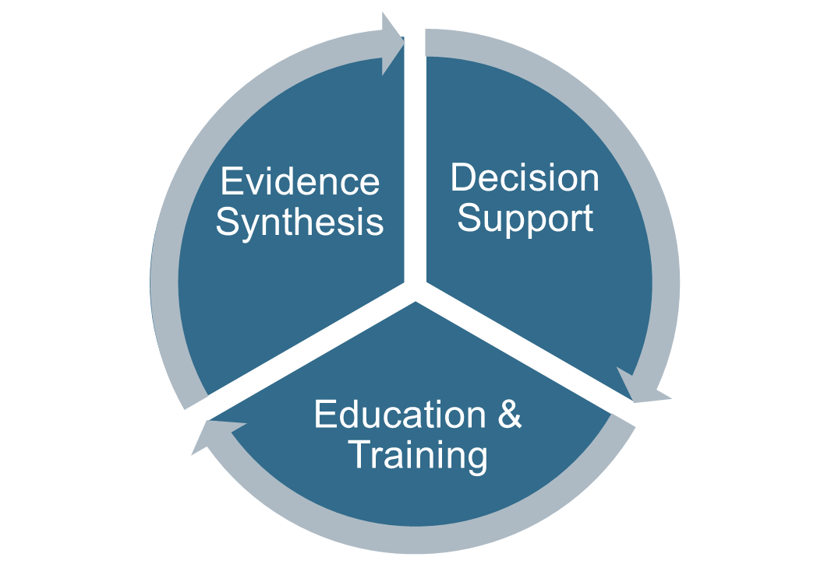
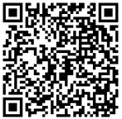
What we do:
How to contact:
Website: https://www.med.upenn.edu/CEP/
Request Link: http://bit.ly/CEPrequest
Twitter: twitter.com/PennMedCEP

Slide 3
Decision Support
Decision Support
Education & Training
Evidence Synthesis
PennPathways Program
Pathway implementation support
Rapid cycle development, pilots, nudges, behavioral change theory, implementation science
EMR decision support design
Guided by human factors design principles, “five rights”, and choice architecture theory
Impact and evaluation
Grant support

Slide 4
How to See PennPathways
Mobile & Intranet Access
6/17/2022

Slide 5
From the Intranet
1
Opens as a web page
2

Slide 6
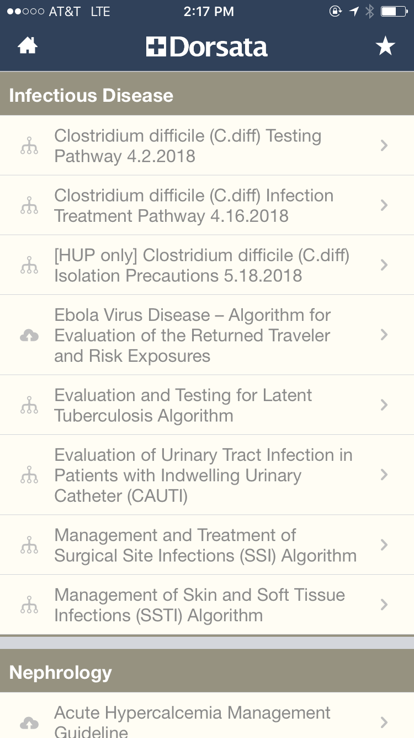
From the Phone
From any SCIP phone, use the Dorsata app

Slide 7
How to See PennPathways
From PennChart
6/17/2022

Slide 8
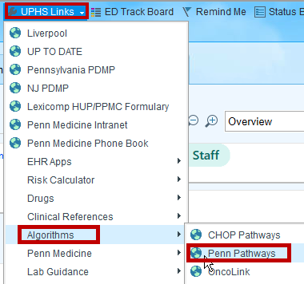
1
Opens as a web page
2
3

Slide 9
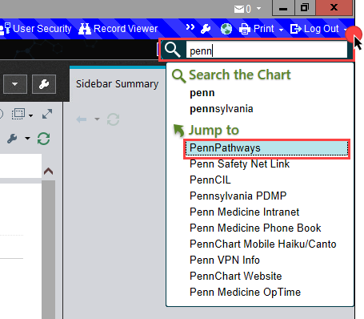
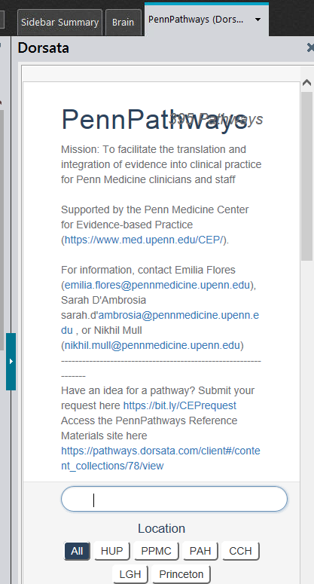
Search bar (magnifying glass) – search PennPathways
Opens PennPathways within PennChart’s SideBar

Slide 10
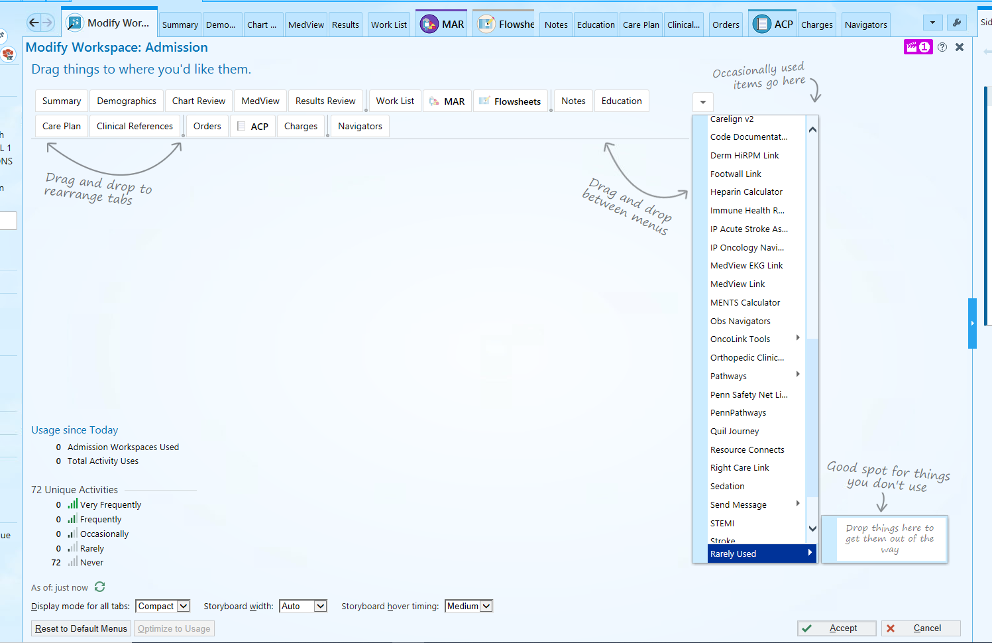
1
3
Using the workspace wrench, drag PennPathways into your preferred default tabs
Opens PennPathways within PennChart’s SideBar
Drag PennPathways to Work Space Tabs
2

Slide 11
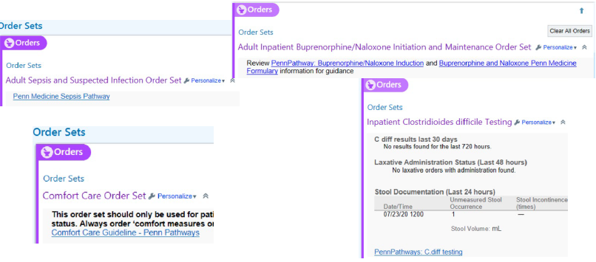
Pathways are also sprinkled throughout Pennchart

