Slide 1
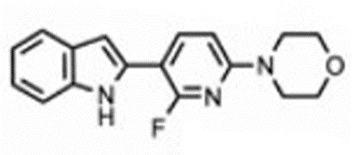
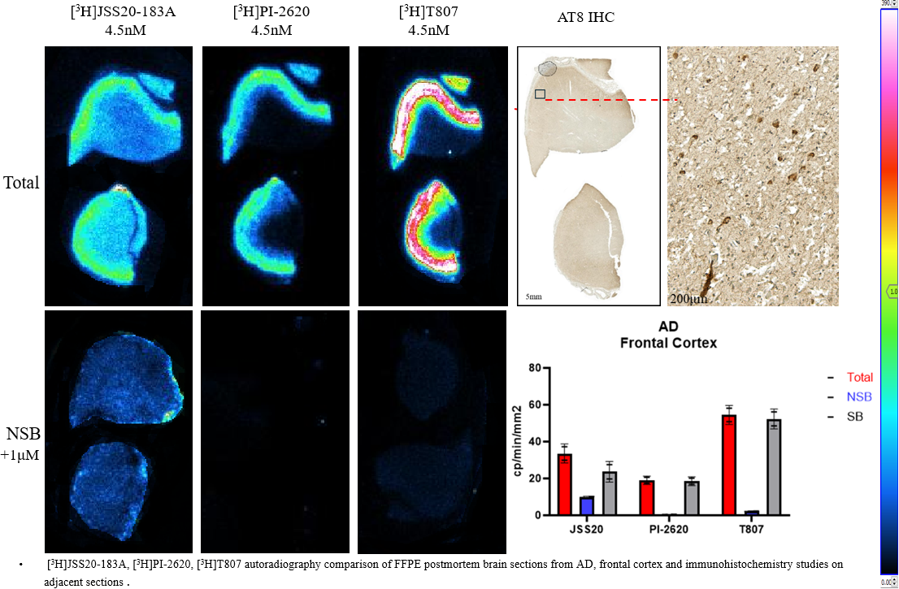
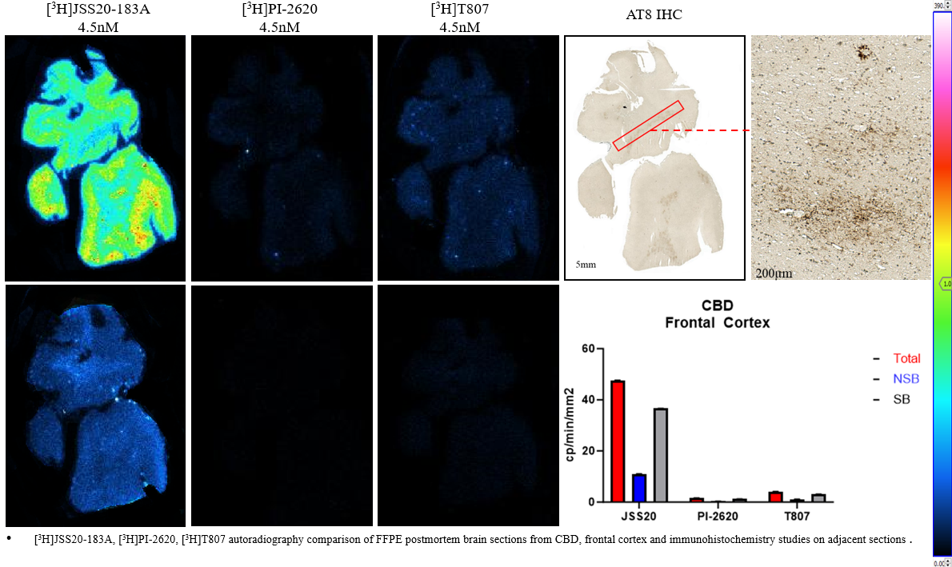
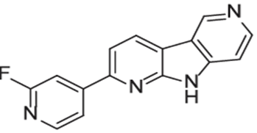
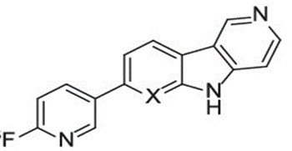
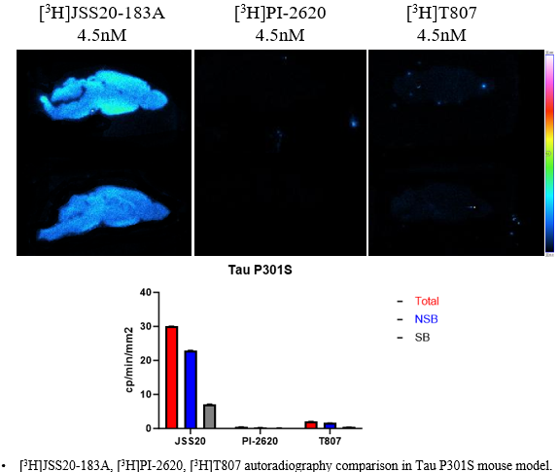
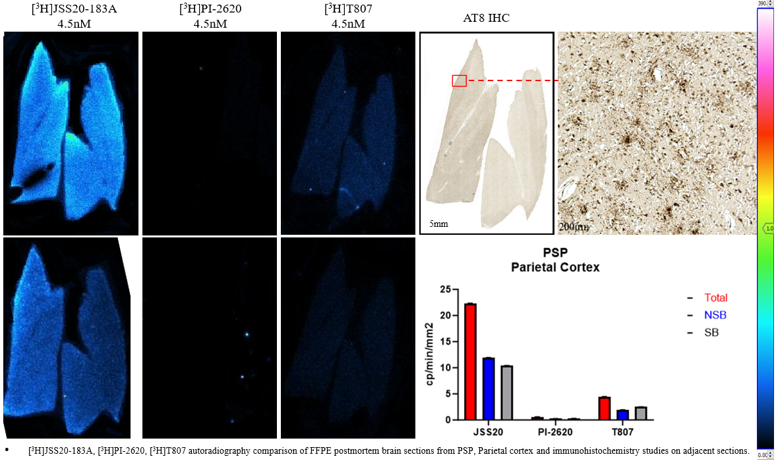
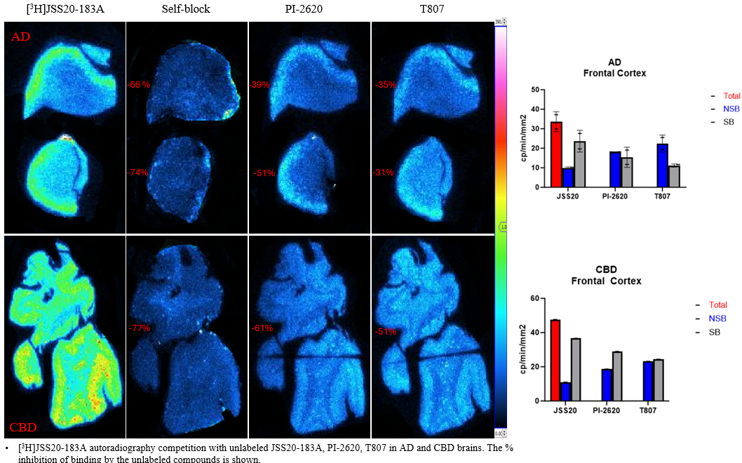
“Comparative binding properties of Tau PET tracers JSS20-183A, PI-2620 and T807 in postmortem Alzheimer’s, progressive supranuclear palsy and corticobasal degeneration brains and in Tau P301S mouse model”.
“Comparative binding properties of Tau PET tracers JSS20-183A, PI-2620 and T807 in postmortem Alzheimer’s, progressive supranuclear palsy and corticobasal degeneration brains and in Tau P301S mouse model”.
Dinahlee Saturnino Guarino,[a] Jeff Stehouwer,[b] Evan Gallagher,[a] Hong Xu,[a] Edward B. Lee,[c] John L. Robinson,[c] Virginia M-Y Lee,[c] Neil Vasdev,[d] Chester A. Mathis,[b] Robert H. Mach[a].
Dinahlee Saturnino Guarino,[a] Jeff Stehouwer,[b] Evan Gallagher,[a] Hong Xu,[a] Edward B. Lee,[c] John L. Robinson,[c] Virginia M-Y Lee,[c] Neil Vasdev,[d] Chester A. Mathis,[b] Robert H. Mach[a].
Depts. of ª Radiology, ^{c} Pathology & Laboratory Medicine, University of Pennsylvania, Philadelphia, PA, 19104, USA
Dept. of ^{b} Radiology, University of Pittsburgh, Pittsburgh, Pennsylvania 15213, United States.
Dept. of ^{d} Psychiatry/Institute of Medical Science, University of Toronto, Toronto, ON M5T 1R8, Canada.
Depts. of ª Radiology, ^{c} Pathology & Laboratory Medicine, University of Pennsylvania, Philadelphia, PA, 19104, USA
Dept. of ^{b} Radiology, University of Pittsburgh, Pittsburgh, Pennsylvania 15213, United States.
Dept. of ^{d} Psychiatry/Institute of Medical Science, University of Toronto, Toronto, ON M5T 1R8, Canada.
Background
Comparative assessment of JSS20-183A binding in AD
Comparative assessment of JSS20-183A binding in CBD
JSS20-183A
PI-2620
T807
Goals:
to evaluate the binding properties of JSS20-183A in AD-tau and to non-AD tauopathies;
to compare the binding properties of JSS-20183A to several tau positron emission tomography tracers, such as PI-2620, T807 (also known as AV1451; flortaucipir), head-to-head in the same post-mortem human brain tissue.
Comparative assessment of JSS20-183A binding in Tau P301S mouse model
Comparative assessment of JSS20-183A binding in PSP
[³H]JSS20-183A autoradiography competition with unlabeled JSS, PI-2620 and T807
Total
NSB
Conclusions
JSS20-183A showed target engagement with NFTs in AD brain , astrocytic lesions in CBD brain
and tufted astrocytes and NFTs in PSP brain.
Visual comparison of autoradiographic JSS20-183A uptake with PI-2620, T807 tau tracers showed
a similar binding profile in AD , but dissimilar in CBD and PSP pathology
This work was supported by grants U19NS110456 (RHM) and U19AG062418 (VMYL)

