Slide 1
Antimicrobial Stewardship in a Pediatric Hospital Lessons Learned
Marian G. Michaels, MD, MPH
Professor of Pediatrics and Surgery
Division of Pediatric Infectious Diseases
Children’s Hospital of Pittsburgh of UPMC

Slide 2
Disclaimers
I have no relevant conflict of interests
I may discuss off label use of drugs or devices

Slide 3
Learning Objectives
At the end of the talk attendees should be able to:
Recognize the necessity for antimicrobial stewardship programs
Describe the essential components of ASP
Understand value of ASP for inpatient settings

Slide 4
A story…….
2 year old child with leukemia is admitted to PICU with high fever, decreased BP, and respiratory distress requiring resuscitation and ventilatory support
Vancomycin, meropenem, clindamycin, liposomal amphotericin and high dose acyclovir
All cultures are negative
But because “he seems better” they continue antimicrobials
Kidney dysfunction develops
Day 10: trach culture has MDR bacteria

Slide 5
What happened?
This is a sick child
But doing everything isn’t necessarily the right thing ….
…and can cause harm
Hopefully an antimicrobial stewardship program (ASP) would help this child avoid untoward side effects…
….and help the hospital have less resistant microbes

Slide 6
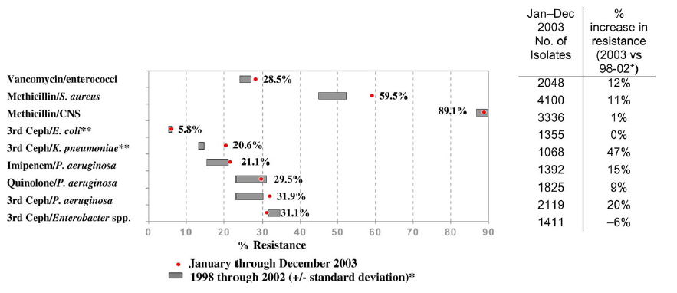
Origins of Antimicrobial Stewardship: Explosion of Antimicrobial Resistance
Selected antimicrobial-resistant pathogens associated with nosocomial ICU infections: Comparison of resistance rates in 2003 vs. 1998- 2002, NNIS system.
Special report NNIS, AJIC 2004

Slide 7
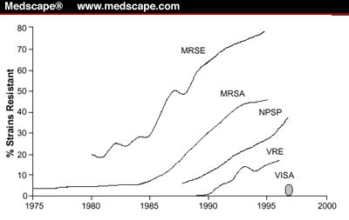
Here Come the Superbugs!

Slide 8
Antimicrobial Resistance hits the News: USA Today (3/6/13)

Slide 9
March 2015

Slide 10
Four Core Actions to Fight Resistance (http://www.cdc.gov/drugresistance/pdf/4-2013-508.pd
1. Prevent infections & spread of resistance
2. Track rates of resistance over time
3. Improve Antibiotic Prescribing / Antimicrobial Stewardship
4. Develop New Drugs & Diagnostic Tests

Slide 11
What Can ASP DO?

Slide 12
ASP Strategies: Inpatient Focus
Core strategies
Formulary restriction and preauthorization
Prospective audit with intervention and feedback
Supplemental Strategies
Education
Clinical Guidelines
IV to PO conversion
Dose optimization
Antimicrobial Order Forms
Newland & Hersh/PIDJ/2010

Slide 13
ASP Core Strategies: PROS
Preauthorization:
↓starting unnecessary/inappropriate Abx
Direct control of chosen Abx use/ cost
Prompts review of available data at time of initiation of Abx
Prospective audit and feedback:
Review when more clinical data available
Greater flexibility in timing of recommendation
Prescriber autonomy maintained
Can address de-escalation, duration & switch to oral Abx
Barlam et al CID 2016 IDSA Guidelines

Slide 14
ASP Core strategies: Cons
Preauthorization:
Only impacts “chosen Abx”
Real-time resource intensive
May delay therapy
Loss of prescriber autonomy
Prospective audit and feedback:
Compliance voluntary
Typically labor –intensive
Requires technology support
Barlam et al CID 2016 IDSA Guidelines

Slide 15
Antimicrobial Stewardship Program: CHP

Slide 16
CHP: Then
> 30 yrs preauthorization approval for “restricted antibiotics” by ID group
Not approved for children – Ex: quinolones
Very broad spectrum drugs – Ex: carbapenems
Expensive new drugs- Ex: linezolid
Direct towards “drugs of choice”
Downside:
No tracking of antibiotic use once approved
Development of antimicrobial resistance
No formal antimicrobial stewardship program

Slide 17
Antimicrobial Susceptibility Tracking

Slide 18
Models of ASP:
“Traditional Model” Includes Involvement of:
CHP Model Includes Involvement of:
ID Physician Leader
Dedicated ASP Pharmacist with ID Training
Pharmacy Director
P&T Committee
Infection Prevention
Informatics
Hospital Administration
ID Physician Leader & Full ID Division
Team of 7 Service-based Pharmacists
Pharmacy Director
P&T Committee
Infection Prevention
Informatics
Hospital Administration

Slide 19
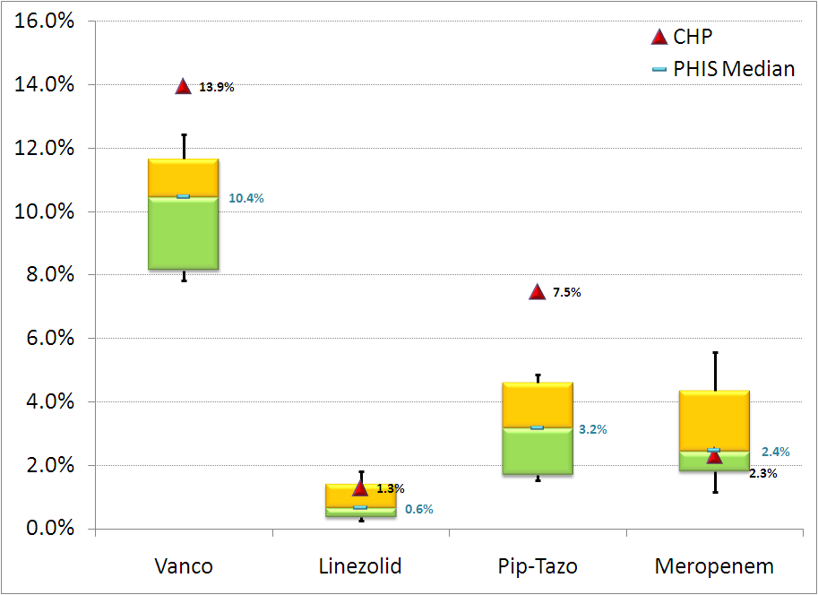
PHIS Antimicrobial Analysis: 2007
Case-Mix Adjusted % Drug Days, CHP and all PHIS Hospitals
Levin J, 2007, Unpublished Data

Slide 20
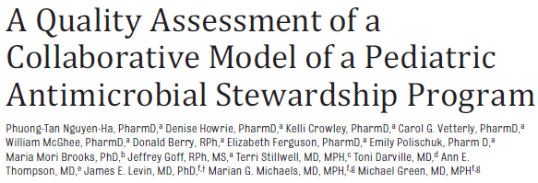
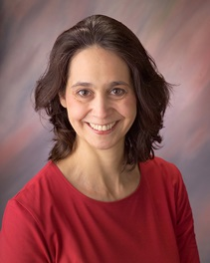
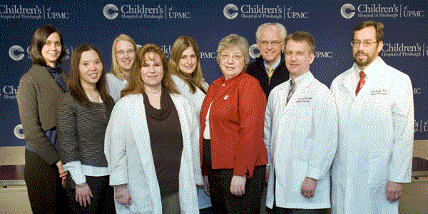
ASP AT CHP: 2008

Slide 21
CHP ASP: Development of Guidelines
Multistep process: targeted antimicrobials
Review of literature
Small group meeting with representatives from key stakeholder groups
Development of “draft” guideline followed by review by full stakeholder groups, P & T Committee and Clinical Resource Management Committee
Approved guidelines = basis for Day 3 Audits
Guidelines include:
Post-op prophylaxis & antifungal use for Liver & Intestinal Tx
Use of ciprofloxacin & vancomycin for IBD patients
Use of meropenem (all CHP patient populations)
Empiric antimicrobial regimens for surgical infants in NICU
Empiric antimicrobial regimens in the CICU

Slide 22
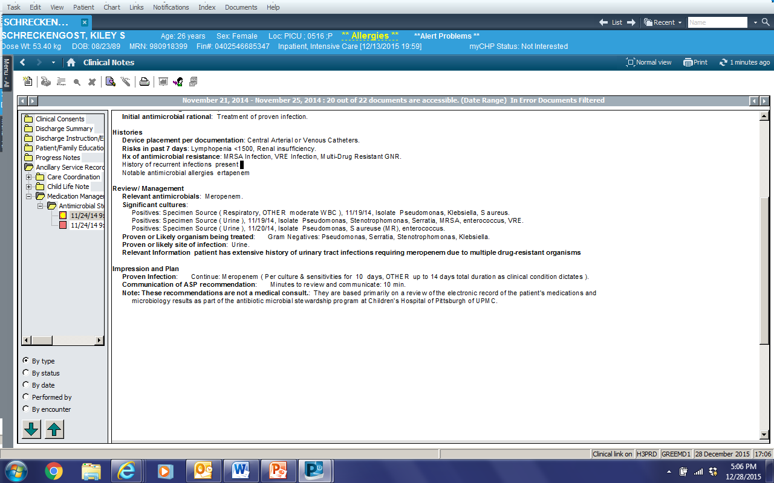
Communicating Recommendations

Slide 23
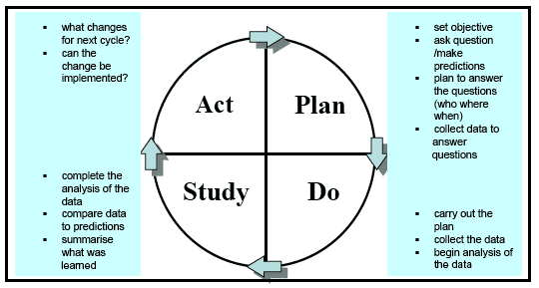
Tracking Results to Enhance Quality
The PDSA cycle is shorthand for testing a change by developing a plan to test the change (Plan), carrying out the test (Do), observing and learning from the consequences (Study), and determining what modifications should be made to the test (Act)

Slide 24
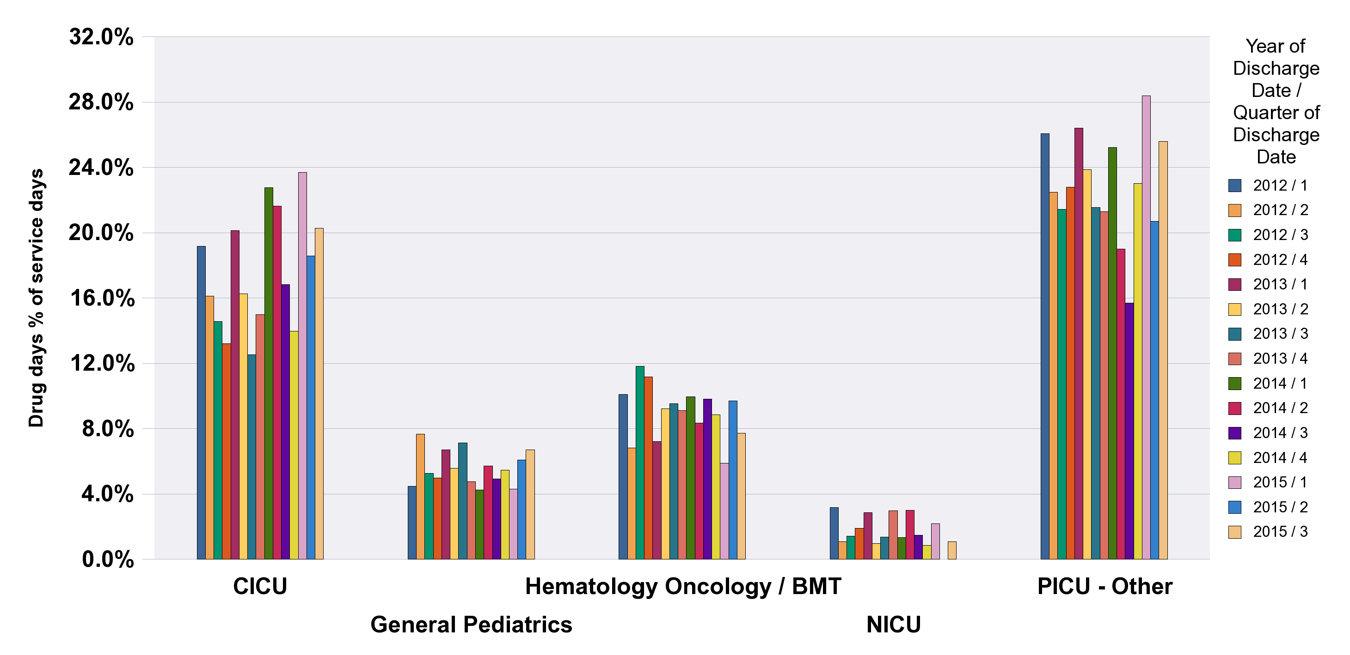
Data Warehouse Track Results over Time
Quarterly reports generated automatically from Data warehouse

Slide 25
Antimicrobial Stewardship At CHP: Where are we now?
ASP officially in use since January 2009
Still require ID Pre-approval for selected Abx
Guidelines for use of “targeted” antimicrobials developed with stakeholders
Day 3 Auditing for caspofungin, meropenem & vancomycin
Results reviewed as part of PDSA process on quarterly basis
The role of ASP established in culture of CHP

Slide 26
Vancomycin Drug Use
Intervention Initiated 2010 Quarter 2

Slide 27
Meropenem Drug Use
Intervention Initiated 2010 Quarter 4

Slide 28
Guidelines: Another story:
5 year old girl worsening abdominal pain, fever and vomiting x 3 days
Comes to Emergency Department
Paucity of bowel sounds
Rebound tenderness
Diagnosed with ruptured appendicitis
Laparascopic surgery performed
Ertapenem given
PIC line placed, home on IV abtiotics for two or more weeks

Slide 29
Appendicitis Guidelines CHP
Surgical NPs and MDs noted problem with prolonged antibiotic use
Prolonged use of PIC lines
Complications:
thrombus, line infection, C diff
Could we do better?
Met with ID and PharmD
Literature review
Development of guidelines
Buy in from all surgeons

Slide 30
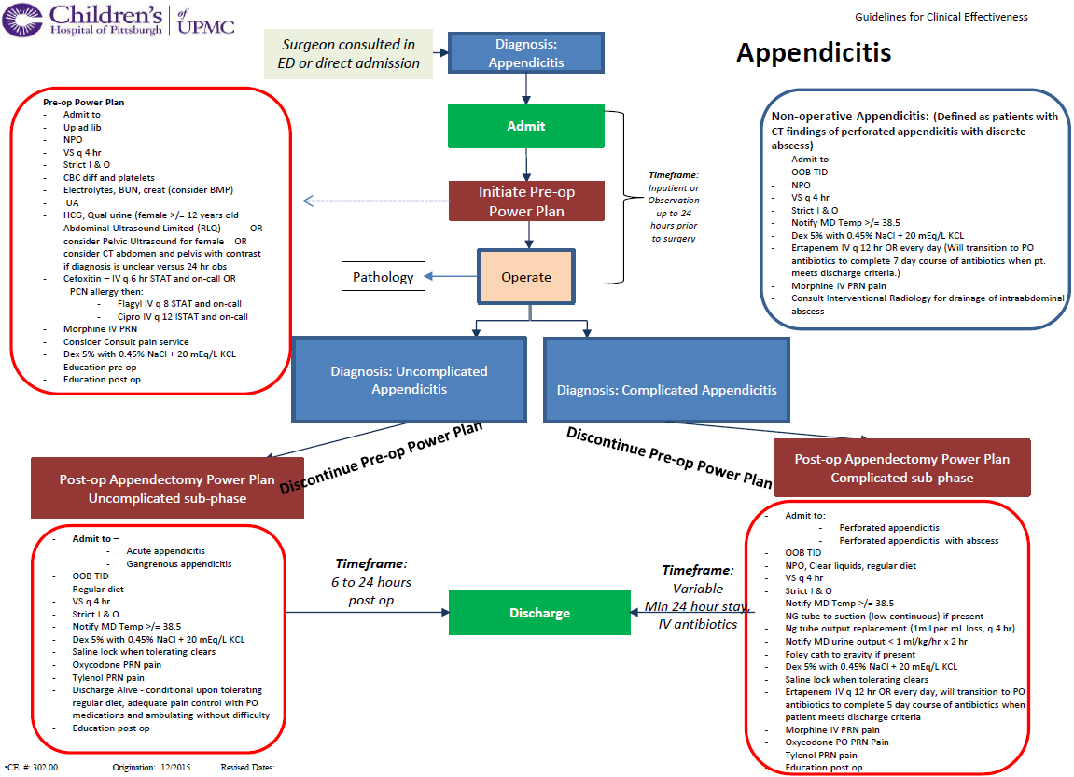
QLIK SCREEN SHOTS

Slide 31
Summary of Guidelines
Perforated appendicitis
At 24 hours: stable and meet d/c criteria
Change to oral antibiotics (5 days total Abx)
Complicated appendicitis
When afebrile can be switched to oral Abx for total of 7 days
Follow up phone call: set questionnaire by pediatric surgical RN
Screen positive come back to clinic

Slide 32
Difference in Length of Stay (LOS) “On” vs “Off” Pathway Post-Operatively
LOS Before Pathway
Median LOS: 36 hrs
"Off Pathway"
Post-Operatively
Median LOS:
33 hrs
"On Pathway"
Post-Operatively
Median LOS:
26 hrs

Slide 33
Difference in LOS “On” vs “Off” Pathway Post-Operatively
LOS Before Pathway
Median LOS: 155 hrs
"Off Pathway"
Post-Operatively
Median LOS:
110hrs
"On Pathway"
Post-Operatively
Median LOS:
107 hrs

Slide 35
Appropriate pre-op Abx
Decreased Surgical Site Infections

Slide 36
Summary
One size doesn’t fit all
See what works at your institution
CHP using combination
Pre-authorization
3 day monitoring
Individual guidelines with specific group

Slide 37
Recognizing the CHP ASP
Clinical Pharmacy Team
Don Berry
Kelli Crowley
Elizabeth Ferguson
Denise Howrie
Bill Mcghee
Tan Nguyen
Carol Vetterly
Emily Polischuck
Jen Shenk
Pharmacy
Jeff Goff
Medical Director’s Office
Ann Thompson
Infectious Diseases
Brian Campfield
Toni Darville
Michael Green
Jim Levin
Ling Lin
Judy Martin
Marian Michaels
Andy Nowalk
Terri Stillwell
John Williams
ID Fellows
GSPH Biostatistics
Maria Mori Brooks
Jong-Hyeon Jeong
Marcia Kurs-Lasky

Slide 38
Questions?

