Slide 1
Regional Approaches to Antimicrobial Stewardship
Keith Hamilton, MD
Director of Antimicrobial Stewardship
Hospital of the University of Pennsylvania

Slide 2
Disclosures
Nothing to disclose

Slide 3
Outline
Background
Case for regional approaches to stewardship
Models of antimicrobial stewardship collaboratives
Future directions
Notes:
With specific focus on Pennsylvania

Slide 4
Outline
Background
Case for regional approaches to stewardship
Models of antimicrobial stewardship collaboratives
Future directions

Slide 5
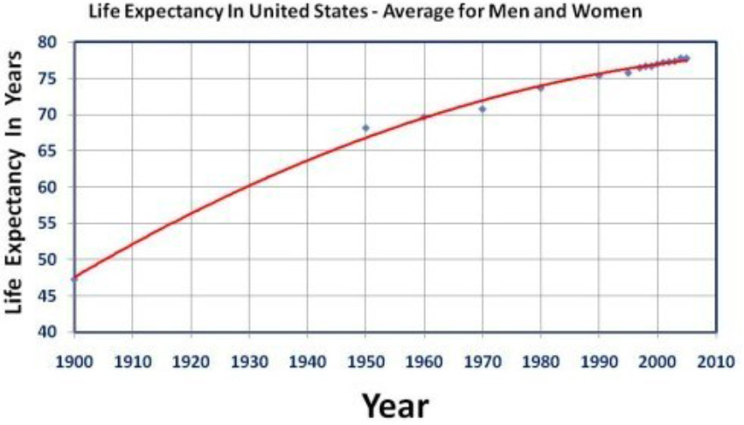
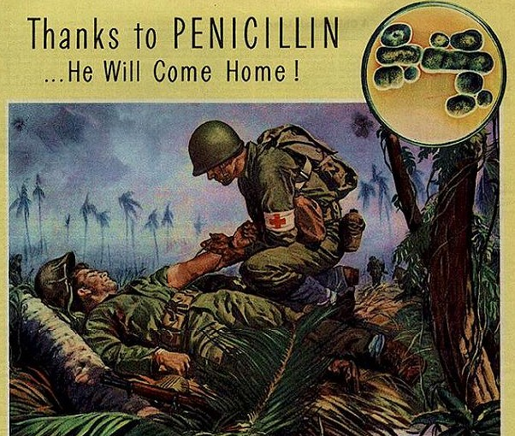
Background
1928
1940
1941
1944
1972
2000
2010
Fleming discovers penicillin from Penicillium chrysogenum
Widespread production of penicillin
Florey, Chain, Heatley, and Abraham demonstrated therapeutic potential in mouse infection study (Oxford)
Human studies for penicillin begin
Notes:
Life expectancy increased by 8 years between 1944 and 1972, largely credited to antibiotics

Slide 6
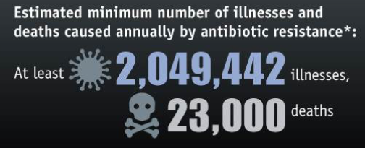
Background
1928
1940
1941
1944
1972
2000
2010
Cephalosporins
Linezolid
Penicillin
Sulfonamides
Erythromycin
Daptomycin
Ampicillin
Carbapenems
Methicillin
Vancomycin
CDC VitalSigns, 2013.

Slide 7
CRE Infections 2006
Carbapenem-resistant Enterobacteriaceae
DC
HI
PR
AK
http://www.cdc.gov/hai/organisms/cre/TrackingCRE.html
Courtesy of Alex Kallen, CDC

Slide 8
CRE Infections 2017
Carbapenem-resistant Enterobacteriaceae
DC
HI
PR
AK
http://www.cdc.gov/hai/organisms/cre/TrackingCRE.html

Slide 9
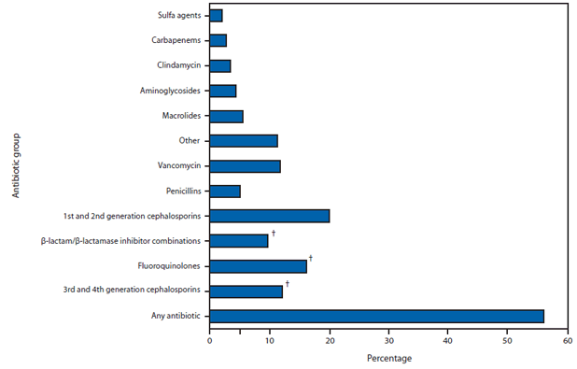
Inappropriate Use in Inpatient Facilities
Approximately 30-63% of hospitalized patients receive an antibiotic
It is estimated that up to 30-68% of antibiotic use is inappropriate
Discharge Antibiotic
Percentage of Patients
Fridkin S, et al. MMWR 2014.
Hecker, Arch Intern Med, 2003.
Jenkins, Clin Infect Dis, 2010.
Polk, Clin Infect Dis, 2011.

Slide 10
Inappropriate Use in Ambulatory Setting
The outpatient setting accounts for >60% of antibiotic expenditures in the U.S.
262.5 million courses of outpatient antibiotics in 2011
789 prescriptions per 1000 adults
889 prescriptions per 1000 children
As many as 50% of all outpatient antibiotics prescribed are unnecessary
Hicks LA, et al. Clin Infect Dis 2015.
Dantes R, et al. Open Forum Infect Dis 2015.
Suda KJ, et al. J Antimicrob Chemother 2013.

Slide 11
Antimicrobial Stewardship
“Coordinated interventions designed to improve and measure the appropriate use of antimicrobials by promoting the selection of the optimal antimicrobial drug regimen, dose, duration of therapy, and route of administration. Antimicrobial stewards seek to achieve optimal clinical outcomes related to antimicrobial use, minimize toxicity and other adverse events, reduce the costs of health care for infections, and limit the selection for antimicrobial resistant strains.”
Reduce Healthcare Costs
Decrease Antimicrobial Resistance
Decrease Adverse Events
Optimize Clinical Outcomes
Infectious Diseases Society of America

Slide 12
Background
Antimicrobial stewardship is a quality improvement initiative proven in multiple, peer-reviewed studies to:
Improve patient outcomes
Shorten length of stay
Reduce Clostridium difficile infection rates
Save money
Reduce antimicrobial resistance
Recommended by major professional societies and federal agencies: CDC, IDSA, SIS, AAP, PIDS
Antimicrobial stewardship and infection control interventions have focused on individual institutions without coordination
Dellit TH, et al. Clin Infect Dis 2007.
Morris AM. Curr Treat Options Infect Dis 2014.
Notes:
Improve patient outcomes; shorten length of stay; reduce antibiotic resistance (GNR, VRE); and save money
Without clear coordination among other facilities in the community, which often care for the same patients.
These independent efforts do not account for the importance of inter-facility spread through movement of patients who are colonized or infected with these organisms, or the impact that one institution's practices might have on the antibiotic resistance encountered by neighboring facilities (4–6).

Slide 13
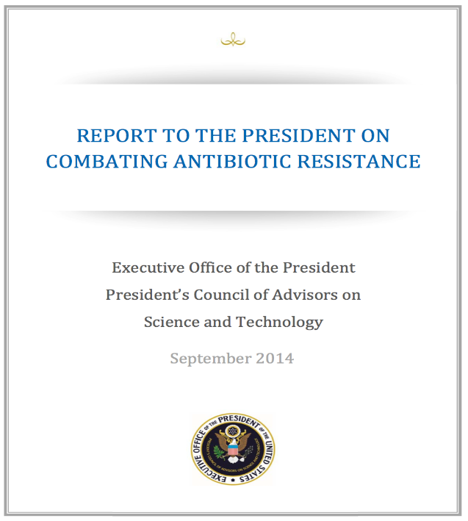
Background
United States agencies have recently stressed the need for implementation of antimicrobial stewardship programs in all healthcare facilities
PCAST report
Joint commission standards
CMS condition of participation
California has enacted some of the most stringent regulations requiring antimicrobial stewardship
California
Senate Bill
1311

Slide 14
Background: New Regulations
Transformative changes in infection control occurred when all healthcare facilities were required to implement infection control programs and required hospitals to report healthcare-associated infection rates
Reinforce that antibiotics are a shared community resource so antimicrobial stewardship should be seen as a community effort
Create challenges for many healthcare facilities to find practical solutions to adhere to these regulations

Slide 15
Outline
Background
Case for regional approaches to stewardship
Models of antimicrobial stewardship collaboratives
Future directions
Notes:
With specific focus on Pennsylvania

Slide 16
Outline
Background
Case for regional approaches to stewardship
Models of antimicrobial stewardship collaboratives
Future directions

Slide 17
Case for Regional Approach to Stewardship
Resistance patterns vary by region
E. coli resistance to fluoroquinolone varies from 18-38% based on geographic region
MRSA rates range from 34-62% based on geographic region
Antibiotics are “shared” community resources
Some antibiotics have significant ecologic impact:
Carbapenems
Fluoroquinolones
Broad-spectrum cephalosporins
New antibiotics represent opportunities to clearly define use criteria
Ceftazidime-avibactam
Ceftolozane-tazobactam
Ceftaroline
Oritavancin
Dalbavancin
Notes:
Differences in antimicrobial needs
This can be recommendations on when hospitals should add drugs to formulary or on treatment guidelines
So antimicrobial stewardship at a long-term care facility that feeds your hospital (with high rates of CRE) benefits an acute care hospital and vice versa
New antimicrobials have been approved by the Food and Drug Administration looking at safety efficacy for “easy-to-achieve conditions”
Skin and soft tissue infection
Intra-abdominal
Urinary tract infection
Little consideration as to how these drugs will be used by the medical community at large
Appropriate use criteria can be defined by regional collaborative groups

Slide 18
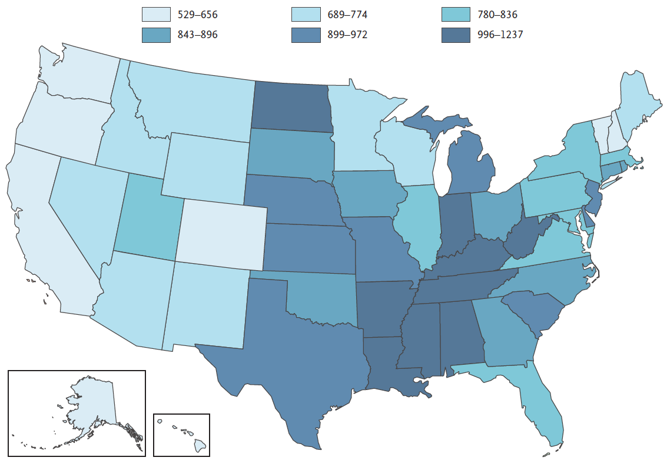
Case for Regional Approach to Stewardship
Antimicrobial use patterns vary by region
Wide variations in ambulatory prescribing by region and state
Southern states [OR 2.4 (95% CI 1.4-4.2)] and Northeastern states [OR 2.6 (95% CI 1.4-4.8)] prescribe more antibiotics for respiratory tract infections when compared to Western states
Differences not explained by patient risk factors, comorbidities or symptoms
Antibiotic prescriptions per 1000 patients of all ages by state, 2010.
Hicks, New Engl J Med, 2013.
Steinman MA, et al. JAMA 2003.
Zhang Y, et al. Arch Intern Med 2012.
Jones BE, et al. Ann Intern Med 2015.
Notes:
Odds ratios are when adjusted for diagnosis and comorbidiy
This time of year saying that someone is a VERY blue state is very politically charged, but politics aside, this is a situation where you really don’t want to be a blue state

Slide 19
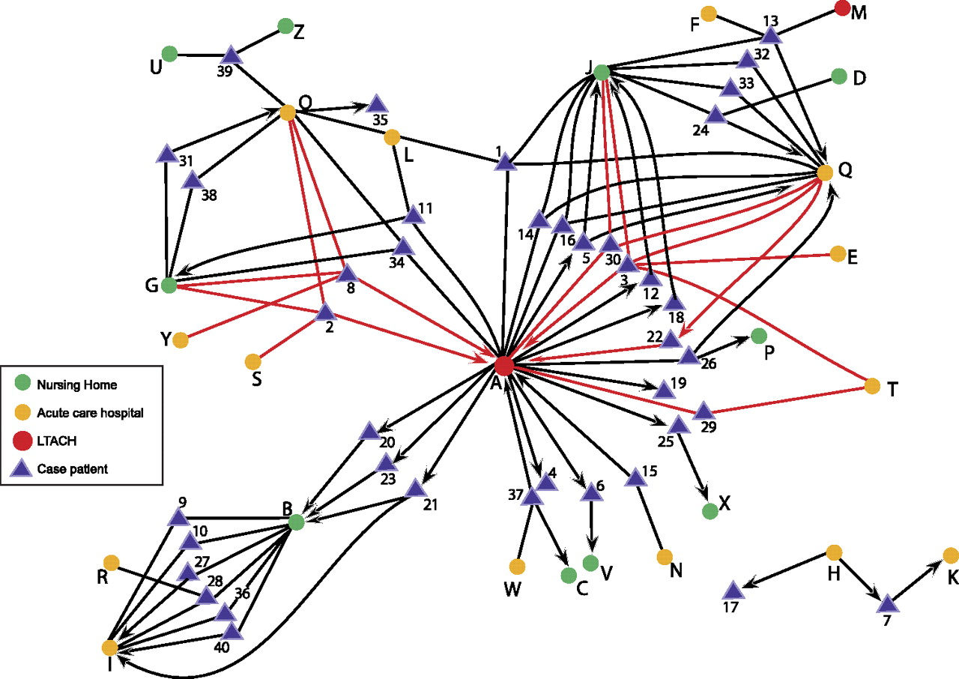
Case for Regional Approach to Stewardship
Patients are transferred between healthcare facilities so can cause horizontal spread of antimicrobial resistance
Won SY, et al. Clin Infect Dis 2011.
Notes:
Exposure network graph demonstrating the relationships of cases to long-term acute care hospitals (LTACHs), acute care hospitals, and nursing homes during the entire 12-month study period.
Extensive transfer of KPC-positive patients throughout the exposure network of 14 acute care hospitals, 2 LTACHs, and 10 nursing homes
Successful control of KPC-producing Enterobacteriaceae will require a coordinated, regional effort among acute and long-term health care facilities and public health departments.
WE SHARE OUR ANTIBIOTIC RESOURCES AS A COMMUNITY
WE ALSO SHARE THE PROBLEMS WE CREATE

Slide 20
Case for Regional Approach to Stewardship
Modeling study examined infections and associated deaths through CDC’s National Healthcare Safety Network (NHSN) and Emerging Infections Program (EIP)
Carbapenem-resistant Enterobacteriaceae
Multidrug-resistant Pseudomonas aeruginosa
Invasive MRSA
Clostridium difficile infection
Projected outcomes from 2014-2019 using simulation models to estimate coordinated approach to prevent spread of these infections by tracking simulated patients through different sized healthcare community
Acute care hospitals
Nursing homes
Used several scenarios:
No coordinated interventions and baseline approach
Upgraded infection control and stewardship efforts but uncoordinated
Coordinated infection control and stewardship efforts
Slayton RB, et al. MMWR 2015.
Notes:
REGIONAL STRATEGIES ARE LIKELY TO BE ASSOCIATED WITH MORE SIGNIFICANT IMPACT
Transfer data of patients was simulated using actual transfer data from healthcare networks
three hypothetical scenarios (1): infection control activity currently in common use (common approach/status quo, or baseline activity with no augmented intervention) (2), augmented efforts implemented independently at individual subsets of facilities (independent efforts), and (3) coordinated augmented approach across a health care network (coordinated approach).

Slide 21
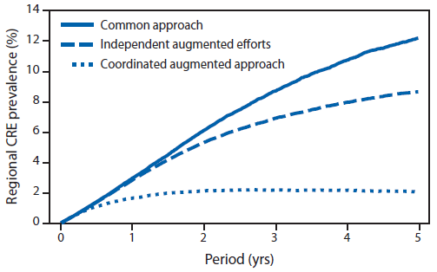
Case for Regional Approach to Stewardship
Slayton RB, et al. MMWR 2015.
Notes:
With effective action now, including nationwide antibiotic stewardship efforts and interventions to prevent spread of antibiotic-resistant infections, an estimated 619,000 infections caused by three problematic antibiotic-resistant HAIs or CDIs, and 37,000 deaths among infected patients might be averted nationally over the next 5 years. When considering published estimates of costs related to these four infections in the projections

Slide 22
Case for Regional Approach to Stewardship
Medical systems vary by region
Types of medical providers (family medicine versus internal medicine)
Advanced practitioners
Minute clinics
Ambulatory practices
Insurance payers
Urban versus suburban versus rural
Private practice versus hospital-affiliated
Large healthcare conglomerates versus independent hospitals
In many cases, resources are not allocated to the facilities in which they may have the most significant impact on the community

Slide 23
Case for Regional Approach to Stewardship
Malpractice case law varies by state
ASPs will likely increase both in number and diversity as a variety of healthcare facilities will strive to either adjust existing programs or create new ones, engaging healthcare professionals with a variety of backgrounds and training
Important questions regarding credentialing and liability coverage need to be addressed
Legal implications of ASPs are not well understood
Because there is limited available legal guidance and precedence in the area of antibiotic stewardship, an important goal of collaboratives should be to outline and elaborate on suggested practices around core areas of ASPs
Program structure
Interventions
Documentation

Slide 24
Case for Regional Approach to Stewardship
Antimicrobial stewardship is a cultural and behavioral intervention and culture varies regionally
Antibiotic prescribing is a social process that is influenced by many relationships and interests
Medical Hierarchy
Education
Facility Organization
Legal Concerns
Social Dynamics
Prescribing Decision
Cost and Availability
Provider Attitudes
Culture Results
Science
Patient Attitudes
Fishman N. Am J Infect Control 2006.
Notes:
Social dynamics such as prescribing etiquette and hidden curriculum that may run countercurrent to science and education
Beliefs about antibiotics and their effects
Or provider perceptions of patient attitudes (mounting evidence that what patients think and what providers think they think are not in agreement)

Slide 25
Case for Regional Approach to Stewardship
Research and Academic Affiliation
Grant funding available for research endeavors in antimicrobial stewardship through federal, regional, and local funding mechanisms for antimicrobial resistance, healthcare-associated infection (HAI) reduction, and community engagement
Antimicrobial stewardship needs larger laboratories to better study meaningful clinical outcomes
Mortality
Length of stay
Clostridium difficile
Morris AM. Curr Treat Options Infect Dis 2014.
Notes:
INVITED TALKS
Can be difficult to show an effect AND When they do…
Mortality, length of stay, and C. difficile in prior studies suffer from secular trends in healthcare where ongoing quality improvement projects are aimed at decreasing these as well so before after studies can be more difficult to interpret but more robust studies such as stepped-wedge quasi-experimental studies can be implemented when you have large collaboratives

Slide 26
Outline
Background
Case for regional approaches to stewardship
Models of antimicrobial stewardship collaboratives
Future directions
Notes:
With specific focus on Pennsylvania

Slide 27
Outline
Background
Case for regional approaches to stewardship
Models of antimicrobial stewardship collaboratives
Future directions
Notes:
With specific focus on Pennsylvania

Slide 28
Grassroots
Does not require the presence of a central organizing structure
Relatively to set up based on connections to affiliated healthcare facilities, existing collaborations (infection control, research, etc.), friendships
Disadvantages: in absence of grant funding may not have resources or money, individual members have many competing interests, buy-in may be more difficult to achieve in facilities that need the collaborative the most
Notes:
The trick here I think would be figuring out sustainability

Slide 29
Top-Down
Antimicrobial stewardship fits with core principles of public health departments
Public health organizations have a unique perspective
Best understanding of the linkages between healthcare facilities
Immediate credibility at generating buy-in
Positioned to generate regional needs assessments
Public health organizations may have money
Affordable Care Act has provided funds for local and state public health organizations to build infrastructure
Disadvantages: may not have money, may have competing interests, may not have practical expertise in stewardship
Trivedi KK, Pollack LA, Clin Infect Dis 2014.
Notes:
There is not mistake about why many of these collaboratives either are driven by or engaged with Public Health Organizations because they are in a unique position to promote the formation and success of stewardship collaboratives
Stewardship collaboratives align with these goals
Needs assessments through survey

Slide 30
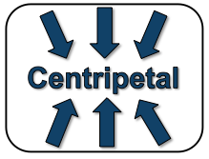
Centripetal
Non-governmental public health agencies and professional societies can act as an organizing force
Public health advocacy groups
Regional professional societies (e.g. APIC)
Can provide planning and organization with dedicated staff
Disadvantages: often dependent on grant funding to provide services so organizational structure may evaporate when grant ends or funding disappears, may not have expertise in stewardship, less of a regional mandate compared to public health departments
Notes:
That being said, they can engage stewardship experts and there are some successful cases, one of which I will discuss

Slide 31
Philadelphia Antimicrobial Stewardship
Philadelphia Community Antimicrobial Stewardship Collaborative (PCASC)
Partnership with the Philadelphia Department of Public Health (PDPH), Penn Medicine, Children’s Hospital of Philadelphia, and Association for Professionals in Infection Control and Epidemiology (APIC)
Supported by Community Engagement and Research grant
40 area healthcare facilities
Gutowski J, et al. SHEA 2015.
Notes:
To facilitate a central structure as well as to add some additional credibility. A decentralized approach would be less effective so we partnered with several invested personnel in the city health department

Slide 32
Role of PCASC
Assess the current state and needs of stewardship in the region
Provide guidance to healthcare facilities using local culture, practices, antimicrobial resistance, and prescribing practices
Develop local curricula to make antimicrobial stewardship education more accessible
Close the gap between stewardship guidelines/research and practice, especially in community hospitals and ambulatory settings
Create regional research networks
Share experiences from a variety of healthcare settings
Train local leaders across healthcare settings to build stewardship capacity in the region
Notes:
Understand facilitators and barriers to stewardship in the “real world”
Current training programs may be more limiting to certain facilities who may not sponsor people to obtain this training

Slide 33
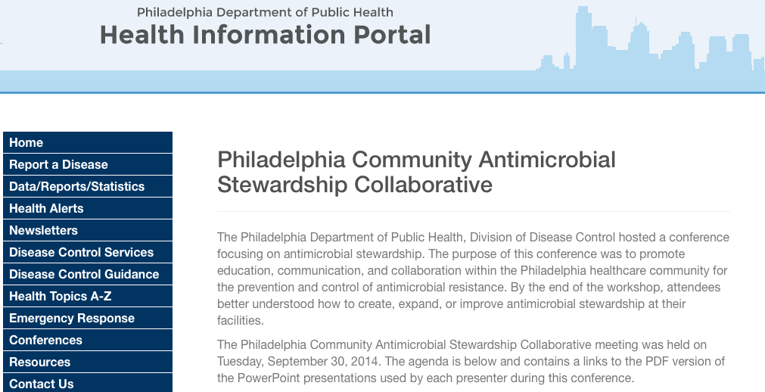
Symposia
Current regulatory landscape of stewardship
Social and behavioral determinants of antibiotic prescribing
Practical strategies for utilizing antimicrobial use data
Discussions on practical stewardship strategies in different settings, including implementation of JC standards
Discussions of practices in documentation and risk management
Discussions about regional guidelines for antibiotic use
Resources/Agenda: https://hip.phila.gov/Conferences/AntimicrobialStewardship
Gutowski J, et al. SHEA 2015.

Slide 34
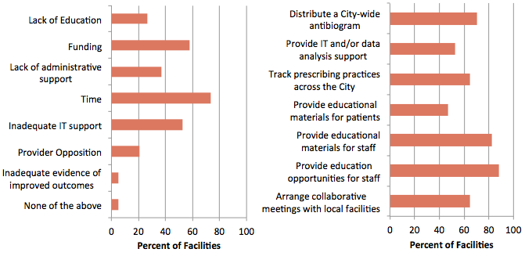
Stewardship Needs in Philadelphia area
Facility-identified barriers to stewardship
Facility interest in support from PCASC
Gutowski J, et al. SHEA 2015.

Slide 35
Healthcare Professional Student Attitudes
Szymczak J, et al. [unpublished data].

Slide 36
Sources of Antibiotic Education
Szymczak J, et al. [unpublished data].
Notes:
How do they want it

Slide 37
Webinar Series
Day-to-Day Antimicrobial Stewardship: Focusing on What Works and What You Have Resources For
David Schwartz, MD (Cook County Health, IL)
129 attendees
Antimicrobial Stewardship: Let’s Do It!
Gail Itokazu, PharmD (Stroger Hospital, IL)
141 attendees
Monitoring Antimicrobial Use with Free or Widely Available Software
Jonathan Beus, MD MS (Children’s Hospital of Phila, PA)
170 attendees
Asymptomatic Bacteriuria: Myths, Magic, and Management
Christopher Ohl, MD (Wake Forest University, NC)
122 attendees
Antimicrobial Stewardship and the Clinical Pharmacist
Jason Pogue, PharmD (Sinai-Grace Hospital, MI)
153 attendees
https://hip.phila.gov/Conferences/AMSWebinarSeries
Notes:
If you build it they will come!

Slide 38
Understanding Culture of Prescribing
“It is surprisingly difficult. How do you define these things? You would think, oh an infection is an infection, but if I see a patient a week after surgery, and there’s still a little redness, and Mom’s nervous I am inclined to just put the kid on the antibiotic. It just makes everyone comfortable, and then a week later, the redness is gone. Did I treat an infection or was there just some redness? Some inflammatory post-operative discharge? I don’t know. I’m more careful about how I give antibiotics than I used to be in the past. You don’t want to be part of the societal issue of creating superbugs, but it is surprisingly difficult to look Mom in the face when she is convinced it’s infected and you’re trying to say ‘look, it’s not infected,’ when you don’t even know for sure yourself and a week later it could pus out and Mom’s like ‘See? Should have put her on antibiotics. I can’t believe you did this to my kid!’ That is what you imagine the scenario being if you don’t do something. It’s so much easier to say ‘look, we’ll put her on a little antibiotic.’”
- Julia Szymczak, PhD, Interview with a Surgeon
Szymczak J, Newland J. Practical Strategies for Implementing Antimicrobial Stewardship [pending publication]
Notes:
These are some of the rich narratives that you can get from focusing on the qualitative aspects of antimicrobial stewardship that can help set priorities and inform regional approaches. There are differences in culture based on the hospital. Private physicians versus staff physicians may and is likely a different approach to stewardship.

Slide 39
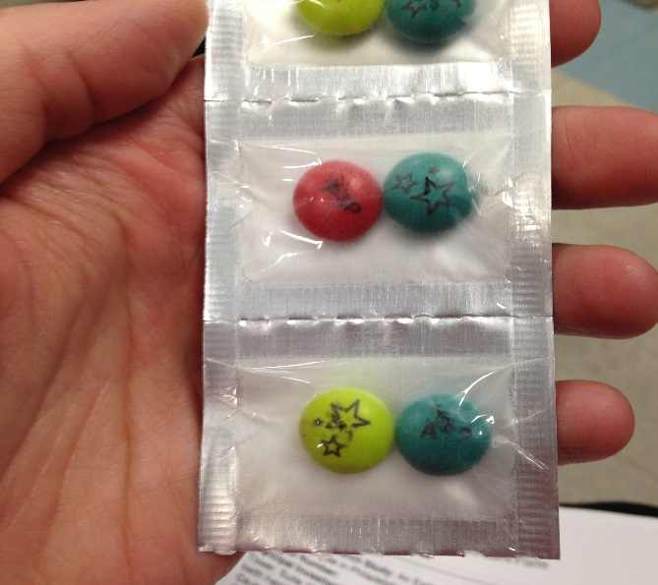
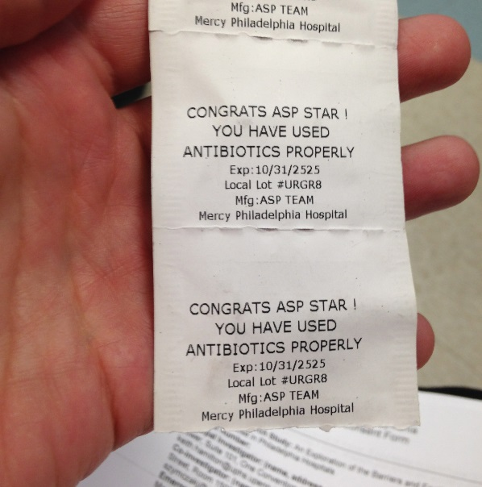
Understanding Culture of Prescribing
Most literature on antimicrobial stewardship has been performed in university/academic hospitals without clearly defined practical advice to “real-world” solutions
Changing prescribing culture requires assessing facilitators and barriers to antibiotic stewardship
Regional collaborations can identify and highlight tools that are effective at changing local prescribing culture
Formal statements
Stories
Symbols
Modeling behaviors
Connectors and Influencers
Spellberg B. JAMA Intern Med 2014.
Meeker D, et al.. JAMA Intern Med 2014.
Szymczak J, et al. SHEA 2016.
Notes:
One hospital has leveraged symbols very creatively (M&M’s)
Hospitals have also found creative ways to engage connectors and infuencers (we have really engaged our ICU pharmacists in this and empowered them because of the virtue they have rounding every day with the teams to influence antibiotic use…one of them wears a sticker she got of her salad on her badge that says “No antibiotics”)
A community hospital that is a part of our collaborative requires all medical teams to come unto a room to talk to the discharge planning staff and rotate through all the tables so the stewardship team got a table and now all the teams need to rotate through their table and explain why they are using antibiotics).
There are many things that you won’t find in the national guidelines on stewardship. I could not find anywhere that it says to put M&M’s in a drug pack
However, many of these are more powerful motivators to change the culture
Judo is a Japanese martial art that can be translated as “gentle way” and focuses on using an opponent’s force against itself rather than directly confronting it with opposing force. A common axiom in Judo is “maximum efficiency with minimum effort.” Meeker et al7 have created a clever Judo-like approach that works with patient and clinician psychology to reduce antibiotic prescriptions. Meaningful gains can be achieved with minimal effort and cost.

Slide 40
Hospital/Healthsystem Association of PA
Healthcare advocacy organization
Created a healthcare engagement network (HEN) using grant from CMS focused on reduction of healthcare-associated infections
HEN includes > 200 healthcare facilities
37 hospitals recruited for project focused on reducing Clostridium difficile through targeted reduction in fluoroquinolone (FQ) use
Methods:
Each facility performed gap analysis to determine state of stewardship
Each facility reported a month of baseline FQ use data in daily defined doses (DDD) per 1,000 patient days
Consortium received education on a variety of practical approaches to reduce FQ use
Interventions were left up to each facility
https://www.haponline.org
Notes:
There were a variety of healthcare facilities with 1/3 having robust programs (at least 5 CDC core measures), 1/3 with at least 2 core measures and 1/3 with no stewardship activities
CEO’s signed hospital up for the programs and pharmacists were recruited (not physicians)
Main challenge was advocacy without physicians especially in hospitals with a lot of non-hospital-employed physicians

Slide 41
Healthsystem Association of Pennsylvania
Clostridium difficile rate decreased by 14%
https://www.haponline.org
27.7%
Reduction
Catanzaro M, Edelmayer C [unpublished data].
Notes:
The large facilities with more resources tended to have lower FQ use to start and had little change. The hospitals with smallest size and less resources typically started higher and stayed higher. Hospitals that were middle sized tended to have the most significant reductions in FQ use
C difficile was reduced by 14%
This approach needs to be studied in more of a formal setting

Slide 42
Conclusions
Antibiotics should be seen as a shared community resource, and we must more clearly define how these medications fit into our regional schemas of antibiotic use
We need to break down healthcare silos in order to coordinate antimicrobial stewardship efforts
Collaboratives offer the possibility to more effectively combat the development and spread of antibiotic resistance
Regional approaches can provide support for the expansion of stewardship to all healthcare settings
More studies are needed to determine the impact on clinical outcomes and antibiotic resistance with regional approaches to antibiotic stewardship
Spellberg B, et al. JAMA 2016.
Notes:
Eventually engage more ambulatory settings, long-term care facilities, dialysis centers, rehabilitation facilities
Sharing the responsibilities to establish a coordinated program among communities of health care institutions with leadership by local health authorities will bring about the collective, shared benefits of coordination. Shifting the current culture to one of sharing information and sharing responsibility in prevention will require local leadership and commitment across various sectors

Slide 43
Thank You!
Keith Hamilton, MD
keith.hamilton@uphs.upenn.edu

Slide 44
Models of Regional Stewardship
Minnesota Department of Public Health
Developed Minnesota Guide to a Comprehensive Antimicrobial Stewardship Program in conjunction with a core steering group
Adapted recommendations for resource and financial differences among healthcare facilities
Oregon Health Authority
Webinar training sessions for healthcare facilities
On-site training in hospitals by expert ASP facilities
http://www.health.state.mn.us/divs/idepc/dtopics/antibioticresistance/mnasp.pdf
http://oregonpatientsafety.org/healthcare-professionals/improvement-initiatives/

Slide 45
Models of Regional Stewardship
Illinois Department of Public Health (IDPH)
Summit on antimicrobial stewardship reviewing regulatory and accreditation updates with focus on practical approaches to stewardship
Qualitative on-site assessments of status and successes of programs
Share experiences from a variety of healthcare facilities
California Department of Public Health (CDPH) developed tools to discuss strategies to implement these requirements
Provides examples of ASP policies and reports
Gives easy access to checklists and tool kits for stewardship facilities in acute care and nursing facilities
Hosts webinar series for practical implementation of stewardship in nursing facilities
Conducted and disseminated assessment of ASPs
Developed a subgroup collaborative of small and rural hospital ASPs
http://www.dph.illinois.gov/sites/default/files/publications/publicationsopps2016-antimicrobial-summit-program.pdf
http://www.cdph.ca.gov/programs/hai/Pages/AntimicrobialStewardshipProgramInitiative.aspx

Slide 46
Models of Regional Stewardship
Indiana Department of Public Health
Formed Indiana Coalition for Antibiotic Resistance Education Strategies (ICARES)
Provides physicians and patients information about harm associated with inappropriate antibiotic use
Michigan Antibiotic Resistance Reduction (MARR)
Collaborative of professional and community groups targeting unnecessary antimicrobial use
Provides education to patients and providers to give practical skills to reduce inappropriate antibiotic prescribing
Georgia Department of Public Health
Initiated assessment of stewardship programs statewide
Created training programs for pharmacists and advocated for recruiting of trained hospital pharmacist
Coordinated stewardship education and advocacy across professional societies
Launching an honor roll program
https://www.cdc.gov/hai/state-based/pdfs/success_story-Georgia_stewardship.pdf
http://www.icares.org/aboutus.html
http://www.mi-marr.org/about.php
Notes:
Some of the oldest collaboratives:
ICARES = 1999
MARR = 1997
Once we in medicine are told that there is going to be competition or that there is something called an Honor Roll, we say. I want that!

