Slide 1


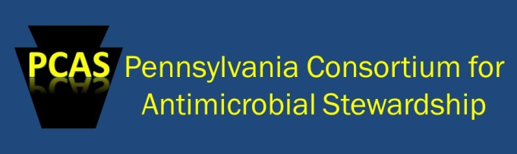
Get Smart Know When Antibiotics Work Pennsylvania
Nkuchia M. M’ikanatha, DrPH, MPH
Lead Epidemiologist, AR Program
Pennsylvania Department of Health
Council of State and Territorial Epidemiologists Annual Conference
Tuesday, June 21, 2016: 2:00 PM-3:30 PM
Kahtnu 1 (Dena'ina Convention Center)

Slide 2
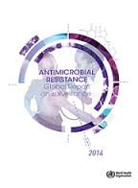

Without urgent, coordinated action by many stakeholders, the world is headed for a post-antibiotic era, in which common infections and minor injuries which have been treatable for decades can once again kill. ∼ Keiji Fukuda, WHO, 2014
Keiji Fukuda,
Source: WHO

Slide 3

Get Smart: Know When Antibiotics
Work - Pennsylvania
Outline
  State perspective on the threat of antimicrobial resistance
  Rationale for a collaborative approach
  Get Smart Program—initiatives
    Pediatric
    Pharmacy
    Communication
  Conclusions
Source: Pa. Publications

Slide 4
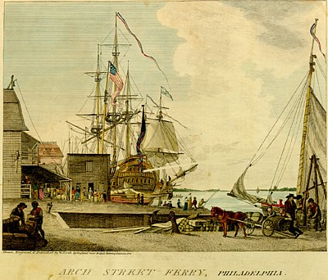
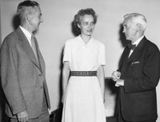
State perspective on the threat of antimicrobial resistance
The state’s role in public health began in late 1800s¹⁻²
  Dreadful epidemics
Pa. DOH mandates include
  prevention/control of infectious disease
  Antibiotics: 20th century revolution
    Resistance is a thriller movie
Philadelphia, 1800
Source: William Birch
  1. Pa. State Archives. Department of Heath records
  2. Harvard University. Contagion: Historical View of Diseases and Epidemics: digital library
Anne Sheafe Miller: first patient to be treated in the US with penicillin
Source: Eric Otman Columbia University
Notes:
Time of dreadful epidemics including Yellow Fever in Philadelphia in 1793²

Slide 5
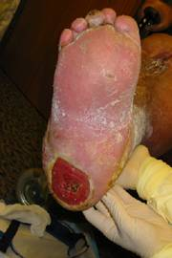
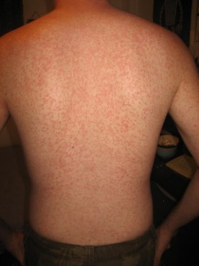
State perspective on the threat of antimicrobial resistance (cont’d)
Consequences of overuse and misuse of antibiotics
  Exacerbates emergence of resistant-bacteria³ as well as increases risk of certain infections
    Increased risk of Clostridium difficile⁴
  Drug adverse events~140,000 ED visits annually⁵
VRSA infected wound;
Source: K. Julian, 2002
Adverse Reaction to Amoxicillin
Source: www.healthtap.com
Adolf W. Karchmer Clin Infect Dis. 2004;39:S142-S150
Lessa FC, Mu Y, Bamberg WM, et al. N Engl J Med 2015;372:825-834
Shehab N, Patel PR, Srinivasan A, Budnitz DS. Clin Infect Dis. 2008; 47:735-43
Notes:
The role of the state to monitor and respond to microbial threats existed before the advent of modern medicine. The Commonwealth established a board of health and vital statistics in 1885 and at the dawn of the 20th century, state legislatures replaced it with the present Department of Health (12-13). Today Pennsylvania has multiple programs focused on the ever-growing threat from infectious pathogens.
Increased risk of certain infections, ~ 453,000 Clostridium difficile incident cases, resulting in 29,000 deaths each year ⁴

Slide 6
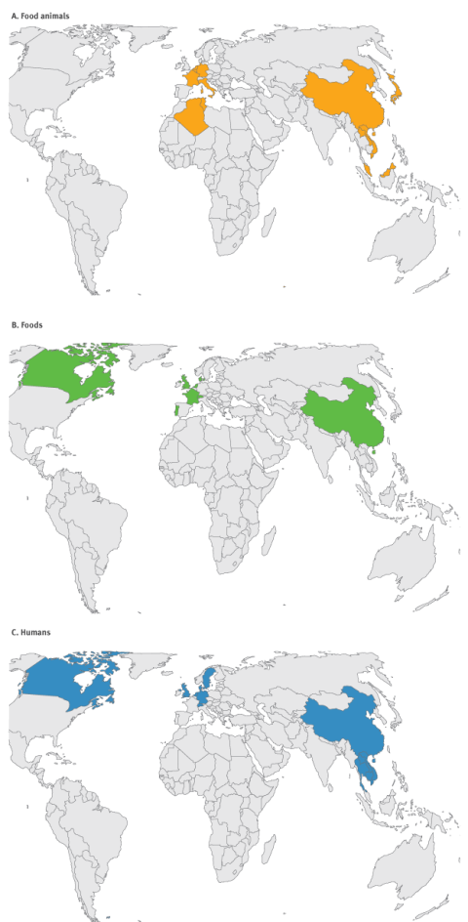

Drug resistant genes spread fast!
Colistin-resistant E. Coli infection ; female 46 yrs old Pa. patient in 2016
The recent discovery of a plasmid-borne colistin resistance gene, mcr-1, heralds the emergence
of truly pan-drug resistant bacteria⁶.
6. McGann P, et al. Antimicrob Agents Chemother. 2016. pii: AAC.01103
7. Skov RL, Monnet DL.
Euro Surveill. 2016;21 doi: 10.2807/1560-791
Rapid spread of colistin resistance gene⁷

Slide 7

Rationale for a Collaborative Approach
Multifaceted pediatric interventions can reduce Abx use
  Statewide campaign in WN compared with MN (control)1998-2003 had limited impact ⁸
  Community-wide interventions in Knox County TN- 1997-1998
    Abx prescription rate: -Decrease was 11%⁹
  16-community trial in MA-1998-2003
    Greater in Medicaid-insured children and for broad spectrum antibiotics (BSA) agents¹⁰
8. Belongia EA, et al. Emerg Infect Dis. 2005;11:912-20
9. Perz JF et al. JAMA. 2002;287:3103-9
10. Finkelstein JA,. et al. Pediatrics. 2008;121:e15-23.
Notes:
The role of the state to monitor and respond to microbial threats existed before the advent of modern medicine. The Commonwealth established a board of health and vital statistics in 1885 and at the dawn of the 20th century, state legislatures replaced it with the present Department of Health (12-13). Today Pennsylvania has multiple programs focused on the ever-growing threat from infectious pathogens.

Slide 8


  Get Smart Program Initiatives
LTCFs*
Communications
Pediatrics
Pharmacy
Decreased Abx, BSAs prescriptions
Pa. Get Smart Initiatives –2016
Get Smart App
Mobile ready site
* Long Term Care Facilities

Slide 9

  Get Smart Program Initiatives: Objectives
Promote guidelines for antimicrobial stewardship
Estimate antibiotic prescriptions
Decrease consumer demand for unnecessary antibiotics
Increase preventive measures (vaccination, hygiene, and infection control)
Dr. Levine reading “Katie Caught a Cold” to children at a child care center in State College, Pa. November 17, 2015

Slide 10
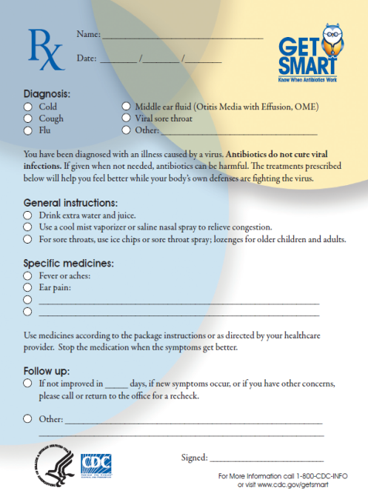

Pediatric Initiative
Pediatric settings
Pediatric clinics Abx stewardship
  Promote Get Smart guidelines
  Provider-based feedback on Abxs and BSAs
  Reduce parental expectations for Abxs
Collaborations
  Penn State Hershey Pediatrics
  Children’s Hospital of Pittsburgh
Focus
  Childcare facilities
    ~7907 facilities
    ~242,324 children in childcare facilities ¹¹
    11. Pennsylvania Department of Human Services
Source: www.examiner.com
Notes:
These program initiatives are developed in collaboration with CDC who provide substantial funding.
A multi faceted approach
Social Science: To refine public health practice

Slide 11



Pediatric Initiative (cont’d)
Example of activities
Develop practical guidance for implementation of model sick-child exclusion policies
  Advisory group of pediatricians, childcare directors, Keystone STARS, regulators and public health
  Identify sources of confusion
  Suggest actions based on experience
  Review mandated exclusions in light of current science
Notes:
Play an important societal role by allowing parents to contribute to economic activities
United States Census estimates 2005. Available at: http://www.census.gov/prod/2010pubs/p70-121.pdf

Slide 12

Pediatric Initiative (cont’d)
Example of outcomes
Pre-intervention study in 2007
  Main finding and editorial suggested the need to promote model policies ¹²⁻¹³
Sick-Child Exclusion Policy Advisory Group (Practical Considerations) in 2014
  Children ≥6 months with fever without behavior change do not need exclusion
12. M’ikanatha et al. Infect Control Hosp Epidemiol. 2010;31:408-11.
13. Kotch JB, Weber DJ. Infect Control Hosp Epidemiol. 2010;31:412-3.
Notes:
Play an important societal role by allowing parents to contribute to economic activities
United States Census estimates 2005. Available at: http://www.census.gov/prod/2010pubs/p70-121.pdf

Slide 13
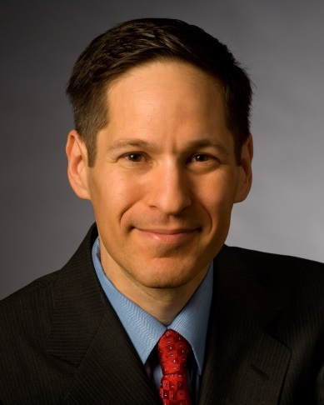
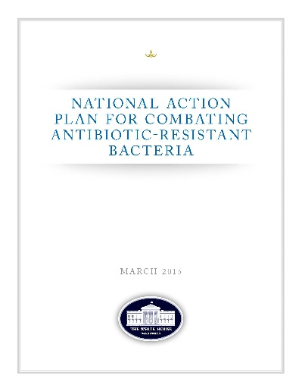
With the growing development of antibiotic resistance, it is imperative that we no longer take the availability of effective antibiotics for granted. As a nation, we must respond to this growing problem, and our response needs to be multifactorial and multidisciplinary.
∼ Thomas Frieden, 2010
Thomas R. Frieden
Source: Wikipedia
March 2015
Notes:
Statement by
Thomas R. Frieden M.D., M.P.H.
Director
Centers for Disease Control and Prevention
U.S. Department of Health and Human Services (HHS)
on
Antibiotic Resistance and the Threat to Public Health
before
Committee on Energy and Commerce
Subcommittee on Health
United States House of Representatives
Wednesday April 28, 2010
Good morning, Chairman Pallone and other distinguished members of the subcommittee. I am Dr. Thomas Frieden, Director of the Centers for Disease Control and Prevention (CDC), an agency of the Department of Health and Human Services, and I appreciate the opportunity to talk to you today about the public health threat of antibiotic resistance and the important role CDC plays in
Conclusion
With the growing development of antibiotic resistance, it is imperative that we no longer take the availability of effective antibiotics for granted. As a nation, we must respond to this growing problem, and our response needs to be multifactorial and multidisciplinary. CDC will continue to develop improved diagnostics to detect resistance rapidly and accurately. With the increased investments under the President’s budget, we will enhance our surveillance systems, such as NHSN, with electronic laboratory data and electronic medical records data, which will facilitate surveillance at the healthcare level and thereby increase surveillance capacity. It will also result in real-time reporting, which means that there will be greater opportunities for a rapid prevention and control response. Healthcare institutions need robust infection control programs and antibiotic stewardship programs to prevent transmission of resistant bacteria and to decrease the selective pressure for resistance. CDC will continue its support of new and effective vaccines, like the pneumococcal vaccine, to prevent infections caused by some of the most serious infections such as MRSA and C. difficile. By building on our current efforts, we can extend the life of current antibiotics and develop future antibiotic therapies to protect us from current and future disease threats.

Slide 14
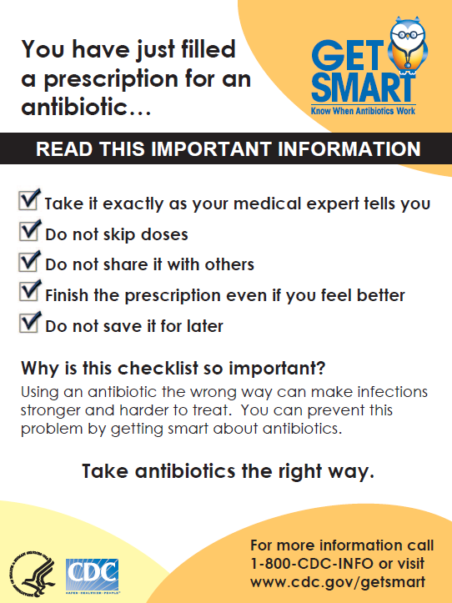
Get Smart Pharmacy Initiative
Objectives
Engage pharmacy faculty and students in antimicrobial stewardship
  Outreach in community pharmacies
  Support preventive measures (hand hygiene and vaccination)
  Research on antibiotic prescribing trends
  Collaborator: University of Pittsburgh School of Pharmacy
Notes:
Pharmacists are a gateway – they are a bridge between the general public and prescribers. Their role is well recognized.

Slide 15
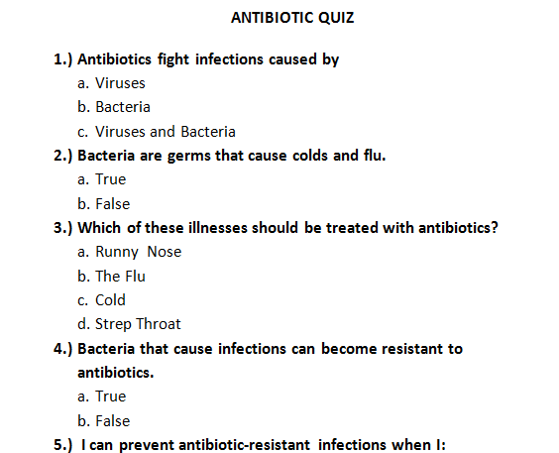
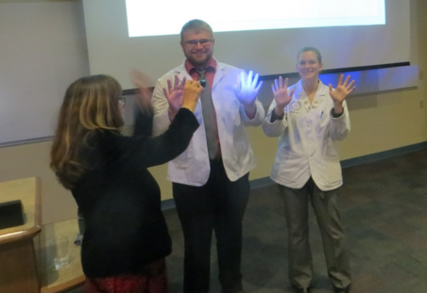
Get Smart Pharmacy Initiative (cont’d)
Examples of activities
Annual Get Smart workshop
  Get Smart CDC and State perspective, since 2014
  Online course “Community Pharmacists Tip the Scales”¹⁴
  ~110 students outreach in ~75 com. pharmacies in Allegheny county each year
  Over 2000 encounters since 2014
Community outreach
  Abx quiz, feedback and Get Smart brochures
Source: CDC
Josh Krise and Melanie Beers: Class of 2018 and Christine Murphy, DOH; Source: NM
14- CDC: Weighing in on Antibiotic Resistance (available at www.cdc.gov)
Notes:
Pharmacists are a gateway – they are a bridge between the general public and prescribers. Their role is well recognized.

Slide 16
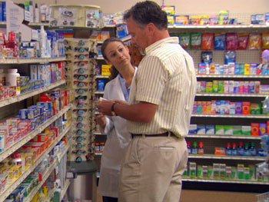
Get Smart Pharmacy Initiative (cont’d)
Example of outcomes
Community outreach in 2015
  778 encounters, 57% females; majority 18-40 yrs old
  37% taken abx within past 6 months
  677 completed abx quiz
Source: CDC
Percentage of pharmacy customers giving correct answers on antibiotic quiz (N=677), western Pa., 2015
Notes:
Pharmacists are a gateway – they are a bridge between the general public and prescribers. Their role is well recognized.
677 quizzes completed – labels are confusing

Slide 17

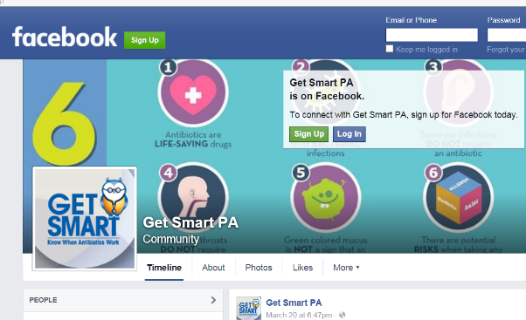
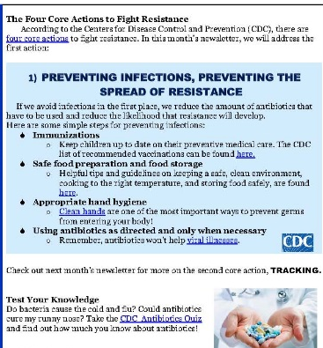
Get Smart Communication Initiative
Objectives
Disseminate guidelines and training materials
  Get Smart Web portal
  Social media Facebook, Twitter, blogs..
  Monthly newsletter
  Conduct behavioral research on drivers of abx use
  Coordinate Get Smart Week and One Health forums
Notes:
Pharmacists are a gateway – they are a bridge between the general public and prescribers. Their role is well recognized.

Slide 18
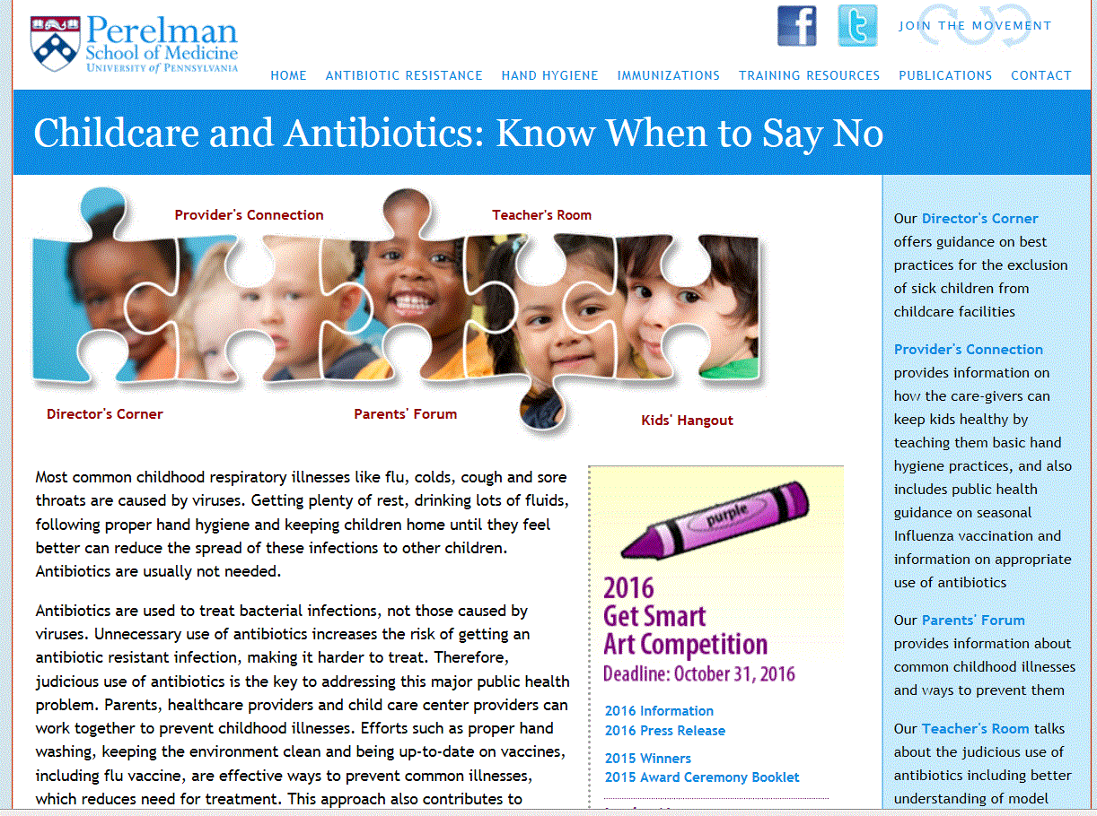

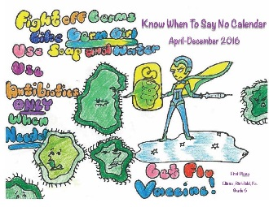
Get Smart Communication Initiative (cont’d)
Examples of activities
Web portal 2012- present
  Engaged target audience
    Childcare directors, parents, teachers, and providers
Kids’ art competition, 2013-
  Art competition engaged children and drove traffic to the website
  Unexpected publicity by media
    Poster session ID #5796

Slide 19
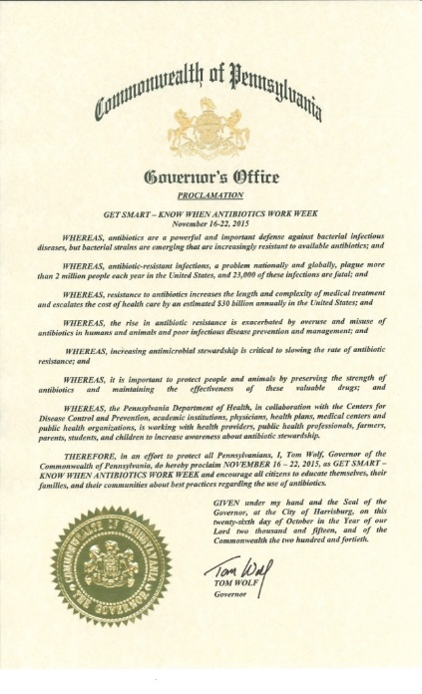
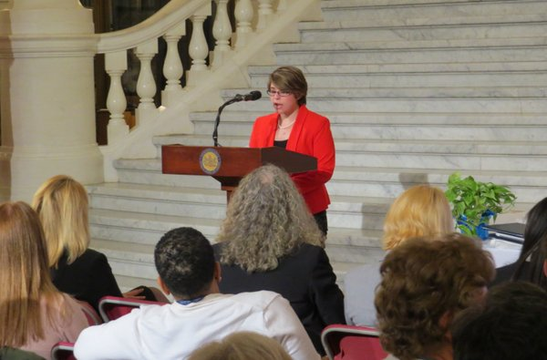
Get Smart Communication Initiative (cont’d)
Examples of activities and outcomes
Get Smart Week
  Governor’s Proclamation 2015
    First seminar at Penn State Nov 17
    ∼300 participants, Student Health Services
Get Smart Award Ceremony
  18 award recipients Mar. 23, 2016
    100 participants—parents, kids, legislators
Jeff Garber, Nov. 17
Lydia Glick- Penn State Student

Slide 20

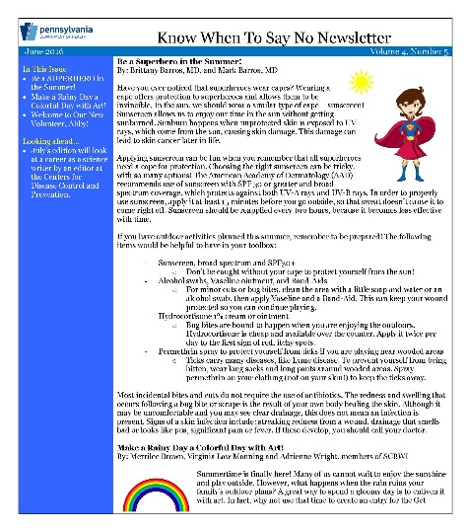
Conclusions
Collaborate in the process
  Review experiences and consult with -stakeholders, CDC, other states, sites…
  Identify mutual benefits
  Involve collaborators from initial steps
Maintain team spirit
  Schedule pre-planned interactions
  Set concrete objectives; yet be flexible
  Ensure shared ownership and shared recognition
source: bussiness2community.com
Notes:
.

Slide 21
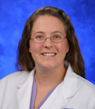
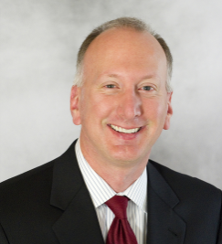
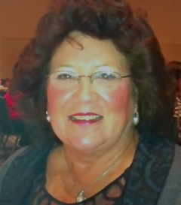
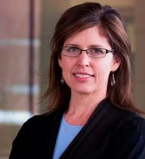
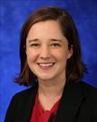


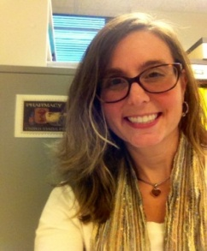
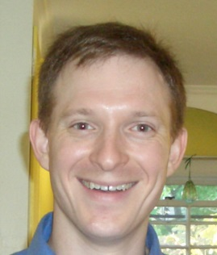
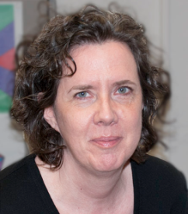
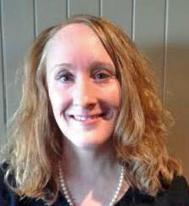
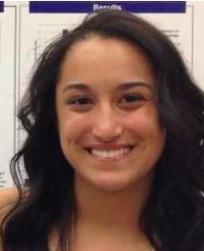
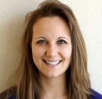
Nicole Hackman
Penn State Hershey Medical Group
Paul Kocis
Get Smart Intern
Anne Dodds
Keystone STARS
Rachel Smith
Penn State
CASHDF & CIDD
Kristin Sznajder
Penn State Hershey PHS
Jennifer Han
Team means Together Everyone Achieves More!
~Author Unknown
Sharon Meropol
CWRU
School of
Medicine
Bonnie Falcione
University of Pittsburgh
School of Pharmacy
Chris Carr
MIT/Harvard
Mary Leonard
Web Designer
Perelman School of Medicine
Julie Droddy
Get Smart
Program Coordinator
Abby Kraus
Get Smart
Volunteer
Tabitha Reefer
Get Smart
Public Health Consultant

Slide 22

“Alone we can do so little; together we can do so much” – Helen Keller

