Slide 1




Outpatient antimicrobial stewardship
Jeffrey S Gerber, MD, PhD
Children’s Hospital of Philadelphia
University of Pennsylvania School of Medicine

Slide 2
DISCLOSURE STATEMENT
I have no conflicts of interest to report

Slide 3
Learning objectives
Explain the need for outpatient antimicrobial stewardship
Describe outpatient antimicrobial stewardship interventions that have been effective
Propose what is needed to further improve outpatient antibiotic prescribing

Slide 4

Notes:
The Eastern State Penitentiary, also known as ESP, is a former American prison in Philadelphia, Pennsylvania.^{[5]} It is located at 2027 Fairmount Avenue between Corinthian Avenue and North 22nd Street in the Fairmount section of the city, and was operational from 1829 until 1971. The penitentiary refined the revolutionary system of separate incarceration first pioneered at the Walnut Street Jail which emphasized principles of reform rather than punishment.^{[6]}
Notorious criminals such as Al Capone and bank robber Willie Sutton were held inside its innovative wagon wheel design. At its completion, the building was the largest and most expensive public structure ever erected, and quickly became a model for more than 300 prisons worldwide.
The prison is currently a U.S. National Historic Landmark,^{[4]} which is open to the public as a museum for tours seven days a week, twelve months a year, 10 am to 5 pm.

Slide 5


Slide 6
WHY outpatient stewardship?
“…because that’s where the money is.”
    Willie Sutton, criminal (1901-1980)
>90% of antibiotic exposure in outpatients

Slide 7
IMS Health Xponent database
262.5 million antibiotic prescriptions dispensed in 2011
842 prescriptions per 1000 persons
Clinical Infectious Diseases 2015;60(9):1308–16

Slide 8

Clinical Infectious Diseases 2015;60(9):1308–16

Slide 9
Clinical Infectious Diseases 2015;60(9):1308–16

Slide 10
Clinical Infectious Diseases 2015;60(9):1308–16

Slide 11
Clinical Infectious Diseases 2015;60(9):1308–16

Slide 12
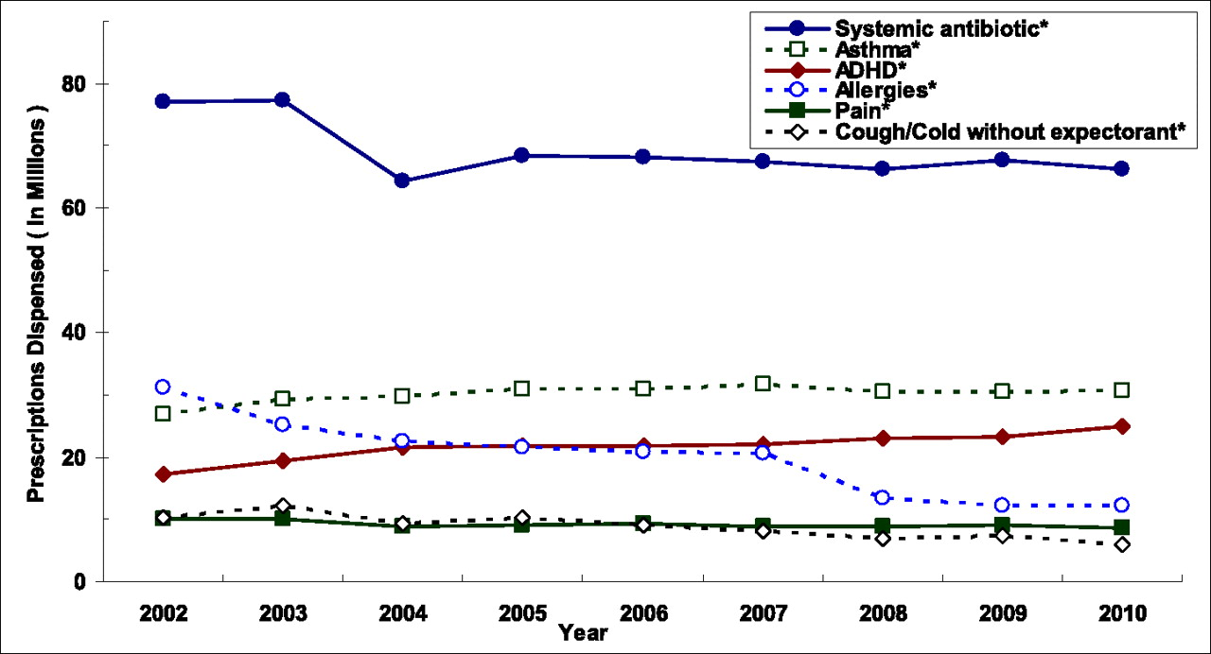
Antibiotic use: outpatient children
Chai G et al. Pediatrics 2012;130:23-31

Slide 13
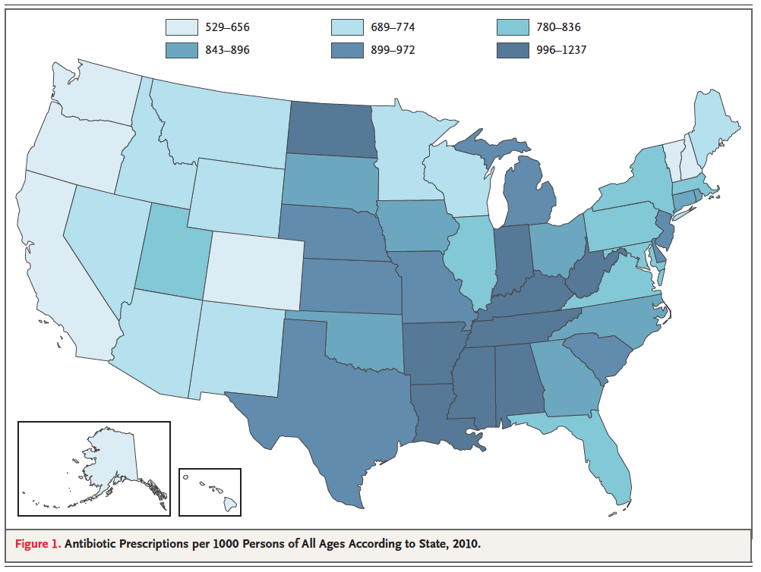
Hicks L et. Al. NEJM April 11, 2013
Hicks L et. Al. NEJM April 11, 2013

Slide 14
Ternhag A. NEJM 2013;369:1175-1176.
Hicks LA et al. NEJM 2010;368:1461-2
Outpatient antibiotic prescribing (Rx/1000)
 | US | Sweden
All | 833 | 388
quinolones | 105 | 25
macrolides | 185 | 12
cephalosporins | 117 | 12
Notes:
Swedish Institute for Communicable Disease Control

Slide 15
Ternhag A. NEJM 2013;369:1175-1176.
Hicks LA et al. NEJM 2010;368:1461-2
Outpatient antibiotic prescribing (Rx/1000)
 | US | Sweden
All | 833 | 388
quinolones | 105 | 25
macrolides | 185 | 12
cephalosporins | 117 | 12
Notes:
Swedish Institute for Communicable Disease Control

Slide 16
Ternhag A. NEJM 2013;369:1175-1176.
Hicks LA et al. NEJM 2010;368:1461-2
Outpatient antibiotic prescribing (Rx/1000)
Age | US | Sweden
0-2 | 1,365 | 462
3-9 | 1,021 | 414
10-19 | 677 | 252
20-39 | 669 | 296
40-64 | 797 | 339
>65 | 1020 | 556

Slide 17
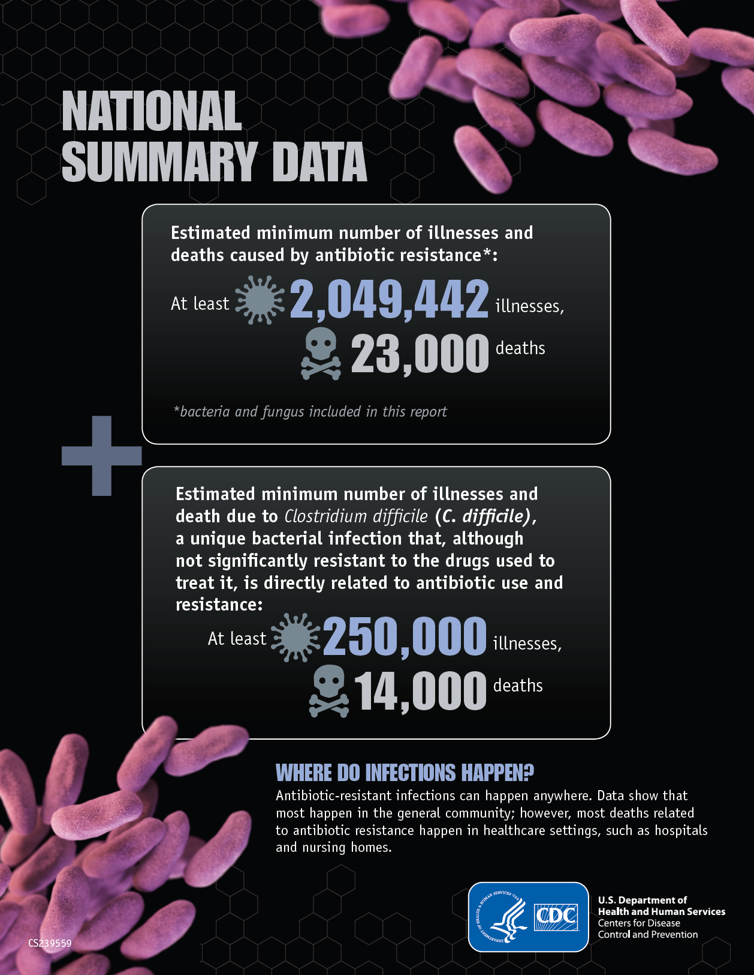

Slide 18
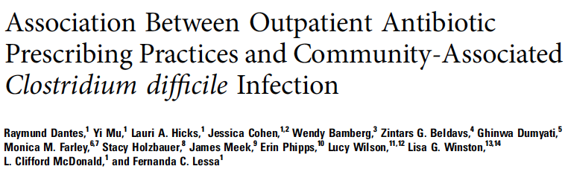
32% of CDI are community-associated
reducing antibiotic prescribing rates by 10% among persons ≥20 years old was associated with a 17% decrease in CDI
reductions in prescribing penicillins and amoxicillin/clavulanate were associated with the greatest decreases in CA-CDI rates
Dantes et. al. Open Forum Infectious Diseases. 2015
Notes:
32% of these infections are community-associated (CA) CDI
reducing antibiotic prescribing rates by 10% among persons ≥20 years old was associated with a 17%
(95% confidence interval, 6.0%–26.3%; P = .032) decrease in CA-CDI rates after adjusting for age, gender, race, and
type of diagnostic assay. Reductions in prescribing penicillins and amoxicillin/clavulanic acid were associated with
the greatest decreases in CA-CDI rates.

Slide 19
Resistance aside…
5%–25% diarrhea
1 in 1000 visit emergency department for adverse effect of antibiotic
  comparable to insulin, warfarin, and digoxin
1 in 4000 chance that an antibiotic will prevent serious complication from ARTI
  Shehab N. CID 2008:47; Linder JA. CID 2008:47

Slide 20


Slide 21
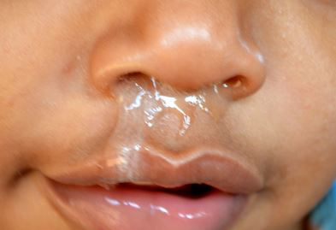

Slide 22
Antibiotic use for artis
21% of all ambulatory visits for children receive an antibiotic RX
72% for ARTI
Hersh Pediatrics 2011;128;1053

Slide 23
Is there room for improvement?
although prescribing rate for ARTIs has declined significantly, this has been modest, and …
  antibiotic use for ARTIs remains common
  most are caused by viruses
  use of broader-spectrum antibiotics for ARTI has increased
  the most commonly prescribed individual antibiotic agent was azithromycin
Grijalva JAMA 2009;302(7):758-766
Hersh Pediatrics 2011;128;1053
Hicks LA et al. NEJM 2010;368:1461-2
Notes:
Some background that is relevant to ASP:
Antibiotics are among the most commonly used drugs nationwide
About half of hospitalized adults get antibiotics
And, from data that we recently published, most kids in freestanding children’s hospitals get antibiotics
HOWEVER, about half of all antibiotic use is inappropriate –the key driver of the need for an ASP

Slide 24
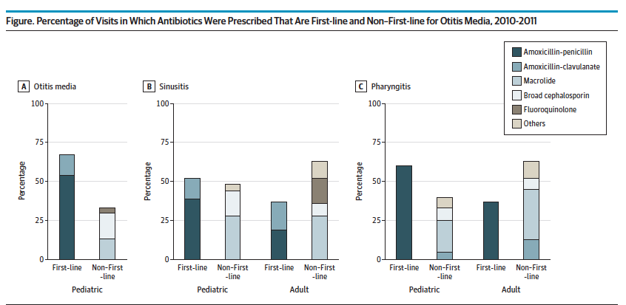

Slide 25
Off-Guideline Antibiotic Prescribing
Excluding: preventive visits, CCC, antibiotic allergy, prior antibiotics
Standardized by: age, sex, race, Medicaid
Gerber et al., JPIDS, 2014
Notes:
If a child is seen at a sick visit and receives an antibiotic, the proportion of broad-spectrum antibiotic use varies even more dramatically – 15% to over 50%. Again standardized using the same variables, with the added exclusion of children with antibiotic allergy or prior antibiotic use – each of which may be a rationale to use broad-spectrum agents.

Slide 26
Barnett and Linder. JAMA. 2014;311(19):2020-2022

Slide 27
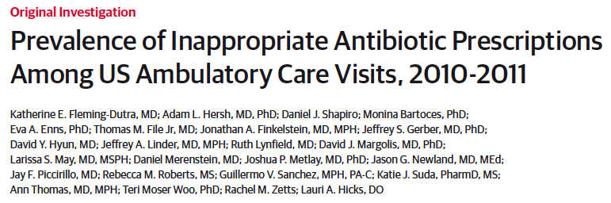
diagnosis-specific rates of total and appropriate antibiotic prescribing determined based on national guidelines and regional variation
  30% overall reduction suggested
  50% for ARTIs

Slide 28
How can we do this?

Slide 29
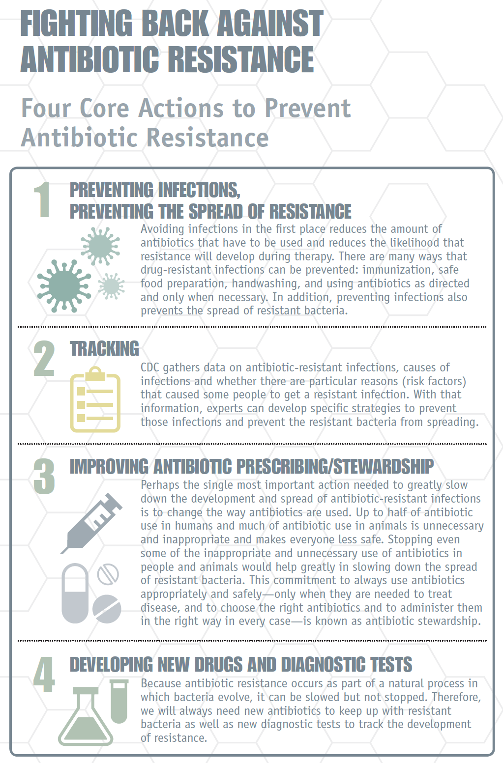
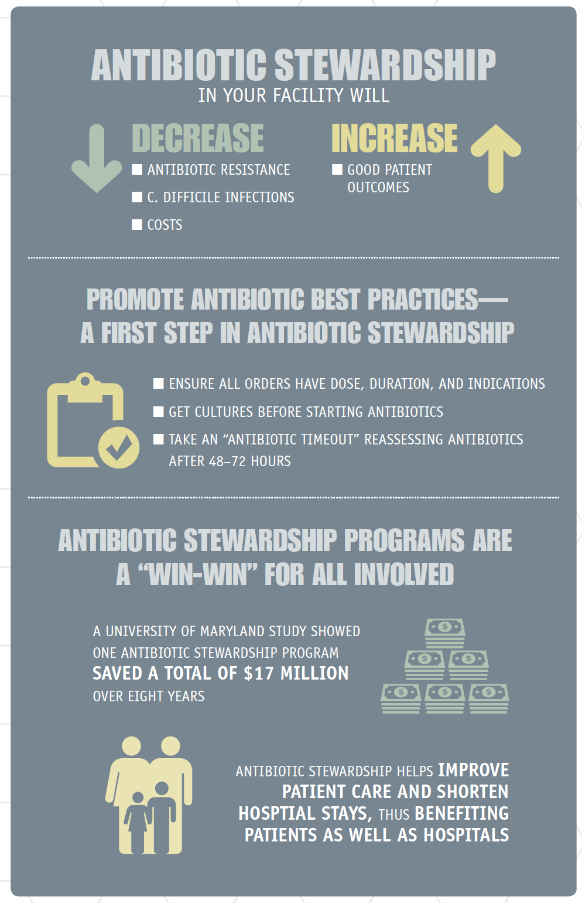

Slide 30
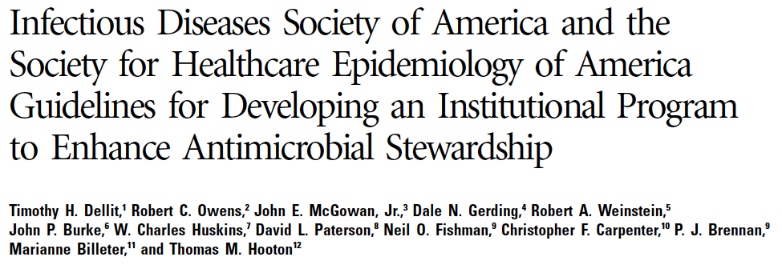
Antimicrobial stewardship
ASPs recommended for hospitals
most antibiotic use occurs in the outpatient setting
is outpatient “stewardship” achievable?
Notes:
To address thee issues for inpatients, the IDSA, SHEA, and other organizations have called for ASPs; however, most antibiotic use – and misuse – occurs in the outpatient setting. This project begins to address the question of whether outpatient antimicrobial stewardship is feasible

Slide 31
Antimicrobial Stewardship
Core Strategies
  prior authorization
  prospective audit & feedback
  formulary restriction
Supplemental Strategies
  education
  clinical guidelines
  IV to PO conversion
  dose optimization
Notes:
Antibiotics are wonderful drugs that can be extremely useful; however, like all medications, they have a downside …
Adverse effects of antibiotics bring children to the ED commonly – rates comparable to warfarin, digoxin, and insulin
Use – and overuse – drives resistance, and antibiotic-resistant infections cause harm (both morbidity and mortality)
And they cost money – CDC estimates $20 billion in excess healthcare costs; 8 million extra days (US)
All of this emphasized the need to use antibiotics judiciously, and, ultimately, the call for ASPs

Slide 32
Antimicrobial Stewardship
Core Strategies
  prior authorization
  prospective audit & feedback
  formulary restriction
Supplemental Strategies
  education
  clinical guidelines
  IV to PO conversion
  dose optimization

Slide 33
What has been done?

Slide 34
Clinical Decision Support

Slide 35
3-arm cluster RCT: 33 primary care practices within integrated health care system
11 sites: print-based decision support
11 sites: computer-assisted (EHR) decision support
both intervention sites also received clinician and patient education
11 control sites
JAMA Intern Med. 2013;173(4):267-273

Slide 36
JAMA Intern Med. 2013;173(4):267-273

Slide 37
Education of Clinicians and Patients

Slide 38
cluster RCT in 16 MA communities (1998 to 2003)
clinician guideline dissemination, small-group education, frequent updates and educational materials, and prescribing feedback
parents received educational materials by mail and in primary care practices, pharmacies, and child care settings
using health-plan data, measured changes in antibiotics dispensed among children aged 3 to 􏰂72 months
Pediatrics. 2008;121;e15-e23

Slide 39
Pediatrics. 2008;121;e15-e23

Slide 40
Audit and Feedback

Slide 41
cluster-RCT of 18 practices, 170 clinicians
common EHR
focused on antibiotic choice for encounters for bacterial infections with established guidelines
  streptococcal pharyngitis
  acute sinusitis
  Pneumonia
(all should get penicillin or amoxicillin)
Gerber et al. JAMA.2013;309(22):2345
Notes:
To briefly outline the rationale for the use of these narrow spectrum agents . . .

Slide 42
Intervention: timeline
Feedback reports
On-site education
20 months
baseline data
12 months of
audit/feedback

Slide 43
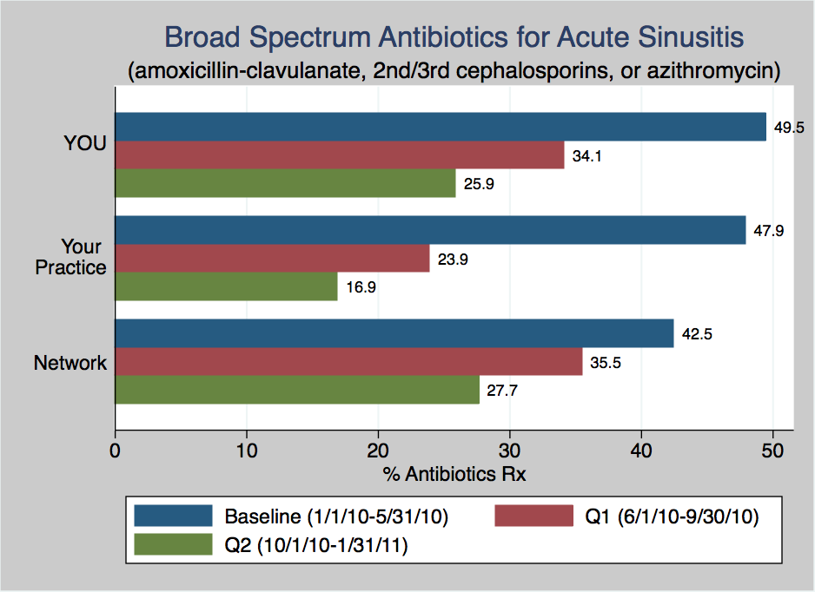

Slide 44
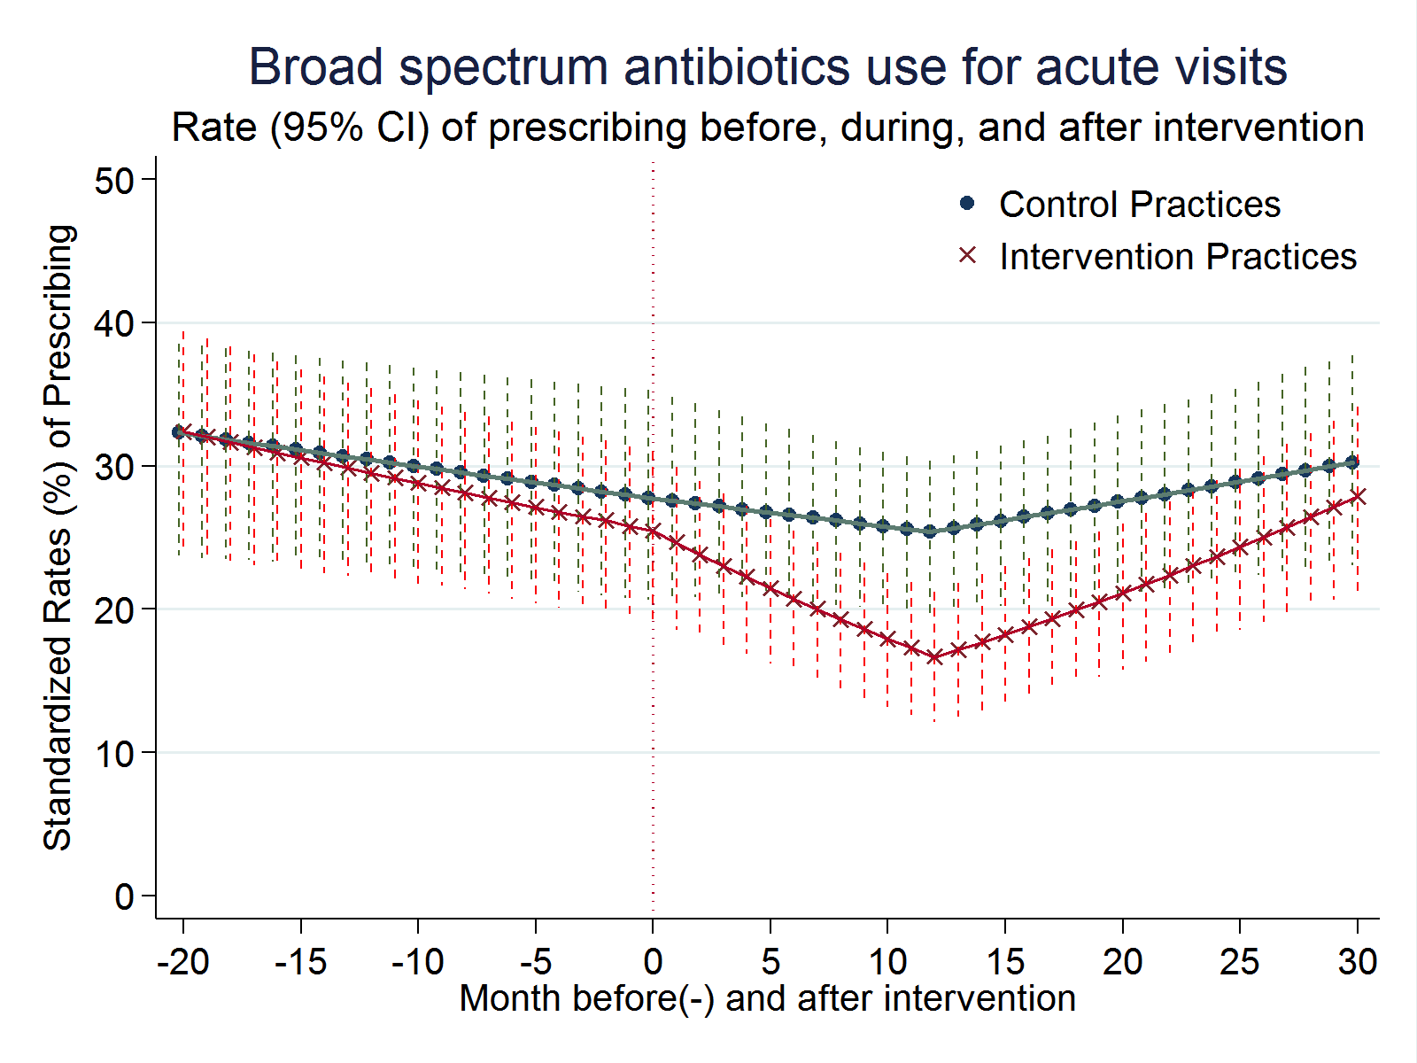
Start audit and feedback
Gerber et al. JAMA.2013;309(22):2345

Slide 45
Start audit and feedback
End of audit and feedback
Gerber et al. JAMA.2013;309(22):2345

Slide 46
Start audit and feedback
End of audit and feedback
Gerber et al. JAMA.2013;309(22):2345

Slide 47
What do Clinicians Think?

Slide 48

Julia Szymczak, PhD
Notes:
PhD sociologist, qualitative methods, particularly ethnography,
focuses on the nonclinical factors that shape antibiotic prescribing and the social factors that influence success in antibiotic stewardship.

Slide 49
Qualitative analyses
most did not believe that their prescribing behavior contributed to antibiotic overuse
reported frequently confronting parental pressure, sometimes acquiescing to:
  appear competent
  avoid losing patients to other practices that would “give them what they want”
Szymczak, ICHE, 2014, vol. 35, no. s3
Notes:
To address thee issues for inpatients, the IDSA, SHEA, and other organizations have called for ASPs; however, most antibiotic use – and misuse – occurs in the outpatient setting. This project begins to address the question of whether outpatient antimicrobial stewardship is feasible

Slide 50
“We have lots of parents who come in and they know what they want. They don’t care what we have to say. They want the antibiotic that they want because they know what is wrong with their child.”
Szymczak, ICHE, 2014, vol. 35, no. s3

Slide 51
Clinician perceptions
interviewed 10 physicians, 306 parents
physician perception of parental expectations for antimicrobials was the only predictor of prescribing antimicrobials for viral infections
  when they thought parents wanted antimicrobial:
    62% vs. 7% prescribed antibiotic
Mangione-Smith et al. Pediatrics 1999;103(4)
Notes:
To summarize ...

Slide 52
What do parents think?

Slide 53
What do parents want?
direct parental request for antibiotics in 1% of cases
parental expectations for antibiotics were not associated with physician-perceived expectations
parents who expected antibiotics but did not receive them were more satisfied if the physician provided a contingency plan
failure to meet parental expectations regarding communication events during the visit was the only significant predictor of parental satisfaction (NOT failure to provide expected antimicrobials)
Mangione-Smith et al. Arch Pediatr Adolesc Med 2001;155:800-806
Notes:
To summarize ...

Slide 54
Parent perceptions
survey of 1500 Massachusetts parents in 2013
  high level of trust in physicians
5 focus groups (31 parents) – knowledge/attitudes surrounding antibiotic use in 2011:
  concerned about antibiotic resistance
  expressed desire to use antibiotics only when necessary
  it appears that parents have become more informed and sophisticated regarding appropriate uses of antibiotics
Finkelstein, Clin Peds. 2014:53(2); Vaz, Pediatrics. 2015:136(2)
Notes:
To summarize ...

Slide 55
What do parents think?
interviewed >100 parents of kids presenting with ARTIs from waiting rooms
parents did not plan to demand an antibiotic for their child
  deferred to medical expertise about the need for antibiotic therapy, contrary to what pediatricians report
  parents are aware of the downsides of antibiotics and may be willing to partner to improve appropriate use
Szymczak, ID Week, San Diego, 2015
Notes:
To summarize ...

Slide 56
communication
parent and clinician surveys after 1,285 pediatric ARTI visits to 28 pediatric providers from 10 Seattle practices
positive treatment recommendations (suggesting actions to reduce child’s symptoms) were associated with decreased risk of antibiotic prescribing
Mangione-Smith et al. Ann Fam Med 2015;13:221-227
Notes:
To summarize ...

Slide 57
246 practices, 4264 patients, 6 European countries
training in enhanced communication skills:
  gathering information on patient concerns/expectations
  exchange of information on symptoms, natural disease course
  Tx; agreement of a management plan
communication training led to a >30% reduction in antibiotic prescribing for ARTI

Slide 58
Non-clinical drivers of antibiotic prescribing?
perceived parental pressure
presence of trainees
time of day
patient race
practice location
Roumie CL et al., Am J Med. 2005;118(6):614-648
Linder, JAMA Internal Medicine 2014;174(12)
Gerber et al., Pediatrics 2013;131:677–684
Handy LK, ID Week 2015

Slide 59
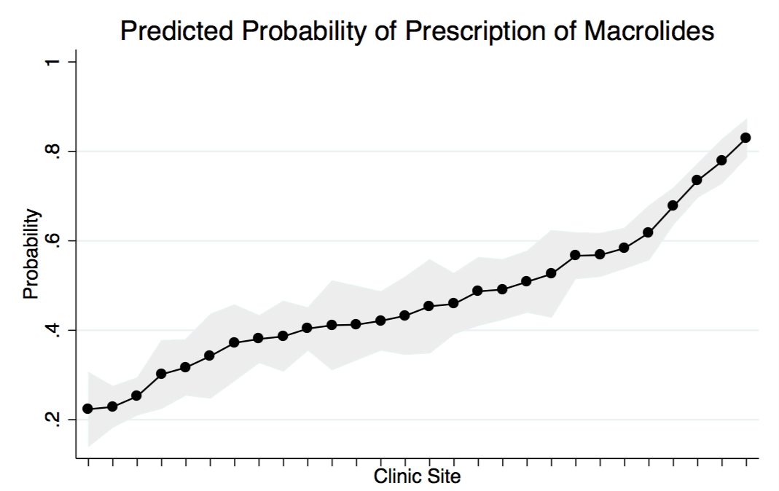
10,414 children Dx with pneumonia
30 practices
41% amoxicillin
43% azithromycin
Handy LK, ID Week 2015
Notes:
Of 10414 children, 4239 (40.7%) received amoxicillin, 4430 (42.5%) received macrolides, and 1745 (16.8%) received broad-spectrum antibiotics. Factors associated with an increased odds of receipt of macrolides compared with amoxicillin included patient age ≥ 5 years (aOR 6.18; 95% CI: 5.53, 6.91), prior antibiotic receipt (aOR 1.79; 95% CI: 1.56, 2.04), and private insurance (aOR 1.47; 95% CI: 1.28, 1.70). The predicted probability of a child being prescribed a macrolide ranged significantly between 0.22 and 0.83 across clinics. Nonclinical characteristics associated with an increased odds of receipt of broad-spectrum antibiotics compared with amoxicillin included suburban practice (aOR 7.50; 95% CI: 4.16, 13.55) and private insurance (aOR 1.42; 95% CI: 1.18, 1.71).

Slide 60

Human behavior And prescribing
behavioral determinants and social norms influence antibiotic prescribing
therefore, different levers that shape clinician behavior need to be considered at the point of care, where the decision to prescribe is made
Notes:
Of 10414 children, 4239 (40.7%) received amoxicillin, 4430 (42.5%) received macrolides, and 1745 (16.8%) received broad-spectrum antibiotics. Factors associated with an increased odds of receipt of macrolides compared with amoxicillin included patient age ≥ 5 years (aOR 6.18; 95% CI: 5.53, 6.91), prior antibiotic receipt (aOR 1.79; 95% CI: 1.56, 2.04), and private insurance (aOR 1.47; 95% CI: 1.28, 1.70). The predicted probability of a child being prescribed a macrolide ranged significantly between 0.22 and 0.83 across clinics. Nonclinical characteristics associated with an increased odds of receipt of broad-spectrum antibiotics compared with amoxicillin included suburban practice (aOR 7.50; 95% CI: 4.16, 13.55) and private insurance (aOR 1.42; 95% CI: 1.18, 1.71).

Slide 61
Novel Socio-Behavioral Strategies

Slide 62
QI interventions often neglect psychosocial and professional factors that may affect clinical decisions
intervention that takes advantage of clinicians’ desire to be consistent with their public commitments
simple, low-cost behavioral “nudge” in form of a public commitment device: a poster-sized letter signed by clinicians and posted in their examination rooms indicating their commitment to reducing inappropriate antibiotic use for ARTIs
Notes:
To summarize ...

Slide 63
Antibiotics, like penicillin, fight infections due to bacteria … but these medicines can cause side effects like skin rashes, diarrhea, or yeast infections. If your symptoms are from a virus and not from bacteria, you won’t get better with an antibiotic, and you could still get these bad side effects.
Antibiotics also make bacteria more resistant to them. This can make future infections harder to treat. This means that antibiotics might not work when you really need them. Because of this, it is important that you only use an antibiotic when it is necessary …
Your health is very important to us. As your doctors, we promise to treat your illness in the best way possible. We are also dedicated to avoid prescribing antibiotics when they are likely to do more harm than good.
Notes:
To summarize ...

Slide 64
Notes:
To summarize ...

Slide 65
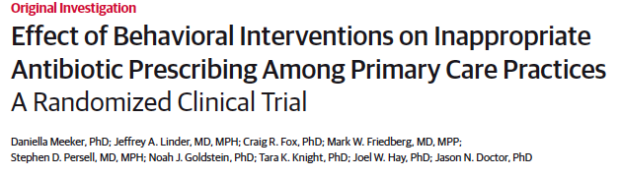
  Suggested alternatives
    antibiotics are generally not indicated for this”
  Accountable justification
    free text, or “no justification given”
  Peer comparison
    top decile “top performer” or “not top performer”
Notes:
To summarize ...

Slide 66
Intervention 3: Peer Comparison
“You are a Top Performer”
You are in the top 10% of clinicians. You wrote 0 prescriptions out of 21 acute respiratory infection cases that did not warrant antibiotics.
“You are not a Top Performer”
Your inappropriate antibiotic prescribing rate is 15%. Top performers' rate is 0%. You wrote 3 prescriptions out of 20 acute respiratory infection cases that did not warrant antibiotics.
Notes:
The third intervention was Peer Comparison, which was not EHR-based.
Each month, we sent clinicians who were in the Peer Comparison group an email that compared their performance with that of their peers.
For clinicians who were in the top 10% best performers – that is, those with the lowest inappropriate antibiotic prescribing rate – we told them that. They got an email that said…
The remainder of the clinicians got an email that said…
You can imagine how well doctors took to receiving this second email.
Here we’re using social motivation and clinicians’ self-image to try to change behavior.

Slide 67
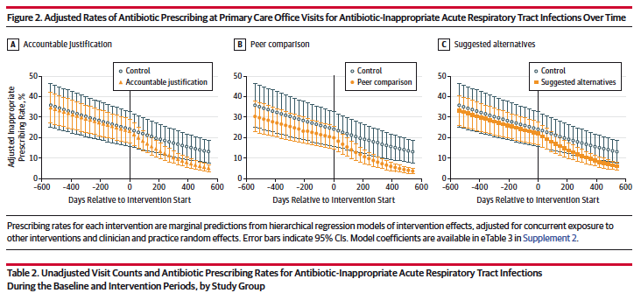

Slide 68
Summary
antibiotic prescribing in the ambulatory setting is common and has only slightly improved in certain areas over time
many investigators and public health entities have implemented promising strategies to improve use, such as education, audit with feedback, and decision support
socio-behavioral approaches, such as improving communication and holding clinicians accountable can also be effective
Notes:
To summarize ...

Slide 69
What we need
Widespread implementation of the approaches we already have
mechanism for tracking antibiotic use for benchmarking/feedback
  overall antibiotic use; by condition/setting to identify targets
  antibiotic choice (FQ, macrolides, 3rd ceph)
additional targets:
  duration of Tx (UTI, CAP, AOM)
  hospital discharge (OPAT, oral)
  Emergency Department
  ambulatory surgery
Notes:
To summarize ...

Slide 70

Thank you
gerberj@chop.edu

