Slide 1
2016 Annual Get Smart Week
Antibiotic Stewardship in Pennsylvania
University of Pittsburgh
O’Hara Student Center
Friday, Nov. 18, 2016
Noon – 1:30 p.m.
Notes:
2. The mechanism that cause bacteria to become resistance to antibiotics can spread fast across the globe. The recent discovery of new gene known as mcr -1—which can make bacteria resistant to colistin, a last-resort drug for some multidrug-resistant infections is a case in point. The gene was first discovered in China in November last year. Within three months, investigators in Europe found that the gene had spread to other parts of the world and mcr -1 was associated with E. Coli infection in a patient in a military facility in Pennslvania

Slide 2
This Week is “Get Smart” Week
Goal : Raise awareness of problem of antibiotic resistance
Dr. Karen Hacker, MD, MPH
Director of the Allegheny County Health Department

Slide 3
Antibiotic resistance
CDC estimates 2 million persons infected by resistant bacteria and 23,000 die from these infections each year
Major contributors are overuse and misuse of antibiotics
50% antibiotics are not needed or not optimally prescribed
Antibiotics are used to promote growth of animals

Slide 4
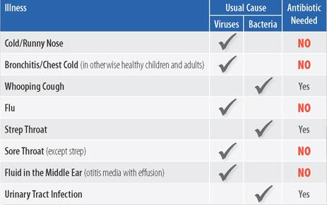
Antibiotics only treat bacterial infections
Source: CDC

Slide 5
CDC’s “Get Smart: Know When Antibiotics Work” Program Objectives
Stop the increase in antibiotic resistance by
Promoting providers’ adherence to prescribing guidelines
Decreasing demand for antibiotics among adults and parents of young children
Increasing adherence to prescribed antibiotics

Slide 6
State and local health departments
Role: promote judicious antibiotic use; track resistant infections
ACHD activities:
Distribute guidelines for prevention and control of carbapenem-resistant Enterobacteriaceae (CRE)
Track invasive MRSA infections
Promote antibiotic stewardship programs

