Slide 1
Pennsylvania’s Response to the Threat of Resistance
Dr. Rachel Levine
Pennsylvania Physician General

Slide 2
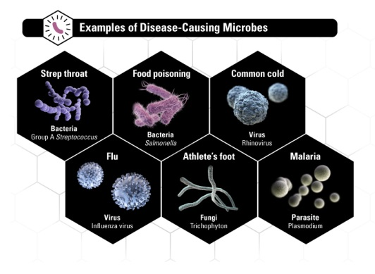
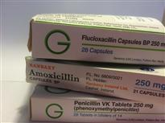
Antimicrobial Resistance (AMR)
Antimicrobial resistance (AMR) is the change in microbes (e.g. bacteria, parasites and fungi) which enable them to withstand treatment by antimicrobial drugs, meaning that the drugs no longer work, or work less effectively
Source: CDC
Source: Imperial College
Notes:
Antimicrobial resistance is change in microbes (e.g. bacteria, parasites and fungi) which enable them to withstand treatment by antimicrobial drugs, meaning that the drugs no longer work, or work less effectively.

Slide 3
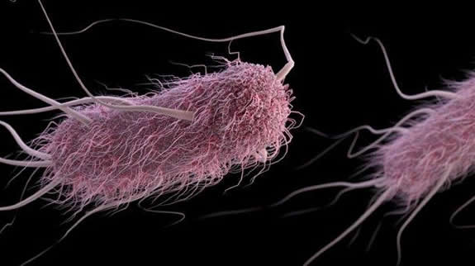
Antimicrobial Resistance (AMR)
The recent discovery of a plasmid-borne colistin resistance gene, mcr-1, heralds the emergence of truly pan-drug resistant bacteria
Colistin-resistant E. Coli infection; female 46 yrs old Pa. patient in 2016
McGann P, et al. Antimicrob Agents Chemother. 2016. pii: AAC.01103
Notes:
2. The mechanism that cause bacteria to become resistance to antibiotics can spread fast across the globe. The recent discovery of new gene known as mcr -1—which can make bacteria resistant to colistin, a last-resort drug for some multidrug-resistant infections is a case in point. The gene was first discovered in China in November last year. Within three months, investigators in Europe found that the gene had spread to other parts of the world and mcr -1 was associated with E. Coli infection in a patient in a military facility in Pennslvania

Slide 4
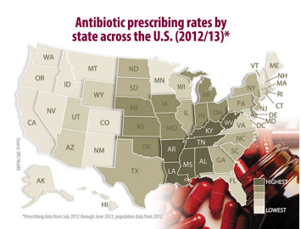
What drives AMR?
National Prescription Rates
262.5 million courses of antibiotics prescribed by health care providers in 2011
842 prescriptions per 1000 persons
Overuse of Abx in animals
≥60% of medically important antimicrobials are used in animals*
Source: *FDA Report on antimicrobials sold in 2014
Source: Hicks L, et al. US Outpatient Antibiotic Prescribing Variation According to Geography, Patient Population, and Provider Specialty in 2011. Clinical Infectious Diseases. 2015; 60(9):1308-16
Notes:
Antibiotics are heavily used in human medicine and in animals. Many antibiotics prescribed to people and to animals are unnecessary. And the overuse and misuse of antibiotics helps to create drug-resistant bacteria.

Slide 5
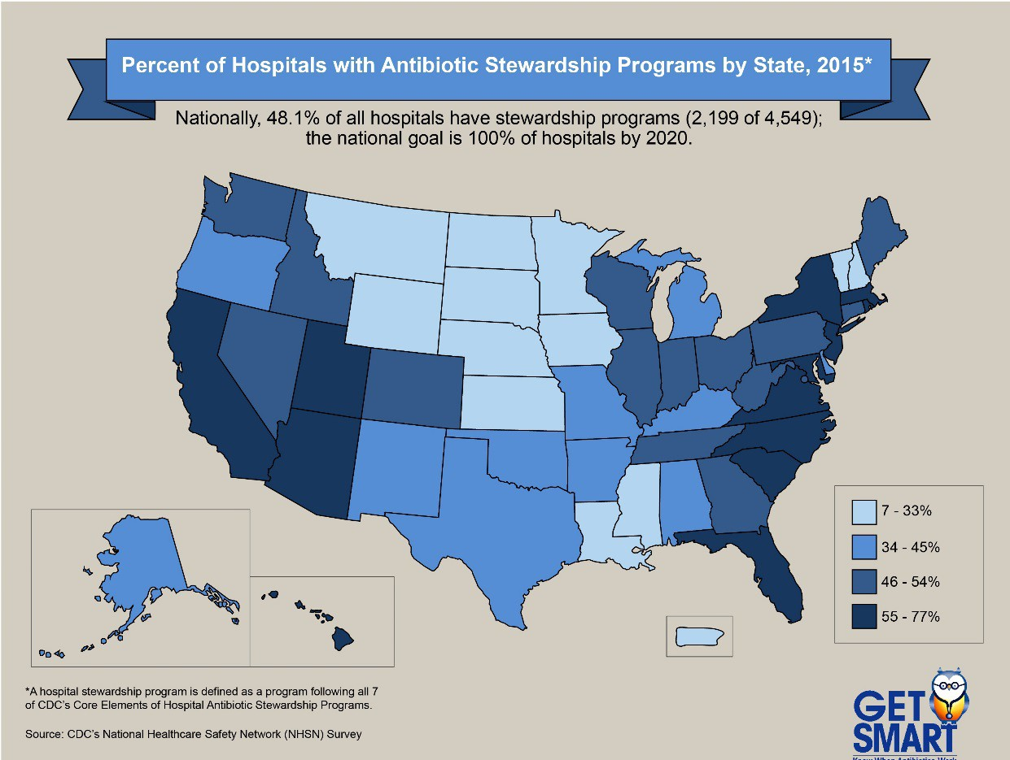
What drives AMR?
Notes:
Half of hospitals do not have antimicrobial stewardship programs.
Of those reporting that they do have antimicrobial stewardship programs, the quality and depth of programs varies.

Slide 6
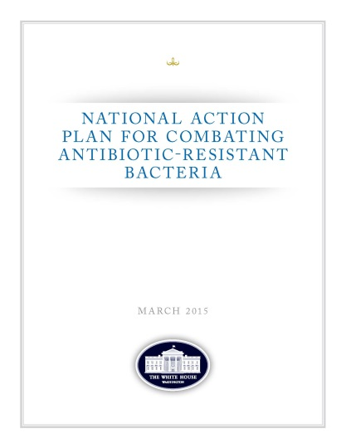
Overview of Commonwealth Response
Notes:
At the Sixty-eight World Health Assembly in May 2015, the World Health Assembly endorsed a global action plan to tackle antimicrobial resistance, including antibiotic resistance, the most urgent drug resistance trend.
Key objectives include:
Improved awareness and understanding of antimicrobial resistance;
Strengthened knowledge through surveillance and research;
The National action plan for combating antibiotic-resistant bacteria also calls for improved monitoring to guide antimcrobial stewardship efforts. Response to AMR require a concerted efforts that involves all stakeholders including students and faculty in biomedical sciences, healthcare providers, researchers and public health workers

Slide 7
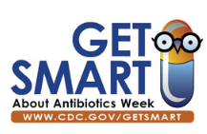
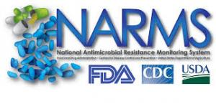
Overview of Commonwealth Response
Pennsylvania Get Smart Program
Antimicrobial stewardship
Program for monitoring antimicrobial resistance
Notes:
Here we are highlighting examples of what the state is doing, but this is not an all inclusive list
NARMS – National Antibiotic Resistance Monitoring System

Slide 8
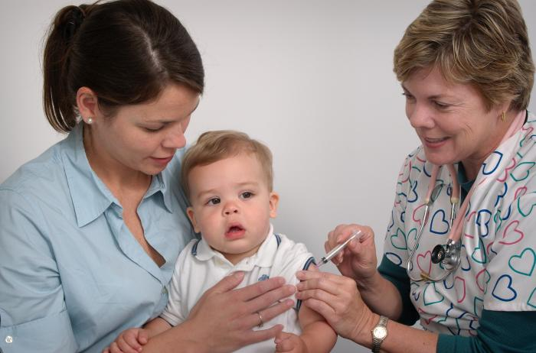
Get Smart Program Objectives
Promote guidelines for antimicrobial stewardship
Estimate antibiotic prescriptions
Decrease consumer demand for unnecessary antibiotics
Increase prevention activities (vaccination and hygiene)
CDC Image Library

Slide 9
Get Smart Program Initiatives
LTCFs*
Communications
Pediatrics
Pharmacy
Decreased Abx, BSAs prescriptions
Pa. Get Smart Initiatives –2016
Get Smart App Mobile-ready site
* Long Term Care Facilities

Slide 10
Pediatric Initiative
Pediatric settings
Pediatric clinics Abx stewardship
Promote Get Smart guidelines
Reduce parental expectations for Abxs
Collaborations
Penn State Hershey Pediatrics
Children’s Hospital of Pittsburgh
Focus
Childcare facilities
~7907 facilities
~242,324 children in childcare facilities³
Source: www.examiner.com
3. Pennsylvania Department of Human Services
Notes:
These program initiatives are developed in collaboration with CDC who provide substantial funding.
A multi faceted approach
Social Science: To refine public health practice

Slide 11
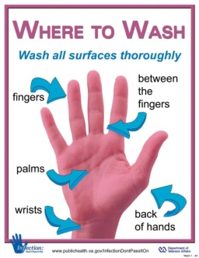
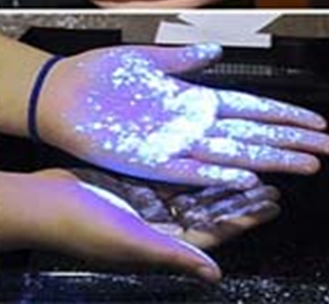
Get Smart Pediatric Initiative (continued)
Primary prevention
Hand hygiene demonstrations are held in child care centers and schools
Dr. Levine reading “Katie Caught a Cold” to children at a child care center in State College, Pa. November 17, 2015

Slide 12
Get Smart Pharmacy Initiative
Objectives
Engage faculty and students in antimicrobial stewardship
Outreach in community pharmacies
Research on antibiotic prescribing trends
Collaborator: University of Pittsburgh School of Pharmacy
Notes:
Pharmacists are a gateway – they are a bridge between the general public and prescribers. Their role is well recognized.

Slide 13
Get Smart Pharmacy Initiative (cont’d)
Examples of activities
Annual Get Smart workshop
Get Smart CDC and State perspective, since 2014
Online course “Community Pharmacists Tip the Scales”⁴
~110 students outreach in ~75 com. pharmacies in Allegheny county each year
Over 2000 encounters since 2014
Community outreach
Abx quiz, feedback and Get Smart brochures
Josh Krise and Melanie Beers: Class of 2018 and Christine Murphy, DOH; Source: NM
4. CDC: Weighing in on Antibiotic Resistance
(available at www.cdc.gov)
Notes:
Pharmacists are a gateway – they are a bridge between the general public and prescribers. Their role is well recognized.

Slide 14
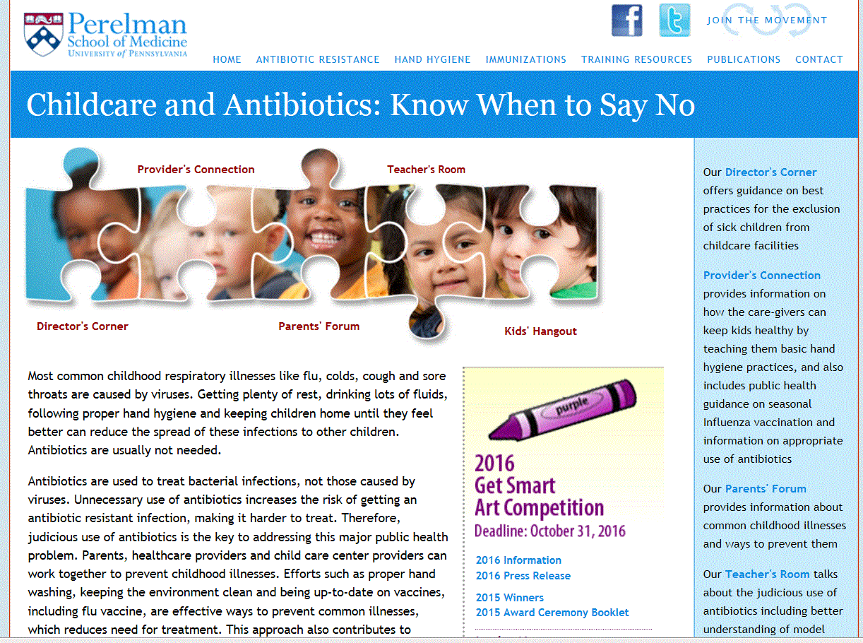
Get Smart Communication Initiative
Objectives
Disseminate guidelines and training materials
Get Smart Web portal
Social media Facebook, Twitter
Monthly newsletter
Conduct behavioral research on drivers of abx use
Coordinate Get Smart Week and One Health forums
Notes:
Pharmacists are a gateway – they are a bridge between the general public and prescribers. Their role is well recognized.

Slide 15
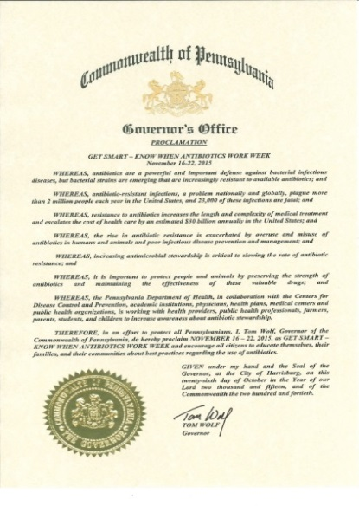
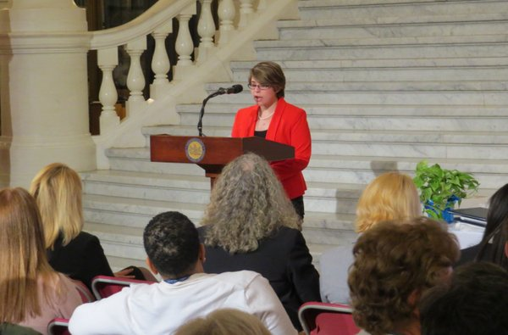
Get Smart Communication Initiative
Examples of activities and outcomes
Get Smart Week
Governor’s Proclamation, 2015
First seminar at Penn State Nov
∼300 participants, Student Health Services
Get Smart Award Ceremony
18 award recipients March 2016
100 participants—parents, kids, legislators
Lydia Glick- Penn State Student

Slide 16
Tracking Antimicrobial Resistance (continued)
Tracking antimicrobial resistant foodborne bacteria—e.g., Salmonella
Clinical isolates analyzed in collaboration with CDC and Pa. Vet Lab
Enteric bacteria in retail meat in collaboration with FDA
Next generation whole genome sequencing (WGS)
An advance over PFGE —WGS is a more precise method to identify related bacterial strains—important for outbreak tracing
Collaborative initiatives: DOH and Penn State College of Ag Sciences
Tracking Carbapenem-Resistant Enterobacteriaceae (CREs) in collaboration Un. Pennsylvania and CDC
Notes:
National Antimicrobial Resistance Monitoring System
Active survey: : Clinical and retail food bacterial isolates are tested by federal partners for resistance to drugs under NARMS program

Slide 17
Call to Action
Prevent spread of pathogens within healthcare settings
Ensure staff ALWAYS clean their hands, instruments & environment at key junctures during care
Major administrative and clinical leadership investment needed to improve infection prevention practices
Promote antimicrobial stewardship programs
Conduct surveillance for antibiotic-resistance pathogens--timely, actionable data

Slide 18
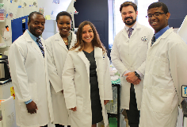
Call to Action
For Providers
Prevent infections by ensuring clean environment, hands, stethescopes, and other medical equipment
Judiciously prescribe antibiotics.
Prescribe ABX only when they are needed
Narrow-spectrum ABX whenever possible
The appropriate dose for the appropriate duration
Keep patient vaccinations up to date
Credit: NIH

Slide 19
2016 Get Smart Art
Competition Winners

Slide 20
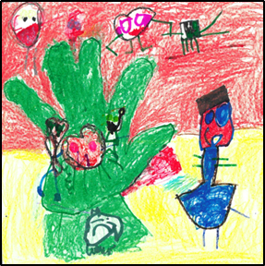
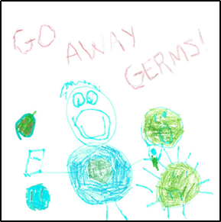
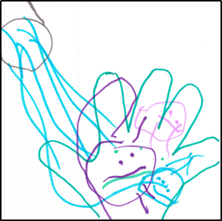
Age Group <4
First place
Kailee Park
Age 4
Lorton, VA
Second place
Landon Moran Age 4
Palmyra, PA
Third place
Kendal Rank
Age 3 Dillsburg, PA

Slide 21
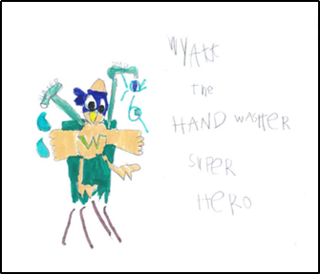
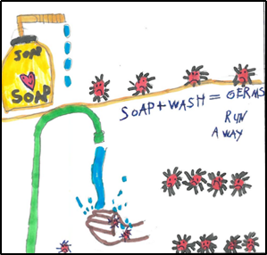
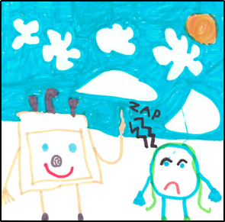
Age Group 5-6
First place
Wyatt Lentz
Age 5
Camp Hill, PA
Second place
Aanya Govil
Age 6
Mechanicsburg, PA
Third place
Alexa Park
Age 6
Dillsburg, PA

Slide 22
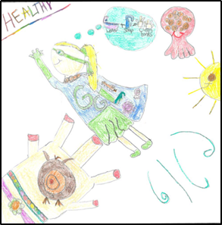
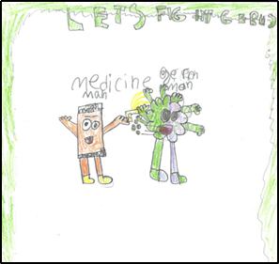
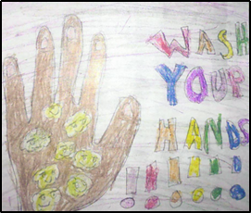
Age Group 7-8
First place
Avery Moran
Age 8
Palmyra, PA
Second place
Romello Torres
Age 8
York, PA
Third place
Naila Nicholson
Age 8
Lancaster, PA

Slide 23
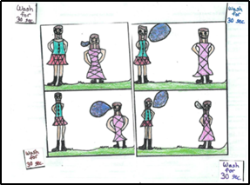
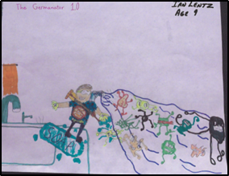
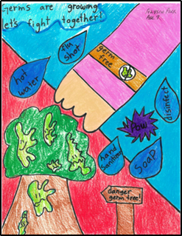
Age Group 9-10
First place
Sarah Watson
Age 9
Atglen, PA
Second place
Ian Lentz
Age 9
Camp Hill, PA
Third place
Alyson Park
Age 9
Lorton, VA

Slide 24
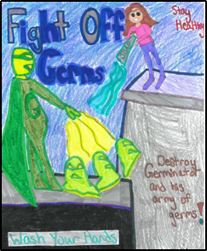
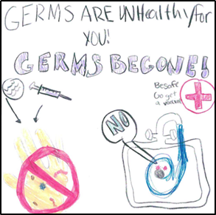
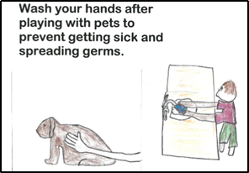
Age Group 11-12
First place
Courtney Keller
Age 11
Kennett Square, PA
Second place
Madyson Isenhour
Age 11
Harrisburg, PA
Third place
Keegan Carter Tilley
Age 12
Harrisburg, PA

Slide 25
Acknowledgment – PCAS Team

Slide 26
Acknowledgements
PCAS Team – Shelley Heffner, Nicole Hackman, Abby Kraus, Bonnie Falcione and Tabitha Reefer
CDC Get Smart Program- Lurie Hicks and Sanchez, Guillermo Vincent
FDA NARMS – Patrick McDermott, Heather Tate, Claudine Kabira and Emily Cracrey
PA Bureau Epidemiology – Sharon Watkins, Ram Nambiar, Kirsten Waller
PA Bureau of Labs, James Lute, Lisa Dettinger and Bridgette Husband
Allegheny County Health Department – Karen Hacker and Jenn Fidnner
Children’s Hospital of Pittsburgh – Marian Michals and Michael Green

Slide 27
Acknowledgement
Get Smart Week Speakers
Michael Katzman, George McSherry, Jeffery Gerber, Andrew Read, Marian Michaels, David Wolfgang and Robin Oliver

Slide 28
2016 Annual Get Smart Week
Antibiotic Stewardship in Pennsylvania
University of Pittsburgh
O’Hara Student Center
Friday, Nov. 18, 2016
Noon – 1:30 p.m.
Notes:
2. The mechanism that cause bacteria to become resistance to antibiotics can spread fast across the globe. The recent discovery of new gene known as mcr -1—which can make bacteria resistant to colistin, a last-resort drug for some multidrug-resistant infections is a case in point. The gene was first discovered in China in November last year. Within three months, investigators in Europe found that the gene had spread to other parts of the world and mcr -1 was associated with E. Coli infection in a patient in a military facility in Pennslvania

