Slide 1
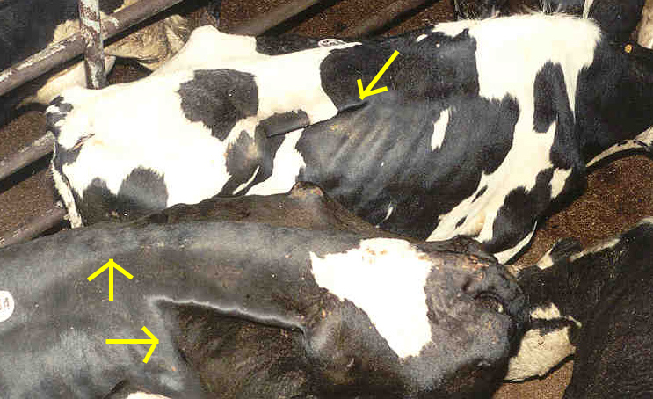
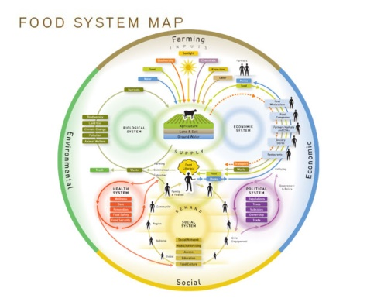
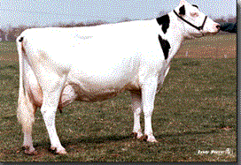
David Wolfgang, VMD, MPH DABVP-Dairy
Director, Bureau of Animal Health and diagnostic Services
Pennsylvania Department of Agriculture
Impact of Antibiotic Use in Animal Agriculture and Influence on Resistance Controversy
Get Smart
PSU Nov. 15, 2016
www.nourishlife.org

Slide 2
Presentation Outline
Animal Care and Therapeutics
Preventative care vs. disease treatment
Quality concerns
Regulatory issues & food safety concerns
  What does that mean for producers
  What does that mean for consumers
  What does it mean for animal well-being
  Impact for markets and environment

Slide 3
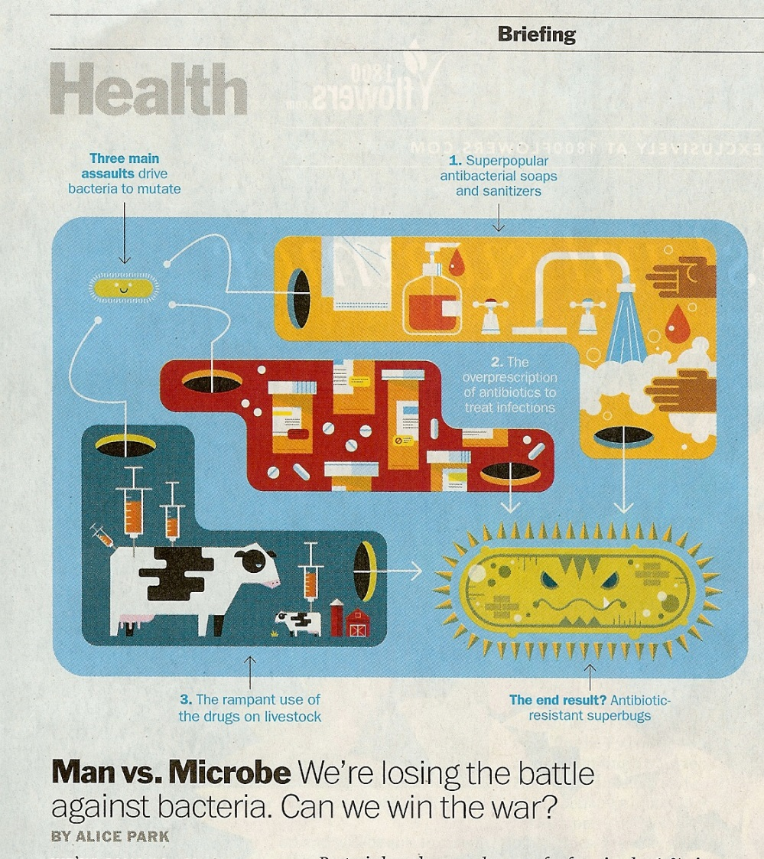
Time Magazine, March 19, 2014 p. 20

Slide 4
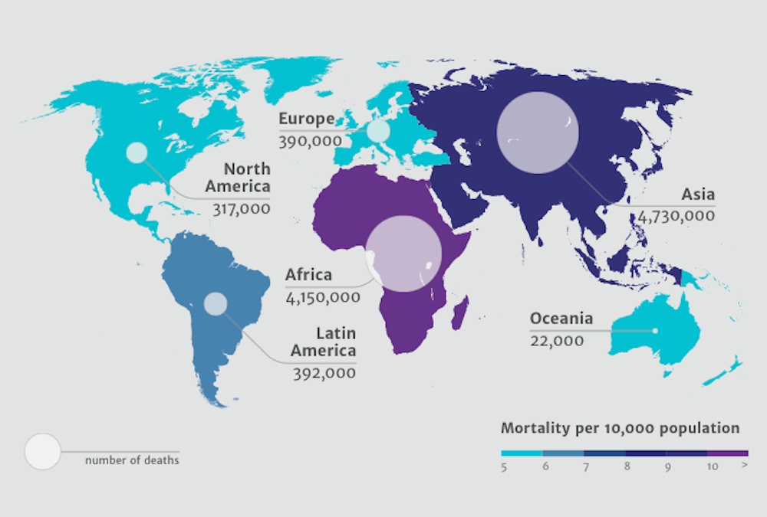
The Worried Well
Review Antibiotic Resistance, 2014

Slide 5
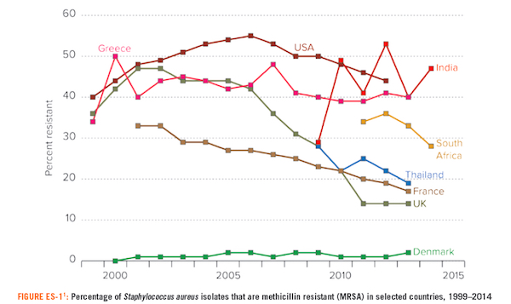
http:\\phenomena.nationalgeographic.com\2015\09\cd

Slide 6
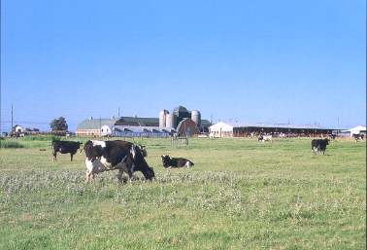

All Animal Ag Species- Care and Well-being Initiatives
Address injured or ill animals
  Treatment protocols
Painful conditions
Chronic conditions and euthanasia
Relative economic value animals
  Routine care procedures of caretakers (+ training)
Care and welfare of animals during transportation
Prevention & keep well > treat when ill

Slide 7
Animal use and contribution to resistance?
Animals consume and excrete antibiotics (~ 2 trillion lbs of manure generated in USA annually)
Animals can transmit resistant bacteria in food
  Food of animal origin as cause of food-borne infections:
    Salmonella
    Campylobacter
    Yersinia
    E Coli 0157-H7
Transfer to human specific organisms (esp. seen in examples from pigs and chickens when sick).

Slide 8
Antibiotic by Route of Use
ANTIMICROBIAL DRUGS APPROVED FOR USE IN FOOD-PRODUCING ANIMALS1
ACTIVELY MARKETED IN 2014
DOMESTIC SALES AND DISTRIBUTION DATA
REPORTED BY MEDICAL IMPORTANCE AND ROUTE OF ADMINISTRATION Annual Totals (kg) % Subtotal % Grand Total
Medically Important Feed1 6,977,747 74% 45%
Medically Important Injection1 341,790 4% 2%
Medically Important3 Intramammary 11,450 <1% <1%
Medically Important Oral5 or Topical1 104,082 1% <1%
Medically Important Water6 2,040,920 22% 13%
Medically Important Subtotal 9,475,989 100% 62%
Not Medically Important4 All Routes7 5,882,221 38%
Grand Total 15,358,210 100%
NARMS 2014, p 44

Slide 9
Why use antibiotics in feed?
Use at periods of higher stress: feed changes, transportation, weather changes
Reduces shedding of food safety pathogens
  Trade 1/53,000,000 illness due to resistance
  Vs. 1/32, 900 illness due to greater food safety illness (additional 6,000 severe cases/yr)
Lower carbon footprint
  Average 13% greater gain/kg of feed
  Saves 4-6% of input cost
Cox and Ricci, Envir Sci, 2007
Matthew, et al., Food Path Dis 2007

Slide 10
Antibiotics
Therapeutic vs. Disease Prevention/control
Acutely ill animals
Many fewer animals
Higher doses (gm vs. mg)
More handling
Tissue residue
New products & cost R&D
Treat pain and suffering
Stunted growth
Higher cost/animal
Keep healthy vs. sick
Entire herd or flock
Low dose, no residue
Fewer food pathogens
Older products, not normally for humans
Avoid prevent pain/ suffering
Lowers cost of production
Improves efficiency (less manure, less acres)

Slide 11
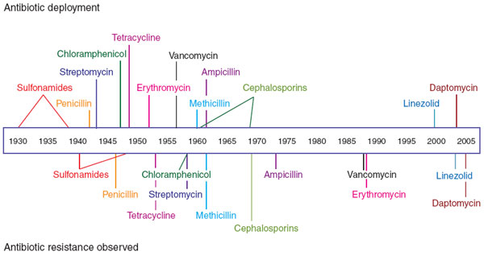
Antibiotic Timeline
nchembio_2007_24-F1

Slide 12
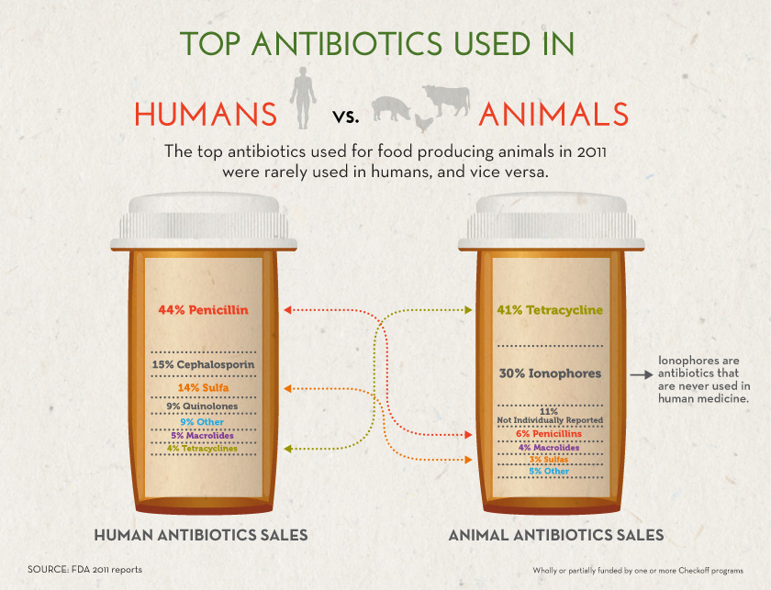
http://www.nppc.org/issues/animal-health-safety/antimicrobials-antibiotics/

Slide 13
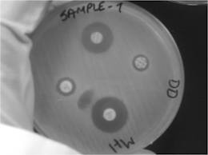
Antibiotic resistance: A public health concern
Increased cost to healthcare ($3 billion/yr, range $100 million to $30 billion)
  More expensive antibiotics required
  Longer hospital stays
  ~23, 000/ year die as result of resistance/complications
Development of new antibiotics is slow and costly
Prolonged illness and greater risk of death
Greater risk of antibiotic resistant food borne illness (Salmonella DT-104, fluoroquinilone resistant Campylobacter)
Precautionary principle drives FDA concerns
http://www.cdc.gov/drugresistance/threat-report-2013/pdf/ar-threats-2013-508.pdf
Notes:
Development in the pharmaceutical industry has shifted to non-infectious disease therapy.
No genuinely new classes have been developed for more than twenty years.
Foodborne illness: 76M illnesses/ yr in US, 5 k deaths
Salmonella DT 104: 120K cases/ yr, 95 % of these are resistant to five antimicrobials: ampicillin, chloramphenicol, streptomycin, sulfonamides and tetracycline.
Prior to the use of Fluoroquinilones in animals, there was no such thing as resistant campylobacter (WHO).
There is also increased risk of resistant foodborne illness in anyone taking antimicrobials: may select for resistant bacteria to colonize gut.

Slide 14
EU and Danish model
Sub therapeutic bans in place since 1998-99
Actual animal disease increased initially
  Today better control in stress areas
  Cost of production has increased
More therapeutic use
  Pounds of antibiotics used up - now overall slightly down
  More residues
  Resistance organisms increasing
More food safety outbreaks in people
(Therapy drives both residues and resistance)
J. Mathers, 2008

Slide 15
Average Intramammary and Systemic Antimicrobial Use by Herd Size
  Responses were: 1 = never, 2 = sometimes, 3 = frequently, and 4 = always
Rebecca Schewe, et. al., NIFA 2013-68004-20439
Notes:
The average frequency of IMM and systemic antimicrobial use varies by herd size.

Slide 16
Average Intramammary and Systemic Antimicrobial Use by State
Rebecca Schewe, et. al., NIFA 2013-68004-20439
Notes:
The average frequency of IMM and systemic antimicrobial use varies by state.

Slide 17

Reduction of Residues and Resistance
Judicious use programs
Restrict extra label use
  Diagnostics to inform science based protocols
  Create written protocols for common conditions
  Up to date and written VCPR and VFD
Supervise use as much as possible on farms
Extended withdrawal times
  Physiological state of animal
  Dose, depot and tissue location
FARAD (www.farad.org)

Slide 18
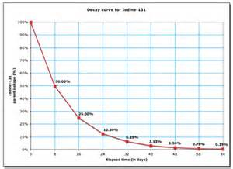
Factors that can affect elimination of therapeutic product
Dose and size of depo
  Rate of absorption
  IV < IM <SQ (product moves depo to plasma)
  Pharmokenetics
    Overall health and status of animal
    Target plus elimination organs
    Special characteristics of product
  Multiple doses or different doses
  Dose in different site than designed

Slide 19
Extended WDT
WDT is the time required after dosing for tissue concentrations to be depleted to or below specific safe concentration
More closely associated to tissue depots vs. plasma depots
Tissue with the slowest depletion determines the WDT for the species
  10 t ½ = 99.9% depletion, days usually rounded up (no fractions of days), physiological state, different tissue
  In US safe concentration can be defined as the tolerance limit-law is zero for not approved compounds
In Europe usually termed Maximum residue level

Slide 20
Normal Dose
Normal Kidney/Liver ~ Predictable Withdrawal
Same dose but repeated
Withdrawal (slightly extended)
  (e.g., few d plus new dose)
Milk withholding
  Pretty predictable even if 1 ppb
MIC
Safe withdrawal
Re-treat ~ 1 days Single dose ~10 wd Multiple doses - safe ~ + few d

Slide 21
Extended Treatment or Compromised Kidney/Liver
Very Long Withdrawal
Same dose but repeated
Withdrawal (can be greatly extended)
  (e.g., not just 3 d plus new dose)
Milk withholding
  Very long if target is 1 ppb
MIC
Safe withdrawal
Re-treat ~ 3 days Safe~30 d Safe ~ 50 + d

Slide 22
Malaria Resistance and Lessons Learned
Read and Huijben, Evol. App., 2009
Fallacies
Drugs with long half lives are preferable
De novo resistance mutations are main enemy
  (vs. transportation around globe)
Genetic trade offs alone determine costs of resistance to pathogen
  (vs. in host ecology)
Fixation of resistance is inevitable if drug pressure is maintained

Slide 23
Antibiotics and 1°fate
Aminoglycosides
Amphotercin
Cephalosporins
Lincosamides/marcrolids
Fluoroquniolones
Penicillins
Phenicols
Sulfonamides
Tetracyclines
Kidney
Liver
Kidney---some liver
Liver
Kidney
Kidney
Liver
Kidney and liver
Liver and kidney
Giguere, Antimicrobial Therapy, 2006

Slide 24
Actual residues- Red Book 2011
FDA Bulk Milk Survey 2015
Chemical compound | Targeted Herds | Non-targeted herds
Total Herds- 3 testing centers* | 953 | 959
Florfenicol® | 6 | 4
Tetracycline's | (1) | 0
Sulfa’s | 1 (3) | (2)
Respiratory Tx | 4 | 0
Gentamicin | 1 (1) | 0
Positives (in violation) | 12 | 4
Lowest level for some 1 ppb, a few not at voliative levels and a few samples excluded
* Denver, Ag Research Lab, S R lab
http://www.fda.gov/downloads/AnimalVeterinary/GuidanceComplianceEnforcement/ComplianceEnforcement/UCM435759.pdf

Slide 25
Mini Pharmokenetics of Florfenicol
Label treatment dose at 40mg/kg SQ
Repeat 4 d if necessary
Withdrawal 38 day
Start at 40 ppm then 10 t ½ = 99.9% reduction
40 ppb, drug with wide distribution, even with normal withdrawal, withholding may be + 40d

Slide 26
Staphylococcus aureus
Samples submitted to ADL for mastitis or bulk tank milk culture (2008, 2013, 2014, 2015) examined for S. aureus
S. aureus isolates
  163 isolates (n=115 QMS; n=48 BTM) from 77 farms
    Small cell variant phenotype analysis
    Antibiotic resistance
      Amoxicillin + Clavulanic acid, Cefoxitin, Ciprofloxacin, Clindamycin, Erythromycin, Gentamicin, Oxacillin, Tetracycline, Vancomycin, Penicillin.
    Enterotoxin genes: A, B, C, D, E, F, G, H, I, J, K, L, M, O, P, Q, R, TSST-1
    Leukocidin genes: LukAB, LukED, LukMF
    DNA Fingerprinting: Multi Locus Sequence Typing
Jayarao, unpublished 2015

Slide 27
Dendrogram based on allelic mismatches between the allelic profiles
1.0
Clonal
complex
0.8
0.6
Linkage Distance
0.4
0.2
0.0
Strain 8
Strain 4
Strain 5
Strain 2
Strain 9
Strain 7
Strain 3
Strain 6
Strain 10
Strain 1
Strain 12
Strain 11
Allelic Profile
Gene: A B C D E F G
Strain 8
9 15 13 27 22 18 14
Clone
Strain 4
9 10 1 19 12 18 14
Strain 12
11 15 30 12 22 11 20
Strain 10
11 15 30 12 22 11 20
Strain 5
11 15 30 12 22 11 20
Strain 2
11 15 30 12 22 11 20
Strain 9
20 11 29 9 21 13 11
Strain 7
20 11 29 9 21 13 11
Strain 3
6 5 9 1 2 13 17
Strain 6
1 5 3 7 2 8 4
Strain 11
1 5 3 5 2 8 4
Jayarao, unpublished 2015
Strain 1
1 5 3 7 2 8 4

Slide 28
Antimicrobial Resistance
Sensitivity
  130/163 = 80% of isolates sensitive to all ten antimicrobials examined.
  BTM: 37/48 =77%
  QMS: 93/115 = 81% NO MRSA strain isolated from Pennsylvania dairy herds
Antibiotic Resistance Profile | No of Isolates | No. of Farms
None | 130 | 74
Clindamycin | 1 | 1(QMS)
Cefoxitin | 3 | 2 (BTM)
 |  | 1 (QMS)
Penicillin | 7 | 1 (BTM)
 |  | 6 (QMS)
Tetracycline | 5 | 5 (QMS)
Vancomycin | 11 | 2 (BTM)
 |  | 3 (QMS)
 |  | 2 (BTM)
 |  | 3
Amoxicillin, Penicillin | 1 | 1 (BTM)
Clindamycin, Erythromycin | 2 | 1(QMS)
Oxacillin, Penicillin | 1 | 1 (QMS)
Clindamycin, Erythromycin, Tetracycline, Penicillin | 2 | 2 (BTM, QMS)
Jayarao, unpublished 2015

Slide 29
Farm B (March 2004 - March 2012)
S. typhimurium
Every other animal immunized
Prevalence of fecal shedding in adult cattle-110 cow free stall barn
  Bedded on sand
  Vaccine intervention
  Water and feed hygiene interventions
  No appreciable clinical disease
(Composite) Wolfgang, et al 2013

Slide 30
(Composite) Wolfgang, et al 2011

Slide 31
% positive individual animal cultures (after initiation of vaccine trial)
(Composite) Wolfgang, et al 2012

Slide 32
Prevalence of Antibiotic Resistance %
Schukken, et al, USDA/RDQMA Pilot Project
Antibiotic | Salmonella | E coli ‘07 | Salmonella | E coli ‘ 08 | Salmonella | E coli ‘09
 | n=202 | n=525 | n=232 | n=500 | n=117 | n=510
Amikacin | 0 | 0 | 0 | 0 | 0 | 0
Amoxi/clav. | 1.0 | 1.5 | 0 | 1.1 | 0 | 0.6
Ampicillin | 1.5 | 2.1 | 0 | 2.2 | 0 | 1.6
Cefoxitin | 1.0 | 1.5 | 0 | 1.3 | 0 | 0.4
Ceftiofur | 1.0 | 0.8 | 0 | 1.1 | 0 | 0
Chloramphenicol | 1.0 | 0.2 | 0 | 0.9 | 0 | 0.4
Kanamycin | 0 | 3.8 | 0 | 4.8 | 1.7 | 3.3
Streptomycin | 1.0 | 5.1 | 0.4 | 6.5 | 1.7 | 2.8
Sulfizoxazole | 1.0 | 3.8 | 0 | 4.8 | 1.7 | 2.8
Tetracycline | 1.0 | 13.1 | 0 | 9.8 | 1.7 | 7.8
Trim. /sulfa | 0 | 1.0 | 0 | 1.5 | 0 | 1.2

Slide 33
Presence of food safety pathogens at packing plant
 |  | n | Sal + | % Sal + | C1 | K | B | E | C2
Farm K | Fecals | 151 | 150 | 99.3 | 147 | 14 | 1
 | Rectal Swabs | 22 | 15 | 68.2 | 12 | 2
 | Hide Swabs | 22 | 21 | 95.5 | 15 | 13 | 3 |  | 1
 | Lymph Nodes | 22 | 0 | 0.0
Farm L | Fecals | 140 | 0 | 0.0
 | Rectal Swabs | 27 | 6 | 22.2 | 1 | 5 | 1
 | Hide Swabs | 27 | 21 | 77.8 | 4 | 18 | 1 | 3
 | Lymph Nodes | 27 | 0 | 0.0
SH-D (excludes K and L) | Rectal Swabs | 317 | 123 | 38.8 | 27 | 98 | 3 |  | 13
 | Hide Swabs | 324 | 276 | 85.2 | 87 | 287 | 4 | 11 | 29
 | Lymph Nodes | 35 | 0 | 0.0
All | Rectal Swabs | 366 | 144 | 39.3
 | Hide Swabs | 373 | 318 | 85.3
 | Lymph Nodes | 36 | 0 | 0.0
Salmonella group
Farm K nearly always positive in cull animals and at farm-1 serotype
Farm L negative at farm-picked up by some animals quickly at packing plant
Hide swabs reflect the diversity of animals in packing plant
Lymph nodes are more likely to be positive only after systemic or serve GI disease

Slide 34
Salmonella isolates from composite samples of various cattle groups on Pennsylvania dairy farms
 |  |  | Serogroup (No. of farms)
 | No. of farms | Sal ⁺ % (n) * | C1 | C2 | E | B | U
Pre-weaned calves | 77 | 13.0 (10) | 1 | 2 | 1 | 0 | 6
Post-weaned calves¹ | 75 | 25.3 (19) | 3 | 6 | 0 | 0 | 14
Dry cows² | 72 | 61.1 (44) | 16 | 8 | 0 | 0 | 30
Lactating cows³ | 80 | 63.8 (51) | 35 | 13 | 0 | 1 | 39
Total | 80 | 63.8 (51) | 25 | 15 | 1 | 1 | 40
*C1 n= 25 Montevideo
C2 n= 14 Kentucky 1 Newport
E n=1 Muenster
B n= 1Paratyphi Bvar. L-tartrate
U n= 40 Cerro
Antibiogram Essentially all pan-susceptible
(Composite) Wolfgang, et al 2015

Slide 35
Resistant E. coli isolates from Various Cattle Groups in PA
Liu, in press 2016
Antimicrobial Agents | Farm Prevalence (%)
 | Pre-weaned calves (n=77) | Post-weaned calves (n=75) | Dry cows (n=72) | Lact. cow (n=80)
AUG | 40.3 (31) | 14.7 (11) | 0.0 (0) | 5.0 (4)
AMP | 57.1 (44) | 33.3 (25) | 1.4 (1) | 12.5 (10)
AZI | 2.6 (2) | 1.3 (1) | 0.0 (0) | 0.0 (0)
FOX | 37.7 (29) | 13.3 (10) | 0.0 (0) | 5.0 (4)
TIO | 31.2 (24) | 12.0 (9) | 0.0 (0) | 5.0 (4)
AXO | 36.4 (28) | 13.3 (10) | 0.0 (0) | 6.3 (5)
CHL | 29.9 (23) | 18.7 (14) | 1.4 (1) | 1.3 (1)
CIP | 1.3 (1) | 1.3 (1) | 0.0 (0) | 0.0 (0)
GEN | 13.0 (10) | 5.3 (4) | 0.0 (0) | 0.0 (0)
NAL | 7.8 (6) | 4.0 (3) | 0.0 (0) | 0.0 (0)
STR | 70.1 (54) | 38.7 (29) | 6.9 (5) | 21.3 (17)
FIS | 67.5 (52) | 44.0 (33) | 11.1 (8) | 22.5 (18)
TET | 81.8 (63) | 69.3 (52) | 26.4 (19) | 40.0 (32)
SXT | 26.0 (20) | 8.0 (6) | 0.0 (0) | 2.5 (2)

Slide 36
No resistance detected
NARMS ‘14

Slide 37
Malaria Resistance and Lessons Learned
White, et. al., Malaria Journal, 2009
Resistance
Greater: fast parasite growth and high burdens
Recrudescence and multiple recrudescence are required for de novo selection of resistance
Inadvertent treatment of asymptomatic parasitemia is unlikely source of resistance
Strive for therapeutic levels in all patients
Ill patients with hyperparasetemia very risky

Slide 38
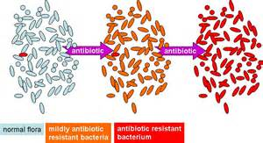
Antibiotic use the only cause or solution for AMR?
Genes in environment
  Co selection against metals
  Allows for plasmids and integrons +cassettes to DNA
  Co-resistance to heavy metals allows for maintenance of resistance (polluted countries)
  Increased use of trace minerals to improve performance
Heavy industrial impact = greater resistance
Berendonk, et.al, Nat Rev Micro, 2015
McAurther, et.al, Micro Ecol, 2015

Slide 39
The Worried Well
Review Antibiotic Resistance, 2014

Slide 40
All Animal Ag Species-Well-being Initiatives
Address injured or ill animals
  Treatment protocols
Painful conditions
Chronic conditions and euthanasia
Low economic value animals
  Routine care procedures of caretakers (+ training)
Care and welfare of animals during transportation
Prevention & keep well > treat when ill

Slide 41
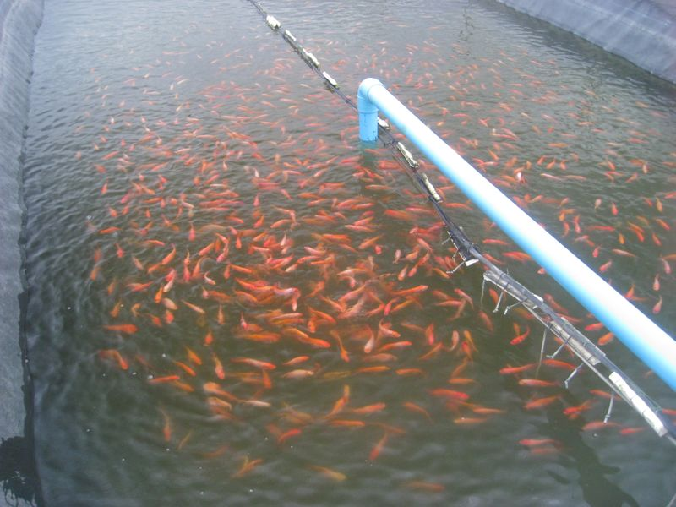
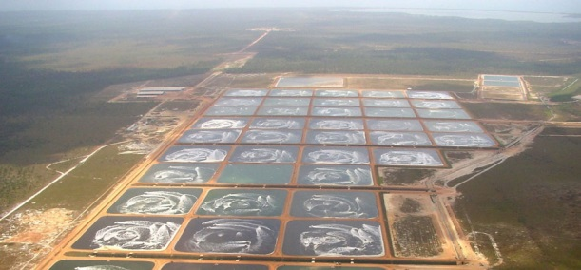
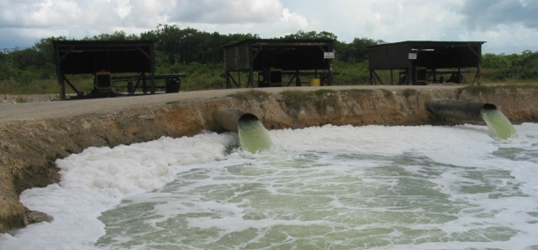
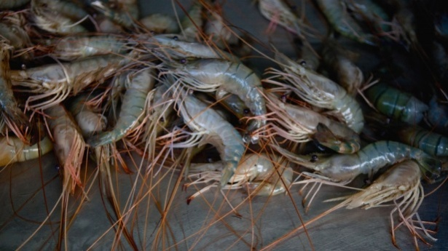
Example: Imported Shrimp
~ One hundred percent of Vietnamese shrimp farms use ciprofloxacin.
Fluoroquinolone concentrations in sediments and surface waters may reach >4,000 μg/kg.
All kinds of bacteria inhabit these ponds, including those present in the manure of terrestrial animals (such as chickens) that is fed to the shrimp
“Where does this lead?”
http://cdn.intechopen.com/pdfs-wm/35141.pdf

Slide 42
Systems Approach
Advantages of US Food Supply vs. Production Forced Out of Country
Environmental
Stewardship
Market
Incentives
INTEGRATOR
DRIVEN
BMP/HACCP
PROGRAMS
Diet Options
Antimicrobial Usage
Rearing
Practices &
Housing
Well being- Welfare
Food Safety and Security

Slide 43
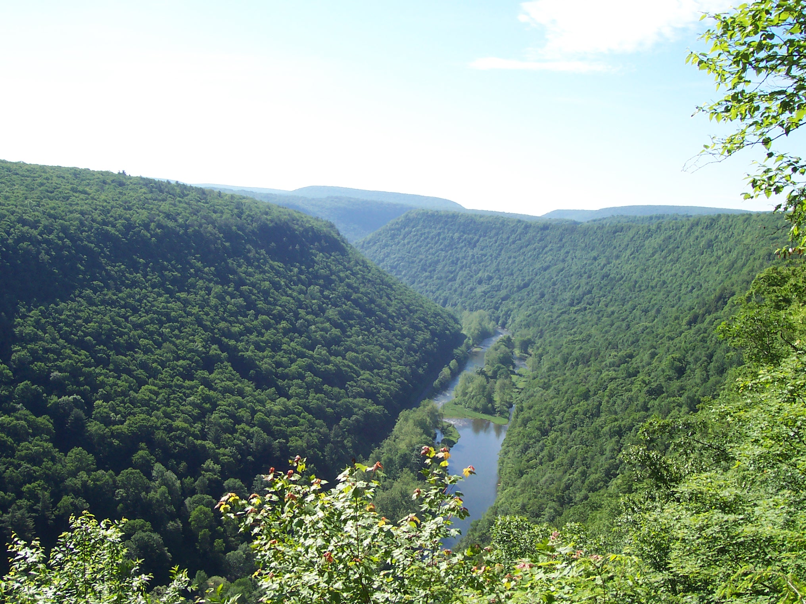

Penn State is committed to affirmative action, equal opportunity and diversity of its workforce.

