Slide 1
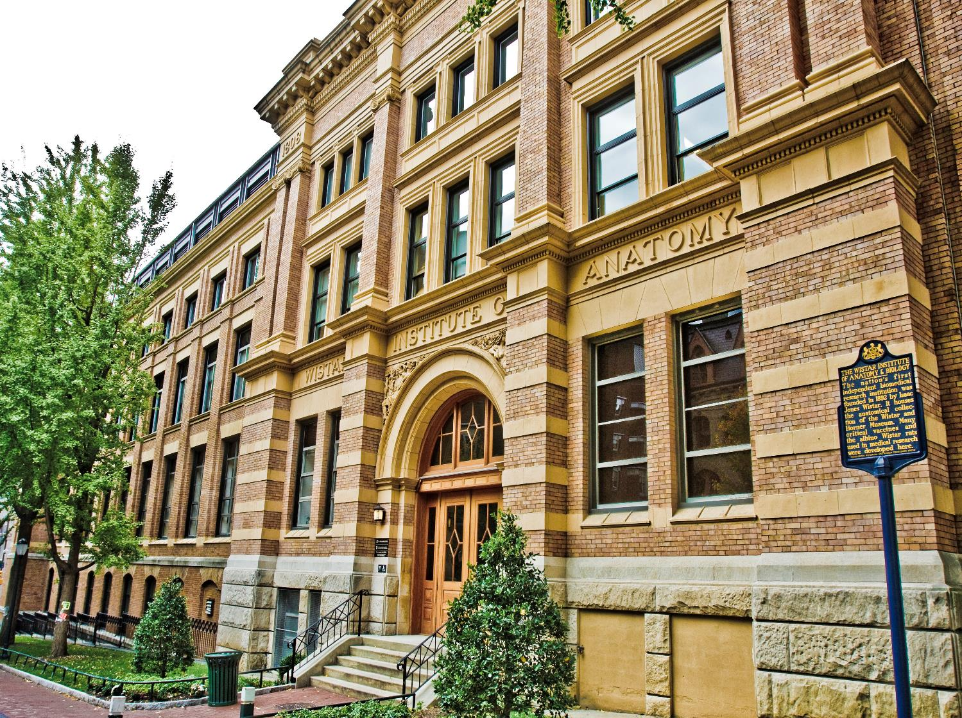
The Wistar Institute
The nation’s first independent biomedical research institution
An international leader in science with a special expertise in cancer research, virology, immunology and vaccine development.

Slide 2
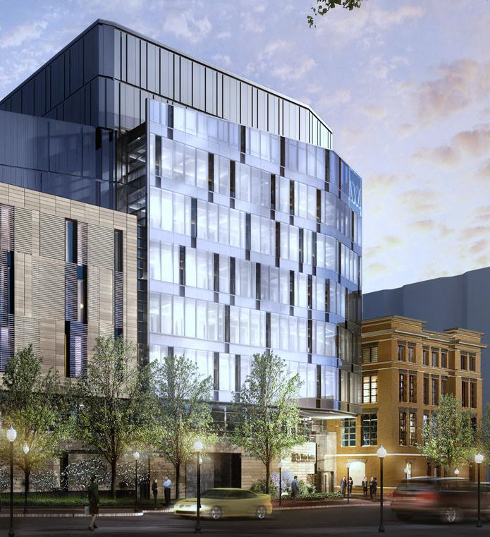
35 Investigators, with >$60 million dollars per year in federal funding
Highly collaborative research environment
11 State-of-the-Art Core Facilities
70 postdocs, 35 pre-docs

Slide 3
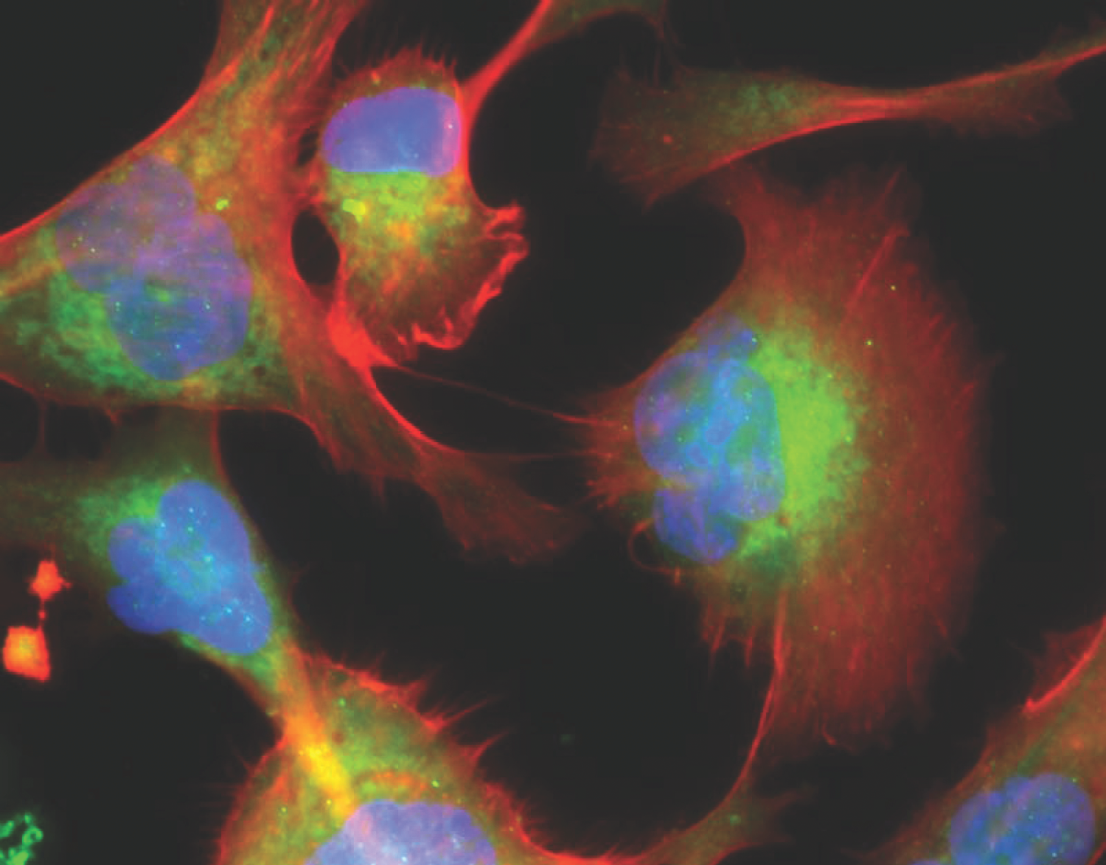
The Wistar Institute Cancer Center
The Ellen and Ronald Caplan Cancer Center is an NCI- designated Cancer Center, organized into two programs:
Genome Regulation and Cell Signaling
Molecular and Cellular Oncogenesis
Six Centers:
The Vaccine & Immunotherapy Center
The Melanoma Research Center
The Center for Systems and Computational Biology
The Hubert J. P. Shoemaker Education and Training Center
*new* The Center for Advanced Therapeutics
*new* HIV Cure and Viral Diseases Center

Slide 4
Many Wistar Faculty are adjunct at Penn:
Dario Altieri: Cancer Metabolism
Hildegund Ertl: Vaccines
Meenhard Herlyn: Melanoma
Paul Lieberman: Virology,
Transcription
Luis Montaner: HIV therapy
Maureen Murphy: p53, HSP70
Yulia Nefedova: Multiple myeloma
Kazuko Nishikura: RNA editing
Joe Salvino: Medicinal chemistry
Jessie Villanueva: Melanoma drug resistance
Qing Chen: Cancer metastasis to the brain
Alessandro Gardini: Chromatin, enhancers and hematopoiesis
Daniel Kulp: Rational design of vaccines
Kavitha Sarma: RNA mediated epigenetic gene regulation
Zachary Schug: Cancer metabolism and metabolomics
David Weiner: DNA vaccines

Slide 5
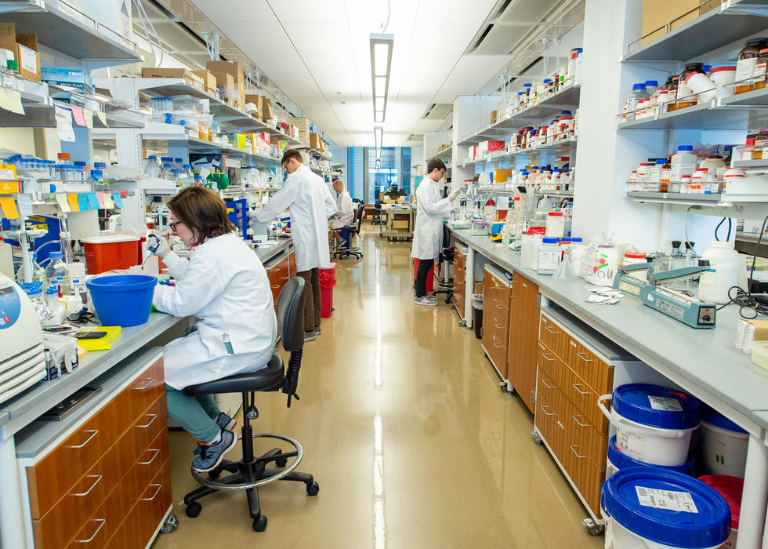
Questions? Tour?
dzuzga@wistar.org

