Slide 1

f
CAMPUS RECREATION
POTTRUCK HEALTH & FITNESS CENTER
3701 WALNUT STREET

Slide 2
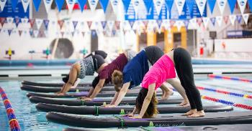
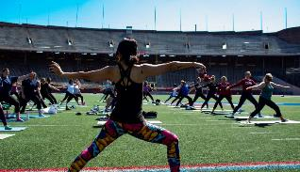
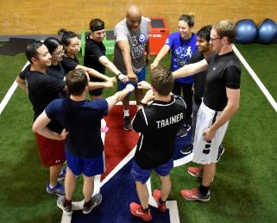

CAMPUS RECREATION
  Membership
    ~27,000 members in the Penn community
    Students, faculty, staff & affiliates can join
    General fee includes membership for full-time students
  Intramurals & Sport Clubs
    IM Leagues offered in Spring, Summer & Fall
    36 Club teams with ~1,000 student-athletes
  Fitness & Wellbeing
    Robust Group Fitness classes
    Personal Training and Workshops
  Adventures
    Open Climbing Wall hours
    Special Events (Womxn climbing nights)

Slide 3
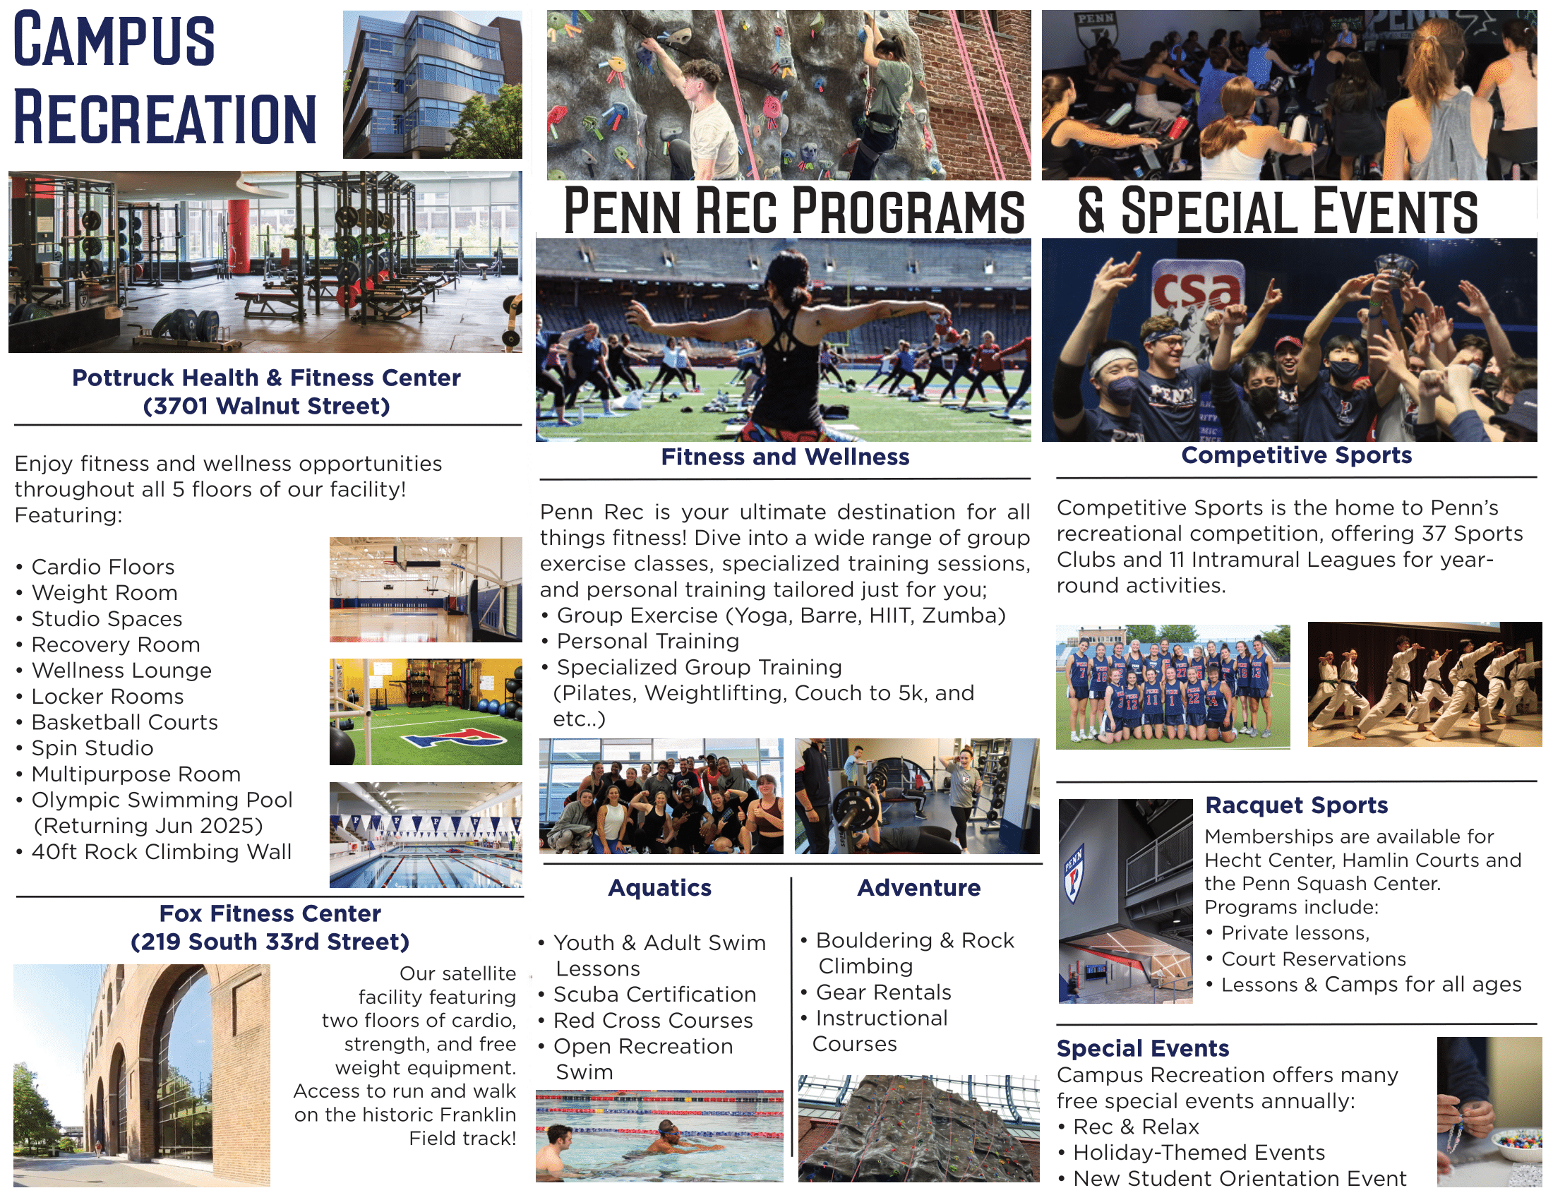

& ATHLETICS SPACES
Please Reach Out to Penn Campus Recreation below:

Slide 4
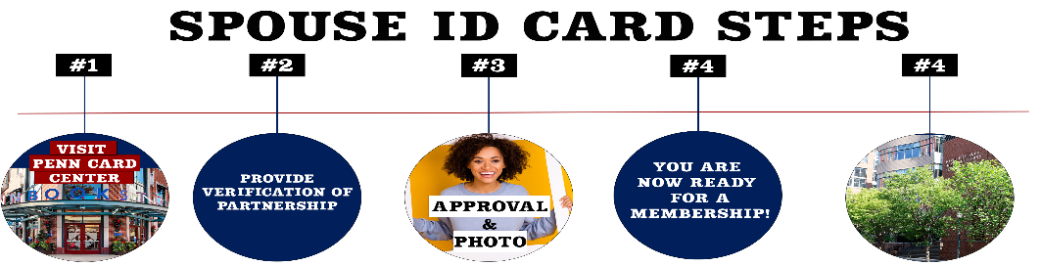
Spouse/dependent membership
Full-Time Students who pay the general fee have their membership through their tuition
If you have a spouse/dependent this information would be valuable in getting them a gym membership alongside you.
Your spouse and/or dependent(s) are eligible to get a Penn ID card at the Penn Card Center!

Slide 5

Sponsored Guest Membership
Have a friend or family member in the city of Philadelphia that would like to have a membership here at Penn Campus Recreation?
Then we are pleased to announce the Sponsored Guest program! This is a reflective membership for friends and family members that will reflect off your status in the University and options.
Process:
Fill out Sponsored Guest Form
Wait up to 24hours for a confirmation email to purchase Penn Card
Purchase with the sponsored guest at the Membership Office

Slide 6
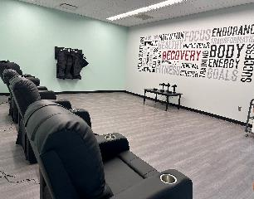
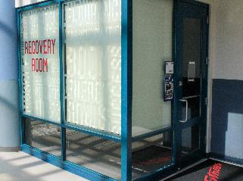
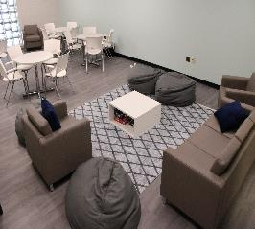
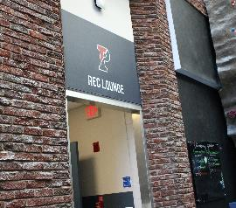
NEW THIS YEAR
Recovery Room Rec Lounge
(Rec Recovery Lounge Interior)
(Recovery Room Exterior)
(Rec Lounge Interior)
(Rec Lounge Exterior)

Slide 7
What's Included in your Membership?
The base membership for Penn Campus Recreation grants access to our two facilities:
Pottruck Health and Fitness
  5 Floors of Recreational Space
  40ft Rock Climbing Wall
  3 Full Length Basketball Courts
  Rec Lounge
Fox Fitness
  First Floor Cardio Room
  Second Floor Weight Room
  Access to the Franklin Field Track
Programs
  Competitive Sports
    Intramurals
    Sport Clubs
  Special Events
  Climbing Wall
  Aquatics
    Return of program in Summer 2025
Add ons to the base membership (fee based)
Fitness and Wellbeing
  Personal Training
  Group Exercise
  Reformer Pilates
  Recovery Room
Aquatics
  Group Swim Class
  Private / Semi Private Lessons
  Scuba
Adventure Programs (coming soon)
  Outdoor Trips
  Team building

Slide 8
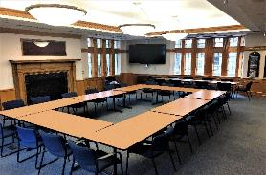
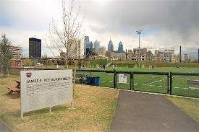
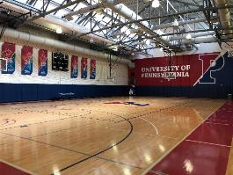
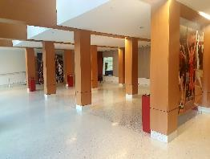
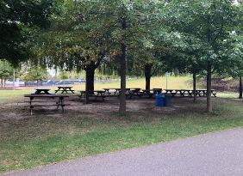
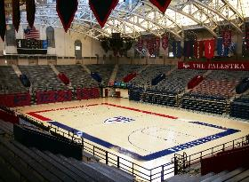


BUSINESS DEVELOPMENT & SPECIAL EVENTS
  If interested in renting athletic space in Penn Park or Pottruck:
    Fill out formsite link (Rental Request Form)
    Once link is submitted, a member of the Business Development department will be in touch within 3-5 business days
    Event request must be submitted 2 weeks prior to event date
  Rental Rates
    Student Group Rate: $75 an hour
    All Student Groups must be registered through University Life
    Penn Athletics Special Events

Slide 9

f
PENN RACQUET SPORTS
Penn Tennis Center 240 S. 31st St
Penn Squash Center 219 S. 32nd St

Slide 10
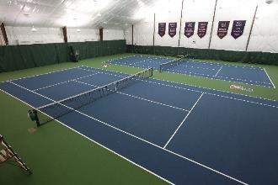
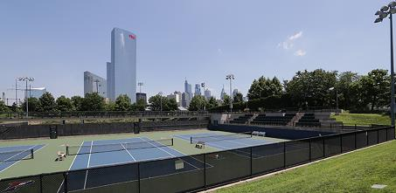
PENN TENNIS CENTER
  Memberships – FREE for Penn Students & Spouses
  Court Reservations- Indoor $20, Outdoor FREE
  Private Lessons - $100- $110- $120
  Clinics - For all skill levels
    Adult 1.0-2.0
    Adult 2.5
    Adult 3.0
    2.5-3.0 Live Ball / Strategy
    Adult 3.5-4.0
    Adult 4.0+
    Lunch Drill 2.0-3.5
    Mid-day Doubles Mixer 3.5-4.0
  Tennis 101, 201, and 301
We offer three specific 5-week programs for beginner to advanced level players Each week provides students with the opportunity to learn specific tennis skills and increase their love for the game.
$200
What will be taught:
Introduction
Strokes
Grips
Footwork
Rallying
Rules of Play
Singles and Doubles
For more information visit pennracquetsports.com

Slide 11
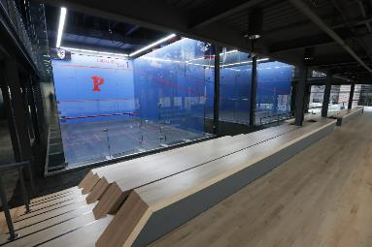
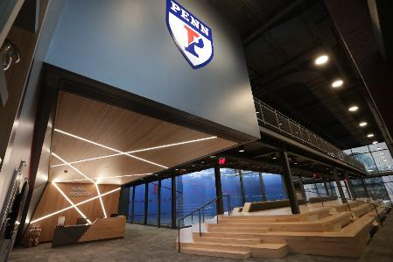

PENN SQUASH CENTER
  Memberships – FREE for Penn Students & Spouses - $900 Annual Student Group Membership
  Court Reservations- FREE on courts 10,11,12
  Private Lessons - $75- $100
  Beginner & Intermediate Clinics
  $40
  Monday 5-5:45p
  Wednesday 5-5:45p
  Saturday 11-11:45a
  Free 30 mins of hitting after each clinic!
For more information visit pennracquetsports.com

