Slide 1
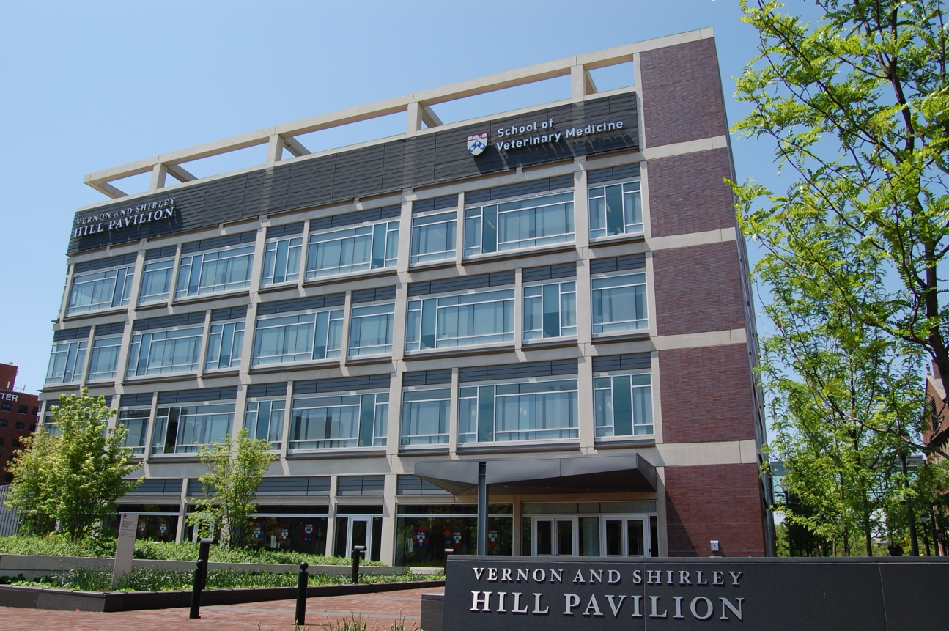
Research at Penn Vet
Chris Lengner, Ph.D.
Department of Biomedical Sciences
Institute for Regenerative Medicine
Abramson Cancer Center
Notes:
Research is at the core of the school– and its success determines the success of the school– we often talk about 3 pillars- research, teaching and service– but they are intertwined- not really separate. As one example– calls to PennVet from clients– they want to bring their animals to Penn Vet because of our reputation in research—

Slide 2
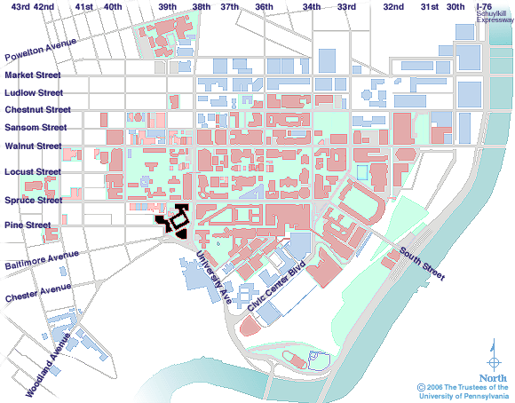
Wawa
John Morgan
SVM
BRB

Slide 3
Types of Research
Basic
Translational
Clinical
Knowledge from experimentation
Application of knowledge for societal benefit
Knowledge from working with patients (or populations)
“Natural history of disease”
Animals and Humans
Notes:
So, there are several different types of research– and it is important to understand them, since as you will see the funding sources for the different types differs.

Slide 4
Core Research Areas
Cancer
Immunology
Microbial Pathogenesis
Stem Cell and Regenerative Biology
Germ Cells and Reproduction
One unique component that SVM brings to Penn is a
companion animal patient population.

Slide 5
Vet School Faculty have significant representation in:
Abramson Cancer Center
Institute for Immunology & Immune Health (I3H)
Institute for Regenerative Medicine (co-founded by Dr. Brinster)
Epigenetics Institute
Center for Women’s Health and Reproductive Medicine
Institute for Infectious and Zoonotic Diseases (IIZD)

Slide 6
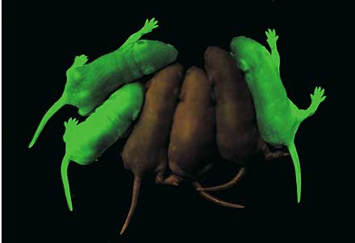
Why choose a lab in SVM?
SVM faculty belong to all the graduate groups within BGS – High representation among CAMB, IGG, NGG
There is a robust grad student population and community at SVM
Research projects opportunities analogous to those in any of the other biomedical schools at Penn, Wistar, or CHOP
Spermatogonial stem cells marked by GFP

Slide 7
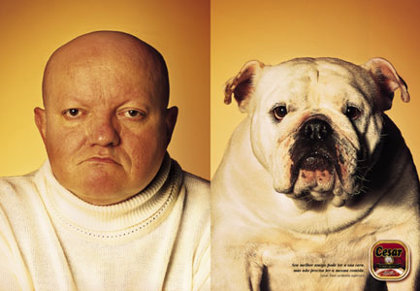

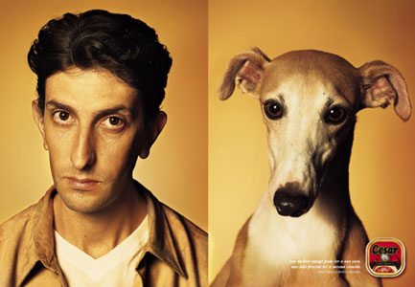
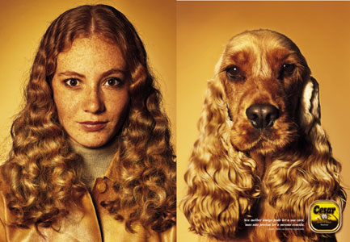
In some cases they might choose SVM to work in organisms beyond flies, fish, or mice….

Slide 8

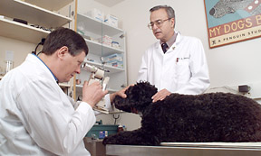
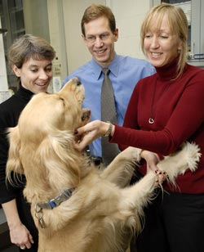
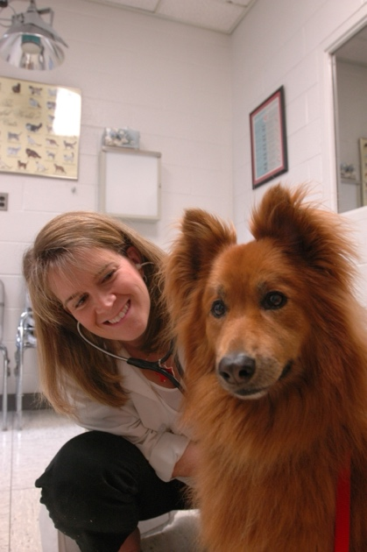
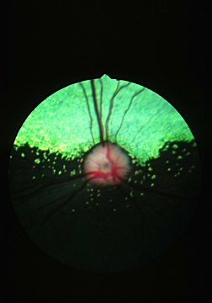
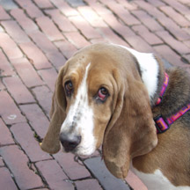
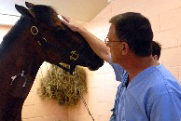
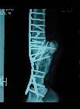
Translational research at Penn Vet
Notes:
Retinitis pigmentosis

Slide 9
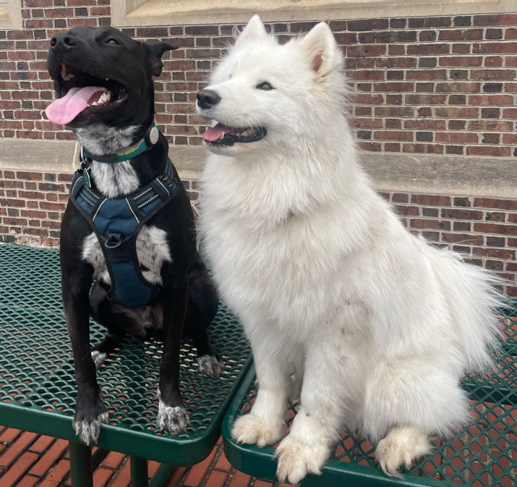
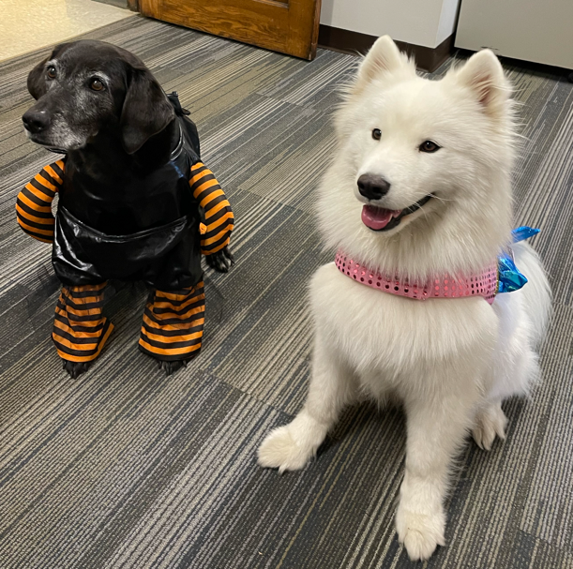
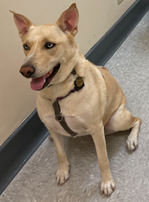
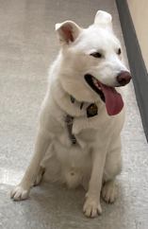
Questions? or more information:
Reach out any time!
Chris Lengner: Lengner@upenn.edu
Dogs of Penn Vet labs!
Nila:
Stem cells
and Cancer
Athena & Atlas
(DSRB)
Pachi:
Immunology,
Epigenetics
Jules:
Microbiology, Host-Pathogen Interaction

