Slide 1
@SDFlies #BGSOrientation #PENNBGS4U Today’s program:
Conducting Research Responsibly — Steve, ~25min
Theme: Starting your Professional Life with Rigor
Laboratory Notebook — Steve, ~ 20min
Emily, Kara & Ben, ~ 40min total
Theme: organize, Organize, ORGANIZE!
Set up an Electronic Notebook — LabArchives
11AM Remote session, in BRB on the big screen
Notes:
What are your goals? Give me some words…
Do Good science
Recognize good science
Help Others – Kelly talked about this a lot from the POV of you getting from others –remember that you guide others, too
You are creating your professional self.

Slide 2
@SDFlies #BGSOrientation #PENNBGS4U Today’s program:
Conducting Research Responsibly — Steve, ~25min
Theme: Starting your Professional Life with Rigor
Laboratory Notebook — Steve, ~ 20min
Emily, Kara & Ben, ~ 40min total
Theme: organize, Organize, ORGANIZE!
Set up an Electronic Notebook — LabArchives
11AM Remote session, here on the big screen https://labarchives.zoom.us/meeting/register/tZwkde6hrD8tHdCHuRDm4279gsbzmfSadNsl
Notes:
What are your goals? Give me some words…
Do Good science
Recognize good science
Help Others – Kelly talked about this a lot from the POV of you getting from others –remember that you guide others, too
You are creating your professional self.

Slide 3
@SDFlies #BGSOrientation #PENNBGS4U Today’s program:
Conducting Research Responsibly — Steve, ~25min
Theme: Starting your Professional Life with Rigor
Laboratory Notebook — Steve, ~ 20min
Emily, Kara & Ben, ~ 40min total
Theme: organize, Organize, ORGANIZE!
Set up an Electronic Notebook — ‘LabArchives’
-- Guided through recording an experiment
-- Tips-n-tricks → lab life more efficient; experiments more rigorous
Notes:
What are your goals? Give me some words…
Do Good science
Recognize good science
Help Others – Kelly talked about this a lot from the POV of you getting from others –remember that you guide others, too
You are creating your professional self.

Slide 4
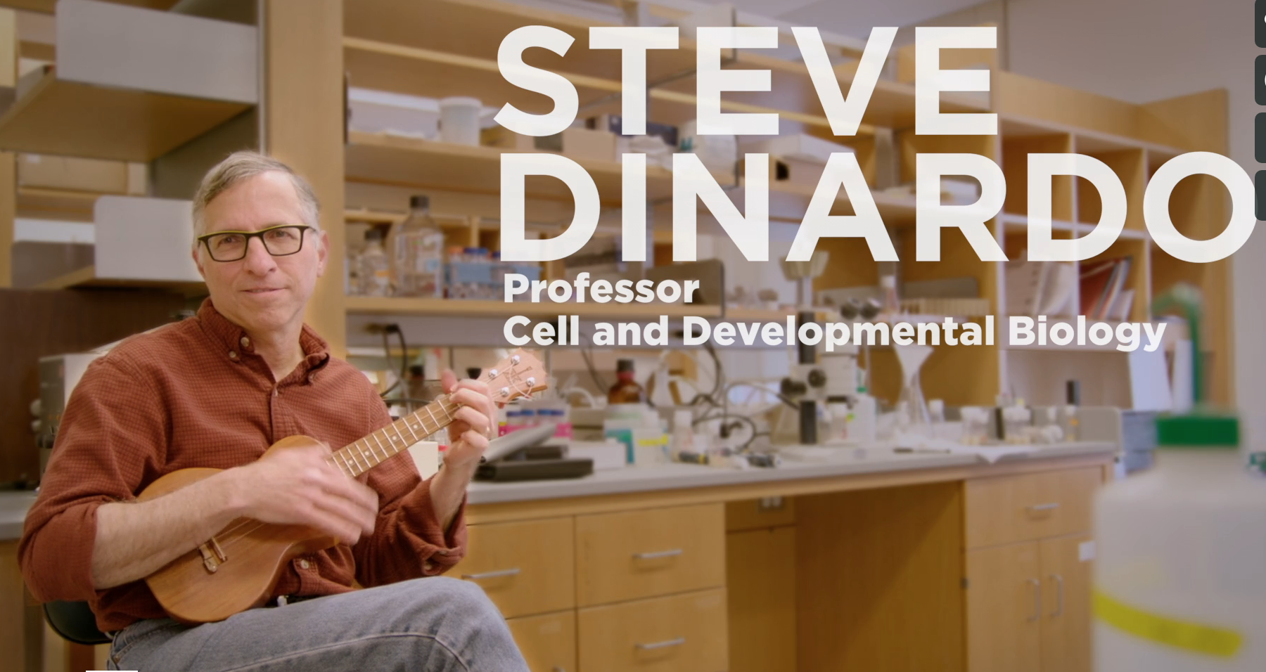
responsible conduct of research (RCR)
Biomedical Graduate Studies
Steve DiNardo (he, him)
Director, Training Support and Career Development, BGS
@SDFlies #BGSOrientation #PennBGS4U
Notes:
I will frame today’s topic around YOUR goals.

Slide 5
What is YOUR PRIMARY GOAL?
pause
DO GOOD SCIENCE —
KNOW HOW TO IDENTIFY GOOD SCIENCE —
{HELP OTHERS IDENTIFY AND DO GOOD SCIENCE}
All, as you CREATE YOUR ‘PROFESSIONAL SELF’!
Notes:
What are your goals? Give me some words…
Do Good science
Recognize good science
Help Others – Kelly talked about this a lot from the POV of you getting from others –remember that you guide others, too
You are creating your professional self.

Slide 6
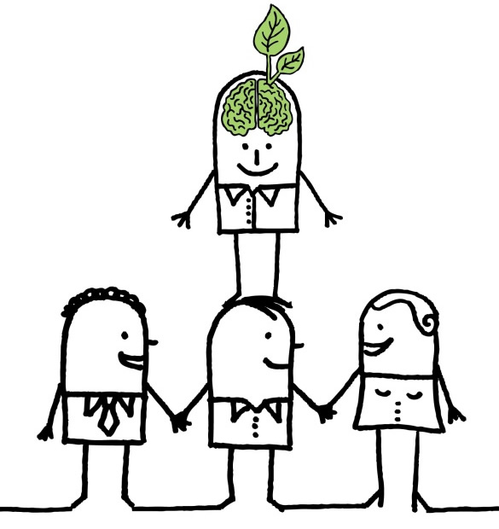
What is YOUR PRIMARY GOAL?
TO DO GOOD SCIENCE —
Must stand on the shoulders of others who came before
How to pick the right shoulders?
MUST IDENTIFY GOOD SCIENCE —
The science that came before was done:
Responsibly
Reproducibly
& with Rigor!
RCR training provides you with tools.
https://blog.yorksj.ac.uk/moodle/files/2014/05/LAWW.jpg
Notes:
Requires that the science that came before is done Responsibly
Reproducibly
& with Rigor.

Slide 7
What is YOUR PRIMARY GOAL?
DO GOOD SCIENCE —
Standing on the shoulders of others who came before:
BY CREATING YOUR ‘PROFESSIONAL SELF’:
You become those shoulders to stand on!
You are here
The science you do must be done:
Responsibly
Reproducibly (with transparency)
& with Rigor!
Notes:
Requires that the science that came before is done Responsibly
Reproducibly
& with Rigor.

Slide 8
Hold it: Let’s Define ‘Professional self’
BY CREATING YOUR ‘PROFESSIONAL SELF’:
You are here
Each of you are individuals:
Celebrate that identity
Bring your perspective & life’s experiences
Do not aspire to any arbitrary criteria
Other scientists will know you first from quality of your published work – that is your ‘professional self’.
Notes:
Requires that the science that came before is done Responsibly
Reproducibly
& with Rigor.

Slide 9
Essential QUALITIES that i strive for:
HONESTY — conveying information truthfully and honoring commitments
ACCURACY— reporting findings precisely and taking care to avoid errors
EFFICIENCY— using resources wisely and avoiding waste, and
OBJECTIVITY— letting the facts speak for themselves and avoiding improper bias.

Slide 10
responsibly conduct research (RCR)
THOSE are the
QUALITIES needed to:
THE IDEAS ARE NOT DIFFICULT TO FATHOM;
BUT THEY NEED TO BE MADE EXPLICIT
Notes:
Those qualities allow you to conduct research responsibly.
Responsible to whom?
Yourself
Peers / Colleagues
Profession
Society

Slide 11
areas that require ‘Responsible Conduct’
Laboratory Notebooks
Acquisition and Management of Data
Collaborative Science
Conflicts of Interest and Time
Mentoring
Peer Review
Research Misconduct
Responsible Authorship and Publication
Scientists as Responsible Members of Society
Use of Animals in Research
Use of Humans in Research
Rigor in Experiment Design
ETHICAL QUESTIONS
CAN WILL ARISE
IN THESE
SUBJECT AREAS

Slide 12
Training in RCR
Your training in RCR is continual.
Why?
See concepts several times; In different contexts
= they are “sticky”!
On-line instruction in Years 1–4 (‘Knowledgelink’)
Workshop-based on ‘Case Studies’ in Years 2–4
RCR-focused lab meetings in Years 3–5
Notes:
So, with regard to the nuts and bolts of training, know first that NIH requires training of us and other biomedical institutions in RCR.
We meet the requirements through …
This is another of Kelly’ s examples of, “You will see this several times, in several contexts.
It must be important.
Oh, I see now why (else) its important (because you are ready for it in another context)

Slide 13
Case Studies
You will read ‘Case Studies’ often
These are a source for discussion
In small groups to promote comfortable discussion
Each group has a ‘facilitator’
One who guides, not lectures
(for some topics) there will be no perfect answer
You had an excellent intro to Case Studies last week
Notes:
We use case studies *a lot*.

Slide 14
Think about these Essential QUALITIES in considering case studies
HONESTY — conveying information truthfully and honoring commitments
ACCURACY— reporting findings precisely and taking care to avoid errors
EFFICIENCY— using resources wisely and avoiding waste, and
OBJECTIVITY— letting the facts speak for themselves and avoiding improper bias.

Slide 15
Example Case Study
Mike is a 4th-year student. His work is progressing well, however some data aren’t falling into place.
Specifically a few control experiments he knows should work are not working.
He doesn’t want to bother his thesis advisor or thesis committee with what he thinks is a minor detail, so he has not asked for advice or help.
(continued)
Notes:
Let’s start with a case study.
This one deals with Mike, a graduate student. We have others that deal with staff, postdocs, faculty.
A control is a validation that your basic experimental assumptions are correct.
How are we feeling about Mike at this point, with regard to the core elements we outlined?
What should we do if we were to counsel him?
(Kelly): seek the advice of others.

Slide 16
Case Study, Continued
Perhaps because he expects them to work soon, or because he does not want to ruin what’s really a pretty nice story, Mike, when asked about the controls at a lab meeting says, “…no worries, I’ve done them; they were as expected”.
How do you rate Mike?
(Honesty, Accuracy, Efficiency, Objectivity)
(continued)
Notes:
How are we feeling now?? So let’s think about that.

Slide 17
Case Study, Continued
The advisor is happy that everything is in place, and asks that the experiments be included in a poster Mike is preparing for a meeting.
Mike does so, without the – nonexistent – controls.
At the meeting, Mike intentionally steers discussion at his poster away from any consideration of controls.
And, now? Honesty, Accuracy, Efficiency, Objectivity
(continued)

Slide 18
Case Study, Continued
When Mike returns to lab, he finds that his advisor has incorporated his data into a manuscript just submitted to a journal, with the controls mentioned in the text.
We’ve focused on Mike …
What about the PI? What is/was their role?
pause
Notes:
-Mike fesses up at this point, the advisor contacts the editorial staff to retract the article from review.
We’ve focused on the student, BUT .. .
Does the advisor come out of this case study unscathed?
Breakdown. Obviously with serious consequences.

Slide 19
Which area(s) does this case study highlight?
Acquisition and Management of Data
Collaborative Science
Conflicts of Interest and Time
Mentoring
Peer Review
Research Misconduct
Responsible Authorship and Publication
Scientists as Responsible Members of Society
Use of Animals in Research
Use of Humans in Research
Notes:
research misconduct
In presenting it, but also in skewing conversations that occurred.

Slide 20
Research Misconduct
A definition:
Fabrication, falsification, plagiarism, or other serious deviation from accepted practices in…”
Proposing
Performing
Reviewing
Reporting
…research results.
Notes:
It’s all about misrepresentation in any setting

Slide 21
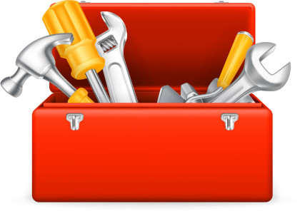
The goal of your RCR training:
Acquisition and Management of Data
Collaborative Science
Conflicts of Interest and Time
Mentoring
Peer Review
Research Misconduct
Responsible Authorship and Publication
Scientists as Responsible Members of Society
Use of Animals in Research
Use of Humans in Research
Provide you with
tools to
anticipate matters
arising in these areas
Notes:
Research misconduct aside, there’s not a week that goes by that I don’t think about each of these in some fashion or another.

Slide 22
RCR will be continual during your time here
On-line instruction in Years 1–4 (‘Knowledgelink’)
Workshops based on Case studies in Years 2–4
Year 2: Research misconduct, Data management; Inclusivity, Diversity & Equity in Science
Year 3: Collaborative science, Mentorship, Animal and human subjects
Year 4: Conflict of interest, Responsible authorship/ publication, Peer review
RCR-focused lab meetings in Years 3–5
BGS Case Study Resources …
Notes:
Manning’s wonderful stuff!

Slide 23
BGS RCR/SRR Website

Slide 24
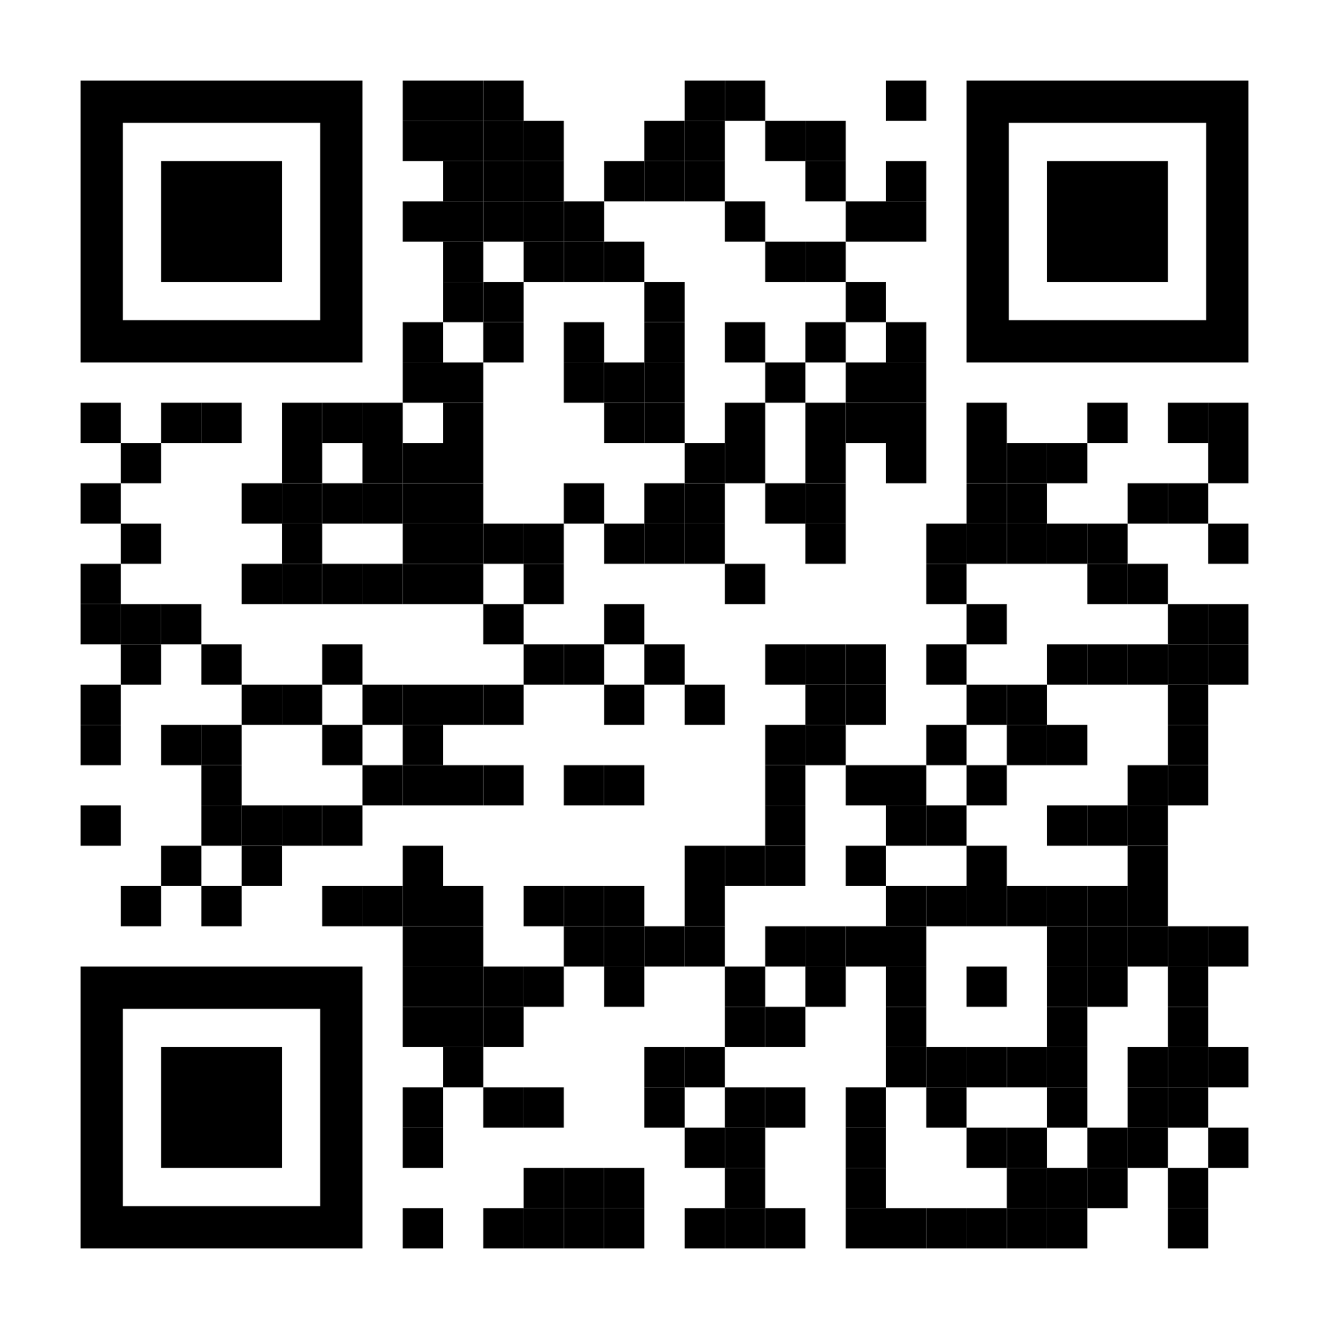
BGS RCR/SRR Website http://bit.ly/BGS_RCR_UPENN
Sydney Cason
&
Alice Sukhina:
Updated narratives (more real-lab-life;
more inclusive)

Slide 25
Training in Scientific Rigor and Reproducibility (SRR)
SRR is related to the ethical conduct of research (RCR).
Rigorous Experimental Design; Authenticate Reagents;
Transparent Protocols.
**Tomorrow, Kurt Engleka: Ready, Set, Experiment!
Notes:
Very closely related to RCR training is training in what’s referred to as Rigorous Experimental Design and Transparency to Enhance Reproducibility

Slide 26
To Sum up: these ARE your QUALITIES
HONESTY — conveying information truthfully and honoring commitments,
ACCURACY— reporting findings precisely and taking care to avoid errors,
EFFICIENCY— using resources wisely and avoiding waste, and
OBJECTIVITY— letting the facts speak for themselves and avoiding improper bias.
Notes:
You are in control of your work. Apply the above to your work. Must consider all areas of your ‘reach’. Must actively think about these.

Slide 27
What is YOUR PRIMARY GOAL?
CREATING YOUR ‘PROFESSIONAL SELF’:
Be the right shoulders to stand on!
Be here
By carrying out your science:
Responsibly
Reproducibly
& with Rigor!
Notes:
Requires that the science that came before is done Responsibly
Reproducibly
& with Rigor.

Slide 28
@SDFlies #BGSOrientation #pennbgs4u Today’s program:
Conducting Research Responsibly — Steve, ~25min
Theme: Starting your Professional Life with Rigor
Laboratory Notebook — Steve, ~ 20min
Emily, Kara & Ben, ~ 40min total
Theme: organize, Organize, ORGANIZE!
Set up an Electronic Notebook — LabArchives Remote session on the BRB Screen ~50min

Slide 29
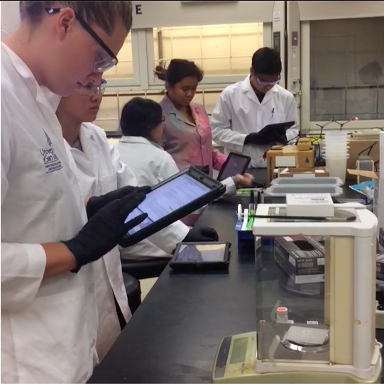
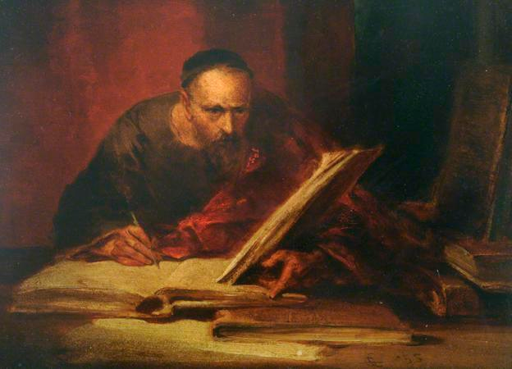
It’s about the way you
Acquire & Manage Data:
Your Laboratory Notebook
George Cattermole – The Scribe
The laboratory now:
We’ve come a long way!
https://www.labarchives.com/
Notes:
Nothing much to say – just Welcome back from Lunch. We will spend some time on “The Laboratory Notebook”

Slide 30
Lab Notebook: Why is it important?
1.
2.
3.
4.

Slide 31
Lab Notebook: Why is it important?
1. Others can reproduce your work
2. Patents
3. Defending claims of misconduct
4. Saves you Time, Energy & Effort
This is the way to do ‘Rigorous Science’
Each a
‘noble’ reason
for a good
notebook
The reason that will impact YOU most often:

Slide 32
Example: Is this a good notebook?
Notes:
Tell me some things that are wrong with this “notebook?
OK –Lots ‘wrong’.
Is this common? Let’s look at a case study.

Slide 33
2nd Example: A (true) case study
Dr. B. convenes a lab meeting in which she asks everyone to bring their notebook.
“Pass your notebook to the person to your right”.
“Take a few moments and quietly read the most current entry.”
Notes:
Follow along …

Slide 34
2nd Example: A (true) case study
“Now, each of you summarize what you read”.
Virtually no one can provide a
satisfactory summary.

Slide 35
2nd Example: A (true) case study
Why can’t anyone provide
a satisfactory summary?
There were many issues:
Handwriting
Haphazard organization
Little or no context
Lack of detail in the protocol
No outcome
No ‘what next?’
Notes:
True story. Maybe for ‘Scavenger Hunt’ you should be charged with figuring out who ‘Dr. B’ is, and who owned that horrid notebook I showed earlier?

Slide 36
Lab Notebook: The Bottom Line --
Could a colleague understand the experiment fully?
Can you reproduce it a year from now? This is the part that
saves you Time, Energy & Effort;
fosters Rigor.

Slide 37
Lab Notebook Guidelines
How to find anything?
Organization is key
First, at the level of the whole notebook
‘Table of Contents’ is essential
see Emily’s talk next.
Second, at the level of individual experiment
Notes:
Drawing back to the notebook as a whole, be sure…

Slide 38
At the level of individual experiments:
Make entries daily; date them.
Why? Memory is faulty.
In ink or use an Electronic notebook (→ next talks)
Why? Entries need to be indelible.
Document everything.
Don’t ‘filter’ out bad experiments.
Yes, omitting data is dishonest, but, also →
Your future self needs to know what did not work
See Responsible Conduct of Research (Shamoo & Resnick) and Scientific Integrity (Macrina)
Notes:
Lesson from this Case Study is our first guideline. [Read first bullet point]
It’s very important to know as you’re making entries that you must [read sub-bullets]

Slide 39
Provide ‘Context’ to your Exp’t:
Purpose: What are you proposing?
Anticipate the results:
Keep these entries simple!

Slide 40
Lab Notebook: How was it done?
Protocol: A critical section.
Did you alter the protocol this time through?

Slide 41
Lab Notebook: What happened?
Results: Enter raw data or a link to storage.
Discussion:
Future Directions:
Keep these entries simple!

Slide 42
Lab Notebook:
As you look back through your notebook:
Feel free to make edits; but date them.
Notes:
…think weekly

Slide 43
Lab Notebook:
Authentication
Your PI should review and sign the notebook
Notes:
…think weekly

Slide 44
Lab Notebook: The Bottom Line --
Could a colleague understand the experiment fully from your entry?
Can you reproduce it a year from now? This is the part that
saves you Time, Energy & Effort;
fosters Rigor.

Slide 45
Who ‘owns’ your Notebook?
Notebooks are under the care of the PI, but ‘belong’ to the University.
Must be retained for a long period.
Required retention period can be long after funding ends.
Notes:
A related topic is ownership. You are not the owner, nor is your PI.

Slide 46
Build good habits early!
During your rotation:
Ask your supervisor or PI to review your notebook weekly and provide suggestions.
Notes:
So I’ve covered the organizational rudiments in terms of guidelines. To keep everything honest, you should know every principal investigator has a distinct set of preferences in this regard. Here’s my strongest recommendation.

Slide 47
Time Management
Data Management / Lab notebook
Planning, Planning, Planning
(You will hear things repeatedly → “sticky”)
Sonia Lombroso …
ORGANIZATION
Keep a calendar for lab, classes and meetings
Managing UP
Map out how long you *think* something will take, and multiply by 1.5. That’s how long you should allot yourself
Keep an eye on big deadlines and add in buffer time those weeks – exams, lab meeting presentations, rotational talks
Make good habits, early. Find what works for you. This will save you A LOT of headache later
Use an online lab notebook in addition to whatever your PI requires - lab archives, benchling
Don’t forget to keep track of negative data (even if you’re sad about it)
Backup your data!! Get an external hard drive, cloud storage or preferably both. Use them CONSTANTLY - PennBox, Dropbox, Google
Daily: What is your intention for that day? What are must do items? What are should do items? What can wait? What can’t?
Weekly: Have a weekly ‘planning’ day where you map out the experiments for the next week
Gather and read the protocols you will use that week
This will help you ensure you have all the needed reagents, including time
Monthly/Bi-monthly: Check-in with your PI/lab mentor. Are you on the same page about goals and priorities? What is the rough outline of what you hope to achieve that month?
Yearly: Individual Development Plan (IDP) meetings with your PI. What worked that year? What do you need more or less of next yeat?

Slide 48
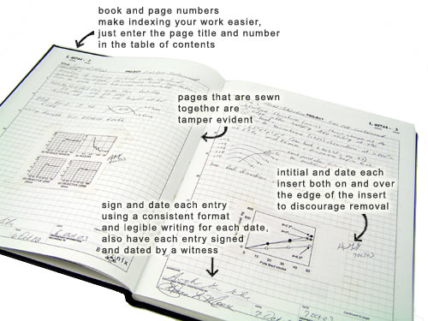
How does one achieve all this ‘Organization’?
Emily Feierman, NGG student
“On File Naming & Organization”
Notes:
One form of the notebook, and the one with which most of you are familiar, is the traditional bound notebook.

Slide 49
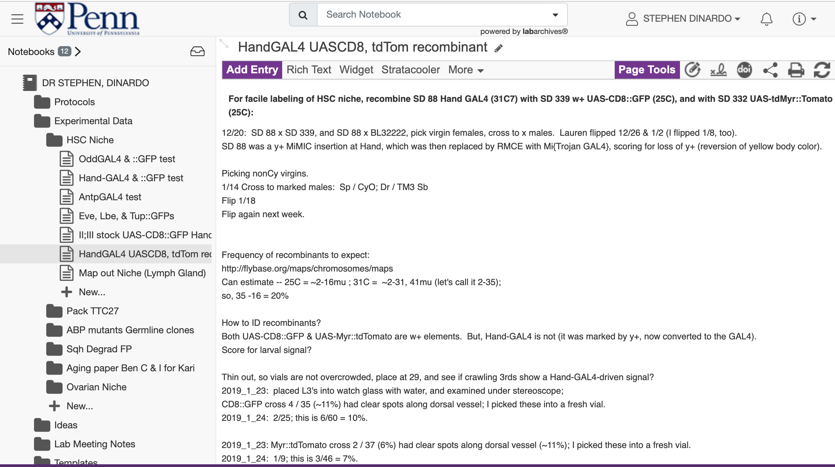
Benefits of an Electronic Notebook
→
Kara McGaughey, NGG Student
“Why you should use an eNotebook”.
Notes:
One form of the notebook, and the one with which most of you are familiar, is the traditional bound notebook. [Describe] Another is the electronic lab notebook, which we’ll describe in the next hour. My comments unless I tell you differently relate to both.

Slide 50
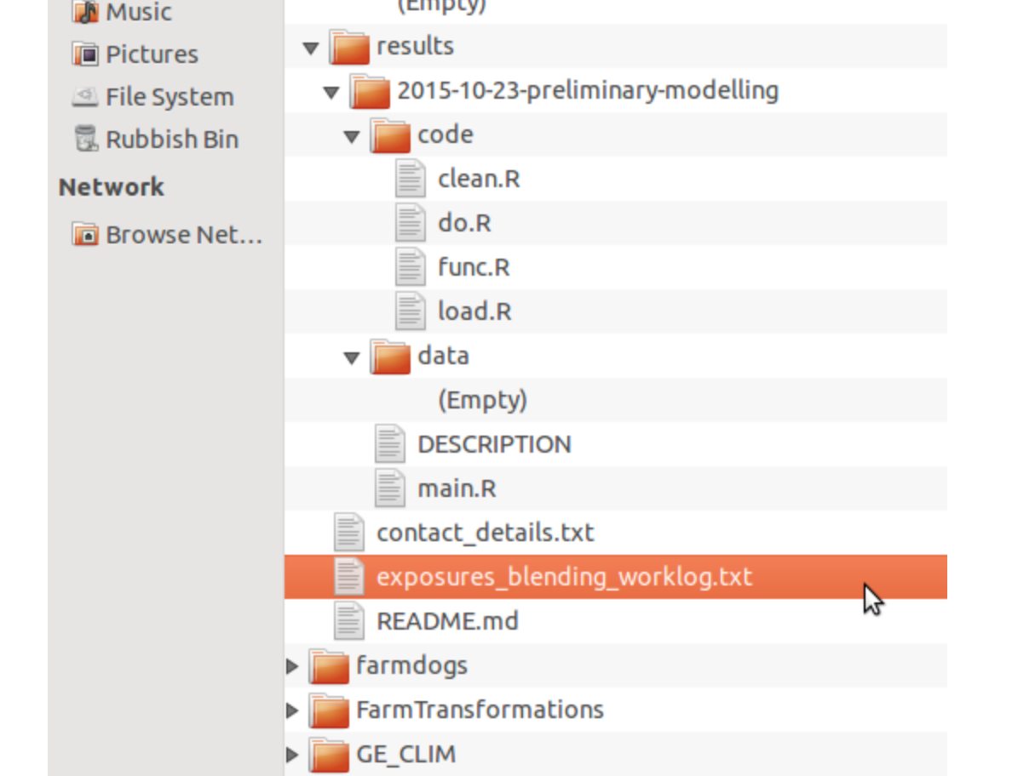
Type of Research => Kind of Notebook
→
Benjamin Heil, GCB student
“Recording Computational Work”
Hanigan site:
https://ivanhanigan.github.io/2015/10/keeping-an-electronic-lab-notebook-for-computational-statistics-projects/
Notes:
One form of the notebook, and the one with which most of you are familiar, is the traditional bound notebook. [Describe] Another is the electronic lab notebook, which we’ll describe in the next hour. My comments unless I tell you differently relate to both.

Slide 51
Please: avoid this!
Notes:
So, let’s figure out how to avoid this …

Slide 52
Benefits of an Electronic Notebook
→
btw: My notebook (years ago) now looks like this (an eNotebook).
Notes:
One form of the notebook, and the one with which most of you are familiar, is the traditional bound notebook. [Describe] Another is the electronic lab notebook, which we’ll describe in the next hour. My comments unless I tell you differently relate to both.

Slide 53
@SDFlies #BGSOrientation #pennbgs4u Today’s program:
Conducting Research Responsibly — Steve, ~25min
Theme: Starting your Professional Life with Rigor
Laboratory Notebook — Steve, ~ 20min
→ Emily, Kara & Ben, ~ 40min
Theme: organize, Organize, ORGANIZE!
Set up an Electronic Notebook — LabArchives On the BRB big screen: 11AM to noon https://labarchives.zoom.us/meeting/register/tZwkde6hrD8tHdCHuRDm4279gsbzmfSadNsl
Notes:
What are your goals? Give me some words…
Do Good science
Recognize good science
Help Others – Kelly talked about this a lot from the POV of you getting from others –remember that you guide others, too
You are creating your professional self.

Slide 54
@SDFlies #BGSOrientation #Pennbgs4u Shout out to:
→ Emily, Kara & Ben
Theme: organize, Organize, ORGANIZE!
NEXT, if you wish - 11AM to noon; On the BRB screen
Set up an Electronic Notebook — LabArchives -- Establish an account (free; LA is Penn-sponsored)
-- Set up your Electronic Notebook
-- Be guided through recording an experiment
-- Tips-n-tricks to make lab life more efficient and your experiments more rigorous
https://labarchives.zoom.us/meeting/register/tZwkde6hrD8tHdCHuRDm4279gsbzmfSadNsl
Notes:
What are your goals? Give me some words…
Do Good science
Recognize good science
Help Others – Kelly talked about this a lot from the POV of you getting from others –remember that you guide others, too
You are creating your professional self.

