Slide 1
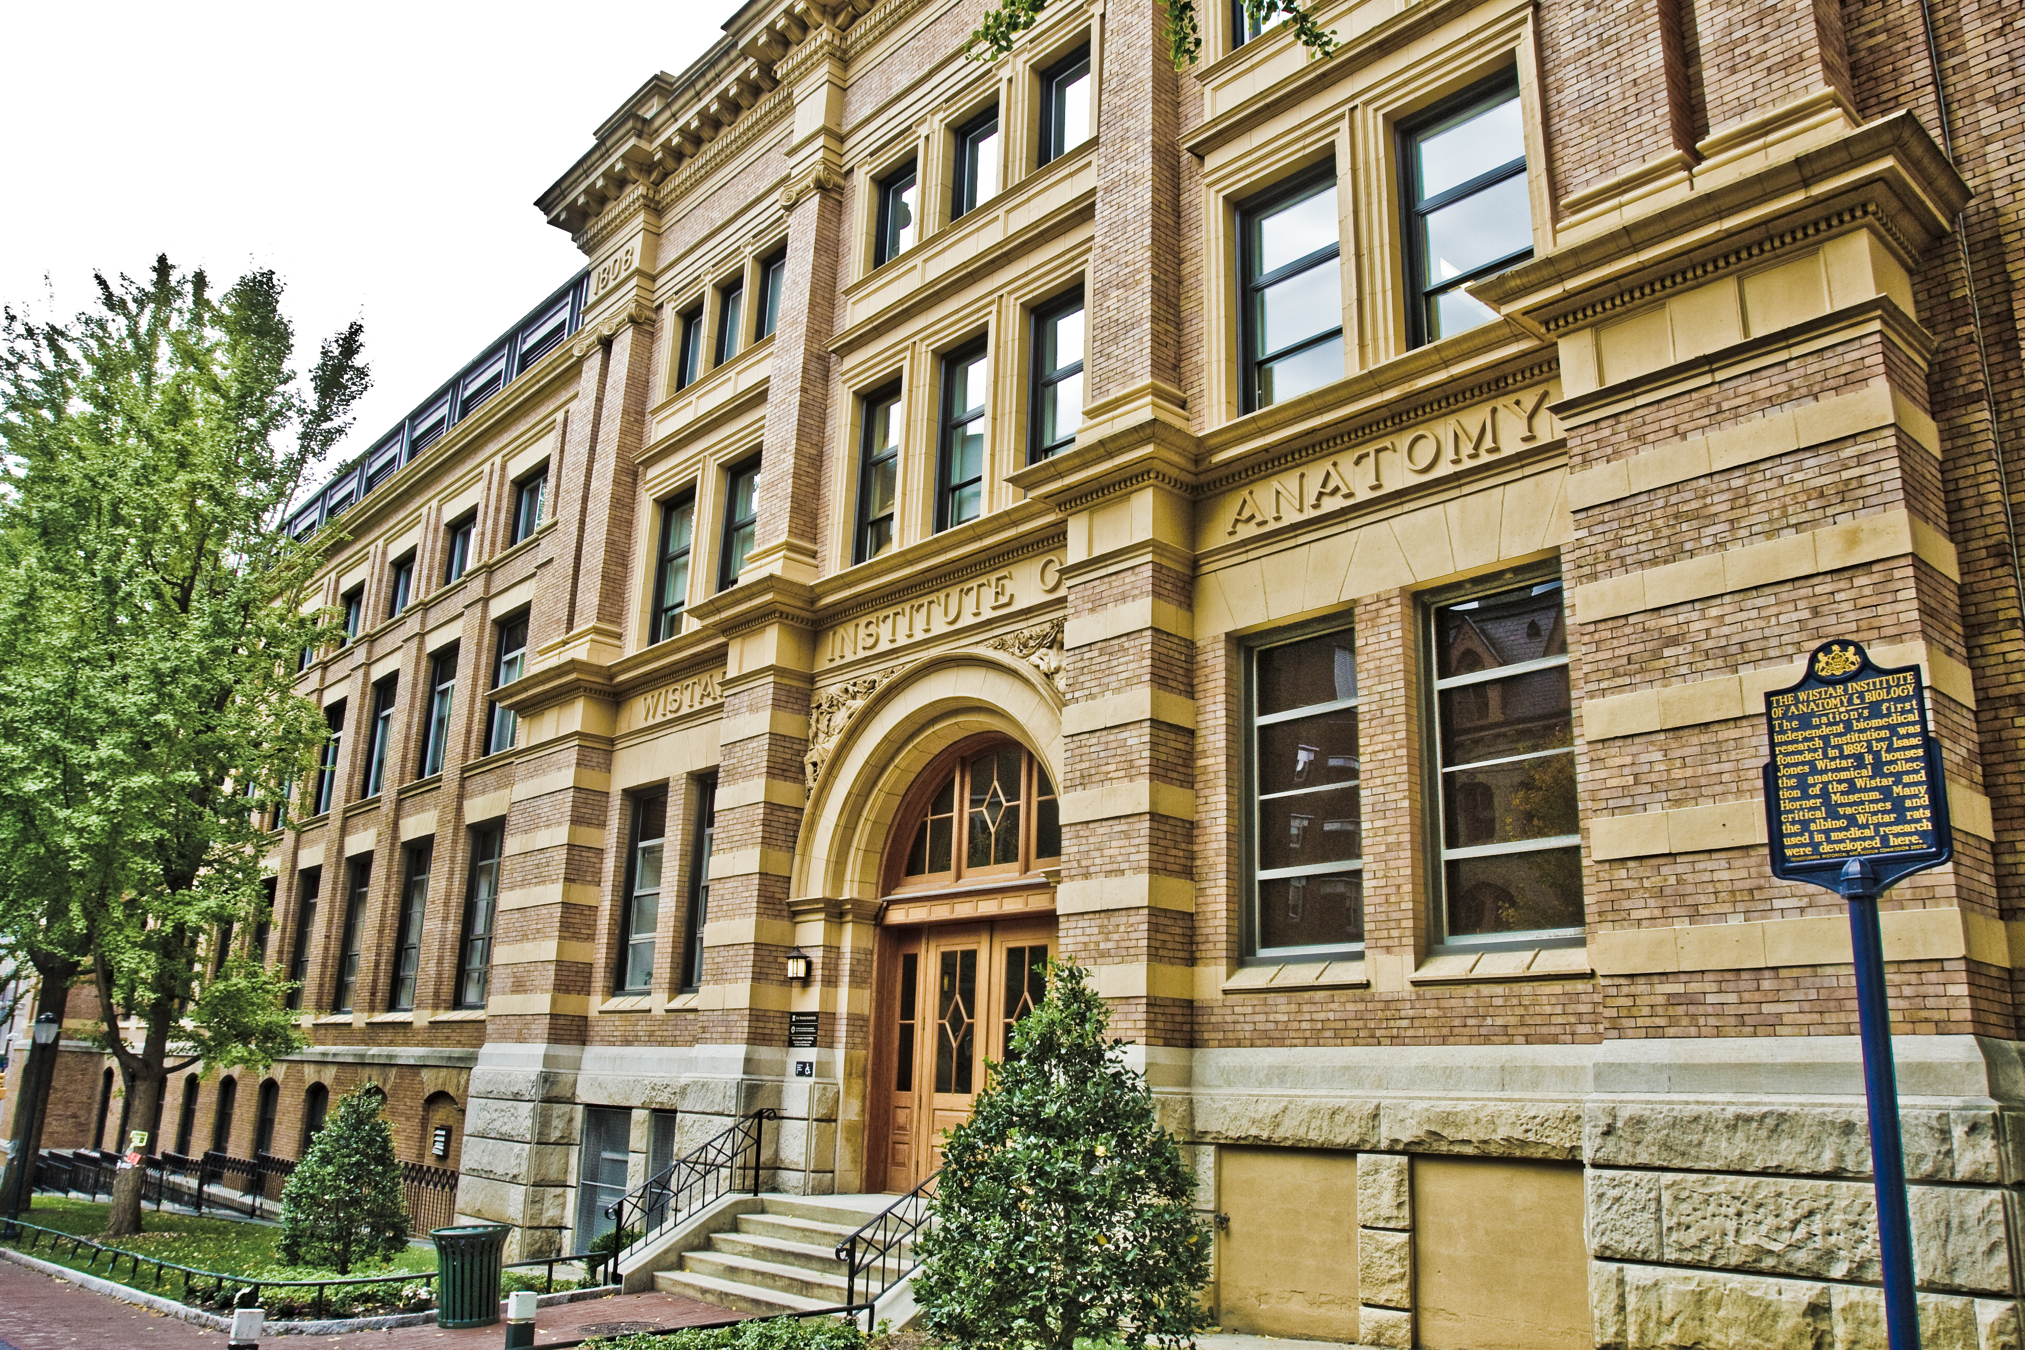
The Wistar Institute
The nation’s first independent biomedical research institution
An international leader in science with a special expertise in cancer research, virology, immunology and vaccine development.

Slide 2
32 Investigators, with >$60 million dollars per year in federal funding
Highly collaborative research environment
11 State-of-the-Art Core Facilities
63 postdocs, 33 pre-docs

Slide 3
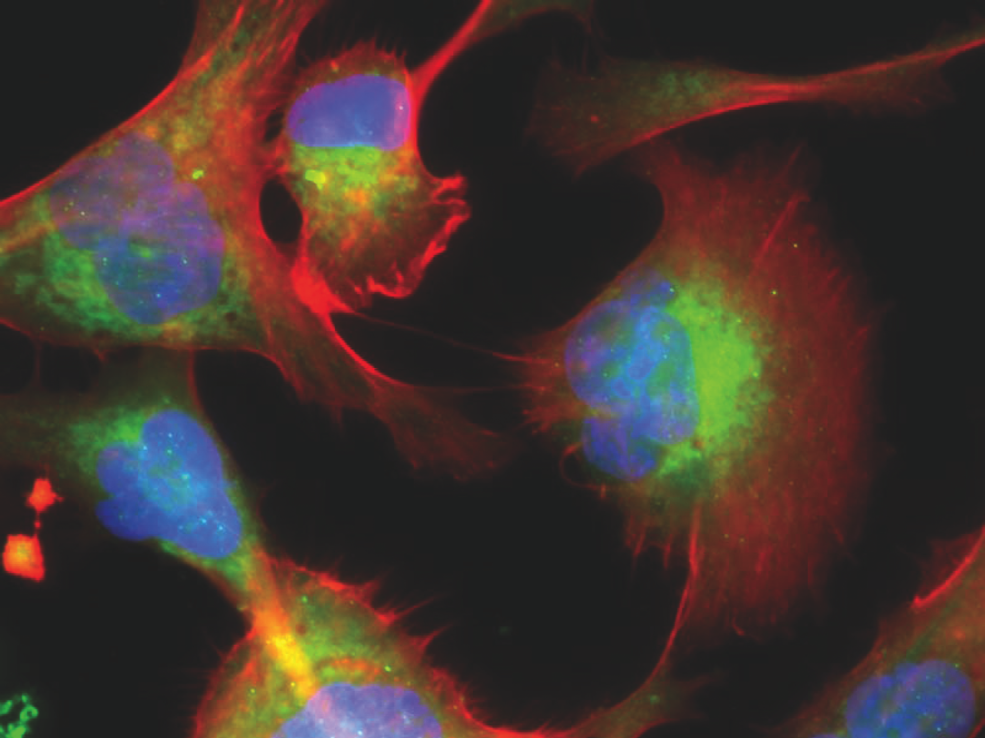
The Wistar Institute Cancer Center
The Ellen and Ronald Caplan Cancer Center is an NCI- designated Cancer Center, organized into three programs:
Gene Expression and Regulation
Molecular and Cellular Oncogenesis
Immunology, Microenvironment and Metastasis
Five Centers:
The Vaccine & Immunotherapy Center
The Melanoma Research Center
The Center for Systems and Computational Biology
The Hubert J. P. Shoemaker Education and Training Center
The Center for Advanced Therapeutics

Slide 4
Wistar Faculty who are adjunct at Penn:
Dario Altieri: Cancer Metabolism
Hildegund Ertl: Vaccines
Meenhard Herlyn: Melanoma
Paul Lieberman: Virology,
Transcription
Luis Montaner: HIV therapy
Maureen Murphy: p53, HSP70
Yulia Nefedova: Multiple myeloma
Kazuko Nishikura: RNA editing
Joe Salvino: Medicinal chemistry
Louise Showe: Functional genomics Jessie Villanueva: Melanoma drug resistance
Mohamed Abdel-Mohsen: Host-virus interactions, HIV
Qing Chen: Cancer metastasis to the brain
Alessandro Gardini: Chromatin, enhancers and hematopoiesis
Daniel Kulp: Rational design of vaccines
Kavitha Sarma: RNA mediated epigenetic gene regulation
Zachary Schug: Cancer metabolism and metabolomics
Rugang Zhang: Cancer metabolism, senescence
David Weiner: DNA vaccines

Slide 5
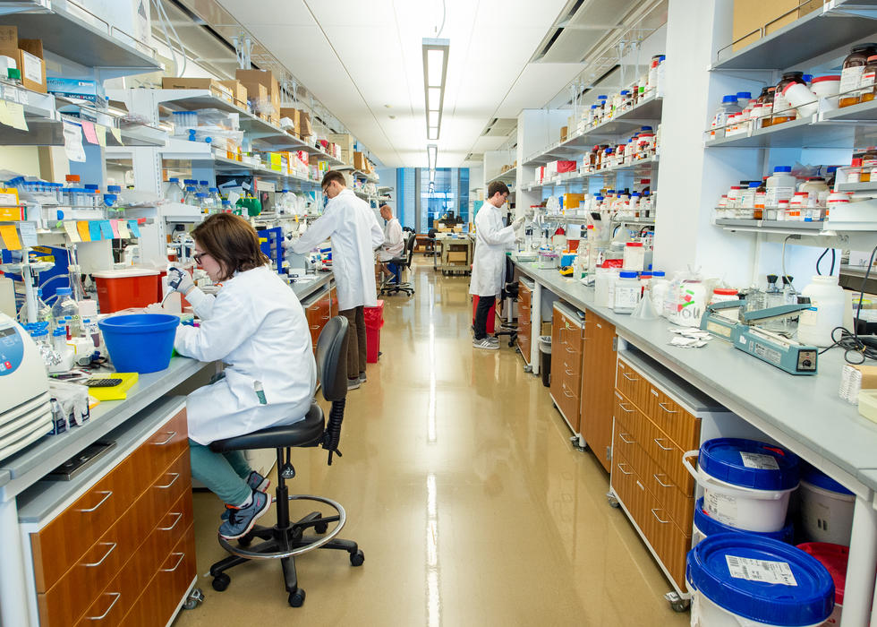
Questions?
dzuzga@wistar.org

