Slide 1
Update on Benign Prostatic Hyperplasia
William I. Jaffe, MD
Assistant Professor of Urology in Surgery
Penn Presbyterian Medical Center
University of Pennsylvania Health System

Slide 2
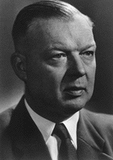
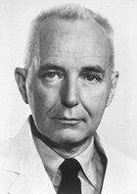
Nobel Prize Winners in Urology
Werner Forssmann- 1956
Charles B. Huggins- 1966

Slide 4
Introduction
Epidemiology
Changes in Terminology
Evaluation
Medical Therapy
Surgical Therapy
BPH and Sex!

Slide 5
A Modern View of BPH Clinical, Anatomic, and Pathophysiologic Changes
BPH = Benign Prostatic Hyperplasia
Histologic: stromoglandular hyperplasia¹
May be associated with
Clinical: presence of bothersome LUTS²
Anatomic: enlargement of the gland (BPE = Benign Prostatic Enlargement)²
Pathophysiologic: compression of urethra and compromise of urinary flow (BOO = Bladder Outlet Obstruction)²
All Men
>50 y
Histologic BPH
BPE
Enlargement
`
BOO
Obstruction
LUTS/
Bother
1. American Urological Association Research and Education Inc. BPH Guidelines 2003.
2. Nordling J et al. In: Chatelain C et al, eds. Benign Prostatic Hyperplasia. Plymouth, UK: Health Publication Ltd; 2001:107166.
Notes:
The definition of BPH is based on prostate size, symptoms, and obstruction.¹
BPH may be associated with clinical signs, anatomic findings, and physiologic or pathophysiologic outcomes.¹
Histologically, BPH is characterized by stromoglandular hyperplasia.²
Clinically, the patient has bothersome LUTS or evidence of lower urinary tract deterioration or upper urinary tract damage.¹
Anatomically, enlargement of the prostate gland or an enlarged transition zone can be demonstrated objectively.¹
Pathophysiologically, compression of the urethra leads to obstruction, with compromised urinary flow.¹
Nordling C, Artibani W, Hald T, et al. Pathophysiology of the urinary bladder in obstruction and ageing. In: Chatelain C, Denis L, Foo KT, et al, eds. Benign Prostatic Hyperplasia. Plymouth, UK: Health Publications Ltd; 2001:107-166.
Roehrborn C (reviewer). Focus on lower urinary tract symptoms: nomenclature, diagnosis, and treatment options. Rev Urol. 2001;3:139-145.

Slide 6
Prevalence of BPH Versus Other Common Conditions
BPH (Men Ages 61 to 72)
Diabetes (Adults Over 65)
Asthma (Entire Population)
0
25
50
75
Berry SJ, et al. J Urol. 1984;132:474-479.
CDC. 2003 National Diabetes Fact Sheet.
Available at http://www.cdc.gov/diabetes/pubs/estimates.htm. Accessed May 16, 2003.
CDC. 1998 Forecasted State-Specific Estimates of Self-Reported Asthma Prevalence.
Available at http://www.cdc.gov/mmwr/preview/mmwrhtml/00055803.htm. Accessed January 8, 2003.
Notes:
The high prevalence of BPH can be appreciated when the prevalence of BPH is compared with that of other common conditions. The prevalence of BPH in men older than 60 years¹ is greater than that of diabetes in adults over 65 years² and greater than that of asthma in the population at large.³
References
1. Berry SJ, Coffey DS, Walsh PC, Ewing LL. The development of human benign prostatic hyperplasia with age. J Urol. 1984;132:474–479.
2. CDC. 2003 National Diabetes Fact Sheet. Available at http://www.cdc.gov/diabetes/pubs/estimates.htm. Accessed May 16, 2003.
3. CDC. 1998 Forecasted State-Specific Estimates of Self-Reported Asthma Prevalence. Available at http://www.cdc.gov/mmwr/preview/mmwrhtml/00055803.htm. Accessed January 8, 2003.

Slide 7
Prevalence of Histologic BPH
100
90
80
70
60
50
Prevalence (%)
40
30
20
10
0
20–29
30–39
40–49
50–59
60–69
70–79
80–89
Age
Pradhan 1975
Swyer 1944
Franks 1954
Moore 1943
Harbitz 1972
Holund 1980
Baron 1941
Fang-Liu 1991
Karube 1961
Notes:
BPH is the most common prostate disease and one of the most common diseases in any body system among aging men. Nearly all men reaching average life expectancy are affected by BPH. Clinical studies conducted over the past 60 years show that histologic evidence of BPH is apparent in approximately 5 of 10 60-year-old men and 9 of 10 80-year-old men.

Slide 8
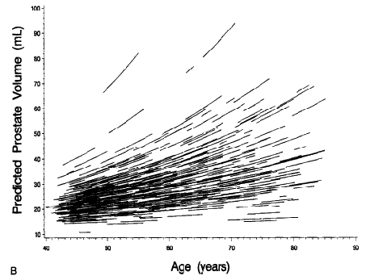
Natural History of BPH: Prostate Volume Increases
631 white men ages 40 to 79 from Olmsted County, Minnesota
Prostate volume measured up to 4 times by transrectal ultrasound during a 7-year follow-up period
Estimated prostate growth rates increased by 1.6% per year across all ages
Higher baseline prostate volume associated with higher rates of prostate growth
Rhodes T et al. J Urol. 1999;161:1174–1179. Collins GN et al. Br J Urol. 1993;71:445–450. Jacobsen SJ et al. Urology. 2001;58(Suppl 6A):5–16.
Notes:
Several studies show that prostate volume increases over time and is directly related to age in patients with BPH.¹⁻³ For example, in the community-based Olmsted County study, prostate volume was measured by transrectal ultrasound in 631 white men ages 40 to 79 years who had not previously undergone prostate surgery or had prostate cancer.¹ The results show that, although prostate growth rates were variable between patients, prostate volume increased with age across the population. Across all age groups, the average annual change in prostate volume (estimated by a mixed-effects regression model) was 1.6%, shown by the red line on the graph. Each black line on the graph represents the prostate growth data for 1 patient.
References
1. Rhodes T, Girman CJ, Jacobsen SJ, et al. Longitudinal prostate growth rates during 5 years in randomly selected community men 40 to 79 years old. J Urol. 1999;161:1174–1179.
2. Collins GN, Lee RJ, McKelvie GB, et al. Relationship between prostate-specific antigen, prostate volume and age in the benign prostate. Br J Urol. 1993;71:445–450.
3. Jacobsen SJ, Girman CJ, Lieber MM. Natural history of benign prostatic hyperplasia. Urology. 2001;58(Suppl 6A):5–16.

Slide 9
Prevalence of Symptomatic BPH
9,000,000
8,000,000
7,000,000
Male Medicare patients (>65 y) with LUTS/BPH
6,000,000
5,000,000
4,000,000
3,000,000
2,000,000
1,000,000
0
1990
2000
2010
2020
Weiner DM et al. Urology. 1997;49:335-342.
1.7
Notes:
The strong positive relationship between advancing age and the prevalence of symptomatic BPH and the aging of the population predicts a substantial increase in the number of men in the United States with this condition over the first 20 years of this century. Weiner and associates reviewed the literature concerned with the prevalence of symptomatic BPH and concluded that 40% of men >65 years of age were likely to have this condition. Review of Medicare records for 1990 indicated that nearly 5 million men in this population had symptomatic BPH. Assuming the prevalence of 40% remains constant, this number is expected to reach over 8.5 million by 2020.
Weiner DM, McDaniel R, Lowe FC. Urologic manpower issues for the 21st century: assessing the impact of changing population demographics. Urology. 1997;49:335-342.

Slide 10
Natural History of BPH: Q_{max} and Voided Volume
40
450
35
400
30
350
25
300
250
20
Volume (mL)
Qmax (mL/sec)
200
15
150
10
100
5
50
0
0
40–44
45–49
50–54
55–59
60–64
65–69
70–74
75+
Age Groups (y)
Qmax
Volume
Roberts RO et al. J Urol. 2000;163:107–113.
Notes:
Data from the Olmsted County study also demonstrate that urinary flow rate (Q_{max}) and voided volume progressively decrease over time and as a function of age.¹ In this analysis, Q_{max} and voided volume were assessed in a sample of 492 men over a 6-year follow-up period. The median decrease in peak urinary flow rate was 2.1% per year. Rapid decrease in peak urinary flow rate (i.e., at least 4.5% decrease per year) was most likely to occur in men at least 70 years of age. Similar results have been observed in other studies of BPH and LUTS.^{2,3}
References
1. Roberts RO, Jacobsen SJ, Jacobson DJ, et al. Longitudinal changes in peak urinary flow rates in a community-based cohort. J Urol. 2000;163:107–113.
2. Wei JT, Schottenfeld D, Cooper K, et al. The natural history of lower urinary tract symptoms in black American men: Relationships with aging, prostate size, flow rate and bothersomeness. J Urol. 2001;165:1521–1525.
3. Girman C, Panser L, Chute C, et al. Natural history of prostatism: Urinary flow rates in a community-based study. J Urol. 1993;150:887–892.

Slide 11
Natural History of BPH: Risk of Acute Urinary Retention Increases
2115 white men ages 40 to 79 from Olmsted County, Minnesota
Symptoms measured via questionnaire
Incidence of acute urinary retention over 4 years ascertained via review of medical records
8344 person-years of data obtained
40
35
34.7
30
25
Incidence of Acute Urinary Retention
(per 1000 person years)
20
15
10
9.3
5
2.6
3
0
40 to 49 years
70 to 79 years
Mild to Moderate Symptoms
Moderate to Severe Symptoms
Jacobsen SJ et al. J Urol. 1997;158:481–487.
Notes:
Like some of the signs and symptoms of BPH, the incidence of serious complications of BPH increases over time and is directly related to age. In the Olmsted County study, for example, the incidence of acute urinary retention increased from 2.6 per 1000 person years among men from 40-49 years old with mild to moderate symptoms to 9.3 per 1000 patient years among men 70-79 years old with mild to moderate symptoms.
The increase in risk of acute urinary retention is even more dramatic among men with moderate to severe symptoms, increasing from 3 per 1000 person years in men 40-49 years old to 34.7 per 1000 person years among men 70-79 years of age.
Reference
Jacobsen SJ, Jacobson DJ, Girman CJ, et al. Natural history of prostatism: Risk factors for acute urinary retention. J Urol. 1997;158:481–487

Slide 12
Natural History of BPH: Risk of Surgery Increases
40
34
30
10-Year Probability of Surgery
(% of Patients)
20
16
13
10
7
9
2
3
2
0
40–49
50–59
60–69
70–79
Age (y)
Without prostatic enlargement and obstructive symptoms
With prostatic enlargement and obstructive symptoms
Arrighi HM et al. Urology. 1991;38(suppl):4–8.
Notes:
The likelihood of needing BPH-related prostate surgery also increases over time. In the Baltimore Longitudinal Study of Aging, which prospectively followed 1057 men for up to 30 years, the 10-year probability of prostate surgery for BPH was directly related to age among those with obstructive symptoms, with or without prostatic enlargement. However, the risk of surgery was particularly high for older men with prostatic enlargement and obstructive symptoms. The 10-year probability of BPH-related prostate surgery among 60- to 69-year-olds with prostate enlargement and obstructive symptoms was 16%. For 70- to 79-year olds with prostate enlargement and obstructive symptoms, the 10-year probability of BPH-related prostate surgery was 34%.
Reference
Arrighi HM, Metter EJ, Guess HA, et al. Natural history of benign prostatic hyperplasia and risk of prostatectomy. The Baltimore Longitudinal Study of Aging. Urology. 1991;38(1 Suppl):4–8.

Slide 13
PSA… It’s not just for cancer
Serine protease produced by epithelial cells
Dissolves semen coagulum
Most bound to antiproteases ACT
Increased with-
Malignancy
Hyperplasia
Infection/Inflammation

Slide 14
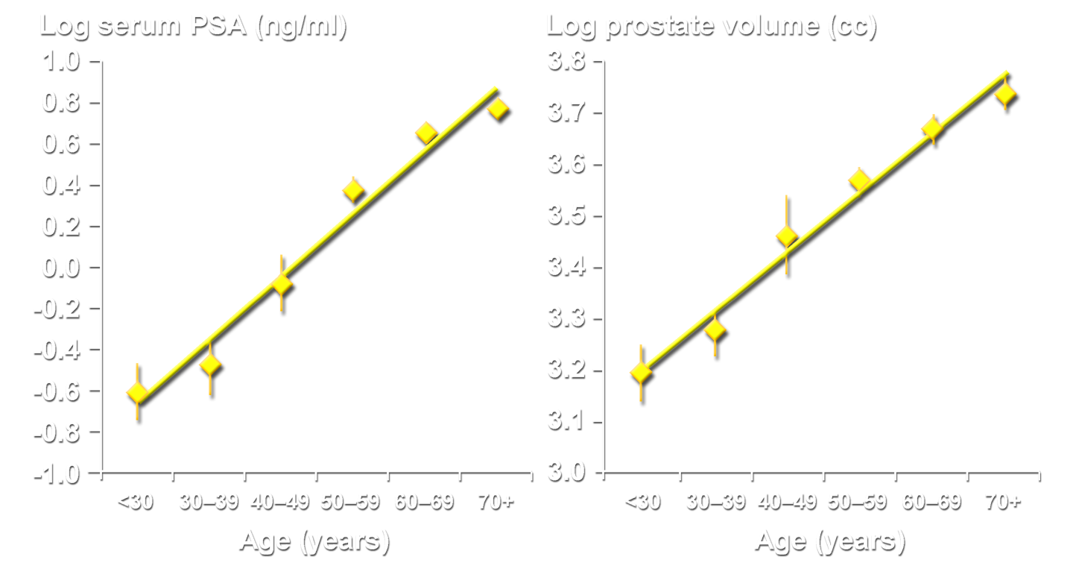
Serum PSA and Prostate Volume Increases Correlate with Age
Roehrborn CG et al. J Urol. 2000;163:13-20.

Slide 15
PSA as a Predictor of Future Prostate Growth
Annualized Growth Rates
Low PSA tertile: 0.7 mL/year
Middle PSA tertile: 2.1 mL/year
High PSA tertile: 3.3 mL/year
% Change in PV at 48 Months
Prostate Volume
Roehrborn CG et al. J Urol. 2000;163:13-20.

Slide 16
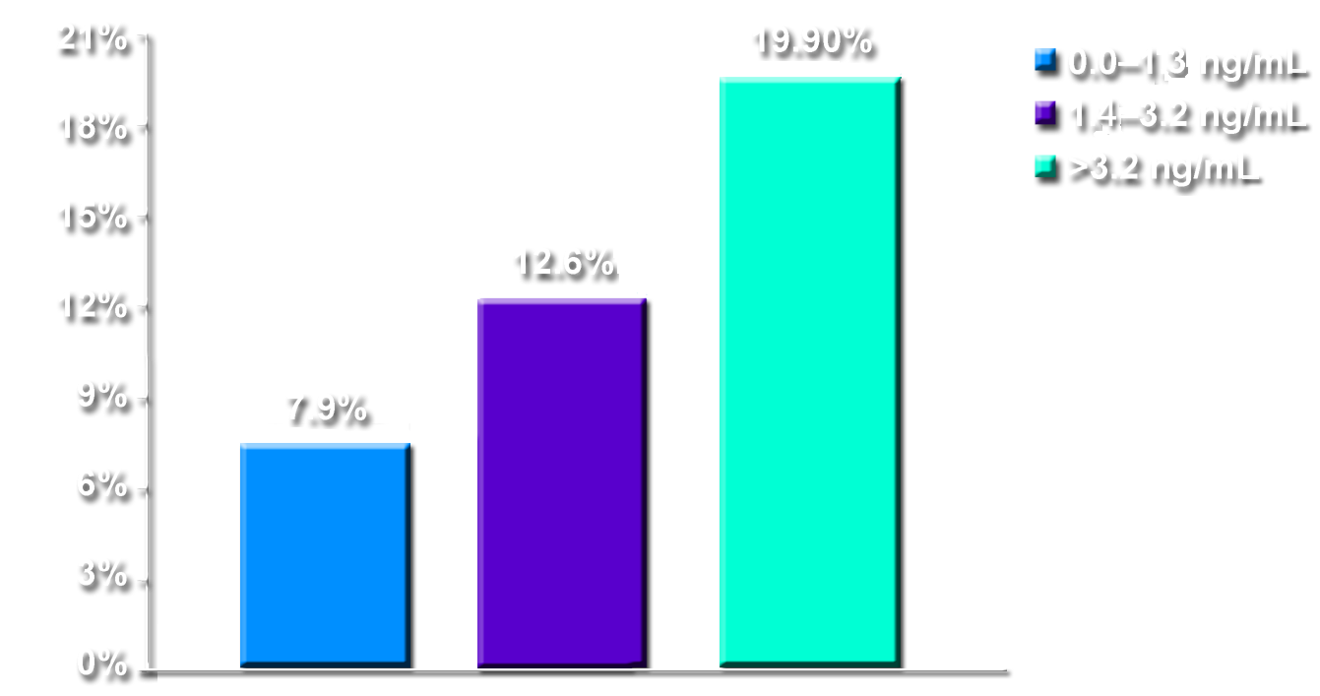
Incidence of AUR and/or Surgery Over 4 Years by PSA Tertiles
Left untreated 1 in 6 patients with a PSA of >1.4 ng/mL will experience AUR or BPH-related surgery over a 4-year time period
% Patients
Surgery/AUR
Baseline PSA tertiles (ng/mL)
Roehrborn CG et al. Urology. 1999;53:473-480.

Slide 17
What is “BPH”?
“Prostatism” and “BPH”
Benign Prostatic Hyperplasia is a histological diagnosis
New Urological Lexicon

Slide 18
Terminology
BPH Histologic diagnosis
BPE Enlargement due to benign growth (can be without obstruction)
BPO Urodynamically proven BOO (static/dynamic components)
BPH = benign prostatic hyperplasia; BPE = benign prostatic enlargement; BPO = benign prostatic obstruction; BOO = bladder outlet obstruction
1.2
Notes:
Previously, obstruction, prostatism, and hyperplasia of the prostate were considered to be almost synonymous. Now, investigators and clinicians are aware that some men have hyperplasia, some have symptoms, and others obstruction, and all three need not occur together in a given patient. Currently, benign prostatic hyperplasia (BPH) is considered in terms of benign prostatic enlargement (BPE), bladder outlet obstruction (BOO), and lower urinary tract symptoms (LUTS).¹ Consideration of clinical BPH, its diagnosis, and treatment requires careful definition of terms associated with this disease. Benign prostatic hyperplasia is a histologic diagnosis. Benign prostatic enlargement is an increase in the size of the prostate that may or may not be associated with obstruction. Benign prostatic obstruction (BPO) is proven BOO and it has both static and dynamic components.^{2,3}
1. Jepsen JV, Bruskewitz RC. Comprehensive patient evaluation for benign prostatic hyperplasia. Urology. 1998;51(suppl 4A):13-18.
2. Nordling J, Artibani W, Hald T, et al. Pathophysiology of the urinary bladder in obstruction and aging. In: Benign Prostatic Hyperplasia. 5th International Consultation on Benign Prostatic Hyperplasia (BPH). Eds: Chatelain C, Denis L, Foo KT, et al. World Health Organization–International Union Against Cancer. Paris, France. June 25-28, 2000:107-166.
3. Barry MJ, Batista JE, Donovan J, et al. Measuring the symptoms and health impact of benign prostatic hyperplasia and its treatments. Benign Prostatic Hyperplasia. 5th International Consultation on Benign Prostatic Hyperplasia (BPH). Eds: Chatelain C, Denis L, Foo KT, et al. World Health Organization–International Union Against Cancer. Paris, France. June 25-28, 2000:203-220.

Slide 19
LUTS
Symptoms attributable to lower urinary tract dysfunction
storage (irritative) symptoms
emptying (obstructive) symptoms
may be associated with BPH, BPE, and BPO, but not exclusive to these
Nordling J et al. Benign Prostatic Hyperplasia. 5th International Consultation on Benign Prostatic Hyperplasia. Paris, France. June 25-28, 2000:107-166.
1.4
Notes:
The term BPH has traditionally been used to describe a constellation of obstructive and irritative voiding symptoms that occur in men as they age. The term LUTS has replaced BPH to describe this symptom complex. Such symptomatology may be due to a variety of causes, including BPH, BPE, or BPO. However, it may also occur in the absence of any of these conditions.
Nordling J, Artibani W, Hald T, et al. Pathophysiology of the urinary bladder in obstruction and ageing. In: Benign Prostatic Hyperplasia. 5th International Consultation on Benign Prostatic Hyperplasia (BPH). Eds: Chatelain C, Denis L, Foo KT, et al. World Health Organization–International Union Against Cancer. Paris, France. June 25-28, 2000:107-166.

Slide 20
OAB: US Prevalence by Age
40
35
Men
Women
30
25
20
Prevalence (%)
15
10
5
0
18-24
25-34
35-44
45-54
55-64
65-74
75+
Age (years)
OAB=overactive bladder.
Stewart W, et al. World J Urol. 2003;20:327-336.

Slide 21
Differential Diagnosis
Urethral stricture
Bladder neck contracture
Bladder stones
Urinary tract infection
Interstitial cystitis
Neurogenic bladder
Inflammatory prostatitis
Medications
Carcinoma of the prostate
Carcinoma in situ of the bladder
1.8
Notes:
The differential diagnosis of BPH must exclude other potential reasons for LUTS. These include:
urethral stricture
bladder neck contracture
bladder stones
urinary tract infection
interstitial cystitis
neurogenic bladder
inflammatory prostatitis
medications
prostate cancer
bladder cancer

Slide 22
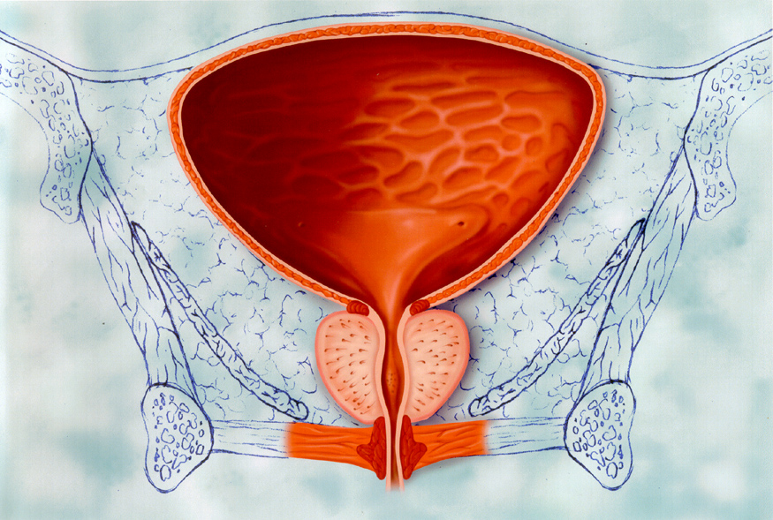
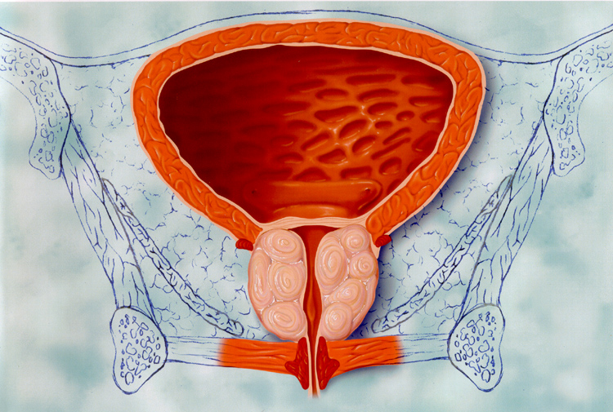
Old Paradigm
Small prostate,
thin bladder wall
Enlarged prostate,
thick bladder wall
2.2
Notes:
Classically, it has been assumed that a small prostate gland is associated with a thin bladder wall and a large prostate gland with a thick bladder wall.
In the absence of bladder outlet obstruction by an enlarged prostate gland or other pathologic condition, the wall of the urinary bladder is normally thin.
When an enlarging prostate gland impinges upon and narrows the urethra and/or bladder outlet, there is a compensatory hypertrophy of the bladder wall muscle with thickening of the wall.
Obstructive symptoms associated with BPH, including reduced urine flow rate and voiding difficulties, are thought to be of a static nature and due almost exclusively to the enlarged prostate gland.
Irritative or storage LUTS associated with BPH have been ascribed to bladder dysfunction that is secondary to outflow obstruction.

Slide 23
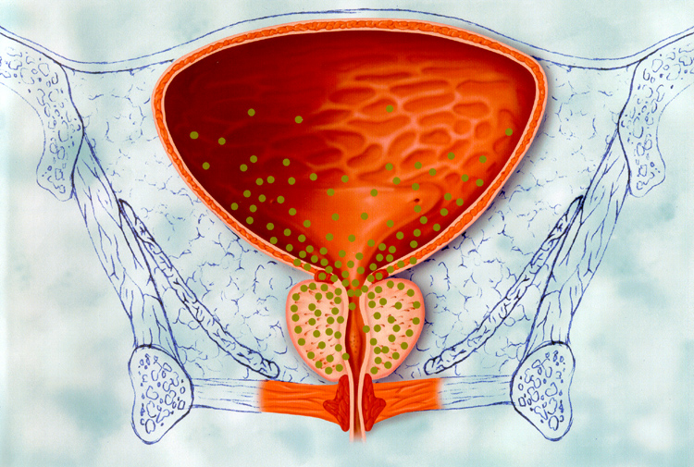
Subsequent Paradigm
Normal prostate
Small prostate with α-receptors
Enlarged prostate
2.3
Notes:
It was subsequently found that obstructive symptoms associated with BPH have not only a static component—the enlarged prostate gland—but also a dynamic component that reflects increased prostatic stromal and urethral smooth muscle tone. Increased tone of this smooth muscle is dependent upon stimulation of α₁-adrenoreceptors by noradrenaline released from adrenergic nerves.
It has also been found that irritative LUTS may have a neural component. The appreciation that there is no direct correlation between LUTS and the size of the prostate gland or the degree of bladder outlet obstruction was followed by the findings that LUTS may be caused by hypertrophy or denervation of lower urinary tract smooth muscle, defective central processing of afferent information, and defects in efferent neurotransmission, in addition to prostatic enlargement.

Slide 24
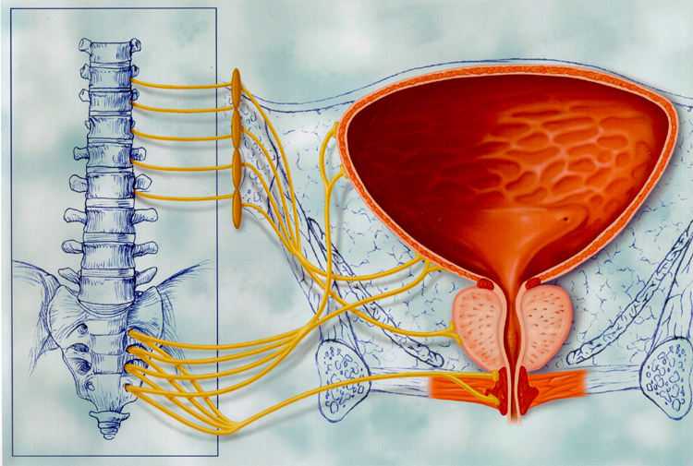
Current Paradigm
Normal
Enlarged
α-receptors
Brain/ Spinal column/ Prostate
2.4
Notes:
It is currently believed that both obstructive and irritative LUTS associated with BPH involve α₁-adrenoreceptors. Much of the current understanding of the mechanisms underlying BPH-related symptoms has come from observations that the administration of α₁-adrenoreceptor antagonists improve both irritative LUTS and flow rate in patients with BPH, even in the absence of outflow obstruction.
• α1-Adrenoreceptors affecting the lower urinary tract are found in prostatic stroma, bladder detrusor and trigone, urethra, ganglia, and spinal and supraspinal structures. The beneficial effects of α₁-adrenoreceptor antagonists on symptoms of BPH may come from action on receptors in any of these areas.
Nerves that affect the bladder, prostate, and urethra include the hypogastric (sympathetic) and pudendal (somatic) nerves, which maintain prostatic and urethral tone during bladder filling, and the pelvic nerves (parasympathetic), which induce detrusor contraction and micturition.

Slide 25
BPH/LUTS Pathophysiology

Slide 26
Initial Evaluation
Detailed medical history
Physical exam
including DRE and neurologic exam
Urinalysis
Serum creatinine no longer mandatory
PSA*
Symptom assessment (AUA-SS)
PSA = prostate-specific antigen *Per physician’s clinical judgment
AUA BPH Guidelines 2003
4.4
Notes:
The following steps are recommended in the initial evaluation of all patients presenting with prostatism.
Detailed medical history focusing on the urinary tract, previous surgical procedures, general health issues, and fitness for possible surgical procedures, in order to identify other causes of voiding dysfunction and comorbidities that may complicate treatment. For some patients, a voiding diary may also be helpful in determining the frequency and nature of complaints.
Physical examination, including a digital rectal examination (DRE) and a focused neurological examination.
Urinalysis by dipstick testing or microscopic examination of sediment to rule out urinary tract infection and hematuria.
Measurement of serum creatinine to assess renal function.¹
Measurement of prostate-specific antigen (PSA) is optional in the evaluation. Testing for PSA increases the detection rate for prostate cancer over DRE alone and tends to detect cancer at an earlier stage. However, the PSA test does not discriminate well between patients with symptomatic BPH and those with prostate cancer.¹
Quantification of symptoms, useful in guiding appropriate treatment options, can be accomplished with a symptom questionnaire. One such questionnaire is the American Urological Association Symptom Index, a self-administered questionnaire developed and validated by the AUA to capture severity of symptoms.^{1,2} The index should not be used as the sole means of diagnosing BPH, but it can be used with patients during follow-up visits.
1. McConnell JD, Barry MJ, Bruskewitz RC, et al. Benign Prostatic Hyperplasia: Diagnosis and Treatment. Clinical Practice Guideline, Number 8. AHCPR Publication No. 94-0582. Rockville, MD: Agency for Health Care Policy and Research, Public Health Service, U.S. Department of Health and Human Services. February 1994.
2. Barry MJ, Fowler FJ, O’Leary MP et al. The American Urological Association Symptom Index for benign prostatic hyperplasia. J Urol. 1992;148:1549-1557.

Slide 27
Evaluation (Part 1)
Initial evaluation
History
DRE & focused exam
Urinalysis
PSA¹
Objective Symptom Assessment
Mild
IPSS≤7
Moderate to severe IPSS≥8
Offer treatment alternatives
Watchful waiting
Medical therapy
Minimally invasive therapies
Surgery
Cystoscopy, if important in planning operative approach
¹Optional in AHCPR Guidelines; Recommended by International Consensus Committee
4.2
Clinical Practice Guideline, Number 8. AHCPR Publication No. 94-0582.
Notes:
Relief of the bothersome and/or more serious symptoms associated with BPH requires prompt, accurate diagnosis and an individualized treatment approach that accounts for patient preference as well as clinical need. The decision diagram shown serves as a framework for diagnosis and treatment. It is less a rigid pathway than a guide from which deviations can be made on a case-by-case basis, as appropriate.
Referring to this guideline, after an initial evaluation, an objective measure of symptom severity can help determine treatment options that can be pursued. Although there is room for clinical judgment, some treatment standards can be applied. For example, the presence of certain symptoms, such as refractory retention, gross evidence of blood in the urine, or renal insufficiency, may necessitate a surgical approach. At the other end of the spectrum, watchful waiting and periodic reassessment is best for a patient with mild, less troublesome symptoms.
McConnell JD, Barry MJ, Bruskewitz RC, et al. Benign Prostatic Hyperplasia: Diagnosis and Treatment. Clinical Practice Guideline, Number 8. AHCPR Publication No. 94-0582. Rockville, MD: Agency for Health Care Policy and Research, Public Health Service, U.S. Department of Health and Human Services. February 1994.

Slide 28
Evaluation (Part 2)
Initial evaluation
History
DRE & focused exam
Urinalysis
PSA¹
Objective Symptom Assessment
Moderate to severe IPSS≥8
Presence of:
Refractory retention
Any of the following clearly 2° BPH:
Recurrent or persistent gross hematuria
Bladder stones
Renal insufficiency
Additional diagnostic tests
Flow rate test¹
Residual urine¹
Pressure-flow²
Compatible with obstruction
Not compatible with obstruction
Surgery
Non-BPH problems identified and treated
¹Optional in AHCPR Guidelines; Recommended by International Consensus Committee
²Optional in both AHCPR and International Consensus recommendations
4.3
Notes:
Relief of the bothersome and/or more serious symptoms associated with BPH requires prompt, accurate diagnosis and an individualized treatment approach that accounts for patient preference as well as clinical need. The decision diagram shown serves as a framework for diagnosis and treatment. It is less a rigid pathway than a guide from which deviations can be made on a case-by-case basis, as appropriate.
Referring to this guideline, after an initial evaluation, an objective measure of symptom severity can help determine treatment options that can be pursued. Although there is room for clinical judgment, some treatment standards can be applied. For example, the presence of certain symptoms, such as refractory retention, gross evidence of blood in the urine, or renal insufficiency, may necessitate a surgical approach. At the other end of the spectrum, watchful waiting and periodic reassessment is best for a patient with mild, less troublesome symptoms.
McConnell JD, Barry MJ, Bruskewitz RC, et al. Benign Prostatic Hyperplasia: Diagnosis and Treatment. Clinical Practice Guideline, Number 8. AHCPR Publication No. 94-0582. Rockville, MD: Agency for Health Care Policy and Research, Public Health Service, U.S. Department of Health and Human Services. February 1994.

Slide 29
Goals of Therapy for BPH
BPH Treatment Success measured by:
↓ symptoms (IPSS/AUA)
↓ bother (bother score) and ↑ QOL
↓ prostate size or arrest further growth
↑Increase in peak flow rate / Relieve obstruction
Prevention of long-term outcomes/complications
Acceptable adverse events profile
US Agency for Health Care Policy and Research. AHCPR publication 94-0582; O’Leary MP. Urology. 2000;56(suppl 5A):7-11.
Notes:
A number of standardized measures and symptom changes across various domains
must be considered together in the treatment of BPH.
Assessing and managing BPH involves not only an evaluation of symptoms and their severity, but also determining the impact of the disease on a patient’s daily activities and sexual function. The degree to which patients are bothered by their symptoms is as important an indication of the need for medical treatment or surgical correction as the presence of the symptoms and parameters, such as peak flow rates and prostate size¹
After reviewing more than 1,200 abstracts from the literature, the BPH guideline panel (AHCPR) analyzed 200 papers in depth and combined data from a variety of treatment and outcome studies. A survey was conducted to determine what treatments patients prefer if given extensive information on probable treatment outcomes. The guideline was peer reviewed and tested in clinical practice before its release. There were several measures of treatment outcomes recommended²
From a clinical standpoint, patients should achieve decreased prostate size (or arresting of growth), increased flow rate, relief of obstruction, and prevention of long-term complications. The agent should also have an acceptable adverse event profile²
1. O'Leary MP. LUTS, ED, QOL: alphabet soup or real concerns to aging men? Urology. 2000;56 (suppl 5A):7-11.
2. US Agency for Health Care Policy and Research. Clinical Practice Guideline No. 8: Benign Prostatic Hyperplasia: Diagnosis and Treatment. Rockville, MD: Agency for Health Care Policy and Research; 1994. AHCPR publication 94-0582.

Slide 30
Medical Treatments for BPH, LUTS, BOO
α-adrenergic blockers
Dynamic component
5 α-reductase inhibitors
Anatomic component
Anticholinergic Therapy
Storage Sx’s
Notes:
Treatment options for BPH include watchful waiting, medical therapy, and various surgical procedures.¹⁻³
Symptom improvement with medical treatment is less than that with surgical procedures. The mean probability of symptomatic improvement is 74% with an α-adrenergic blocker versus 98% with an open prostatectomy.² However, disadvantages of surgery include invasiveness, a period of recuperation and, in the case of open surgery, a comparatively prolonged hospitalization.³
Today, α-adrenergic blockers, which inhibit contraction of prostatic smooth muscle, are first-line treatment for LUTS/BPH. Another pharmacologic option is the 5ARI, finasteride, which lowers prostatic androgen levels and can result in some decrease in prostate size.
Chatelain C, Denis L, Foo JKT, et al. 5th International Consultation on BPH. Recommendations of the International Scientific Committee: Evaluation and treatment of lower urinary tract symptoms (LUTS) in older men. In: Chatelain C et al, eds. Benign Prostatic Hyperplasia. Plymouth, UK: Health Publication Ltd; 2001:519-534.
McConnell JD, Barry MJ, Bruskewitz RC, et al. Benign Prostatic Hyperplasia: Diagnosis and Treatment. Clinical Practice Guideline, Number 8. AHCPR Publication No. 94-0582. Rockville, MD: Agency for Health Care Policy and Research, Public Health Service, U.S. Department of Health and Human Services. February 1994.
Columbia University website. Therapies for the treatment of benign prostatic hyperplasia (BPH). Available at http://cpmcnet.columbia.edu/dept/urology/bphtherapy.html#translas. Accessed 8/23/01.
Dreikorn K, Lowe I, Borkowski A, et al. Other medical therapies. In: Chatelain C et al, eds. Benign Prostatic Hyperplasia. Plymouth, UK: Health Publication Ltd; 2001;479-511.

Slide 31
Role of α₁-Adrenoreceptors
α₁-ARs and Human LUTS
Smooth muscle contraction
α_{1A}
Lumbosacral
α_{1D}
Instability Irritative symptoms
α_{1D}>α_{1A}
Resistance vessels
α_{1A}
Aging effects
α_{1B}>α_{1A}
Prostate
Spinal cord
Detrusor
Vessels
Schwinn DA. BJU Int. 2000;86:11-22.
Jardin A et al. Benign Prostatic Hyperplasia. 5th International Consultation on Benign Prostatic Hyperplasia. Paris, France. June 25-28, 2000:459-477. Rudner XL et al. Circ. 1999;100:2336-2343.
2.8
Notes:
• α₁-Adrenoreceptors are expressed in a variety of tissues and they play an important role in the dynamic component of BPH.¹ There are four major α₁-adrenoreceptor subtypes, α_{1A}, α_{1B}, α_{1D}, and α_{1L}. These subtypes have different patterns of expression. α_{1A}-adrenoreceptors are the dominant subtype in prostatic stromal tissue, accounting for approximately 85% of the α₁-adrenoreceptor messenger RNA (mRNA) in this tissue. These receptors play a key role in contraction of this muscle mediated by noradrenergic input from the sympathetic nervous system. α1-adrenoreceptors in the lumbrosacral spinal cord are also involved in control of urinary function, and the α_{1D} subtype predominates in this tissue. The clinical significance of these receptors in the treatment of LUTS remains to be determined. The action of norepinephrine at α_{1D}- and α_{1A}-adrenoreceptors in the detrusor muscle is thought to be involved in irritative symptoms associated with BPH. In young individuals, α_{1A}-adrenoreceptors are the dominant subtype in resistance vessels, but α_{1B}-adrenoreceptors become the most highly expressed subtype in older individuals.^{2,3}
While the most advantageous subtype selectivity profile for an α₁-adrenoreceptor antagonist used for the treatment of BPH has not yet been determined, the concept of clinical uroselectivity, as defined by the International Consultation on BPH, remains a valid concept.²
1. Schwinn DA. Novel role for alpha₁-adrenergic receptor subtypes in lower urinary tract symptoms. BJU Int. 2000;86:11-22.
2. Jardin A, Andersson K-E, Chapple C, et al. α₁-adrenoreceptor antagonists in the treatment of BPH. In: Benign Prostatic Hyperplasia. 5th International Consultation on Benign Prostatic Hyperplasia (BPH). Eds: Chatelain C, Denis L, Foo KT, et al. World Health Organization–International Union Against Cancer. Paris, France. June 25-28, 2000:459-477.
3. Rudner XL, Berkowitz DE, Booth JV, et al. Subtype specific regulation of human vascular α₁-adrenergic receptors by vessel bed and age. Circ. 1999;100:2336-2343.

Slide 32
Comparison of α-Adrenergic Blockers
Agent | Dosing | Titration | Uroselective
Terazosin (Hytrin®) | 1 mg, 2 mg, 5 mg, 10 mg, 20 mg | + | NO
Doxazosin (Cardura®) | 1 mg, 2 mg, 4 mg, 8 mg, 16 mg | + | NO
Tamsulosin (Flomax®) | 0.4 mg, 0.8 mg | +/- (for improved efficacy) | YES (Relative affinity for α_{1A} receptors over α_{1B} )
Alfuzosin | 10 mg | - | YES (Highly diffused in prostatic tissue vs serum)
1. Hytrin^{R} (terazosin hydrochloride) Prescribing information, Abbott Laboratories.
2. Cardura^{R} (doxazosin mesylate tablets) Prescribing Information, Pfizer Inc.
3. Flomax^{R} (tamsulosin hydrochloride) Prescribing Information, Boehringer Ingelheim Pharmaceuticals Inc.
4. Uroxatral^{R} (alfuzosin HCl extended release tablets) Prescribing Information, Sanofi-Synthelabo Inc.
Notes:
All of the α-adrenergic blockers, with the exception of alfuzosin, require dose titration to minimize the potential for hypotensive effects.¹⁻⁴
Each of these agents has a sufficiently long half-life to permit once-daily administration.¹⁻⁴
Terazosin and doxazosin are not pharmacoselective/ uroselective and so do not show selectivity between α₁-adrenergic receptor subtypes. Tamsulosin selectively blocks α_{1A}-α_{1D} adrenergic receptors. Alfuzosin, although not subtype selective, shows functional uroselectivity because it distributes preferentially in the prostate relative to the serum.¹⁻⁴
1. Hytrin^{R} (terazosin hydrochloride) Prescribing information, Abbott Laboratories.
2. Cardura^{R} (doxazosin mesylate tablets) Prescribing Information, Pfizer Inc.
3. Flomax^{R} (tamsulosin hydrochloride) Prescribing Information, Boehringer Ingelheim Pharmaceuticals Inc.
4. Uroxatral^{R} (alfuzosin HCl extended release tablets) Prescribing Information, Sanofi-Synthelabo Inc.

Slide 33
Tamsulosin: Clinical Efficacy
Tamsulosin
2
1.78 *
1.75 *
1.79 *
Placebo
0
1.52
-2
Mean Change in Q_{max} (mL/s)
-4
-3.60
Mean Change in Symptom Score
1
0.93
-6
-5.5
* -5.1
0.52
* -5.8
-8
* -8.3
0
-10
* -9.6
Study 1
(13 wk;
0.8 mg, 0.4 mg)
Study 2
(13 wk;
0.8 mg, 0.4 mg)
Study 1
(13 wk;
0.8 mg, 0.4 mg)
Study 2
(13 wk;
0.8 mg, 0.4 mg)
*P≤0.05 statistically significant difference from placebo. Tamsulosin Prescribing Information. Boehringer Ingelheim Pharmaceuticals, Inc.; 2003.
N=1,486
Notes:
In clinical trials, the tamsulosin group showed a statistically significant improvement in symptom score and peak flow rate when compared to placebo (P≤0.05)

Slide 34
Dihydrotestosterone (DHT) Action
Testosterone is converted to DHT by two 5α-reductase isoenzymes
The target for DHT is the androgen receptor
DHT has approximately 5 times greater affinity for the androgen receptor than testosterone
The greater affinity makes DHT a more potent androgenic steroid at physiologic concentrations
The DHT/androgen receptor complex alters gene expression
Krieg M. Prog Cancer Res Ther. 1984;31:425–440. Kyprianou N et al. Prostate. 1986;8:363–380. Grino PB et al. Endocrinology. 1990;126:1165–1172.
Notes:
The mechanism of BPH is multifactorial and not yet definitively established; however, BPH is known to depend on androgens—in particular, the androgen DHT. DHT is also crucial to the ontogenetic development and normal growth of the prostate. At the molecular level, DHT in the prostate (or in any other tissue where DHT is found) exerts is physiologic effects by binding to the androgen receptor—the target receptor for DHT. DHT’s binding to the androgen receptor constitutes the fourth step of the androgen signaling axis.
The androgen receptor is a member of the superfamily of (intracellular) nuclear receptors, which includes steroid hormone receptors and thyroid hormone receptors. Androgen receptors are found in both the epithelium and the stroma of the prostate.^{1,2}
When bound with DHT or other androgens, the androgen receptor stimulates or inhibits gene expression in order to influence prostate cellular function including cellular proliferation and cell death. The most potent endogenous androgen, DHT has approximately 5 times greater affinity for the androgen receptor than does testosterone.³ This differential affinity results in more efficient activation of gene expression with DHT compared with testosterone.
Reference
1. Krieg M. Biochemical endocrinology of human prostatic tumours. Prog Cancer Res Ther. 1984;31:425–440.
2. Kyprianou N, Davies P. Association state of androgen receptors in nuclei of human benign hypertrophic prostate. Prostate. 1986;8:363–380.
3. Grino PB, Griffin JE, Wilson JD. Testosterone at high concentrations interacts with the human androgen receptor similarly to dihydrotestosterone. Endocrinology. 1990;126:1165–1172.

Slide 35
Clinical Efficacy of 5-ARIs
 | Finasteride¹ 48-Mo Controlled Trial in 3040 Men |  |  | Dutasteride² 24-Mo Controlled Trial in 4325 Men
 | Finasteride | Placebo |  | Dutasteride | Placebo
Volume changes | -18% | +14% |  | -26% | -2%
IPSS reduction | -3.3 | -1.3 |  | -4.5 | -2.3
Q_{max} improvement | +1.9 | +0.2 |  | +2.2 | +0.6
AUR risk reduction | 57% |  |  | 57%
Surgery risk reduction | 55% |  |  | 48%
*Not from a comparative trial.
1. McConnell JD et al. NEJM. 1998;338:557-563. 2. Roehrborn C et al. Urology. 2002;60:434-441.
Notes:
The clinical effects of finasteride and dutasteride were evaluated in large-scale, randomized, placebo-controlled clinical trials lasting 48 months (finasteride)¹ and 24 months (dutasteride).²
Both agents produced substantial reductions in prostate volume and symptom scores that were significantly greater (P<.001) than changes seen with placebo.^{1,2}
The risk of AUR was reduced 57% by 5ARI therapy.^{1,2} Likewise, the risk of BPH-related surgical intervention was reduced by 55% with finasteride¹ and 48% with dutasteride.²
McConnell JD, Bruskewitz R, Walsh P, et al. The effect of finasteride on the risk of acute urinary retention and the need for surgical treatment among men with benign prostatic hyperplasia. NEJM. 1998;338:557-563.
Roehrborn CG, Boyle P, Nickel JC, et al. Efficacy and safety of a dual inhibitor of 5-alpha-reductase types 1 and 2 (dutasteride) in men with benign prostatic hyperplasia. Urology. 2002;60:434-441.

Slide 36
Adverse Events
 | Finasteride¹ |  |  | Dutasteride²
 | Finasteride | Placebo |  | Dutasteride | Placebo
Erectile dysfunction | 8 | 4 |  | 7 | 4
Altered libido | 6 | 3 |  | 4 | 2
Ejaculatory disorder | 4 | 1 |  | 2 | <1
Gynecomastia and breast tenderness | 1 | 0.2 |  | 2 | <1
The new 5 alpha-reductase inhibitor Dutasteride has been shown to be of similar efficacy as Finasteride in terms of symptom score and flow-rate improvement, as well as in the prevention of disease progression, while having a comparable safety profile.³
*Not from a comparative trial.
1. McConnell JD et al. NEJM. 1998;338:557-563. 2. Roehrborn C et al. Urology. 2002;60:434-441. 3. American Urological Association Research and Education Inc. BPH Guidelines April 2003: page 33
Notes:
The adverse events most commonly reported by patients treated with finasteride or dutasteride in the large-scale clinical trials were erectile dysfunction, altered libido, ejaculation disorders, and gynecomastia and breast tenderness.^{1,2}
McConnell JD, Bruskewitz R, Walsh P, et al. The effect of finasteride on the risk of acute urinary retention and the need for surgical treatment among men with benign prostatic hyperplasia. NEJM. 1998;338:557-563.
Roehrborn CG, Boyle P, Nickel JC, et al. Efficacy and safety of a dual inhibitor of 5-alpha-reductase types 1 and 2 (dutasteride) in men with benign prostatic hyperplasia. Urology. 2002;60:434-441.

Slide 37
Rationale for Combination Therapy
Alpha- Blockers:
Relieve
Symptoms Rapidly
5α-Reductase Inhibitors:
Arrest Disease Progression
Combination Therapy: Arrest Disease Progression and Rapidly Relieve Symptoms
Notes:
The use of combination therapy for BPH is based on the rationale that alpha blockers and 5α-reductase inhibitors have complementary pharmacologic and clinical properties and that the combination of the two can provide the complementary benefits of both classes of therapy. Alpha-adrenergic blockers block alpha₁-adrenergic receptors on prostate and bladder smooth muscle to relax the muscle and provide symptomatic relief.¹ On the basis of data collected to date, they do not appear to alter prostate volume or serum PSA. Furthermore, they have not been shown to significantly alter the risk of acute urinary retention or BPH-related surgery.
5α-reductase inhibitors act by preventing the conversion of testosterone to dihydrotestosterone, which is a primary contributor to prostatic enlargement in BPH.^{2,3} DHT contributes to cellular proliferation and inhibition of apoptosis in the prostate, and 5α-reductase inhibitors counteract the actions of DHT. 5α-reductase inhibitors thus act at the pathophysiologic substrate of BPH. They do not provide fast relief of LUTS. However, they do retard or prevent disease progression as reflected in reduced prostate volume and serum PSA values as well as reduced risks of acute urinary retention and BPH-related surgery.
Thus, the combination of a 5α-reductase inhibitor and an alpha blocker can in theory provide both the disease-arresting efficacy and rapid symptom relief.
References
1. Clifford GM, Farmer RDT. Medical therapy for benign prostatic hyperplasia: A review of the literature. Eur Urol. 2000;38:2–19.
2. Ekman P. Finasteride in the treatment of benign prostatic hypertrophy: An update. Scand J Urol Nephrol. 1999(Suppl 203):15–20.
3. Bartsch G, Rittmaster RS, Klocker H. Dihydrotestosterone and the concept of 5α-reductase inhibition in human benign prostatic hyperplasia. World J Urol. 2002;19:413–425.

Slide 38
MTOPS (Medical Treatment of Prostatic Symptoms) & Combination Therapy

Slide 39
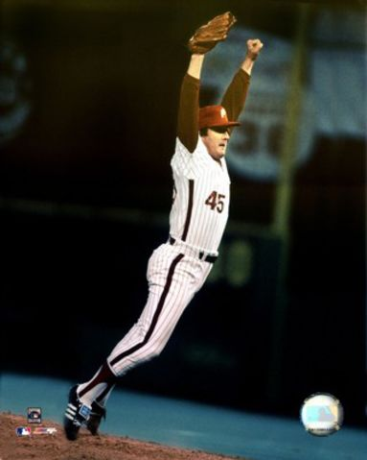

Slide 40
MTOPS Doxazosin/Finasteride/Combination
Double-masked, randomized, placebo-controlled, multicenter study
3047 men aged ≥50 years with BPH
Average follow-up: 4.5 years
Primary outcome: time to clinical progression
AUR
Renal insufficiency due to BPH
Recurrent UTI or urosepsis
Incontinence
≥4-point rise in baseline AUA symptom score confirmed within 2-4 weeks
Secondary outcomes
Changes in symptom and flow rate over time
Rate of invasive therapies for LUTS/BPH
MTOPS = Medical Therapy Of Prostatic Symptoms.
McConnell JD et al. NEJM, 2003.
Notes:
The Medical Therapy Of Prostatic Symptoms (MTOPS) trial was a double-masked, randomized, placebo-controlled, multicenter study conducted in 3047 men aged 50 years and older with BPH to determine whether medical therapy with either finasteride or doxazosin alone, or a combination of these agents, prevents or delays disease progression. The average length of follow-up was 4.5 years.
The primary outcome was time to clinical progression. Disease progression was defined by the occurrence of any one of the following: AUR, renal insufficiency due to BPH (ie, ≥50% rise in baseline serum creatinine and ≥1.5 mg/dL), recurrent UTI or urosepsis, incontinence, or a ≥4-point rise in baseline AUA symptom score confirmed within 2 to 4 weeks.
Secondary outcomes were changes in symptoms and maximal urinary flow rate over time, and time to BPH invasive therapy.
McConnell JD, Andriole GL Jr, Bautista O, et al. The long-term effects of doxazosin, finasteride and the combination on the clinical progression of benign prostatic hyperplasia. NEJM, submitted 2003.

Slide 41
Cumulative Incidence of BPH Progression
P<.0001; df=3
Placebo
Finasteride:
Risk Reduction = 34%
Event (%)
Doxazosin:
Risk Reduction = 39%
Combination:
Risk Reduction = 67%
Years From Randomization
McConnell JD et al. NEJM, 2003.
Notes:
[Compared with placebo, the reduction in the risk of BPH progression was similar with single-agent therapy: 34% with finasteride and 39% with doxazosin.
The reduction in the risk of BPH progression with combination therapy was nearly twice as great at 67% as that with single-agent therapy.
McConnell JD, Andriole GL Jr, Bautista O, et al. The long-term effects of doxazosin, finasteride and the combination on the clinical progression of benign prostatic hyperplasia. NEJM, submitted 2003.

Slide 42
Cumulative Incidence of AUR
P<.0034; df=3
Placebo
Event (%)
Doxazosin:
Risk Reduction
Finasteride:
Risk Reduction = 67%
Combination:
Risk Reduction = 79%
Years From Randomization
McConnell JD et al. NEJM, 2003.
Notes:
Compared with placebo, the reduction in the risk of AUR was 67% with finasteride and 79% with the combination of finasteride and doxazosin.
Doxazosin delayed but did not prevent AUR.
McConnell JD, Andriole GL Jr, Bautista O, et al. The long-term effects of doxazosin, finasteride and the combination on the clinical progression of benign prostatic hyperplasia. NEJM, submitted 2003.

Slide 43
Cumulative Incidence of BPH-Related Surgery
P<.0001; df=3
Doxazosin:
Risk Reduction = 0%
Placebo
Event (%)
Finasteride:
Risk Reduction = 64%
Combination:
Risk Reduction = 67%
Years From Randomization
McConnell JD et al. NEJM, 2003.
Notes:
Compared with placebo, the reduction in the risk of BPH-related surgery was 64% with finasteride and 67% with the combination of finasteride and doxazosin.
Doxazosin did not reduce the long-term cumulative incidence of BPH-related surgery.
McConnell JD, Andriole GL Jr, Bautista O, et al. The long-term effects of doxazosin, finasteride and the combination on the clinical progression of benign prostatic hyperplasia. NEJM, submitted 2003.

Slide 44
MTOPS Conclusions
In selected patients, combination therapy is most effective in
Reducing risk of clinical progression
Improving AUA symptom score
Improving maximum urinary flow rate
Monotherapy significantly reduces risk of clinical progression of BPH
Finasteride (5ARI) and combination therapy significantly reduce the risk of AUR and invasive therapy
Doxazosin (α-adrenergic blocker) prolongs time to progression of AUR and invasive therapy, but does not reduce overall risk
Both long-term monotherapy and combination therapy are safe and effective
McConnell J et al. Program Abstracts of the American Urological Association 2002 Annual Meeting (Abstract 1042, updated).
Notes:
Results of the MTOPS trial showed that, in selected patients, combination therapy with an α-adrenergic blocker and a 5ARI is most effective in reducing the risk of clinical progression of BPH, improving AUA symptom score, and improving maximum urinary flow rate.
Monotherapy with either agent also significantly reduced the progression of BPH. However, only finasteride and combination therapy significantly reduced the risk of AUR and invasive therapy (BPH-related surgery).
Doxazosin monotherapy prolonged the time to progression of AUR but did not reduce the overall risk of AUR; similarly, doxazosin did not reduce the incidence of invasive therapy.
Data from pill counts indicate that 27% of doxazosin-treated patients discontinued their coded doxazosin compared to 30% of patients in the placebo group and 29% in the combination group. The difference was not significant. Likewise, 24% of finasteride-treated patients discontinued their coded finasteride, compared to 26% of patients in the placebo group and 25% of patients in the combination group. Again, this was not significant.
Overall, both long-term monotherapy and combination therapy are safe and effective.
McConnell JD, Andriole GL Jr, Bautista O, et al. The long-term effects of doxazosin, finasteride and the combination on the clinical progression of benign prostatic hyperplasia. NEJM, submitted 2003.

Slide 45
Combination Treatment with An α-Blocker Plus An Anticholinergic for Bladder Outlet Obstruction: A Prospective, Randomized, Controlled Study
Athanasopoulos A, Gyftopoulos K, Giannitsas K, Fisfis J, Perimenis P, Barbalias G.
J Urol. 2003;169:2253-2256

Slide 46
Detrol® and Tamsulosin Combination Therapy in Men With BOO and OAB
Randomized, controlled trial (independent research)
50 men
52 to 80 years of age (average, 69 years)
Mild/moderate BOO on PFS
Concomitant IDO
Study design
Complete QoL 9 UROLIFE questionnaire prior to study onset
1-week tamsulosin 0.4 mg qd, then randomized to receive concomitant Detrol® 2 mg bid or continue tamsulosin monotherapy
Repeat QoL 9 and PFS at 12 weeks
IDO=idiopathic detrusor overactivity; PFS=pressure flow studies.
Athanasopoulos A, et al. J Urol. 2003;169:2253-2256.
Notes:
For mild to moderate obstruction, pharmacotherapy with both antimuscarinic agents and α-adrenergic blockers may be a feasible option for the treatment of BOO. The quality-of-life aspect of this was assessed in a trial in which 50 men with mild to moderate BOO and concomitant idiopathic detrusor overactivity (IDO) were randomized to receive tamsulosin, 0.4 mg daily; 1 week later, either Detrol®, 2 mg twice daily, or placebo was added. Disease-specific quality-of-life assessments were used.
This study was independent and was performed without industry sponsorship.
Athanasopoulos A, Gyftopolous K, Giannitsas K, Fisfis I, Perimenis P, Barbalias G. Combination treatment with an α-blocker plus an anticholinergic improves quality of life in patients with bladder outlet obstruction. A prospective, randomized, controlled study. Neurourol Urodyn. 2002;21:208-209. Abstract 19.
Key Message:
Detrol was demonstrated to be safe and effective in the treatment of filling symptoms in men with OAB/BOO symptomatology

Slide 47
Detrol® and Tamsulosin Combination Therapy in Men with BOO and OAB: Effects on Urodynamic Parameters
 | Tamsulosin (n = 25) |  | Tamsulosin+Tolterodine (n = 25)
 | Mean Change from Baseline | P Value | Mean Change from Baseline | P Value
Maximum detrusor pressure (cm H₂O) | –5.2 | 0.0827 | –8.24 | 0.0082
Maximum flow rate (mL/second) | +1.16 | 0.0001 | +1.32 | 0.0020
Pressure at maximum unstable contraction (cm H₂O) | –2.16 | 0.05690 | –11.16 | <0.0001
Volume at first unstable contraction (mL) | +30.40 | 0.0190 | +100.40 | <0.0001
Athanasopoulos A et al. J Urol. 2003;169:2253-6.

Slide 48
Detrol® and Tamsulosin Therapy in Men With BOO and OAB: Effects on QoL
640
628.4
620
P=0.0003
600
P=NS
580
Improved QoL
560
548.2
Mean score (QoL 9 UROLIFE)
542.2
540
525
520
500
480
460
Tamsulosin (n=25)
Tamsulosin + Detrol® (n=25)
Baseline
12 Weeks
Athanasopoulos A, et al. J Urol. 2003;169:2253-2256.
Notes:
The combination, but not tamsulosin monotherapy, produced significant improvements in quality of life.
Athanasopoulos A, Gyftopolous K, Giannitsas K, Fisfis I, Perimenis P, Barbalias G. Combination treatment with an α-blocker plus an anticholinergic improves quality of life in patients with bladder outlet obstruction. A prospective, randomized, controlled study. Neurourol Urodyn. 2002;21:208-209. Abstract 19.
Key Message:
Detrol was demonstrated to be safe and effective in the treatment of filling symptoms in men with OAB/BOO symptomatology

Slide 49
Detrol® and Tamsulosin Therapy in Men With BOO and OAB: Conclusions
Efficacy
Improved QoL
Increased bladder capacity
Safety
No acute urinary retention was observed
Did not affect quality of urinary flow
Did not affect postvoid residual urine volume
“The proposed combination of Detrol® and tamsulosin appears to be an effective and relatively safe treatment option in patients with bladder outlet obstruction and detrusor overactivity”
Athanasopoulos A, et al. J Urol. 2003;169:2253-2256.

Slide 50
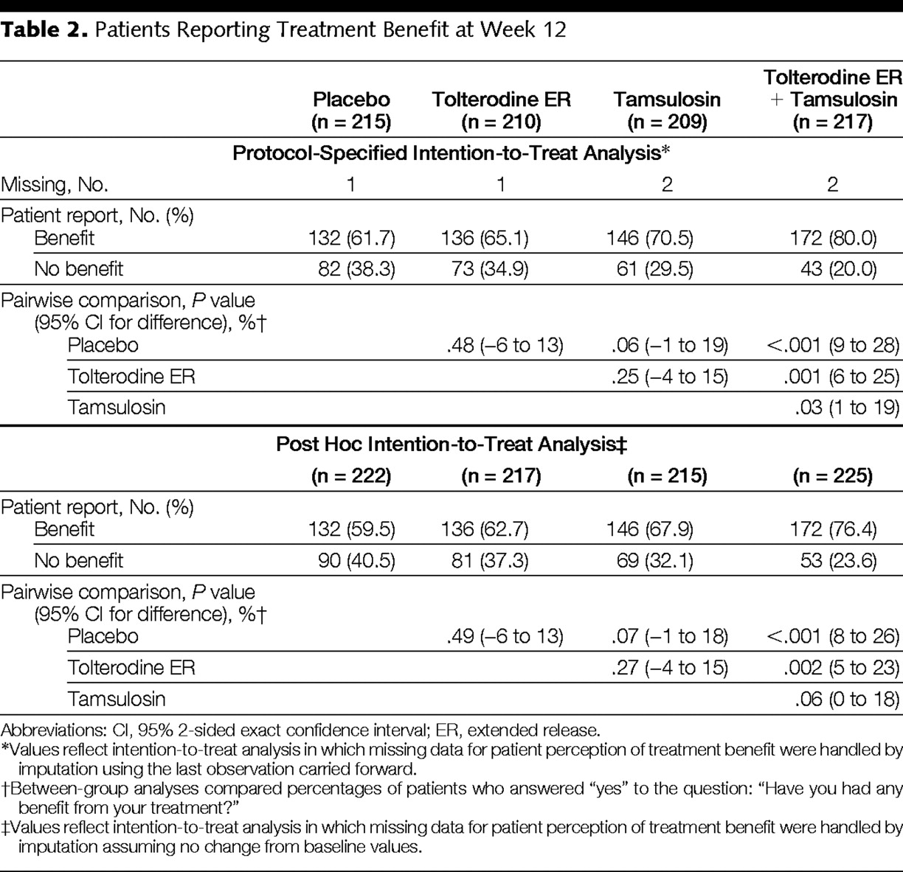

Slide 51
Surgical Therapy

Slide 52
Indications for Surgery
Absolute
Relative
None
Symptoms
Pt. Choice
AUR
Bleeding
Bladder Calculus
UTI
Renal Insufficiency

Slide 53
Alphabet Soup
Electrosurgical
TURP
TUVP
Gyrus
TUIP
Laser
PVP
HoLAP
HoLEP
ILC
CLAP
VLAP
Minimally-Invasive
TUMT
TUNA
WIT
TEAP
Botox
ILC
Open
Suprapubic
Retropubic
Perineal

Slide 54
Transurethral Resection of the Prostate (TURP): Overview
Advantages
Availability of long-term outcomes data
Good clinical results
Treats prostates <150 g
Low retreatment rate
Low mortality
Disadvantages
Retrograde ejaculation
Bleeding
TUR Syndrome
Catheter time
Hospital Stay
Borth CS et al. Urology. 2001;57:1082-1086. Mebust WK et al. J Urol. 1989;141:243-247.
Wagner JR et al. Semin Surg Oncol. 2000;18:216-228.
7.21
Notes:
TURP offers several potential advantages for the treatment of BPH. First, it is associated with good clinical results. Indeed, with the possible exception of open prostatectomy, no other surgical modality has been shown to be its equal in terms of symptom improvement. TURP allows for treatment of glands with masses of up to 100 g; and the retreatment rates in patients who undergo TURP are low.
One of the disadvantages of this procedure is its reliance on the skill of the individual surgeon. Moreover, although improvements in technology and technique have resulted in marked reductions in postoperative mortality and morbidity, postoperative bleeding and impairments in sexual function, such as retrograde ejaculation, are still disturbing complications of TURP.
Borth CS, Beiko DT, Nickel JC. Impact of medical therapy on transurethral resection of the prostate: a decade of change. Urology. 2001;57:1082-1086.
Debruyne FMJ, Djavan B, DeLaRosette J, et al. Interventional therapy for benign prostatic hyperplasia. In: Benign Prostatic Hyperplasia. 5th International Consultation on Benign Prostatic Hyperplasia (BPH). Eds: Chatelain C, Denis L, Foo KT, et al. World Health Organization–International Union Against Cancer. Paris, France. June 25-28, 2000:397-421.
Mebust WK, Holtgrewe HL, Cockett ATK, Peters PC, for the Writing Committee. Transurethral prostatectomy: immediate and postoperative complications. A cooperative study of 13 participating institutions evaluating 3,885 patients. J Urol. 1989;141:243-247.
Wagner JR, Russo P. Urologic complications of major pelvic surgery. Semin Surg Oncol. 2000;18:216-228.

Slide 55
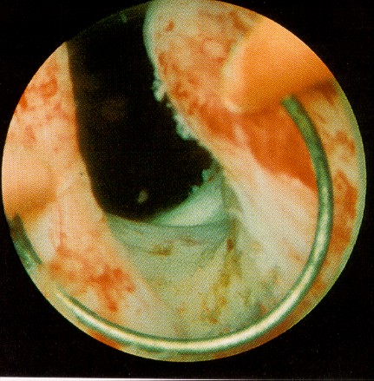

Slide 56
TURP: Efficacy
Symptom improvement in 88% of patients
82% decrease in AUA Symptom Score
125% improvement in peak flow rate (Q_{max})
Re-op rate approx. 1.5%/yr
Jepsen JV et al. Urology. 1998;51(suppl 4A):23-31.
7.22
Notes:
Study results indicate that approximately 88% of patients have improved symptoms 1 year after undergoing TURP for BPH. AUA Symptom Scores decrease by an average of 82% and peak urinary flow rates increase by an average of 125%.
Jepsen JV, Bruskewitz RC. Recent developments in the surgical management of benign prostatic hyperplasia. Urology. 1998;51(suppl 4A):23-31.

Slide 57
TURP: Complications
Clot Retention 16%
Urethral Stricture 8.4%
Transfusions 7.0%
TUR Syndrome 0.9%
Incontinence 1.3%
Hoffman RM, et al: J Urol 2003. 169: 210-215

Slide 58
BPH, LUTS & SEX
LUTS and ED are common in middle age and older men
Sexual function is an important aspect of quality of life
sexual activity decreases with age
sexual problems increase with age

Slide 59
BPH, LUTS & SEX
Erectile dysfunction is often associated with chronic diseases (i.e. diabetes, hypertension, … )
25% of men over 60 years have BPH and HTN (4)
Recent community-based studies have shown a possible relationship between LUTS and sexual dysfunction (1,2,3)
(1) Mc Farlane et al. - J.Clin.Epidemiol. 1996; 49:1171-76 (2) Franckel et al. - J.Clin.Epidemiol. 1998; 51:677-68 (3) Braun et al. - International Journal of Impotence Research 2000; 12:305-311 (4) Flack.Int. J. Clinical Practice 2002; 56(7): 527-530

Slide 60
Are they related?
Affects similarly aged populations
All have significant negative impact upon quality of life
Association versus Pathophysiologic link?
Proof of link requires robust epidemiologic data analyzing a large cohort of a representative population in a cross-sectional fashion

Slide 61
BPH and Sexual Dysfunction
Chances of developing BPH and/or sexual dysfunction increase with age
sympathetic overreactivity
Treatments may cause sexual dysfunction
erectile dysfunction (ED)
altered ejaculation
Treatments should be tailored according to QOL and sexual function issues
QOL = quality of life
DaSilva FC et al. Eur Urol. 1997;31:272-280. Zlotta AR et al. Eur Urol. 1999;36(suppl 1):107-112.
3.3
Notes:
A vital part of men’s health focuses on age-related pathologies, including BPH, erectile dysfunction (ED), and hypertension—conditions all related to sympathetic overreactivity.¹
Treatments for BPH have been associated with sexual dysfunction, including decreased libido, decreased ejaculation, or ejaculation disorders. It also is important to keep in mind that sexual dysfunction often occurs in men with symptomatic BPH, which may make it difficult to differentiate treatment-related sexual dysfunction from BPH-related dysfunction.¹
It has been demonstrated that quality-of-life aspects, especially sexual aspects of QOL, are important issues that must be considered in the treatment approach for men with BPH.²
With an overall aging population—and with it, an increase in age-related conditions and diseases—treatments that balance efficacy and side effects, including sexual side effects for those who are sexually active, will be important.
1. Zlotta AR, Schulman CC. BPH and sexuality. Eur Urol. 1999;36(suppl 1):107-112.
2. DaSilva FC, Marquis P, Deschaseaux P, et al. Relative importance of sexuality and quality of life in patients with prostatic symptoms. Eur Urol. 1997;31:272-280.

Slide 62
MSAM-7
Objectives:
To evaluate in a population of men aged 50 to 80 years
The incidence of LUTS
The sexuality and the incidence of sexual disorders
The possible relationship between LUTS, sexual dysfunction, and co-morbid medical conditions

Slide 63
MSAM-7
Methodology:
Patients
14,000 men aged 50 to 80 in
7 countries (US, UK, F, D, I, Sp, NL)
In each country, the sample was representative of the target population

Slide 64
Methodology:
MSAM-7
Postal questionnaire
- Demographic characteristics - I-PSS and Quality of Life index - Dan-PSS sex (6 questions) - IIEF (15 questions) - Co-morbidity factors
12,815 questionnaire were exploitable (89.9%)

Slide 65
Average Number of Sexual Intercourse or Activity per Month
Base: Total sample
10
9
8
6.5
6.5
7
5.8
6.0
6.3
5.8
6
5.4
5.3
5.6
5
4
3
2
1
0
USA
France
Italy
Europe
Germany
Netherlands
UK
Global
Spain

Slide 66
Average Number of Sexual Intercourse or Activity per Month
Base: Total sample
10
9
8
8.6
7
7.6
6
6.6
5
5.7
5.7
4
4.9
4.6
3
3.7
4.0
3.5
2
2.6
1
1.7
0
LUTS
0
Mild
Severe
0
Mild
Severe
0
Mild
Severe
Moderate
Moderate
Moderate
50 - 59 years
60 - 69 years
70 - 79 years

Slide 67
MSAM-7: Sex Declined With Increasing Severity of LUTS
10
LUTS Effect
Age Effect
9
8.6
8
7.6
LUTS
7
6.6
LUTS Effect
None
6
5.7
5.7
Average Number of Sexual Activities per Month*
4.9
Mild
5
4.6
LUTS Effect
4.0
Moderate
4
3.7
3.5
Severe
3
2.6
2
1.7
1
0
50-59
60-69
70-79
N=12,815 (total sample)
Age (years)
*Among total sample.
Rosen R et al. Eur Urol. 2003; 44:637-649.
Notes:
Sexual activity, including intercourse, decreased significantly with increasing lower
urinary tract symptoms severity independently of age.
The average monthly frequency of sexual activity decreased from 7.6 times per month for men aged 50-59 years to 3 times for men aged 70-80 years (P<.001). A similar decline in sexual activity was seen in relation to LUTS severity (P<.001)
Within EACH group of men at each decade of life from age 50, frequency of sexual activity declined significantly with increasing LUTS symptoms—the connection is AGE INDEPENDENT
For example with no LUTS, men in their 50s continue to have sex eight times a month; this drops off significantly as LUTS increases
To illustrate the severity of this, men in their 50s with severe LUTS have the same level of sexual activity as men in their 70s with no LUTS
Rosen R, Altwein J, Boyle P, et al. Lower urinary tract symptoms and male sexual dysfunction: the Multinational Survey of the Aging Male (MSAM-7). Eur Urol. 2003;44:637-649.

Slide 68
MSAM-7 ED Increased With Increasing Severity of LUTS
Average score on a scale from 1 to 30 (6 questions) measured by IIEF
Per question: 1 = Negative to 5 = Positive
30
Age Effect
LUTS Effect
22.3
LUTS Effect
LUTS
21.0
20
18.9
19.3
18.3
None
Average Erectile Function Score (IIEF)*
15.9
LUTS Effect
15.0
15.2
Mild
12.6
13.2
Moderate
10
10.3
Severe
7.5
0
50-59
60-69
70-79
Age (years)
Base: Men sexually active/sexual intercourse during past 4 weeks (n=9099)
*as measured by IIEF.
Rosen R et al. Eur Urol. 2003; 44:637-649.
Notes:
Erection problems (as measured by IIEF) were strongly associated with lower urinary
tract symptom severity in each category of age.
The International Index of Erectile Dysfunction (IIEF) is the gold standard measure of male sexual function, used in the majority of clinical trials in ED. The IIEF subscore of erectile function (6 items)
This slide shows the decline in erectile function (assessed by mean scores on the IIEF questionnaire) among men who reported sexual intercourse in the past 4 weeks, stratified by age group and severity of LUTS
Thus, not only was sexual frequency decreased (previous slide), but erectile function decreased with increasing LUTS—again, independent of age. That is, there is a LUTS effect on sexual activity and erectile dysfunction at all ages studied
Within each age group, erectile function declined with increasing severity of LUTS, independent of other comorbidities
Rosen R, Altwein J, Boyle P, et al. Lower urinary tract symptoms and male sexual dysfunction: the Multinational Survey of the Aging Male (MSAM-7). Eur Urol. 2003;44:637-649.
SPEAKER NOTE:
As an example, males in their 50s with severe LUTS have as much erectile dysfunction as men
in their 70s with no LUTS.

Slide 69
Mechanisms for Co-existence
of ED and BPH
Diminished quality of life theory
Increased sympathetic tone theory
Ischemia/Endothelial Dysfunction
NO alteration theory

Slide 70
Sildenafil Citrate Improves LUTS
Mulhall et al, 2002
Men (n=30) presenting with ED and LUTS (IPSS ≥ 10)
No prior or current alpha-blocker therapy
Treated with Viagra (standard fashion)
Sequential assessment of IIEF and IPSS
Statistically significant improvement in IPSS on Viagra

Slide 71
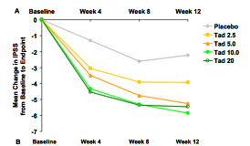
Tadalafil for BPH/LUTS

Slide 72
Take-Home Messages
Aging Population= More BPH
Not all Male LUTS=BPH
Not all BPH=LUTS
Consider Combination Therapy
Quality of life issues

