Slide 1

iLab Introduction
External User Guide
Rodent Metabolic Phenotyping Core
Perelman School of Medicine
Link: https://med-upenn.corefacilities.org/service_center/show_external/5249

Slide 2
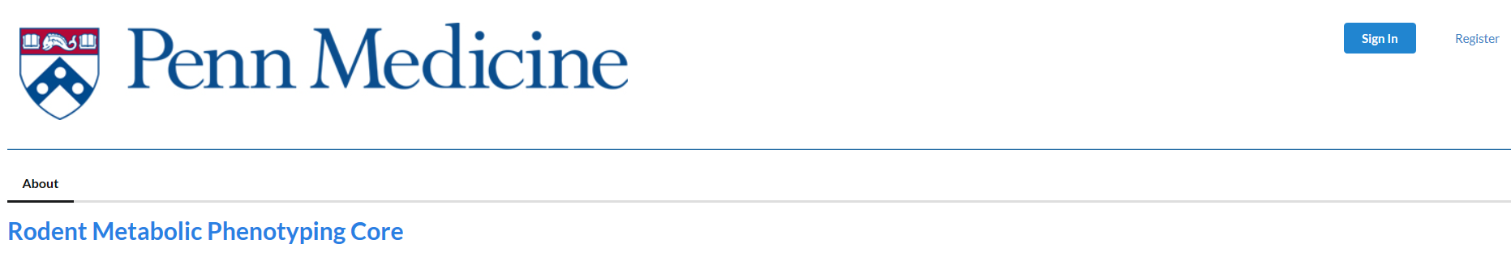
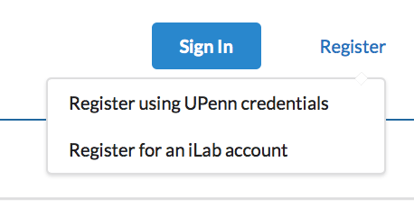
The opening page for iLab gives you the option to sign in or register as a new user.
To register as a new user, please click the “Register” button – the following dropdown menu will become available.
Select the “Register for an iLab account” button and follow all instructions.

Slide 3
New User Registration
IMPORTANT STEPS FOR A NEW USER
After you register, iLab will send you an email with your new account information.
You will want your P.O. information ready before you submit a request.
Return to the Rodent Metabolic Phenotyping Core to enter your P.O. and your request.

Slide 4
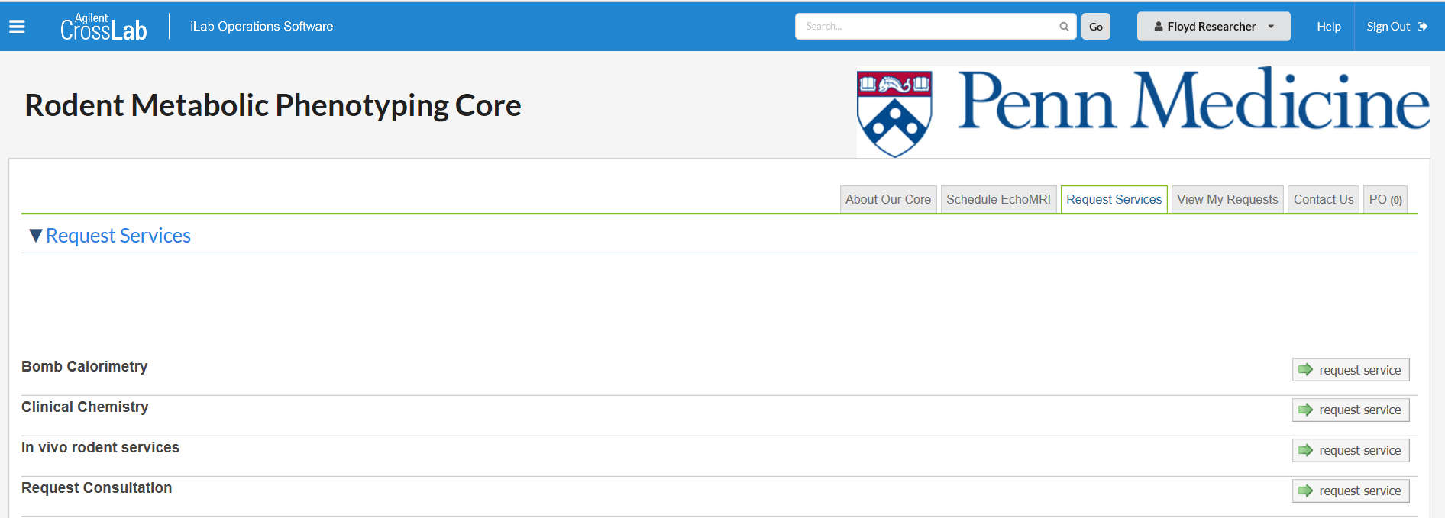
To enter a P.O., select the ‘P.O.’ tab

Slide 5
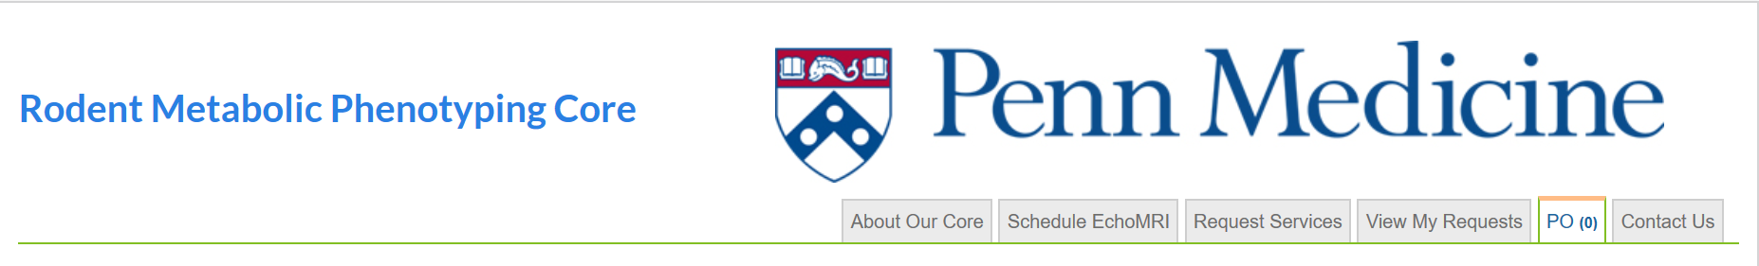
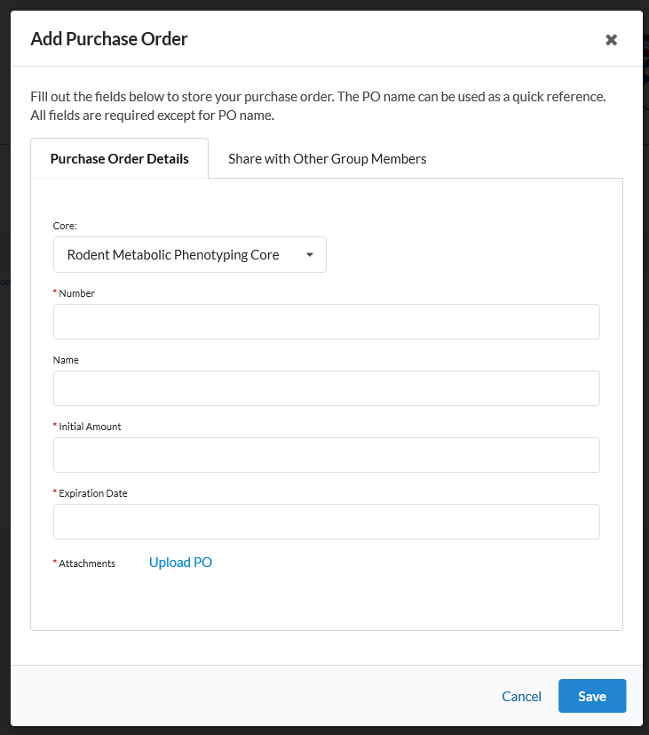
First Step – Enter your P.O.
In the P.O. tab, click
“New Purchase Order”
Choose the Rodent Metabolic Phenotyping Core.
Complete all required fields –
(they’re identified with a red star).
Upload a copy of your P.O.
Save it.
NOTE: The core administrator will have to approve your P.O. before you can enter service requests.

Slide 6
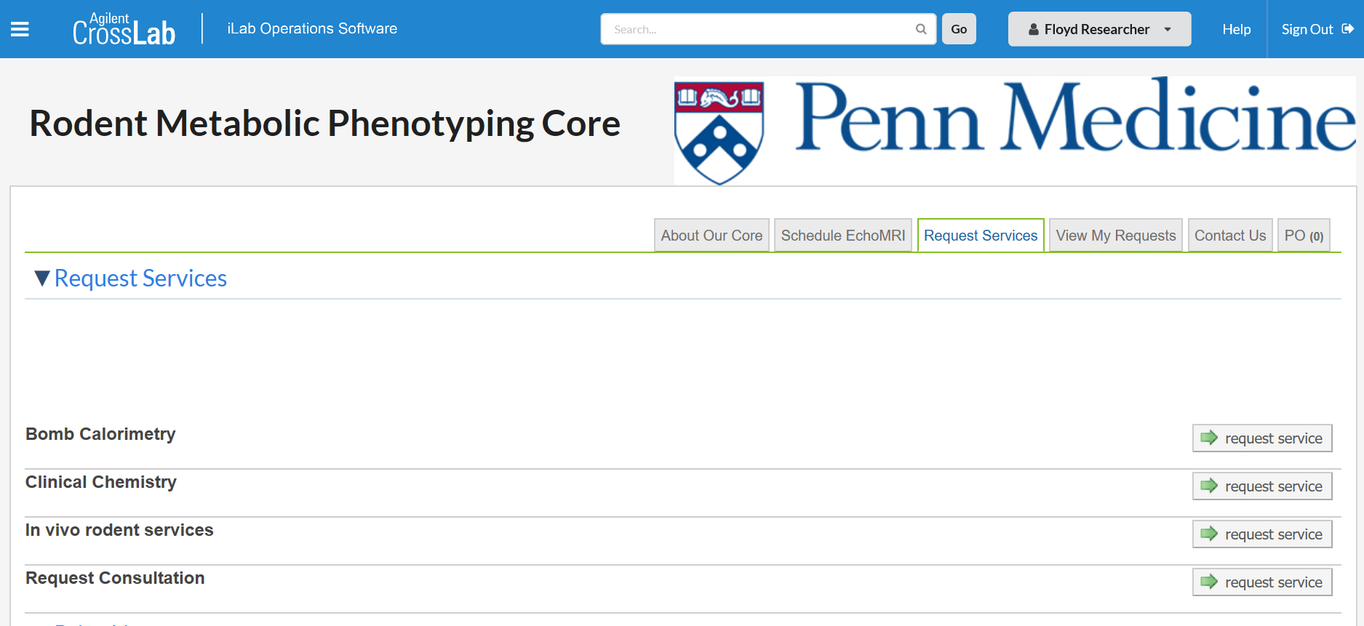
To start your request,
select the tab to request services then click the request service button for your selected category

Slide 7
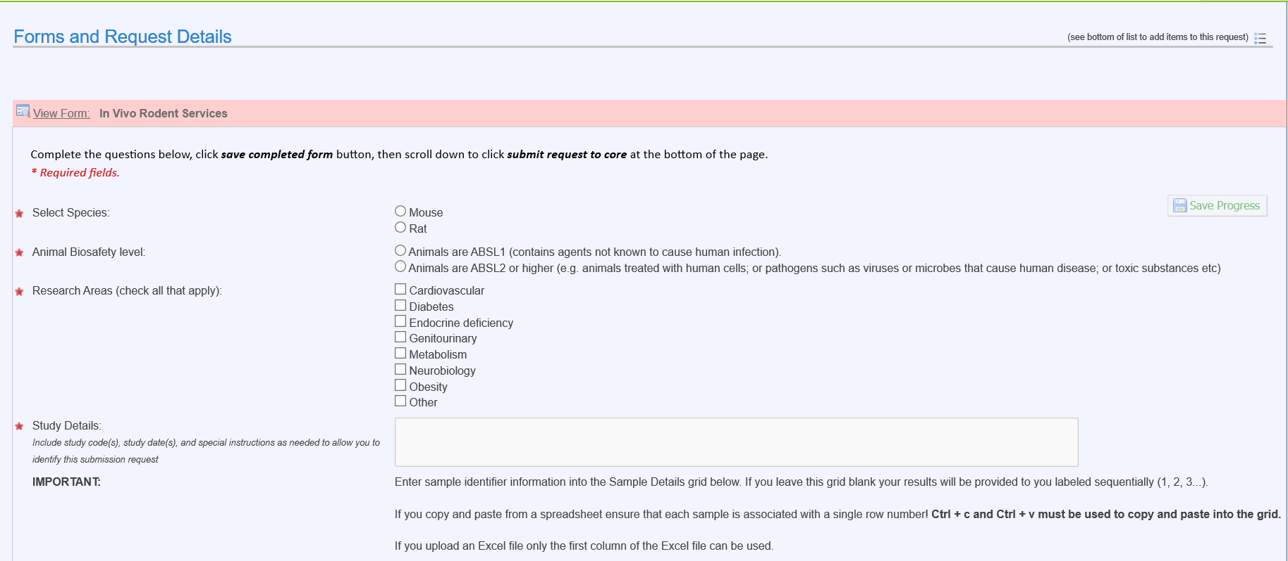
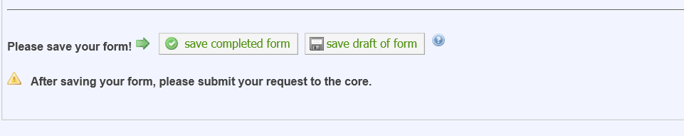
There are 3 sections to Request Services
SECTION 1: Forms and Request Details:
Complete all required fields - (they’re identified with a red star).
Save the Section 1 form.

Slide 8
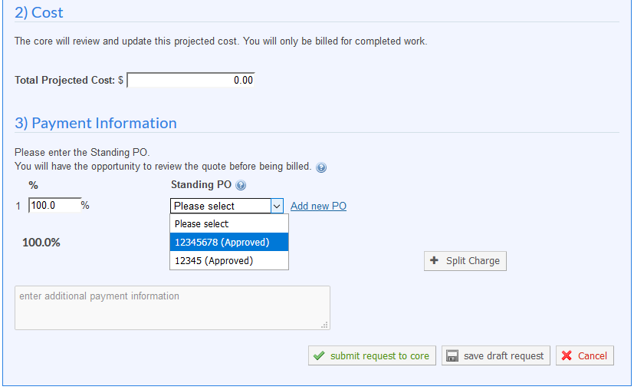
There are 3 sections to Request a Service
The core will complete Section 2 and send you a quote with the final price for your approval.
SECTION 3 :
Use the drop-down arrow to choose a P.O. for payment.
Submit your request to the core.

Slide 9
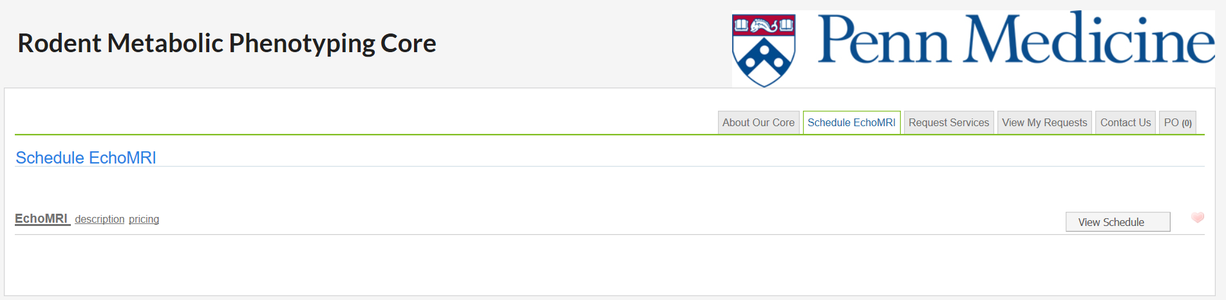
Scheduling EchoMRI: Accessible to trained EchoMRI Users Only
Click on Schedule EchoMRI tab
1) Click on EchoMRI to book use of EchoMRI as a “trained user.”
2) If not a “trained user”, you will need to complete a one-time EchoMRI training session which can be requested under the Request Services tab.

Slide 10
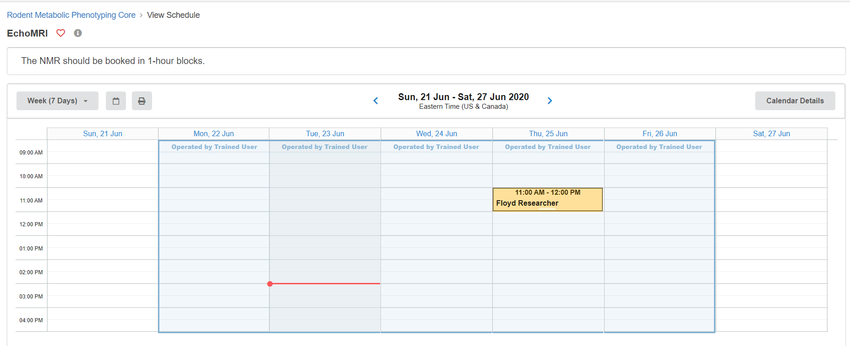
Scheduling EchoMRI: Accessible to trained EchoMRI Users Only
Click on Calender to reserve 1-hour time blocks.
1) When scheduling the EchoMRI, you can only create reservations in the future. You cannot create a reservation with a start time within 24 hours of the current time.
2) If you cancel the booking with a less than 24-hour notice, you will automatically be charged for the service.

Slide 11
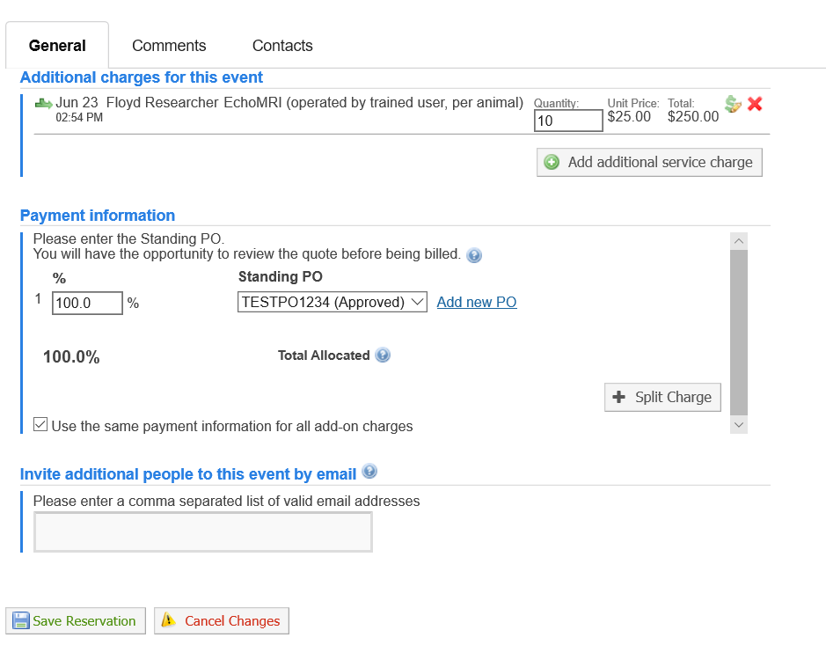
Scheduling EchoMRI: Accessible to trained EchoMRI Users Only
Fill out the form that automatically populates after reserving a time block on the Calendar:
Enter quantity of animals.
Enter P.O. number.
Click on Save Reservation.

Slide 12
iLab access issues
If you are unable to access iLab:
Make sure you are a registered user of the iLab system
Please send an e-mail to ilab-support@agilent.com describing your issue. iLab staff responds quickly to support requests.

Slide 13
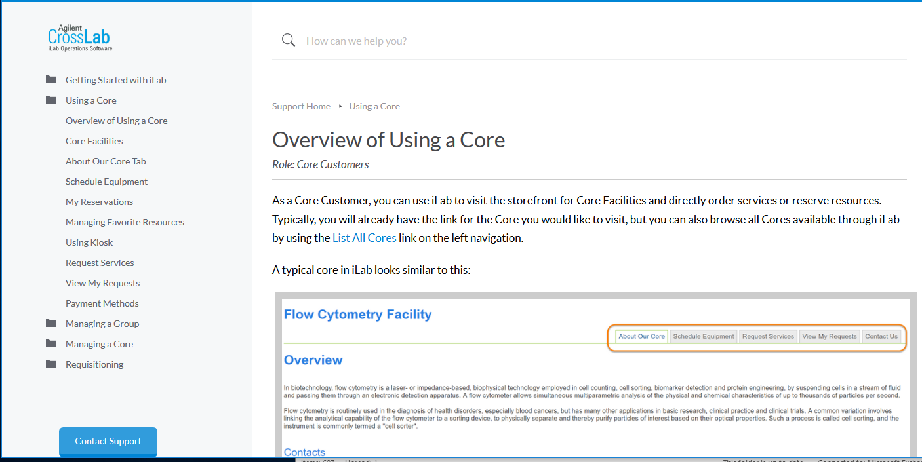
Additional Resources
iLab documentation:
https://help.ilab.agilent.com/37179-using-a-core/264646-using-a-core-overview
Screen by screen help, with a direct link to iLab support.
Resources also available at Penn Medicine’s iLab website: https://www.med.upenn.edu/pmacs/iLab.html

