Slide 1
How to Harvest the Most from Your Food
Nutrition hacks and methods to help make foods more digestible and nutrient-dense
“If it came from a plant, eat it; if it was made in a plant, don't. ” ― Michael Pollan

Slide 2
The content of this presentation is intended for general nutrition information. The presentation is not a substitute for treatment specific recommendations.
Please consult with your oncologist and cancer care team for treatment specific recommendations.
For privacy sake, all attendees will have their microphone and camera “muted”
We will take questions via the “chat” function and will answer as feasible
A list of resources and references can be found on the last slide of this presentation. You should have received a copy of this presentation and the recipe via email so check your spam mail to make sure it didn’t go there ☺

Slide 3
How can we get the most health benefits from our food?
This talk will cover some of the reasons why even small changes to our diet can help improve our health and our digestion
The presentation will review some of the research related to the role of whole plant foods in human health (Greens, Beans and Grains)
We will look at ways to prepare and cook these plant foods so that they yield their nutritional benefits with delicious results
It will include plenty of “hacks” for simple ways to add more nutrient rich, fiber containing plant foods to your diet

Slide 4
Today’s talk will provide some nutrition research and cooking tips for some of the many wonderful members of the plant family
Plant foods contain phytochemicals and fiber which are beneficial to our health

Slide 5
Phytochemicals and anti-oxidants: what are they and what’s the difference
Phytochemical: refers to plants (phyto) and the chemical compounds in them. We may also refer to them as phytonutrients
Anti-oxidants are substances that help prevent cells from damage from unstable molecules known as “free radicals”.
How we prepare and eat plant foods can maximize our intake of these healthful compounds
Notes:
not all phytochemicals are anti-oxidants.
Carotenoids often have an orange color which may become in more vivid when cooked.
Sulforaphanes found in the "Brassica" family of cruciferous vegetables is sensitive to heat. there is some evidence that adding mustard (or mustard seeds) to cooked brassicas may help increase the bioavailability of the sulforaphanes. sulforphanes are potent compounds and act in multiple ways as antioxidants and also may prevent cancer cells from growing by altering the cell DNA and also can cause cell death (apoptosis). the key chemical cmpd is enzyme MYROSINASE which is sensitive to heat.

Slide 6
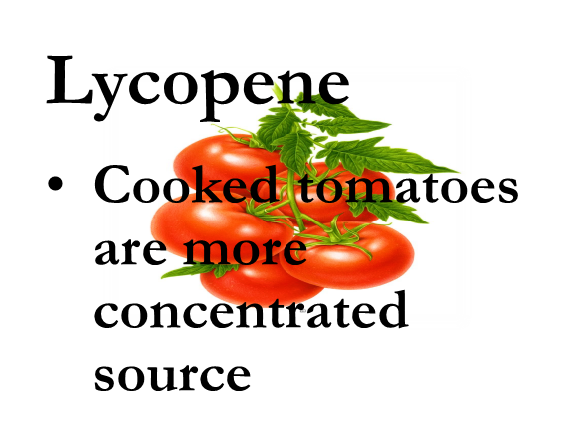
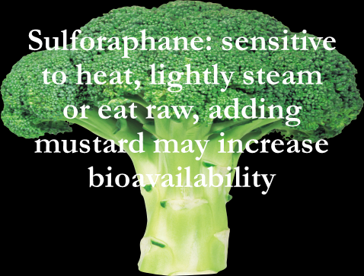
Raw vs Cooked
Does cooking reduce the amount of nutrients in fruits and vegetables?
Yes and No – vitamin C is sensitive to heat, whereas beta-carotene may be more available for
absorption when cooked
The key is to include both cooked and raw plant foods daily

Slide 7
Raw vs Cooked
Some vegetables are not edible raw: potatoes, sweet potatoes, yucca root, uncooked dried beans; some folks may also have difficulty digesting raw cruciferous vegetables like cauliflower, Brussels sprouts, broccoli, collard greens, kale, and cabbage
Also, sprouts should not be eaten raw due to concerns for bacteria and mold – cooking will destroy these potential sources of food-borne illness

Slide 8
How many servings/day?
Research suggests that the optimal number of servings of fruits, vegetables and whole grains – which provide fiber, vitamins, minerals and plant chemical compounds called “phytochemicals” :
Fruit: 1-2 servings/day. Go for variety. Fresh is best but frozen is a great option too
Vegetables: VARIETY! 3-5 servings/day of NON-Starchy vegetables A combo of cooked and uncooked, depending on the vegetable
Starchy vegetables and whole grains: 1-2 servings/day
Notes:
Try to think about having half of your plate with vegetables. If you enjoy crunchy foods, have some raw snap peas, celery and radishes as part of that equation.
Eat in season but remember that frozen is a great option

Slide 9
The Power of Plants
2 ½ cups of vegetables/day and 2 cups of fruit / day
1-2 servings fruit daily and 3-5 servings of vegetables daily – some raw and some cooked
Variety (hint: eat the rainbow)
Lower starch vegetables: leafy greens, mushrooms, tomatoes, beets, cruciferous vegetables, summer squash and zucchini, celery, asparagus, artichokes, pea pods, radishes, turnips, green beans, onions
Colorful fruits: Berries, citrus fruits, pomegranates, apples, kiwi (did you know you can eat the skin)and avocado (a fruit) are great sources of vitamins, minerals and fiber
Notes:
Add some olive oil to tomato sauce to help enhance the absorption of lycopene
Add crunch with celery, raw snap peas, carrots, radishes, sweet peppers
Use romaine lettuce leaves to hold tuna sal, egg sal, chicken sal, hummus, or almond butter

Slide 10
How’s Your Plumbing?
Many folks have issues with gas, bloating and constipation. In some cases, they may have been diagnosed with IBS (Irritable Bowel Syndrome). They may attribute these symptoms to specific foods:
Beans/legumes*
Dairy/lactose
Certain fruits and vegetables*
Wheat/gluten*
*These foods are also sources of dietary fiber

Slide 11
Is it a food intolerance or something else? Food intolerances or sensitivities are not food allergies. Food allergies are an immune response by the body – for instance, celiac disease or peanut allergies. Food intolerances or sensitivities cause a reaction in the GI tract – for instance: bloating, cramping, gas, constipation and /or diarrhea. FODMAPs*: the term refers to a large list of foods that may cause some GI discomfort for certain folks. FODMAP is an acronym that describes the short-chain carbohydrates that are poorly digested by humans FODMAPs stands for fermentable oligo-saccharides, di-saccharides, mono-saccharides and polyols. Put more simply, FODMAPs are certain types of carbohydrates -- the sugars, starches, and fiber in foods. Certain foods may be eliminated from the diet to see if the GI discomfort improves. Those foods are then reintroduced to see if they are the cause of the GI discomfort
Notes:
This slide is hidden

Slide 12
Identifying Foods that May Cause GI Discomfort
The goal is to be able to have the most diversity and variety in your diet as possible
It is important to work with a registered dietitian-nutritionist in order to make sure that the individual’s diet is well balanced and appropriate.
For many folks, they can eat small amounts of these foods occasionally without experiencing discomfort
Many folks are well aware that they may experience some gas and bloating from eating beans/legumes – this is normal ! Try using a product like Beano which may help decrease the gas and bloating. Often, over time, the gut will adjust to digesting beans

Slide 13
Why is fiber so special? Friend or Foe?
Fiber: Go Slow, or a friend may become a foe
Intro to fiber
resistant start
insoluble fiber
soluble fiber
prebiotics and postbiotics
Notes:
Soluble fiber can help lower blood cholesterol and glucose levels. Slows digestion and may help with weight loss due to creating feeling of fullness. Some folks are concerned about Phytates and phytic acid which are antioxidant compounds found in whole grains, legumes, nuts and seeds. The chief concern about phytates is that they can bind to certain dietary minerals including iron, zinc, manganese and, to a lesser extent calcium, and slow their absorption. Cooking reduces the amount of phytic acid as does soaking in something acidic like vinegar, yogurt or buttermilk. Phytates have benefits like protecting normal cells and reducing inflammation
Oligosaccharides: chemical chains of plant sugars, found in many vegetables, and provide soluble fiber. They are also important for good immune function.

Slide 14
Fiber Terms
Resistant starch: Prebiotic – this refers to the “fuel” that feeds the organisms that make up our gut microbiome – come from plants. Many of these organisms living in our gut are “probiotics”
Certain soluble fibers and insoluble fiber ferment in our gut (this is what produces gas and bloating for some folks) and are considered “prebiotics”
Insoluble fiber*: adds bulk to our waste and helps promote regular, easy to pass bowel movements
Soluble fiber*: forms a gel-like consistency in our waste which holds moisture and makes bowel movements softer and easier to pass (apples, citrus fruits, carrots, peas, beans, oats and barley)
Postbiotics**: the short chain fatty acids formed by the fermentation in our large intestine which provide the fuel to feed our gut microbiome. Think of these as the end products of prebiotics and the food for your gut “bugs”

Slide 15
What do We Need to Know:
AICR recommends at least 30 grams of dietary fiber daily as part of a healthy eating pattern to lower cancer risk.
For men, the recommendations for fiber is at least 30 grams/day from whole, plant food sources.
For women, the fiber amount is a bit less (25 grams/day) based on overall calorie needs
To put that in context, a slice of whole wheat bread has 2 grams; a cup of cooked oatmeal has 5 grams, a medium orange or banana have about 3 grams and a cup of green peas has 8 grams
Dietary fiber is considered a “nutrient of public health concern” because low intakes are associated with potential health risks.
Even small increases of fiber can help protect your health. The AICR report on colorectal cancer shows that each 10-grams increase in dietary fiber lowers risk of colorectal cancer by 7 percent
https://www.aicr.org/news/can-a-certain-type-of-fiber-help-with-weight-loss/
Notes:
Higher fiber intake may lower risk for death from heart disease, stroke, T2DM, and/or colon cancer by as much as 24% compared to people who eat little fiber. With each additional 8 gm fiber, risk is decreased btw 5% to 27%. Greatest reductions seen in those with daily intake btw 25-29 gm
You can see that for folks who eat higher amounts of processed foods that are made from white flour are shortchanging themselves of dietary fiber. Also folks may be filling up on higher fat foods like cheese and meats which contain no fiber.

Slide 16
OK Audrey – I know I need to eat more plants but I am not really a fan and I really don’t enjoy cooking and/or I don’t know how to prepare these foods
2 cutting boards: one strictly for plants and the other for animals
Good knives (paring knife and a knife for chopping)
Spices (cumin, cinnamon, ginger, curry, any medley of spices and herbs that doesn’t contain salt)
Take advantage of frozen whole grains that can be steamed or microwaved
Buy frozen fruits and vegetables
Strive for having half of every meal come from vegetables

Slide 17
Beans, beans the magic fruit, the more you eat the more you …
Beans, legumes and pulses are packed with nutrients but are also notorious for causing bloating and gas.
Inexpensive source of protein, vitamins, complex carbohydrates, and fiber. Long shelf life. Canned or dried.
Low in fat, no saturated fat or cholesterol
Protein: 6-11 grams per serving (about ½ cup)
Folate: an important B vitamin
Fiber (both insoluble and soluble)
Iron: a good way to get in iron from a vegetarian source (include some Vit C rich food to help absorb the iron)
Phosphorus: an important mineral for bone health and for nerves and muscles
Polyunsaturated and monounsaturated fatty acids including linoleic and oleic acids
https://www.hsph.harvard.edu/nutritionsource/legumes-pulses/
Notes:
Legumes contain fiber, resistant starches, and non-digestible carbohydrates like oligosaccharides. Resistant Starch, sometimes called slowly digestible starch, is not digested and enters the colon where it works similarly to fiber by promoting bulky stool and acting as a prebiotic food for beneficial bacteria like Bifidobacteria. [9] As these bacteria break down and ferment resistant starches and oligosaccharides, they create gas, which causes bloating and abdominal cramping in some people. Soaking dried beans for at least three hours and cooking them may help decrease this side effect. In the long run, however, these beneficial bacteria support normal bowel function and may reduce levels of cancer-causing compounds. [9] During fermentation, the bacteria also create a short-chain fatty acid called butyrate that may be associated with the prevention of colorectal cancer.

Slide 18
But I can’t eat beans!
Here are some tips to help improve digestibility:
Soak dried beans for at least 12 hours and rinse before cooking
Try canned, rinse before use to decrease sodium content and assist with digestion
Add a bay leaf or kombu (seaweed) to the cooking beans – this trick may help make them more digestible
Smaller beans like lentils and split peas are easier to digest
Start with just ½ cup serving. The key is get your system used to digesting beans
Use Beano®
Remember that gas is “normal” but if you are experiencing painful bloating, try starting with hummus or lentils and work your way up to the larger beans like chick peas and kidney beans

Slide 19
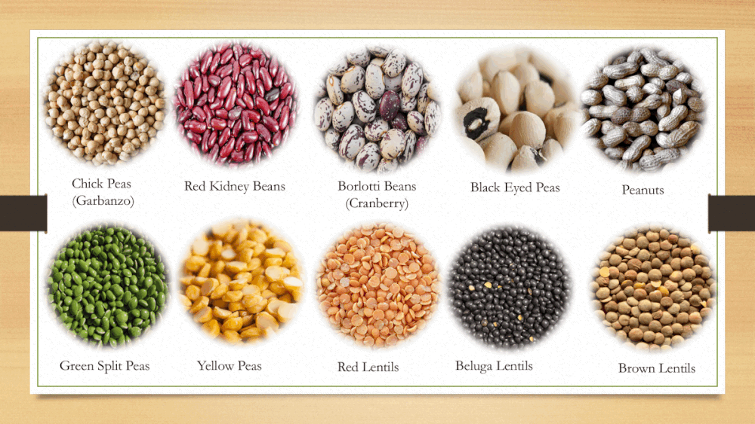

Slide 20
Bean Hacks
Chickpeas
Use canned chickpeas to make hummus – add lemon juice, extra virgin olive or tahini (sesame seed paste), garlic, salt, cumin, black pepper and mash into a paste or mix in a food processer. Or purchase ready made! Lots of flavors and choices
Add a small amount of water to hummus to make a salad dressing.
Try pastas made with chickpea flour (or red lentil or green pea) for a protein and fiber boosted pasta that tastes great!
Use chickpeas to replace tuna or chicken for a sandwich or salad. Drain and rinse a can of low sodium chickpeas. Mash gently and mix in some mayonnaise, some Dijon or yellow mustard (about 1 Tb), chopped celery, pickle relish, salt and pepper to taste
Try Crunchy: Rinse and drain a can of low sodium chickpeas. Toss in a bowl with a drizzle of olive oil and season with curry powder or chili powder, some salt and pepper. Spread on a baking sheet and bake in the oven at 375 degrees for about 20 minutes or until crispy

Slide 21
Next up: leafy greens What does the research suggest?
Leafy green vegetables contain a range of nutrients and bioactive compounds including vitamin E and K, lutein, beta carotene and folate.
Phytochemicals
Anti-oxidants
Fiber
Vitamins
Minerals
1 serving per day of leafy green vegetables may reduce cognitive decline compared to folks who rarely or never eat leafy green vegetables*

Slide 22
Brassica Vegetables aka Cruciferous Vegetables
Rich sources of antioxidants, sulfur containing phytochemicals (glucosinolates), nutrients (vitamin C, vitamin K, vitamin A, potassium) and fiber. May help reduce inflammation
Versatile and available all year round – at least 375 different varieties
Because cooking can reduce the amount of some of the glucosinolates and vitamin C, lightly steaming will help preserve more of these compounds
Many of the cruciferous vegetables can be eaten raw: radishes, daikon, arugula, watercress, mizuna, and cabbage
Add to smoothies, use in stir-fries, soups, slaws and salads. Roasting Brussels sprouts and cauliflower mellows the flavor. Steamed collard greens can be used for a low carb wrap for a sandwich
Notes:
Low in calories high in fiber – may support healthy weight loss
May help improve blood sugar levels: fiber and other natural compounds
Goitrogens, substance that may interfere with thyroid gland function may inhibit uptake of iodine in the thyroid. Most likely to effect those with an iodine deficiency or those consuming excessive servings/day (multi daily servings) and cooking deactivates the enzyme that releases the goitrin

Slide 23
Greens
Raw kale can be tough to digest. Use kitchen shears (make sure you wash them first!) to cut kale into small pieces. Take some apple cider vinegar or fresh lemon juice and sprinkle over the kale. Use your hands to massage the kale until it becomes soft and reduced in volume. Add to your regular green salad or dress it up with some diced apple, toasted almonds and a drizzle of olive oil.
Add small amounts of raw kale, or baby spinach to a smoothie. Note that the color may be somewhat unappetizing so stick with a green smoothie that has a bit of apple or banana for sweetness, ½ cup of raw kale or spinach and the liquid of your choice (dairy or non-dairy), and a scoop of protein powder or nut butter.
Adding more greens to your diet: use frozen chopped spinach (thaw and squeeze out the liquid) mixed into ground turkey when making meatballs
Sauté shredded Swiss chard with garlic in some olive oil, add some raisins or chopped dried apricots and a drizzle of aged Balsamic vinegar and a bit of salt. Serve on toasted Italian bread with some ricotta cheese or as a side dish.
Have a small green salad with a light dressing made from extra virgin olive oil and a squeeze of lemon after your meal. This may help your brain and stomach get the message that the meal is over and may reduce your desire for something sweet (eg dessert)

Slide 24
Am I gluten intolerant?
While very few folks are actually gluten intolerant, some folks find that when they eat wheat or other gluten containing grains (barley, rye and other wheat varieties) they feel bloated and/or gassy.
You may want to try some of the other grains mentioned rather than eliminating whole grains altogether. Whole grains provide fiber, protein, complex carbohydrates, B vitamins, zinc, magnesium, potassium and other vitamins and minerals in lesser amounts

Slide 25
Whole grains: fiber, B-vitamins, protein, minerals and more
Brown rice*
Buckwheat*
Millet*
Amaranth*
Quinoa*
Oats*
Teff*
Sorghum*
Popcorn*
Freekeh
Whole Wheat
Rye
Barley
Kamut
*gluten free

Slide 26
Quick quiz
True or false: raw vegetables are more nutritious than cooked?
True or false: Beans, legumes and pulses are low in protein ?

Slide 27
Adding more whole grains
Use brown rice, quinoa or kamut (or try one of the whole grain mixtures found in the frozen food section) to make a savory bowl:
Layer the cooked grains (1/2 cup) with ½ cup of beans, 1 cup of shredded lettuce/raw greens or some leftover roasted vegetables and drizzle with 1 tablespoon extra virgin olive oil and the juice of ½ lemon, lime, orange or 1 tablespoon of your favorite vinegar.
Add leftover cooked grains to canned soups to bump up the fiber and nutrition
Turn a savory grain like quinoa into a sweet one by using cooked quinoa instead of your morning oats

Slide 28
How to help improve your digestion
Chew chew chew! If you have difficulty chewing or swallowing (or you are just not getting in enough of those greens) – add baby kale or baby spinach to your smoothies to get in those greens
Follow the 70% rule / stop eating before you feel full
Eat like a queen/king at breakfast; a duchess/duke at lunch and a peasant at dinner
Respect your stomach’s bedtime
Go slowly when increasing fiber in the diet – too much too fast may cause bloating, gas and discomfort
Discuss the use of antacids and other medications to reduce acid with your health care providers. Long term use, unless under medical supervision, can lead to some significant side effects
Drink plenty of fluids, especially water – this often helps relieve constipation

Slide 29
More Hacks
Roast vegetables for a milder, sweeter taste. Lightly coat with olive oil and balsamic vinegar for sweet/tangy taste
Puree cooked vegetables in broth for a cream style soup. Add some leftover rice or potato to thicken the soup
Using clean kitchen scissors cut greens into bite sized pieces which are easier to eat and require less chewing
Try adding a little bit of natural sauerkraut to salads and sandwiches. Use plain yogurt for making dips and salad dressings. These foods will add a bit of live, natural bacteria (probiotics) that may be beneficial
Try sourdough whole grain or sprouted whole grain breads: these may be easier to digest
Add a bit of grated ginger root to your salad dressing – ginger may aid digestion and it kicks up the flavor

Slide 30
Fiber hacks
Keep the core of the zucchini from zoodles, put it in the blender with your smoothie or when making a creamy salad dressing for some added fiber
Add hummus to tomato pasta sauce or pizza sauce to make it creamy, more fiber-filled and bumped up with protein.
Use hummus thinned out with some extra olive oil and lemon juice as a salad dressing for extra creaminess, fiber and protein
Rolled oats can be added to ground beef or turkey when making meatloaf or meatballs for extra fiber and to decrease the amount of meat in the recipe
Ground flax seeds can be added to oats or other whole grain cereals for fiber and omega-3 fats (just start with 1 tsp and gradually increase to 1 tablespoon per day). Keep in freeze to prevent rancidity

Slide 31
Recipe: Easy Massaged Kale Salad
Ingredients
2 large bundles curly kale*, large stems removed and roughly chopped
1 Tbsp lemon juice
1 Tbsp extra virgin olive oil (if avoiding oil, omit)
1 healthy pinch sea salt
DRESSING
1/3 cup tahini 3 Tbsp lemon juice
1-2 Tbsp maple syrup (or sub agave, or honey if not vegan)
1 pinch sea salt (optional)
Water to thin (~3-6 Tbsp or 45-90 ml as original recipe is written)
TOPPINGS optional
Crispy Baked Chickpeas (or store-bought)

Slide 32
Instructions
Once you’ve rinsed and dried your kale, run your hand along the stem to remove the green leaves from the stalky stem. You don’t have to remove the stem completely (we actually enjoy the top 2/3 in the salad),
Stack your stalks of kale on top of each other and finely chop. No need to mince, just cut into manageable, bite-size pieces.
Add kale to a large mixing / serving bowl and top with lemon juice and extra virgin olive oil. Then massage with clean hands for about 3 minutes.
Season with salt, massage/toss once more, then set aside.
Next prepare the dressing by adding tahini, lemon juice, maple syrup, and salt (optional) to a medium mixing bowl.
Whisk to combine. Then slowly add water until creamy and pourable. The mixture may seize up and thicken at first, but continue adding water a little at a time, whisking until creamy and smooth. Taste and adjust flavor as needed, Set aside. (Store leftover dressing in the refrigerator up to 5-7 days — sometimes longer.)
To serve, top with desired amount of dressing and crispy chickpeas (optional), toss, and serve. Leftovers keep covered in the refrigerator up to 3-4 days (not freezer friendly). We enjoy leftovers chilled, but also find that they sauté nicely (even with the dressing and chickpeas) if you’re looking for a cooked version.

Slide 33
Quick White beans AKA Cannellini Beans recipes
White Bean Dip:
Puree a can of white beans with the juice of ½ lemon, a dollop of extra virgin olive oil, a clove of garlic, some S&P.
Sprinkle some extra virgin olive oil, black pepper and paprika on top.
Serve as a dip for raw vegetables and crackers.
White Bean Fritters
Rinse and coarsely mash a can of cannellini beans,
then stir in 1 sautéed finely chopped onion, 1/2 cup grated Parmesan,
and the juice of 1 lemon. Shape mixture into 1 1/2" balls, then flatten into patties.
Dredge patties in all-purpose flour, shaking off excess, and fry in olive oil until golden on both sides.
Serve with lemon wedges alongside.

Slide 34
Resources/Recipes
Overnight oats https://www.eatthis.com/overnight-oat-recipes-for-weight-loss/
Cooking beans https://food.unl.edu/article/how-cook-dry-beans-scratch
https://www.healwithfood.org/chart/beans-cooking-times.php#:~:text=Cooking%20Times%20for%20Beans%2C%20Lentils%20and%20Peas%20,15%20to%2025%20%2028%20more%20rows%20
Lectins, soaking beans https://www.hsph.harvard.edu/nutritionsource/anti-nutrients/lectins/
Recipes to help manage side effects (lots of smoothie recipes): https://www.oncologynutrition.org/erfc
Recipes for a variety of plant-based, Mediterranean meals: https://oldwayspt.org/traditional-diets/mediterranean-diet
Websites for reliable, evidence-based nutrition information
www.aicr.org (American Institute for Cancer Research)
www.oncolink.org (Oncolink provides a wide variety of up-to-date cancer information ranging from treatments, side effect management, integrative therapies, nutrition and support)
Articles pertaining to fiber, plant foods and health
Mediterranean diet intervention alters the gut microbiome in older people reducing frailty and improving health status: the NU-AGE 1-year dietary intervention across five European countrieshttps://pubmed.ncbi.nlm.nih.gov/32066625/
Less PROCESSED WHOLE GRAIN FOODS LINKED WITH BETTER BLOOD SUGAR CONTROL IN PEOPLE WITH DIABETES https://care.diabetesjournals.org/content/early/2020/05/13/dc20-0263
Nutrients and bioactives in green leafy vegetables and cognitive decline: Prospective study https://pubmed.ncbi.nlm.nih.gov/29263222/

