Slide 1


MD PhD Return to the Clinics
2023

Slide 2
Agenda
Goal: Help everyone feel oriented to the process of returning to Mod 4 and next steps….
Introduction | Ms. Maggie Krall
Overview to Post PhD | Dr. Jen Kogan
Transition Resources and Tips MED 240/MED 250 | Dr. Peter Yen
Clerkship Block Structure 2022 | Dr. Nadia Bennett
Electives and Advising Resources | Dr. Jen Kogan
Logistics and Scheduling | Ms. Beth Marra
Questions and Answers | All
Closing Tips | Ms. Maggie Krall

Slide 3
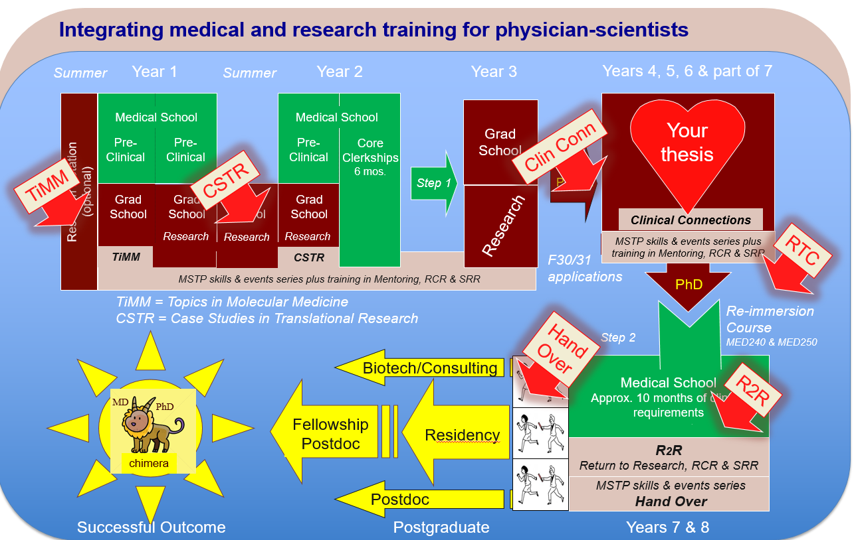


Integrating medical and research training for physician-scientists
Summer
Year 1
Summer
Year 2
Year 3
Years 4, 5, 6 & part of 7
Medical School
Medical School
Grad
School
Your
thesis
Pre-
Clinical
Pre-
Clinical
Pre-
Clinical
Core
Clerkships
6 mos.
Clin Conn
TiMM
CSTR
Step 1
Prelim.
Research Rotation
(optional)
Grad School
Grad School
Grad School
Grad School
Research
Clinical Connections
Research
Research
Research
MSTP skills & events series plus
training in Mentoring, RCR & SRR
RTC
TiMM
CSTR
F30/31
applications
MSTP skills & events series plus training in Mentoring, RCR & SRR
PhD
TiMM = Topics in Molecular Medicine
CSTR = Case Studies in Translational Research
Re-immersion Course
MED240 & MED250
Hand
Over
Step 2
Biotech/Consulting
Medical School
Approx. 10 months of clinical requirements
R2R
MD
PhD
Fellowship
Postdoc
Residency
R2R
Return to Research, RCR & SRR
chimera
Postdoc
MSTP skills & events series
Hand Over
Successful Outcome
Postgraduate
Years 7 & 8

Slide 4
Post PhD Clinical Phase
THIS IS AN OVERVIEW AND RESOURCE
Your schedule will be a combination of core clerkships and electives
Different students will have different optimal timing for return to clinics depending on several factors, including clinical field choice(s)
Careful planning, field-specific guidance, and faculty advice (from clinical advisors and physician-scientist advisors) are important
Let Maggie know when you think you are going to return
  Sooner is better
  Keep her updated monthly until your plan is locked in
Look out for Beth's emails!!!
Within a few weeks, Beth will contact you with your 2023 schedule
Look at your schedule –let us know if issues
You will get a 2024 schedule closer to 2024

Slide 5
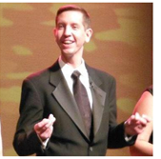
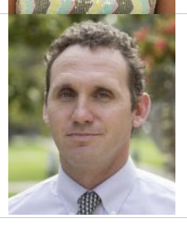
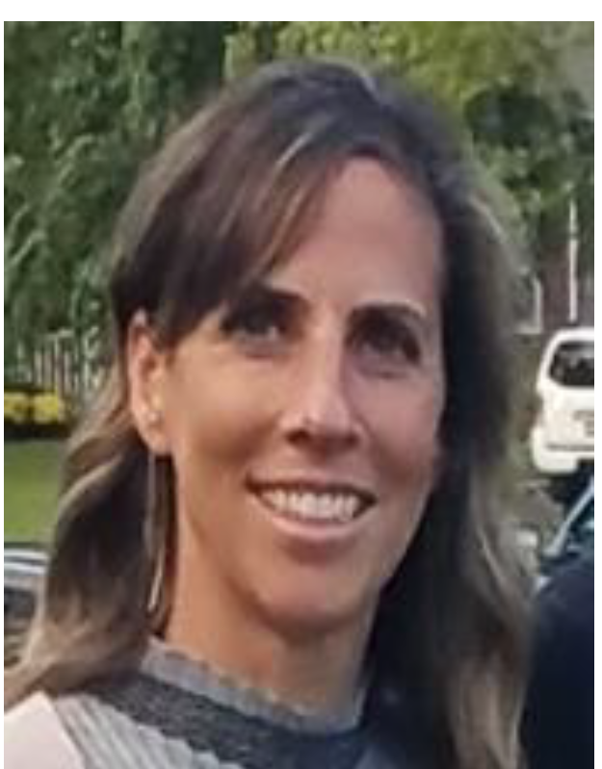
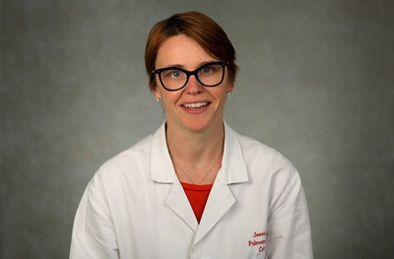
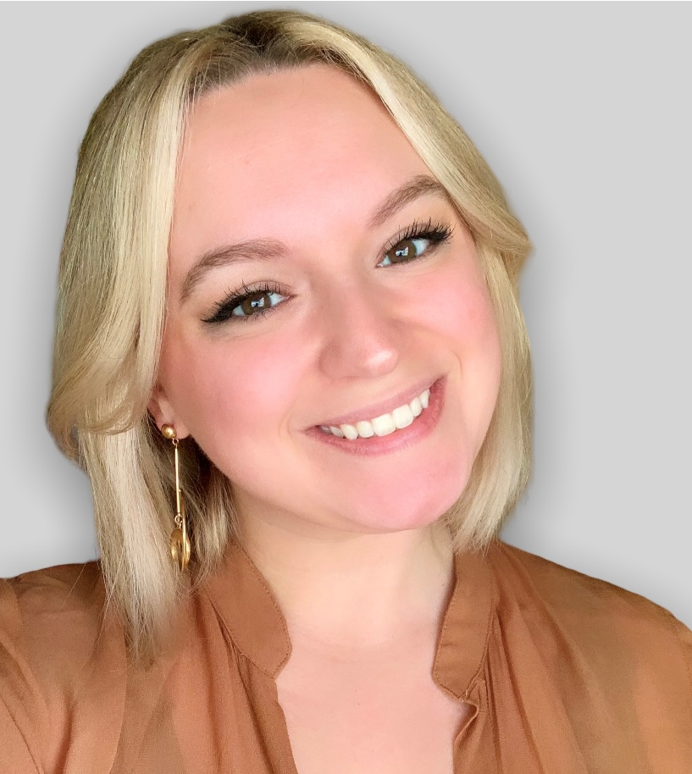
New Faces
Mr. Mark Malacheksy
Director for Medical Education
Dr. Will Pluta
Director, Assessment
& Student Data
Registrar
Exam scheduling
Ms. Beth Marra
Registration and Visiting
Student Coordinator
Clinical scheduling
Away electives
Dr. Jessica Dine
Associate Dean for Evaluation
and Assessment
Gianna Pelletier
Associate Director, Medical Education

Slide 6
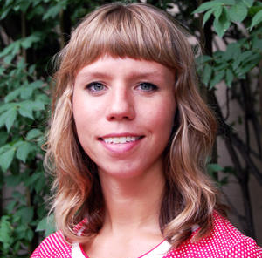
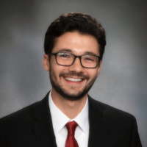
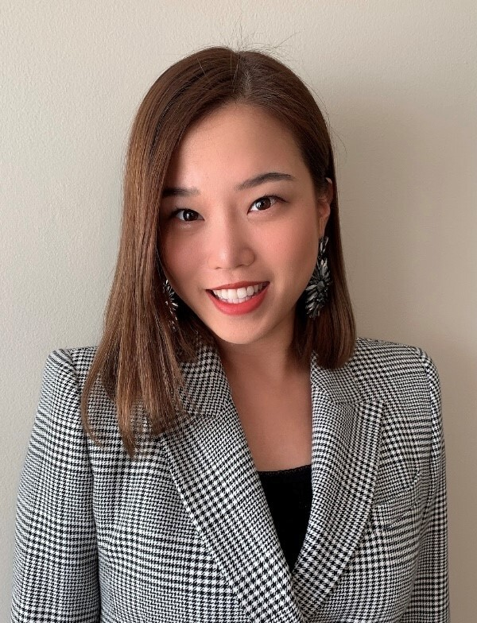
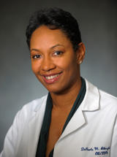

Student Affairs
Ms. Carrie Renner
Director, Student Affairs
Mr. Joe Gallo
Coordinator, Student Affairs
Ms. Ash Kim
Coordinator, Student Affairs
Dr. Sankar
Assistant Dean of Student Affairs
and Residency Planning
Dr. Albright
Associate Dean Student Affairs

Slide 7
Agenda
Introduction | Dr. Skip Brass
Who's Who in APO | Dr. Jen Kogan
Transition Resources and Tips MED 240/MED 250 | Dr. Peter Yen
Clerkship Block Structure 2022 | Dr. Nadia Bennett
Electives and Advising Resources | Dr. Jen Kogan
Logistics and Scheduling | Ms. Beth Marra
Questions and Answers | All
Closing Tips | Ms. Maggie Krall

Slide 8
Electives to Prepare for Your
Return to Clinical Rotations
MED 240
Standardized patient experience to practice basic clinical skills
Two dates offered
MED 250
P/F, two week inpatient medicine rotation with didactics
Largely throughout the summer and fall
Can be scheduled at less typical times, too, for students with unusual schedules

Slide 9
MED 240
Standardized Patient Experience
Opportunity to refresh the following clinical skills on standardized patients cases
  history-taking
  physical exam
  interpersonal communication
  clinical reasoning and differential diagnosis
  oral and written presentation
Non-evaluative/non-graded feedback from SPs and physicians (residents/fellows/faculty)
DATES for those aiming to return for all of block 4:
  August 1st OR August 11th

Slide 10
MED 250
Opportunity to refresh clinical skills in a live but low-stakes setting
2-week elective rotation prior to returning to clerkship rotations
Occurs on the general medicine services at PPMC, PAH, or HUP
Didactic sessions on topics such as:
  Clinical Reasoning Cases, EKGs, Radiology, Antibiotics
Rotation is graded Pass/Fail
Goals of the elective:
Get you re-acquainted with the wards
Practice history taking and physical exam
Practice clinical reasoning skills
Practice presentations
Receive formative feedback

Slide 11
How Can I Best Prepare for Return to Clerkships?
Read the GHHS/Med Ed Guide (formally known as AOA Guide)
Regain access to PennChart and do training in Knowledge Link
If possible, take advantage of opportunities to get you reacquainted to the wards in a low stress environment
  MED 240
  MED 250
  Clinical connections
  Shadowing
2023 Clerkships Canvas page
Read through all of Beth Marra’s emails
Complete checklists (especially fingerprinting, EPIC access etc.)

Slide 12
Agenda
Introduction | Dr. Skip Brass
Who's Who in APO | Dr. Jen Kogan
Transition Resources and Tips MED 240/MED 250 | Dr. Peter Yen
Clerkship Block Structure and Logistics 2023 | Dr. Nadia Bennett
Electives and Advising Resources | Dr. Jen Kogan
Logistics and Scheduling | Ms. Beth Marra
Questions and Answers | All
Closing Tips | Ms. Maggie Krall

Slide 13
2023 Clerkship
Each Block Consists of:
Clerkship Practicum
Clinical Rotation
2 days
12
weeks

Slide 14
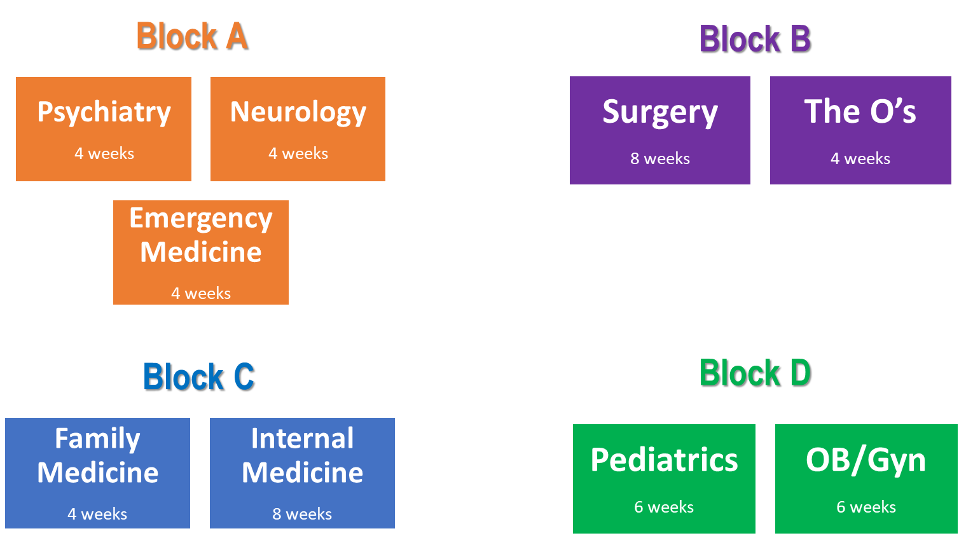
2023 Block Structure

Slide 15
Excused Absence Personal Days off
All returning MD/PhD students can take up to 2 personal days off during the remainder of their clerkships
Students must request a personal day 2 weeks in advance
See Core 2 attendance/absence policy for details
Attendance/Absence: Core 2 Clerkships

Slide 16
2023 Practicum Schedule
Session | Topic | Date | Block
1 | Clinical Informatics/EPIC | 1/3/23 | Block 1
2 | Interprofessional Practice | 1/4/23
3 | Patient Safety | 3/27/23 | Block 2
4 | Transitions in Care | 3/28/23
5 | Palliative Care and Advanced Communication | 7/5/23 | Block 3
6 | Advanced Clinical Skills: Sub-I Boot Camp | 9/25/23 | Block 4
7 | Wildcard! | 9/26/23

Slide 17
Practicum Expectations for MD/PhD Students - 2023
If you are enrolled in clerkships during a particular block, you should complete the practicum at the start of that block
All returning students must complete the EPIC practicum before returning
  EPIC practicum modules can be accessed here on the resources page of Clerkship Canvas site
Block 2: Patient Safety/Transitions in Care (3/27 and 3/28)
  required if you are enrolled in the block
Block 3: Palliative Care (7/5)
  required if you are enrolled in the block
Block 4: Sub-I boot camp and wild card (9/25 and 9/26)
  required if you are enrolled in the block
If you have extenuating circumstances and need to request an absence for a practicum that is required for you, reach out to Anna Delaney

Slide 18
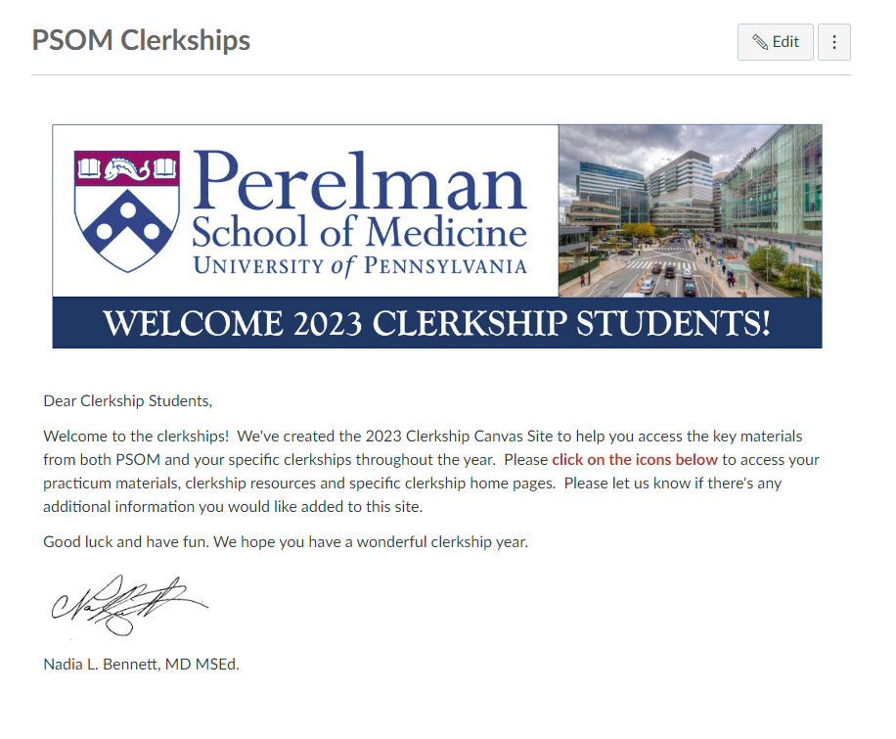
PSOM Clerkship Canvas Site
https://canvas.upenn.edu/courses/1628743

Slide 19
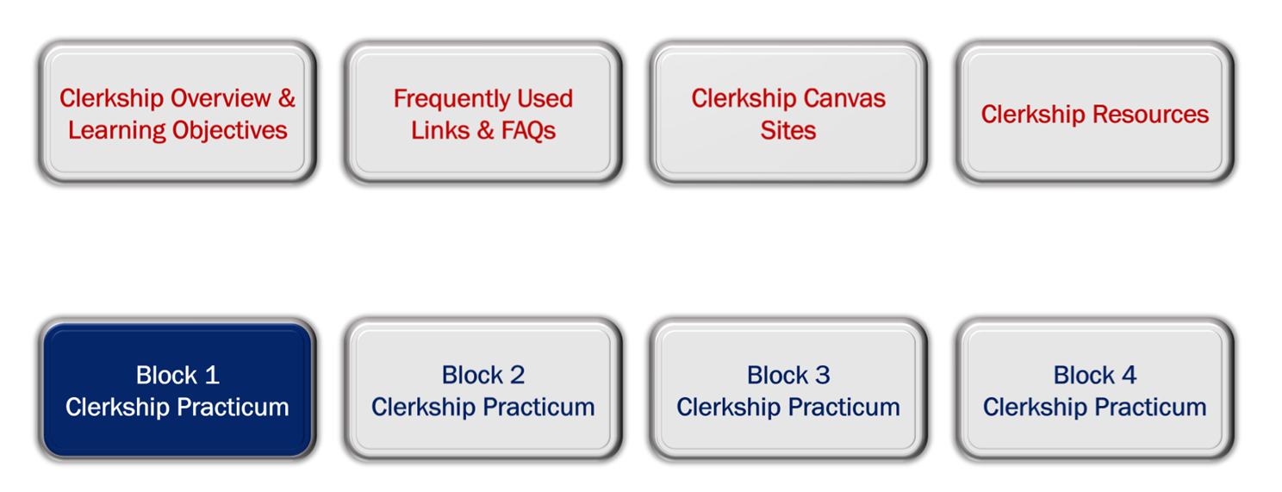
PSOM Clerkship Canvas Site

Slide 20
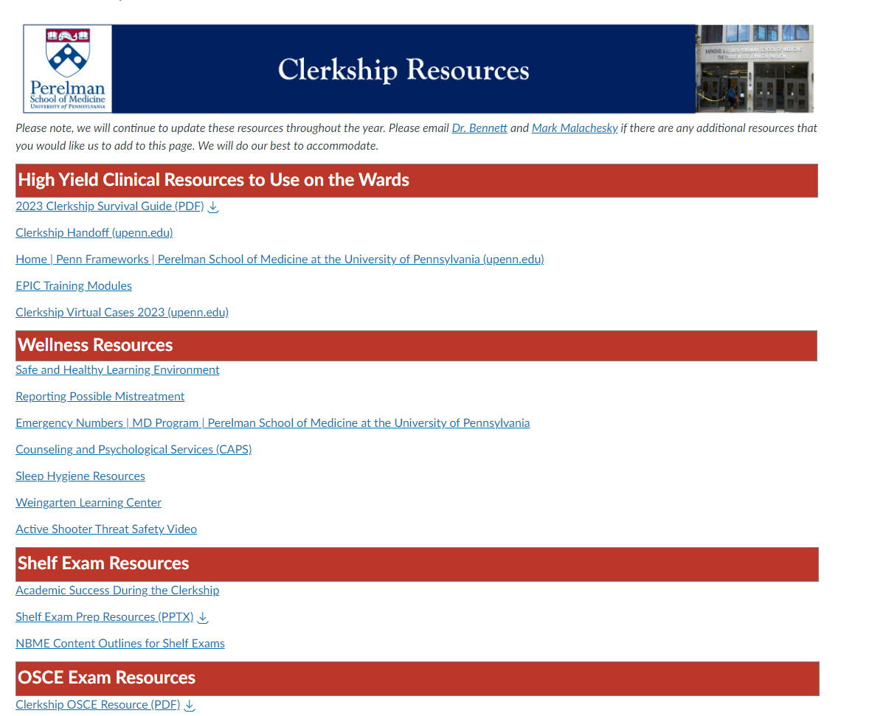
Clerkship Resources Page
https://canvas.upenn.edu/courses/1628743/pages/clerkship-resources

Slide 21
Agenda
Introduction | Dr. Skip Brass
Who's Who in APO | Dr. Jen Kogan
Transition Resources and Tips MED 240/MED 250 | Dr. Peter Yen
Clerkship Block Structure 2022 | Dr. Nadia Bennett
Electives and Advising Resources | Dr. Jen Kogan
Logistics and Scheduling | Ms. Beth Marra
Questions and Answers | All
Closing Tips | Ms. Maggie Krall

Slide 22
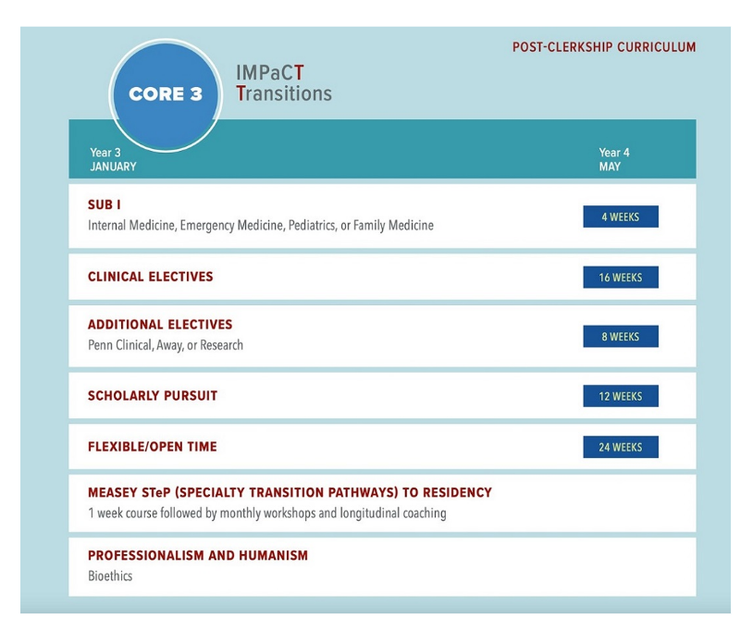
Core 3 Requirements for MD PHD Students
Electives: 14 weeks
8 wks clinical
2 wks clinical/non-clinical
4 wks post PhD research

Slide 23



Core 3 Goals
Notes:
If you talk to the current 44th years, they will likely tell you that the first goal of Mod 5 is to resurface or emerge. We know that the clerkship year is rigorous, intellectually and emotionally demanding with little free time. What is wonderful about Mod 5 is that you will have more time to re-engage with many of your hobbies and interests that may not have gotten such full attention this past year.
The next goal is to explore and decide on a specialty by taking different electives.
We also hope that you use Mod 5 as a time to continue to grow and develop – continuing to develop your skills as a physician but also to grow and develop in the areas you are interested in – from the perspective of a specialty, in research, in community engagement, in education, or what ever you are interested in- such as a dual degree.

Slide 24
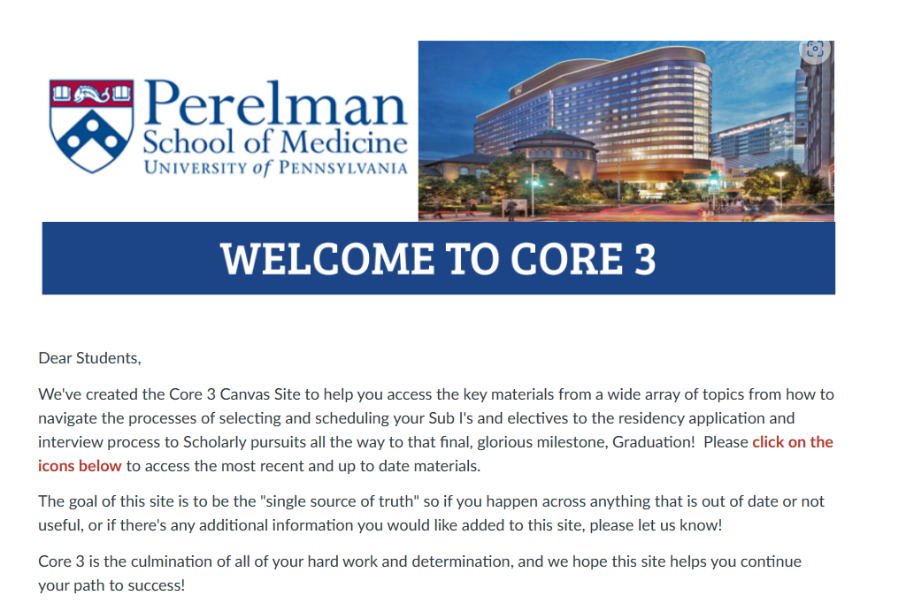
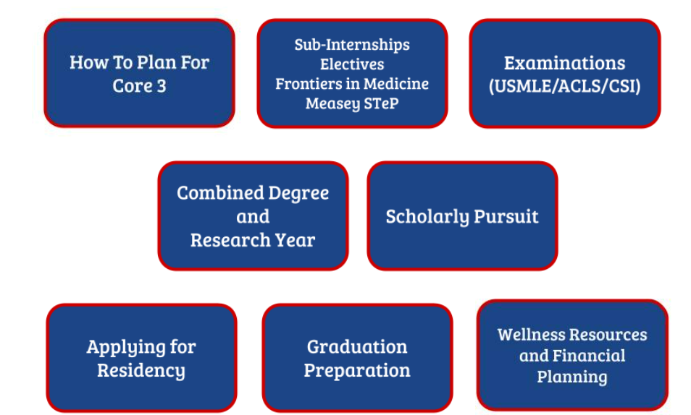
Core 3 Canvas Course

Slide 25
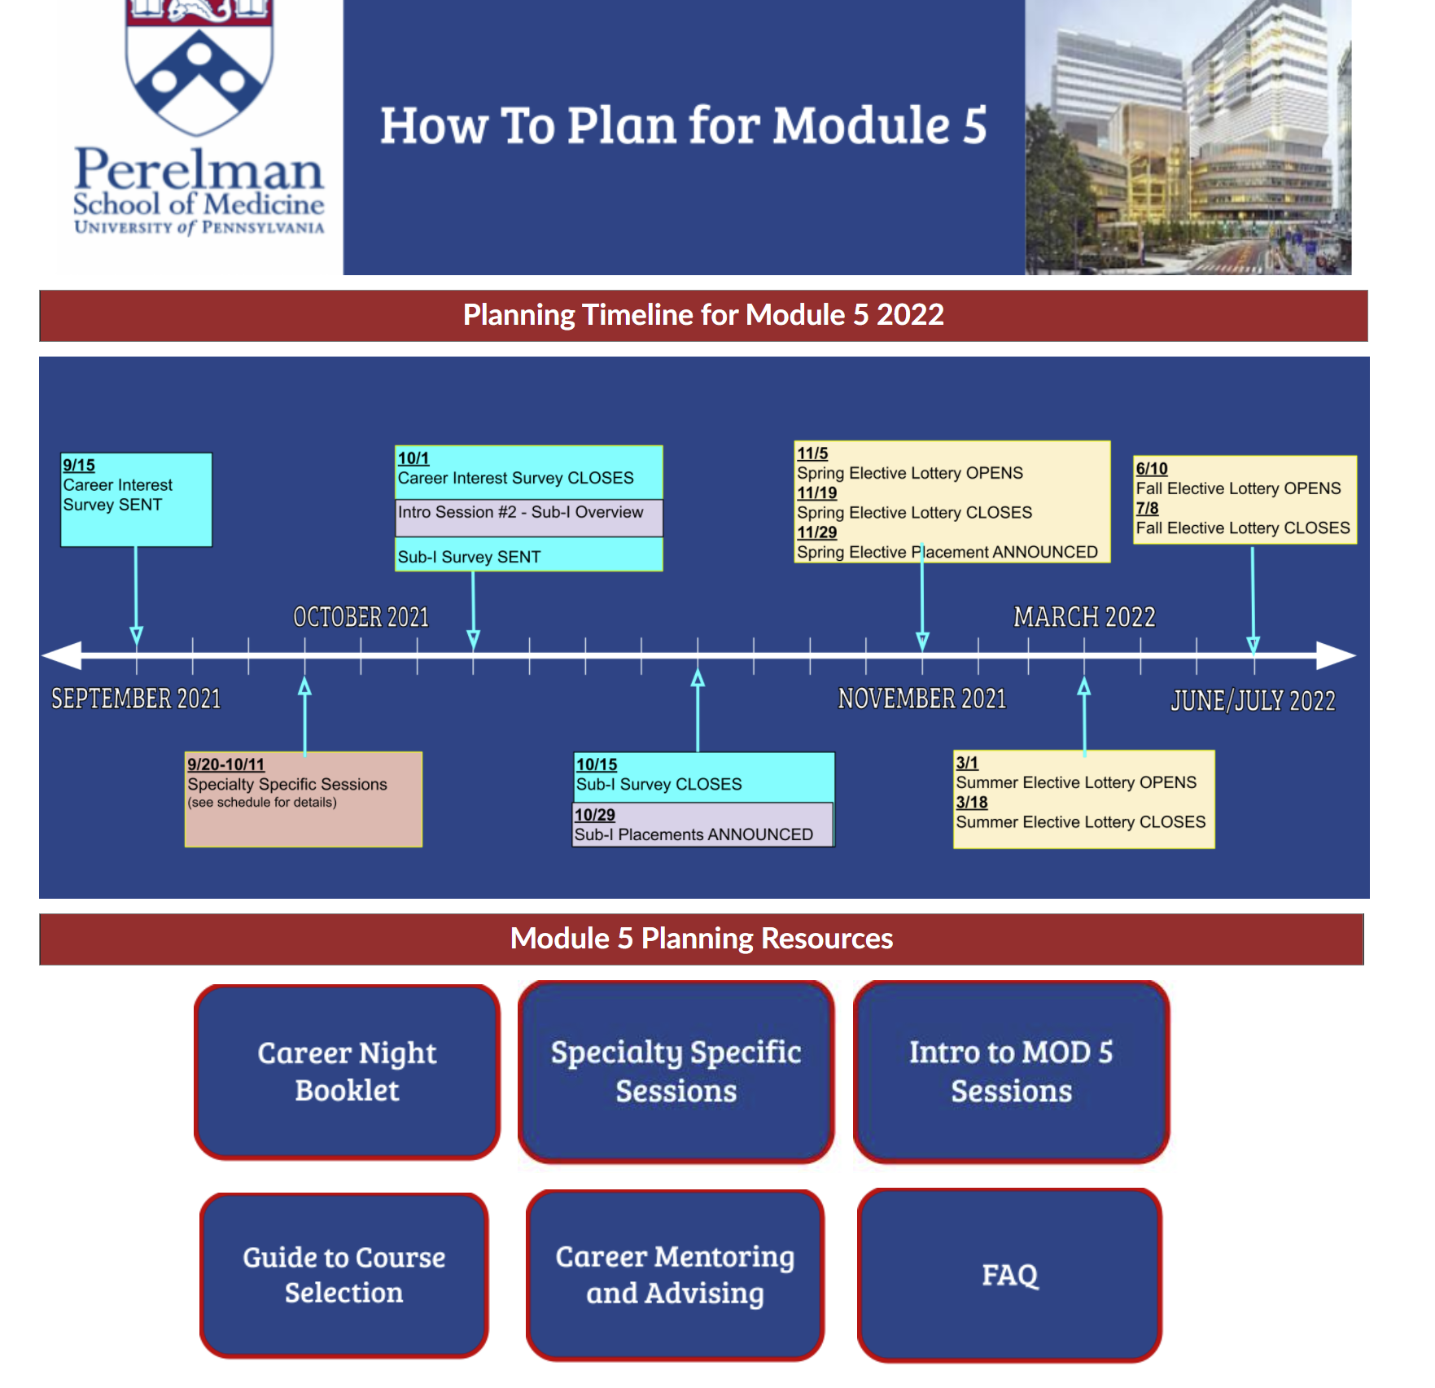

Slide 26
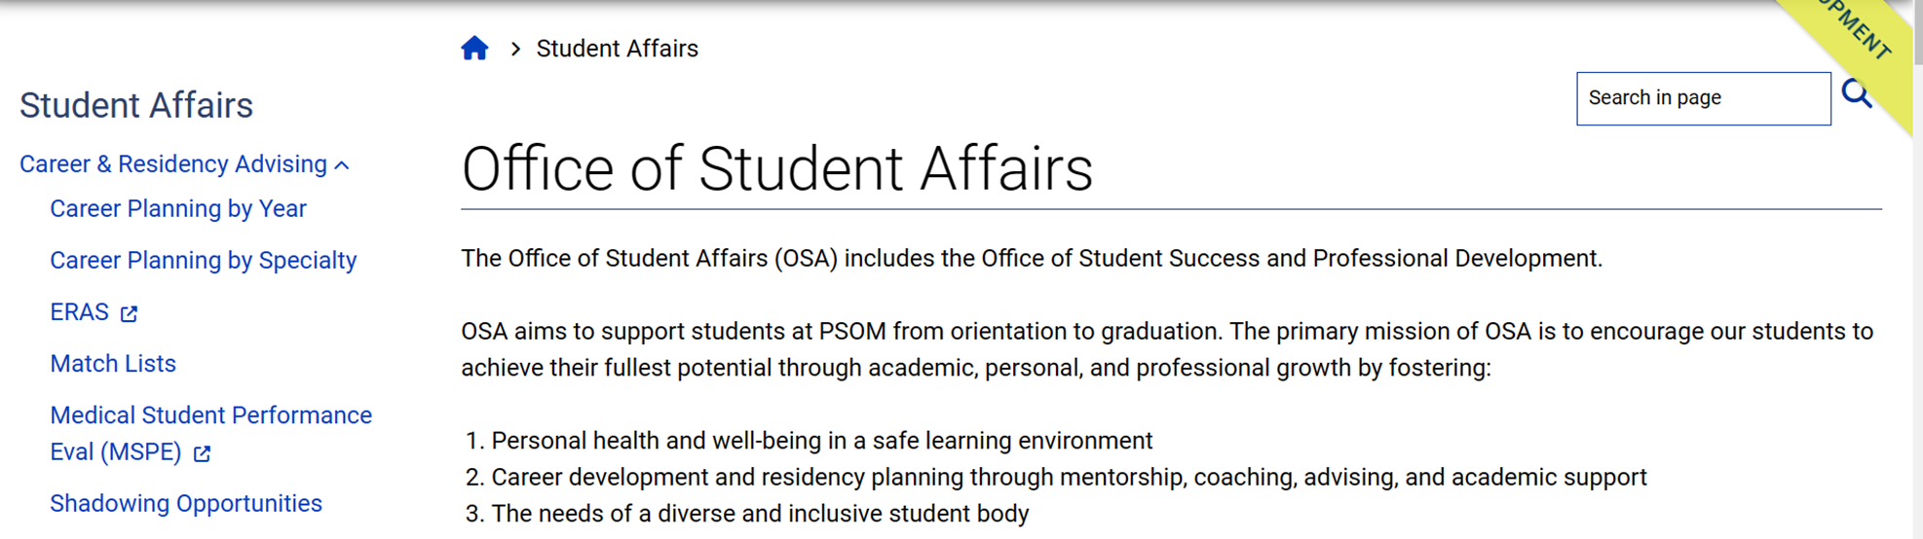

New Website for Career Exploration

Slide 27
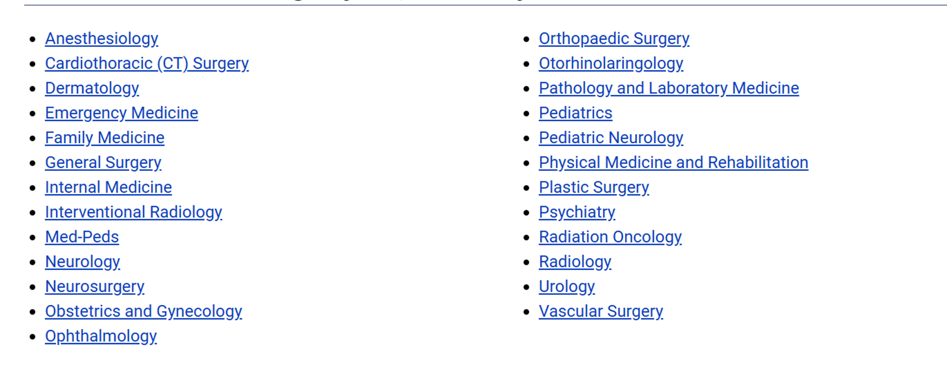
Career Planning By Specialty

Slide 28
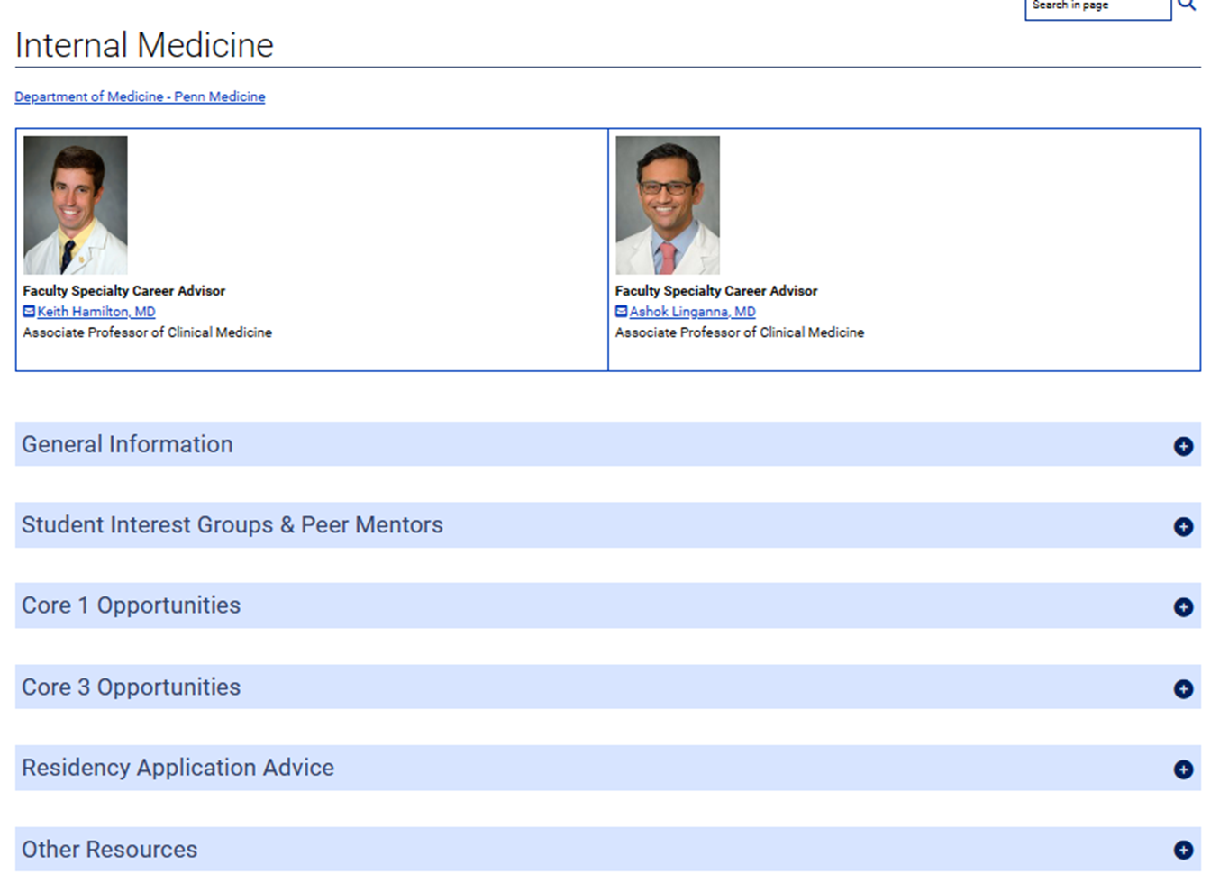


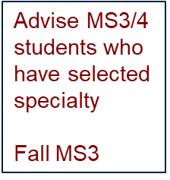

Slide 29

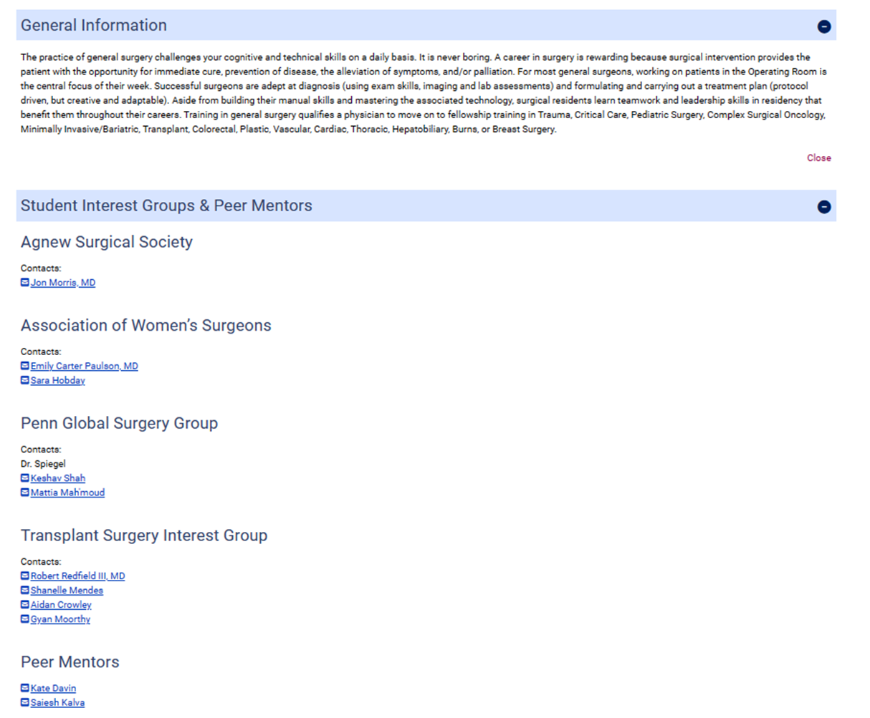

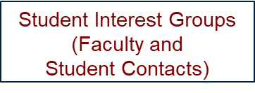


Slide 30
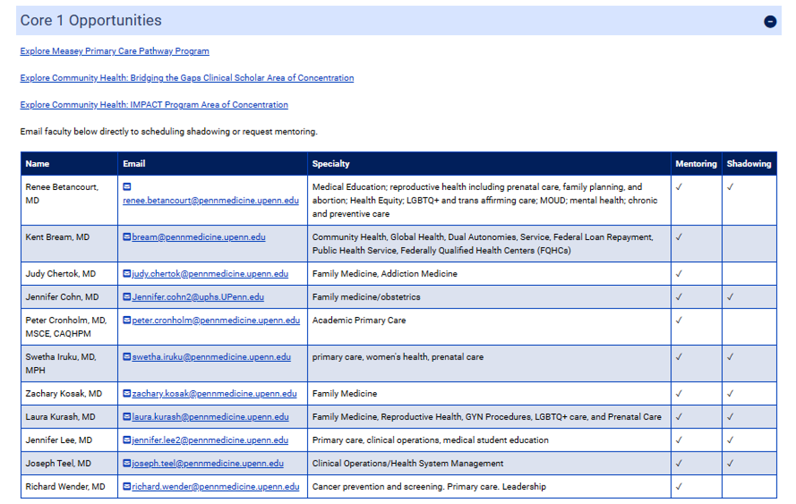
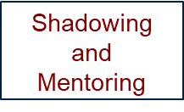

Slide 31
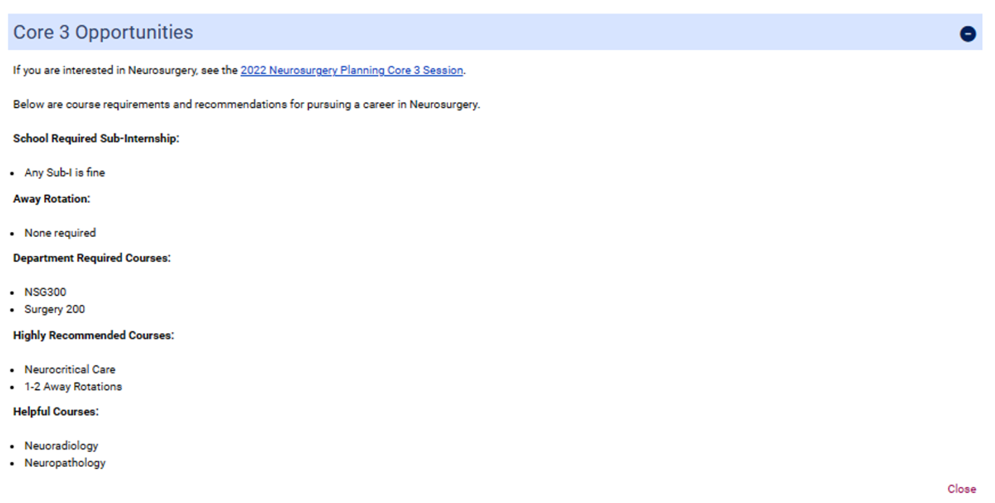
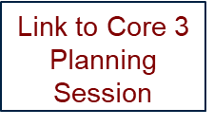


Slide 32
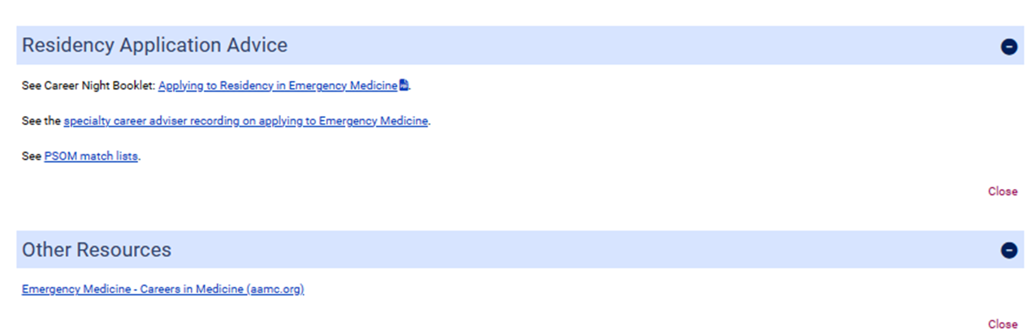


Slide 33
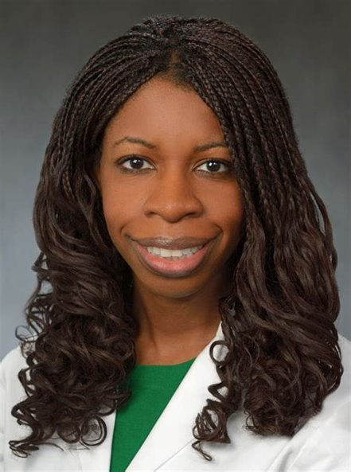
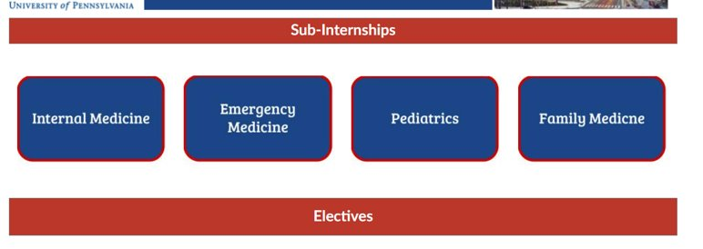
Sub-Is
Requirement: 1 Sub-I
REVIEW WHAT SUB-Is REQUIRED FOR SPECIALTIES YOU ARE CONSIDERING
ATTEND SUB-I PREP DAY (PART OF THE CLERKSHIP PRACTICUM)
ATTEND SPECIALTY MOD 5 TOWN HALLS IN FALL

Slide 34

Electives
4 weeks long (2 week rotations available)
Consults, ICU rotations, outpatient, preceptorships
HUP, PPMC, VAMC, PAH, CHOP
Individualized experiences
Explore interests
Specialty preparation/
requirements

Slide 35
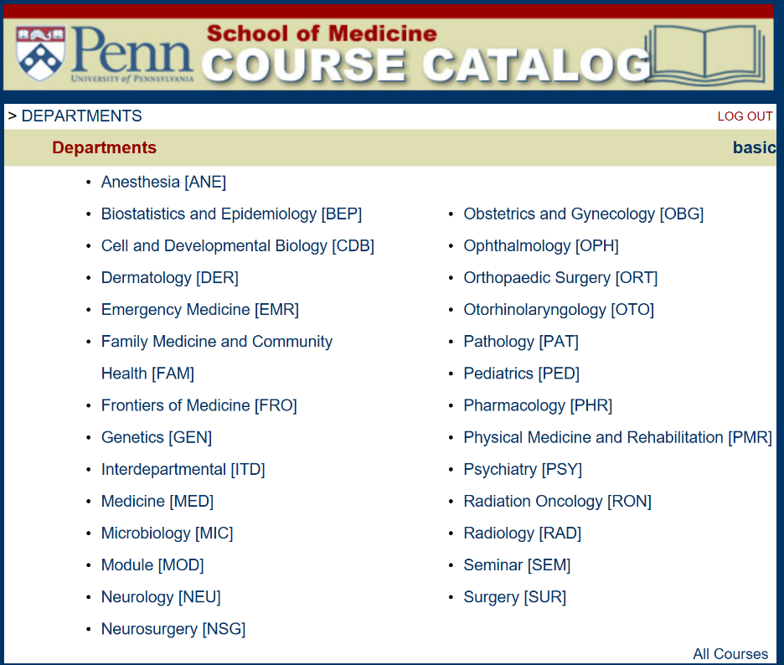

Slide 36
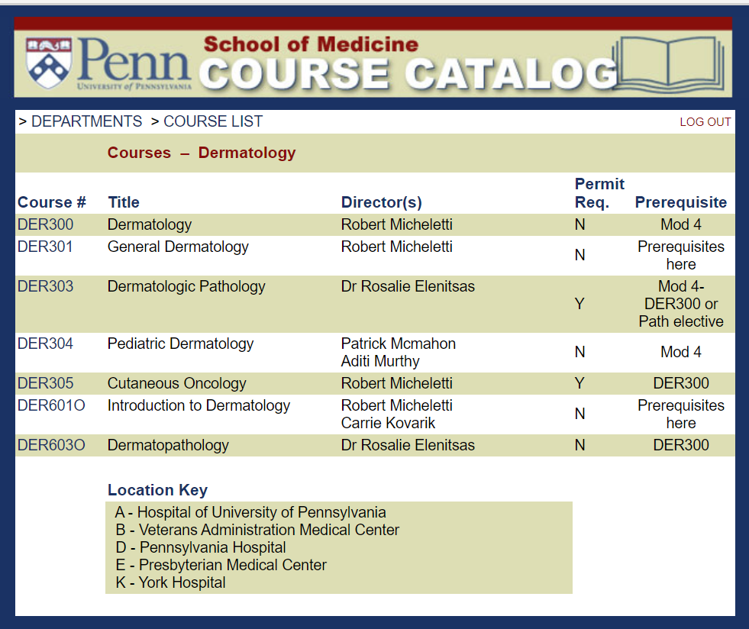

Slide 37
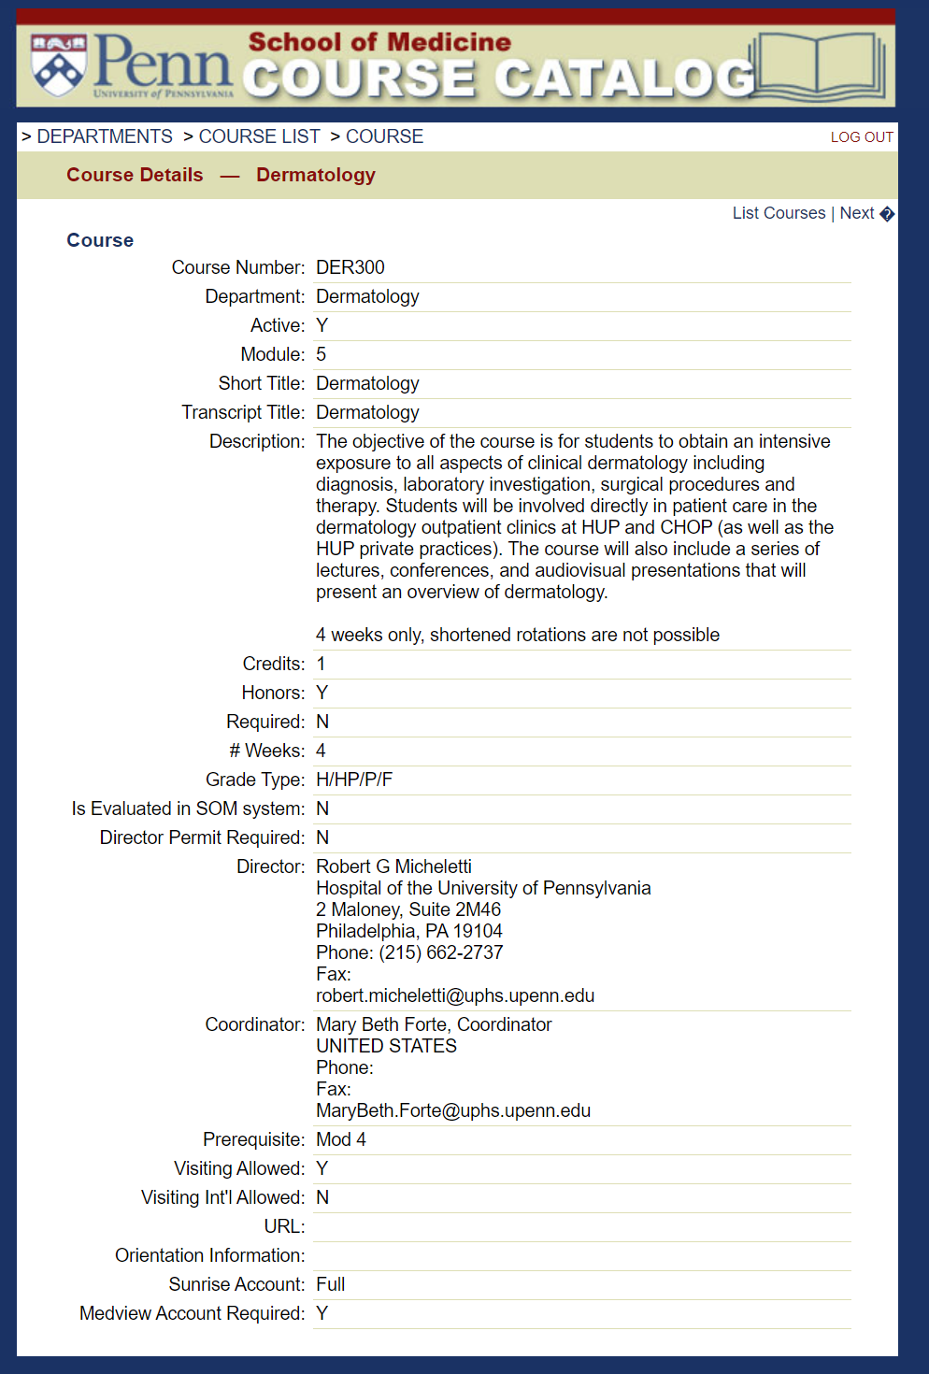

Slide 38
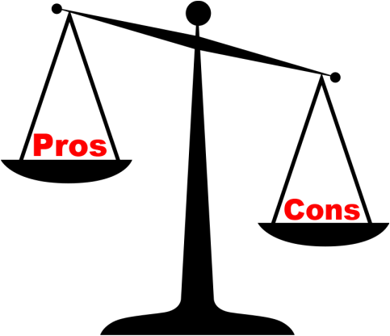
Away Rotations
Required in emergency medicine, orthopedics
+/- neurosurgery, plastic surgery, urology
Inverse return on investment

Slide 39
Exams
USMLE | Deadline to Register | Deadline to Take
Step 2 CK**** | 8/1/2024 | 11/10/2024
Clinical Skills Exam | Feb-May 2024 or Fall 2024
ACLS
*** If possible, take Step 2 by mid-August of year you plan to graduate

Slide 40
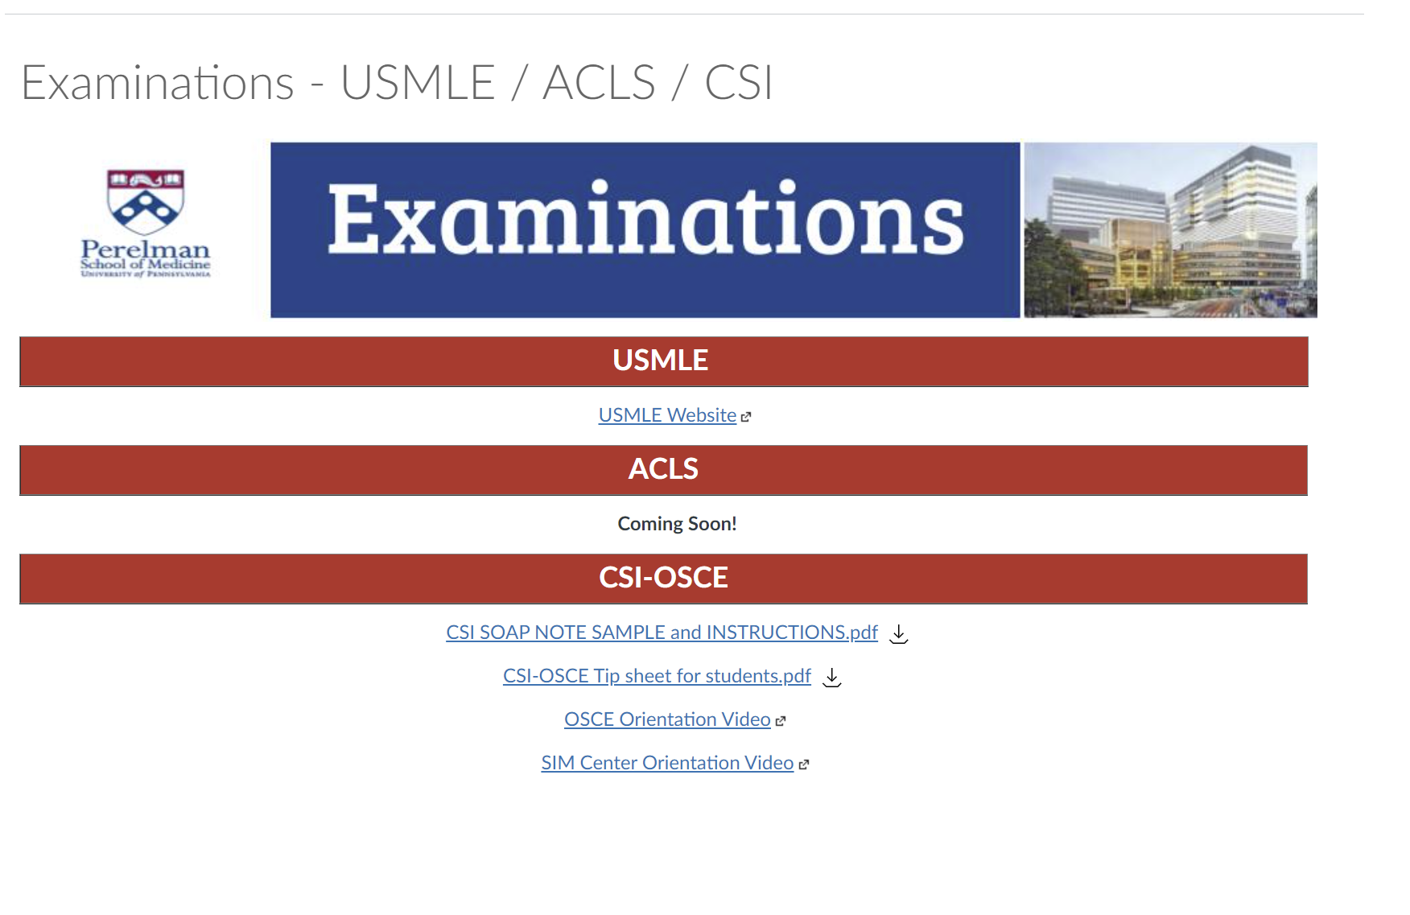

Slide 41
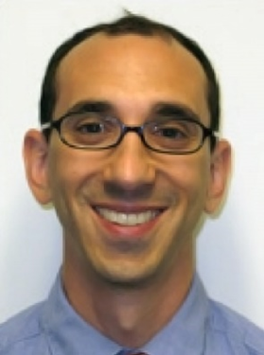
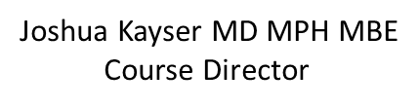
Bioethics
One-week course February of graduating year
Example Topics
Informed consent | Conflict of interest | Decision making
Privacy | Allocating resources | Medical errors
Confidentiality | End of life | Medical malpractice

Slide 42
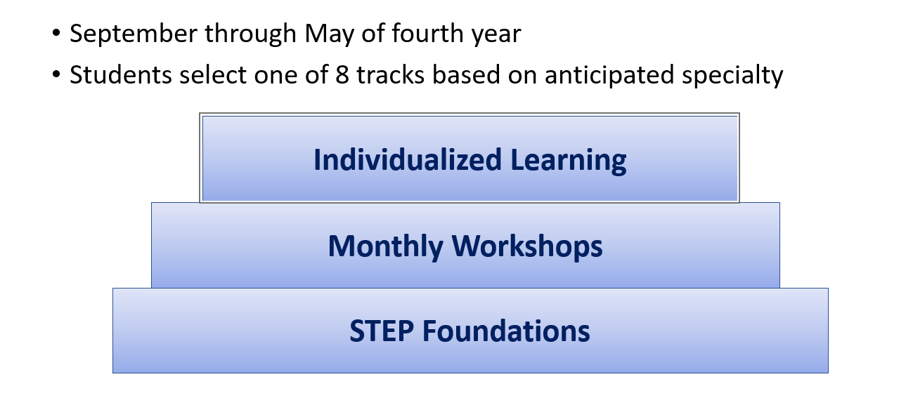
Measey STeP to Residency

Slide 43

Core 3 Canvas Course
Student Affairs Website
Specialty Career Advisors
Physician Scientist Advisors
MSTP Clinical Connections
Jen Kogan
MS4s
Student Affairs Office
Remember: Multiple schedules
can meet your needs
I’m so overwhelmed!
What should I take. . . .
And when should I take what?

