Slide 1
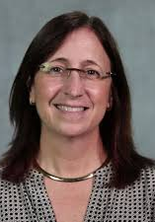
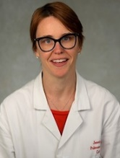
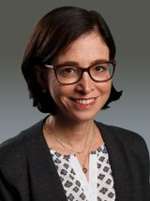
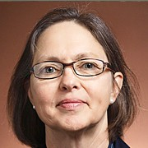
Faculty Life & Professional Development
| First Few Years Series |
Teaching Expectations & Evaluations
Lisa Bellini, MD, Senior Vice Dean, Academic Affairs; Professor of Medicine
Jessica Dine, MD, Associate Dean, Faculty Development; Associate Professor of Medicine
Jennifer Kogan, MD, Associate Dean, Student Success and Professional Development; Professor of Medicine
Judy Shea, PhD, Director, Office of Evaluation and Assessment; Professor of Medicine
Session Date: 10/9, 12PM-1

Slide 2
Faculty Life & Professional Development
| First Few Years Series |
Program
Fall
September: Faculty Tracks
October: Teaching Expectations & Evaluations
November: Research Resources & Support
December: Research & Conflicts of Interest
Spring
January: Your Well Being
February: Working with Industry
March: Mining Clinical Data
April: Networking Virtually
May: Mentoring Up
June: Perks Mash-Up

Slide 3
Faculty Life & Professional Development
| First Few Years Series |
Topics
Protocols
Section I: Teaching Expectations: Categories & Credits
Section II: Teaching Evaluations
Section III: Teaching Effectiveness, Resources & Support
Each section will include an opportunity to ask questions about general guidelines. Please use the chat box
Any questions not addressed during the session will be answered in the follow up email

Slide 4
Our Mission
Perelman School of Medicine
Our mission is to advance knowledge and improve health through research, patient care, and the education of trainees in an inclusive culture that embraces diversity, fosters innovation, stimulates critical thinking, supports lifelong learning, and sustains our legacy of excellence.

Slide 5
Research Patient Care Education
Section I: Teaching Expectations
Achieving teaching excellence starts with knowing what is expected of you in your role as a teacher in clinical, didactic, and small group settings, as well as in your efforts toward mentoring trainees and supervising their scholarship.

Slide 6
Teaching Expectations
General Principles
All faculty on the AC, CE, and Tenure Tracks are required to contribute to the education mission of PSOM
All efforts toward teaching excellence and the overall education mission are highly valued
Faculty will be offered opportunities to improve their teaching as part of the onboarding process, when in need of coaching and remediation, throughout their careers, and for those who so choose, as progress toward becoming educational leaders in the institution

Slide 7
Teaching Expectations: Credit Principles
Research Patient Care Education
Faculty on the AC, CE, and Tenure Track are expected to accrue at least 100 credits per academic year*
Credits are allotted in different denominations (e.g., time, # of learners, etc.) across teaching categories to achieve systematic parity
The PSOM Teaching Definition and Standards Committee determines the number of credits assigned to specific teaching activities (not individuals, course directors, or departments)
Complete explanations of teaching categories and credits are available on the FLPD website. *Department chairs have discretion to modify teaching assignments for individual faculty for compelling reasons

Slide 8
Teaching Expectations: Penn Learners
Research Patient Care Education
It is expected that at least 50% of teaching be completed for Penn learners:
Undergraduates and post-bacc students
Med students
Residents and Fellows (including those at CHOP)
Graduate students
Pre-professional students (NP, PA, Pharm, etc.)
To receive credit for teaching learners who are not a part of the Penn Community, faculty must arrange for and submit teaching event evaluation data
This is not a complete list of potential Penn learners. If more than 50% of your learners in any given academic year do not fall into one of these categories, please reach out to your department EO.

Slide 9
Teaching Expectations: Categories
These teaching categories recognize that at PSOM all contributions to the education mission are critical and highly valued, and that some contributions take forms not traditionally viewed as a part of a faculty member’s role as a teacher.
Lecture
Facilitated Learning
Clinical Teaching
Supervised Scholarship
Longitudinal Mentorship
Lab Rotations, Pre-Thesis, and Short-Term Research-Related Teaching
Assessment Activities
Educational Leadership
Complete explanations of these categories are available on the FLPD website.
Notes:
We will distribute teaching category definitions and credits allotted

Slide 10
Teaching Expectations: Credit Principles
Credits allocated for teaching activities reflect time spent in preparation, exam grading/feedback, and evaluation of teaching activities.
Faculty are responsible for tracking their own teaching credits
Credits should be reported via the Teaching Workbook
Credit reporting should accurately reflect your annual contribution –even if you are well over the 100 credits, please do record your efforts as this information is helpful in annual and academic reviews
If you have any doubt about whether you will meet the annual 100 credit requirement, contact your department EO ASAP. He/she/they will work with you to find teaching opportunities.

Slide 11
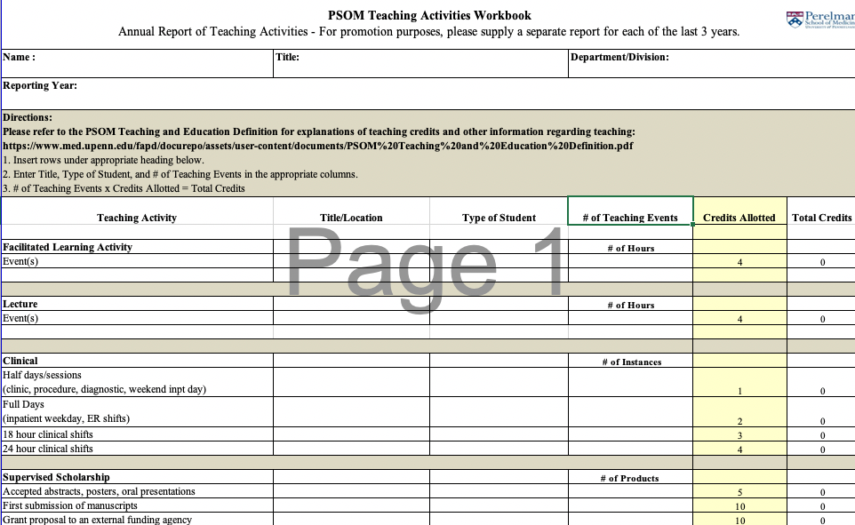
Teaching Expectations: Teaching Workbook
Research Patient Care Education
Tip: Keep the workbook on your desktop / handy so you can easily update it as you go …

Slide 12
Teaching Credits for Categories: Example #1
Research Patient Care Education
Teaching Category: Lecture or Facilitating a Seminar or Small Group
4 Credits per hour
Regardless of # of learners
Regardless of modality (online, in person, pre-recorded)
Notes:
We will distribute teaching category definitions and credits allotted

Slide 13
Teaching Credits for Categories: Example #2
Research Patient Care Education
Teaching Category: Clinical. Credit will be given based on total number of sessions in the ambulatory, diagnostic and procedural areas or total days for OR and inpatient service time as follows:
1 credit for a half-day clinic, procedure or diagnostic session, or weekend inpatient service day spent with trainees.
2 credits for an inpatient service weekday or 8-12 hour ED shift.
4 credits for a 24-hour period in-house on clinical service with trainees.
Notes:
We will distribute teaching category definitions and credits allotted

Slide 14
Teaching Credits for Categories: Example #3
Research Patient Care Education
Teaching Category: Supervised Scholarship. Faculty who work directly with trainees and participate heavily in the design, conduct, analysis and drafting of the scholarly products of trainees are eligible for credit as follows:
Accepted abstracts, posters, oral presentations (internal or external): 5 credits.
Submitted/Accepted manuscripts: 10 credits.
Thesis/Postdoc advisors: 50 credits annually
Grant proposal to an external funding agency: 10 credits
Each type of product can only be claimed once (year of pub)
Trainee must be first or second author
Notes:
We will distribute teaching category definitions and credits allotted

Slide 15
Teaching Credits for Categories: Example #4
Research Patient Care Education
Teaching Category: Longitudinal Mentoring is broadly defined and includes activities that relate to mentoring learners for career development, capstone projects, thesis committee chairs, qualifying exam membership, etc. No teaching credit is allotted for informal mentoring that is an expectation of an academic department, or mentoring performed in the context of a role that is already supported (e.g., duties performed as a Course Director)
Credit for Longitudinal Mentoring and Supervising Scholarship for the same learner cannot be claimed in the same academic year
Each longitudinal mentoring relationship of >8 hours per year = 5 credits
Notes:
We will distribute teaching category definitions and credits allotted

Slide 16
Research Patient Care Education
Section I Questions: Teaching Expectations
Do you have any questions about the general guiding principles of PSOM Teaching Categories & Credits?
Please Note: For specific case questions, see your Division / Department Educational Officer.

Slide 17
Research Patient Care Education
Section II: Teaching Evaluations
For faculty on the Academic Clinician, Clinician Educator, and Tenure tracks, teaching evaluations are an important component of the promotional dossier. Teaching evaluation data is used to ensure your efforts are in line with track and Academic Plan requirements, and of course, to ascertain teaching effectiveness. Teaching effectiveness is one component of the Perelman School of Medicine's tripartite mission.

Slide 18
Teaching Evaluations
Research Patient Care Education
General Principles
Some, but not all, teaching activities are formally evaluated
The PSOM teaching evaluation systems capture some lecture, FLA, and clinical teaching
Evaluating learner groups enter data via the following systems:
Biomedical Graduate Education, PSOM Masters Programs: BLUE
Graduate Medical Education: MedHub
Medical School Students: OASIS
Teaching evaluations are used by department and school COAPs as a component of reviews for reappointment and promotion
Notes:
We will distribute teaching category definitions and credits allotted

Slide 19
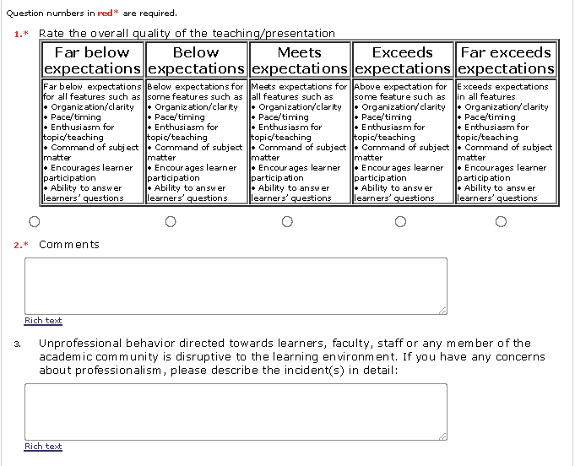
Teaching Evaluation Form
Research Patient Care Education
Notes:
We will distribute teaching category definitions and credits allotted

Slide 20
Teaching Evaluations: TED
Teaching Evaluation Data (TED). Evaluation collection systems funnel data into TED, a reporting tool for reviewing formally evaluated teaching activities.
You can access your TED report anytime via my.med
Every six months, you will be emailed a link to your updated TED report
AT LEAST every six months, review your teaching evaluation data to ensure the following:
Evaluation scores
Learner comments!

Slide 21
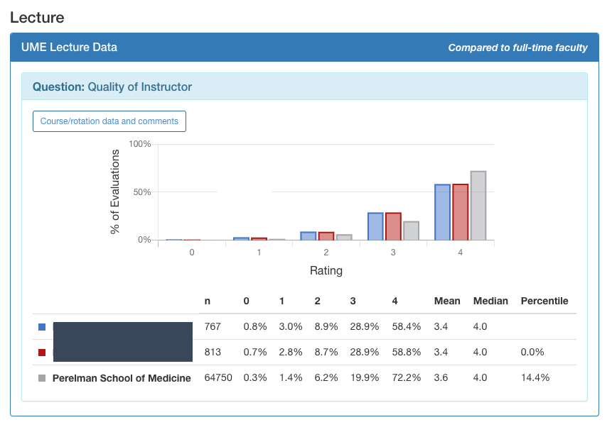
Teaching Evaluations: TED Basic Report
Research Patient Care Education
Q. Rate the overall quality of the teaching / presentation
Notes:
We will distribute teaching category definitions and credits allotted

Slide 22
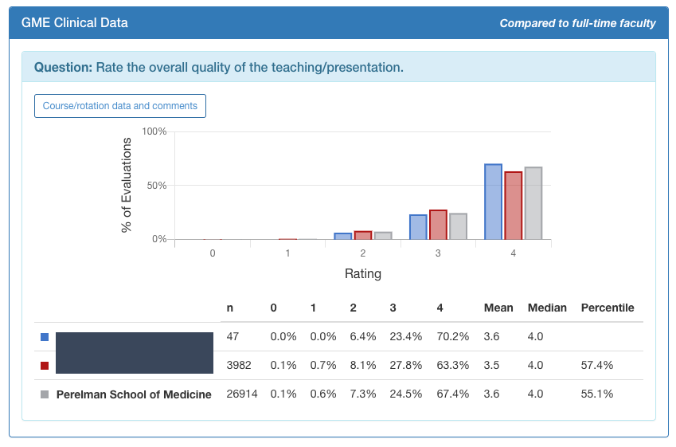
Teaching Evaluations: TED Basic Report
Research Patient Care Education
Q. Rate the overall quality of the teaching / presentation
Notes:
We will distribute teaching category definitions and credits allotted

Slide 23
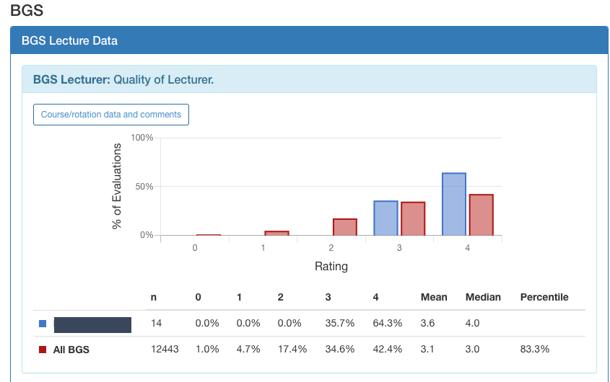
Teaching Evaluations: TED Basic Report
Research Patient Care Education
Q. Rate the overall quality of the teaching / presentation
Notes:
We will distribute teaching category definitions and credits allotted

Slide 24
Teaching Evaluations: Notes on “Unevaluated” Teaching
Research Patient Care Education
Some forms of teaching are not/cannot be evaluated and then reported via TED
Assessment activities
Educational service and leadership (e.g., course directorships)
Lab rotations/pre-thesis research
Longitudinal mentorship
Supervised scholarship
You should track all teaching quantity, including these forms of teaching, in the Teaching Workbook (even beyond your 100 credit per academic year requirement)
When delivering talks for non-Penn learners, ask hosting institution to provide you with evaluations (e.g., any CME events) or use the PSOM evaluation form to collect learner data
Reach out to your Education Officer as needed –and at least once a year
Notes:
We will distribute teaching category definitions and credits allotted

Slide 25
Teaching Evaluations: Reappointment & Promotion Reviews
At review time … If a considerable amount of teaching that you do is not reportable via TED, then you may be asked by your Education Officer for supplementary materials, such as letters from trainees or documentation of trainee productivity through scholarship or other projects.
Notes:
We will distribute teaching category definitions and credits allotted

Slide 26
Teaching: Myths, Poor Advice, & Just Plain Ol’ Bad Info
Research Patient Care Education
“Don’t teach”
“Don’t teach medical school students”
“Don’t teach your first few years”
“One bad teaching evaluation will tank your promotion”
“Teaching in some categories counts more and/or means more to COAP than others” (e.g., teaching medical students is more important than facilitating a lab rotation)
“Teaching in other Penn schools counts less and/or means less than teaching via PSOM”
“COAP doesn’t really care about teaching”

Slide 27
Research Patient Care Education
Section II Questions: Teaching Evaluations
Do you have any questions about the general guiding principles of Teaching Evaluations?
Please Note: For specific case questions, see your Division / Department Educational Officer.

Slide 28
Section III: Teaching Effectiveness, Resources, & Support
We recognize that few faculty members are formally trained in teaching. It can be challenging to develop teaching skills while you are establishing yourself as a clinician or getting your research up and running. The goal of the Advance teaching program is to provide you with resources and support to hone your teaching.

Slide 29
Teaching Professional Development
Educational Leadership
Select Faculty
Specializations
Most Teaching Faculty
Foundational Competencies
Feedback
Learning Environments
Goals & Objectives
All Teaching Faculty

Slide 30
Scheduled Options
You
Online Engagement with Peers
Micro-Learning Videos
Print & Go
Mentoring & Coaching
Relationships & Roles
Just in Time Learning
Enduringly Available Options

Slide 31
Teaching Professional Development
med.upenn.edu/flpd/

Slide 32
Teaching Professional Development
med.upenn.edu/flpd/
Canvas Online Asynchronous Courses
Teaching @ PSOM 101 (Goals & Objectives, Learning Environments, Feedback)
Coaching for Quality & Improvement
Managing Discriminatory Patient Encounters While Teaching
Providing Effective Feedback II & III
Teaching Clinical Reasoning I & II
Teaching Residents & Fellows to Disclose
The Intergenerational Workplace & Teaching
Writing Letter of Recommendation for Trainees

Slide 33
Teaching Professional Development
med.upenn.edu/flpd/
Just-In-Time Micro-Learning Videos
The Profession & Role
Professionalism in Teaching
Dynamic Supervision
Reporting Harassment/Mistreatment of Learners
The Six-Module Curriculum
Medical Students in the First Five Months
Small Group Curriculum Context
Team Training
Lecture and Curric Integration
Lectures
Effective Pre-Clinical Lectures
Clinical Lectures
Small Group Facilitation
Pedagogical Value and Strategies
Classroom Management
Clinical Teaching
Priming Clinical Trainees
Prioritizing in Clinical Training
BGS
Learners & Lab Rotations
PhD Students
GME
Programs
Clinical Learning Evaluation Program

Slide 34
Teaching Professional Development
med.upenn.edu/flpd/
Experts
Associate Dean of Faculty Development
Associate Dean of Student Success & Professional Development
Department Education Officers
Clerkship Directors
Course Directors
Program Directors
Your Department Education Officer (EO) is your first-line, go-to expert for all things teaching. They are leaders, mentors and experts in connecting you with teaching opportunities, resources, and support for success.

Slide 35
Teaching Professional Development
med.upenn.edu/flpd/
Tools
Teaching Tools
Best Practices Tip Sheet: Clinical Teaching
Best Practices Tip Sheet: Small Groups
Best Practices Tip Sheet: Learning Environments
Best Practices Tip Sheet: Learner-Focused Lectures
Best Practices Tip Sheet: Lectures Delivered Online
Best Practices Tip Sheet: Integrating Poll Everywhere for Online Presentations
Best Practices Tip Sheet: Professionalism
Best Practices Tip Sheet: Supervision
Peer Coaching
Faculty Self-Assessment
EO Tool for Faculty Evaluation
Initial Meeting with Faculty
Getting Learner Input
Faculty Development Plan
Peer Observation Forms
Clinical Observation Form
Lecture Observation Form
Instrument for Peer Assessment of Medical Lecturing
Small Group Observation Form
Surgical Observation Form

Slide 36
Research Patient Care Education
Section III Questions: Teaching Professional Development
Do you have any general questions Teaching Professional Development?
Please Note: For specific case questions, see your Division / Department Educational Officer.

