Slide 1

Mechanically Testing Bone Tissue
Snehal Shetye, Rob Mauck

Slide 2
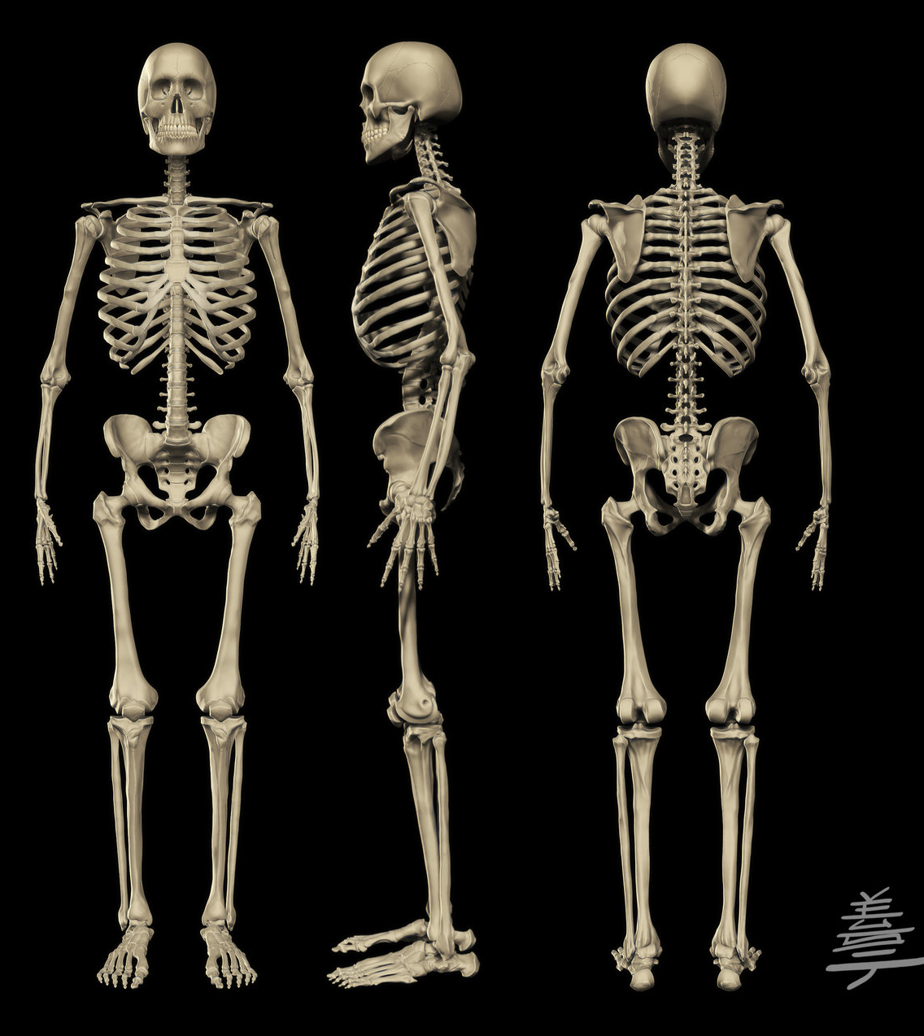
Function of the Skeleton
Support and protection for internal organs
Attachment sites for muscles allowing movement of limbs
Structure support for bone marrow and blood vessels
Mineral reservoir for calcium and phosphorus
Endocrine organ
  Osteocalcin
  FGF23

Slide 3
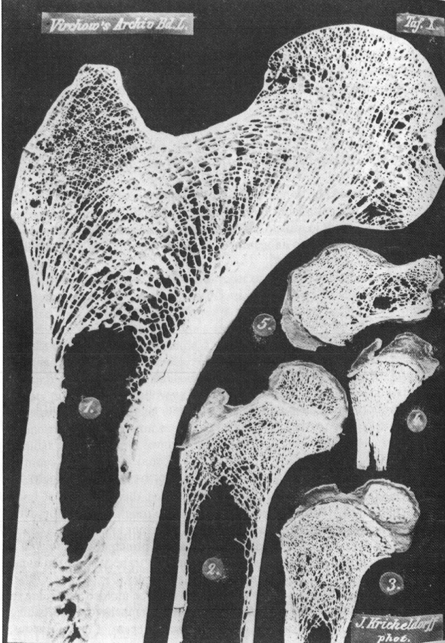
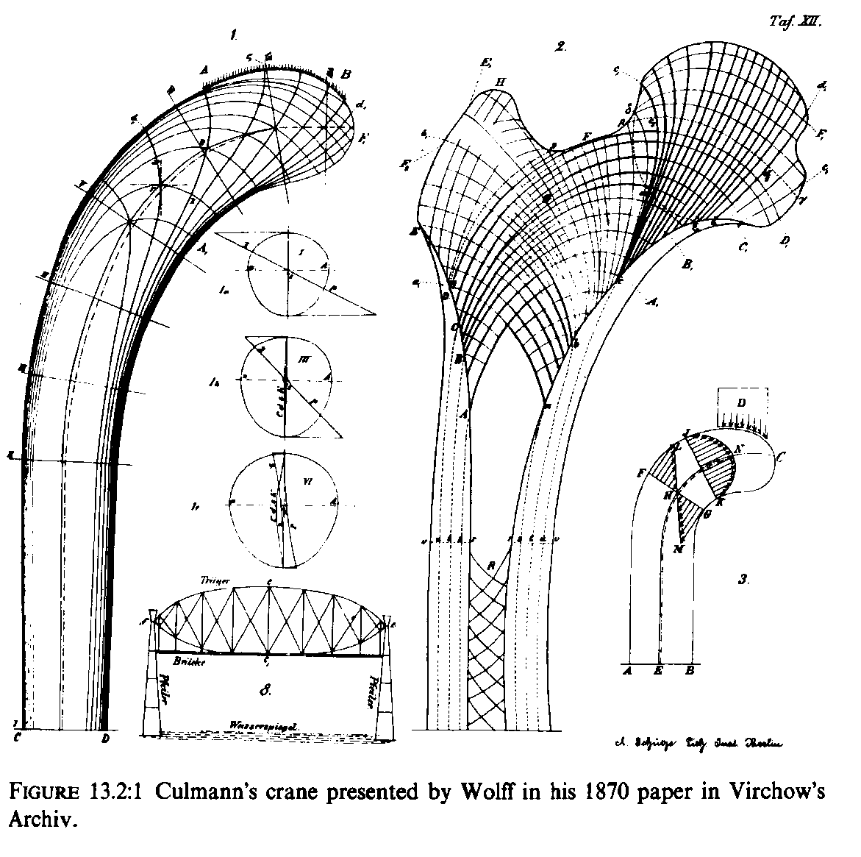
Adaptation to Load
G.H. von Meyer’s trabecular bone architecture in human femur (1867)
Principal stress trajectories of Culmann’s crane and human femur (1870)

Slide 4
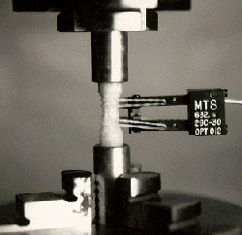
Tension/Compression Test
Bone material property (mesoscale)
Bone ends embedded in metal end caps
Testing machine slowly applies force to specimen
Force
Extensometer arms firmly attached with rubber bands
Test region
Deformation

Slide 5
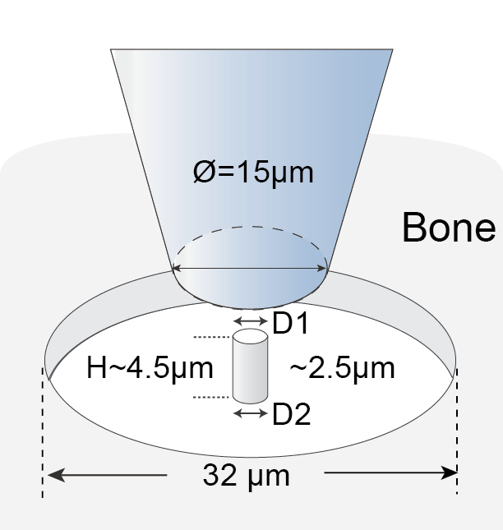
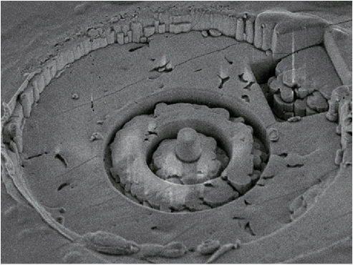
Compression test
Bone material property (microscale)
  Bone micropillar manufactured by focused ion beam
  Uniaxial compression
  Stress-Strain curve
Stress
Strain

Slide 6
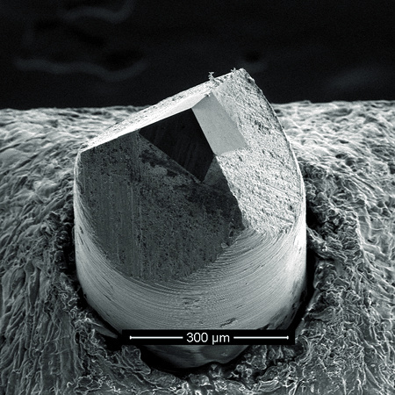
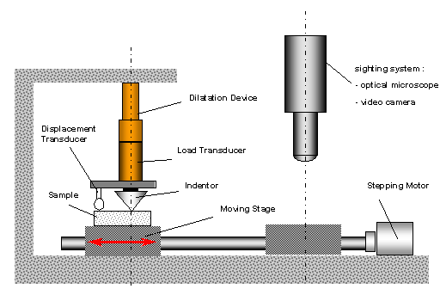
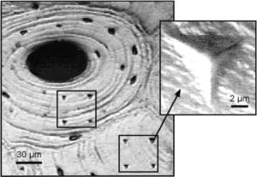
Nanoindentation
Bone material property (nanoscale)
Birkovich tip

Slide 7
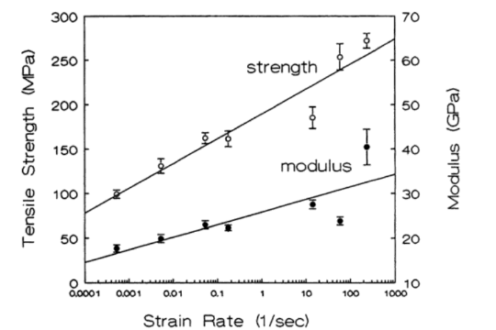
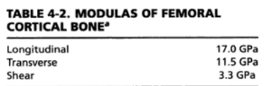
Load Response of Bone
Cortical bone

Slide 8
Load Response of Bone
Trabecular bone

Slide 9
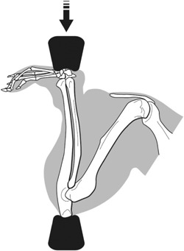
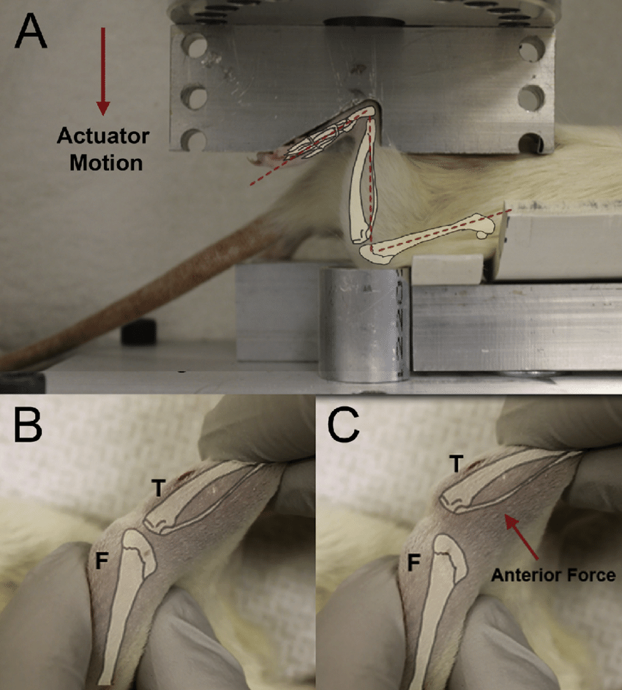
In Vivo loading of bone
Ulnar overloading
Non-invasive ACL rupture
Tibial overloading

Slide 10
3-point Bending
Load (F)
3-point test

Slide 11
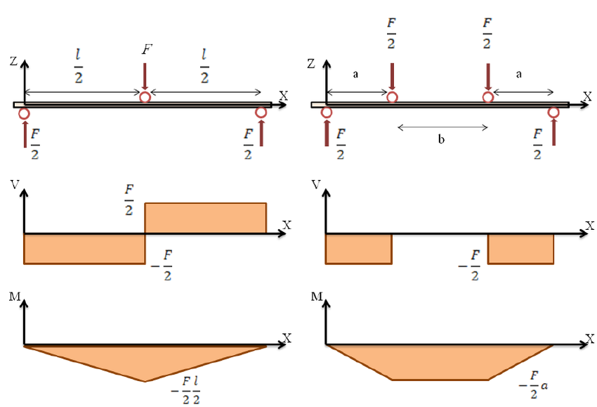
Shear and Moment Diagram
Maximum moment at center point of beam

Slide 12
4-point Bending
Load
4-point test

Slide 13
Shear and Moment Diagram
Maximum moment spans distance between top actuators

Slide 14

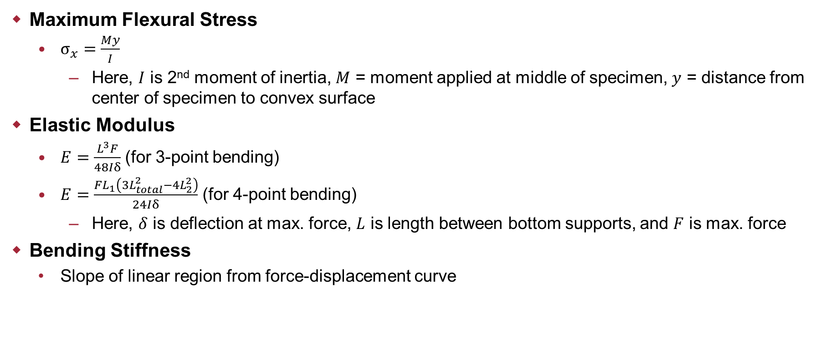
Parameters
Compression
$$y$$
Maximum Flexural Stress
  $σ_{x}=\frac{My}{I}$
    Here, $I$ is 2nd moment of inertia, $M$ = moment applied at middle of specimen, $y$ = distance from center of specimen to convex surface
Elastic Modulus
  $E=\frac{L^{3}F}{48Iδ}$ (for 3-point bending)
  $E=\frac{FL_{1}\left(3L_{total}^{2}−4L_{2}^{2}\right)}{24Iδ}$ (for 4-point bending)
    Here, $δ$ is deflection at max. force, $L$ is length between bottom supports, and $F$ is max. force
Bending Stiffness
  Slope of linear region from force-displacement curve
Tension

Slide 15
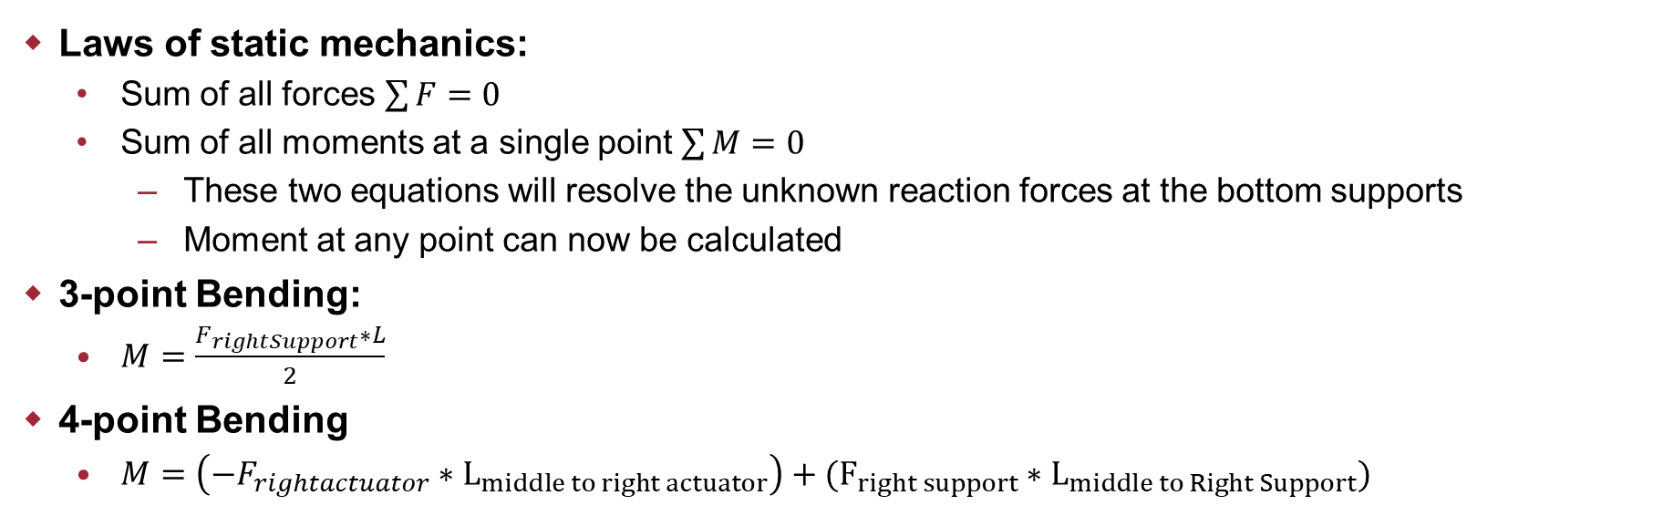
How do we calculate $M$?
Laws of static mechanics:
  Sum of all forces $\sum{F}=0$
  Sum of all moments at a single point $\sum{M}=0$
    These two equations will resolve the unknown reaction forces at the bottom supports
    Moment at any point can now be calculated
3-point Bending:
  $M=\frac{F_{rightSupport}∗L}{2}$
4-point Bending
  $M=\left(−F_{rightactuator}∗L_{middle to right actuator}\right)+(F_{right support}∗L_{middle to Right Support})$

Slide 16
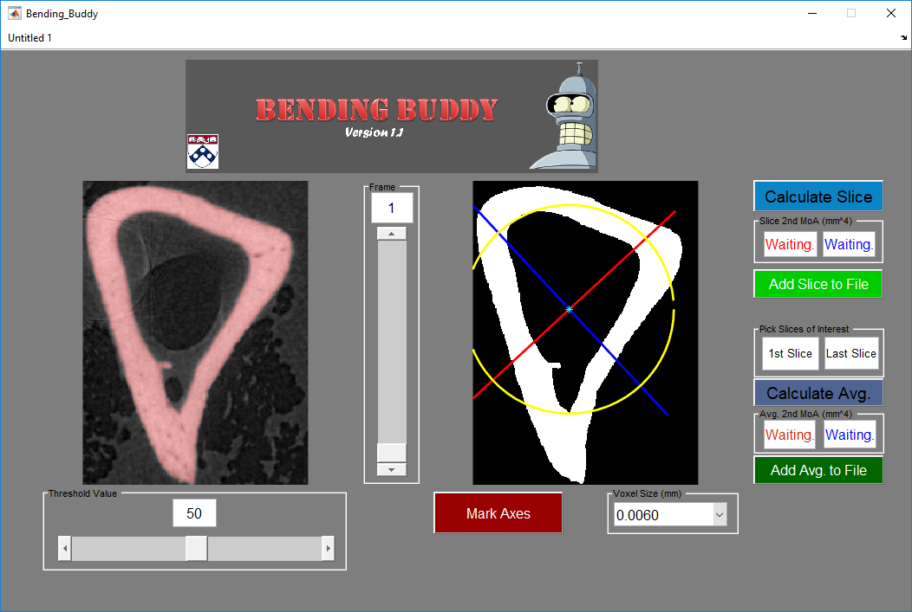
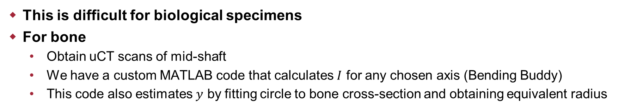
How do we calculate $I$?
This is difficult for biological specimens
For bone
  Obtain uCT scans of mid-shaft
  We have a custom MATLAB code that calculates $I$ for any chosen axis (Bending Buddy)
  This code also estimates $y$ by fitting circle to bone cross-section and obtaining equivalent radius

Slide 17
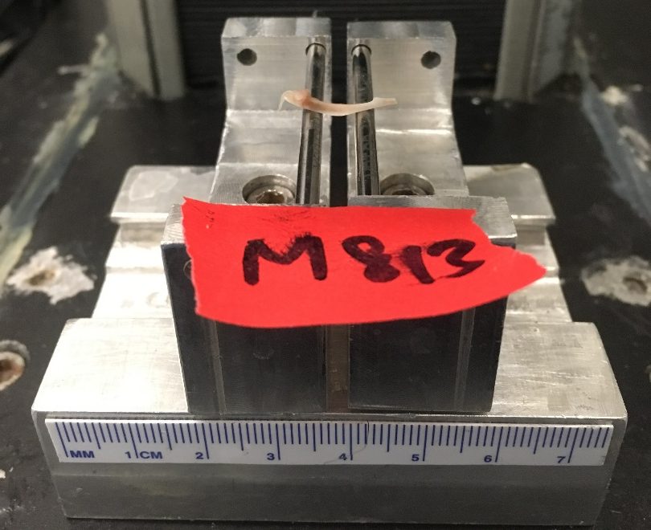
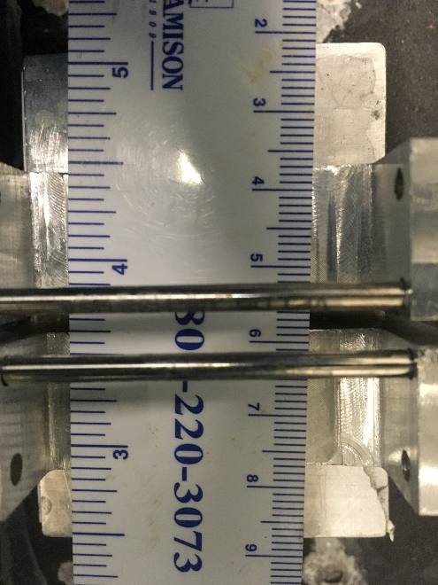
Stuff to Consider
Measure length of all your samples to determine proper support spacing
3-point bending not recommended for fractured bone
4-point bending is generally always recommended over 3-point unless tissue is too small
Torsion tests work well for fractured specimens
Most ideal to test all samples on same day (day-to-day variation in test setup can influence results)
Keep orientation constant for all samples!
  Find a stable orientation such that bone does not rotate while being loaded

Slide 18
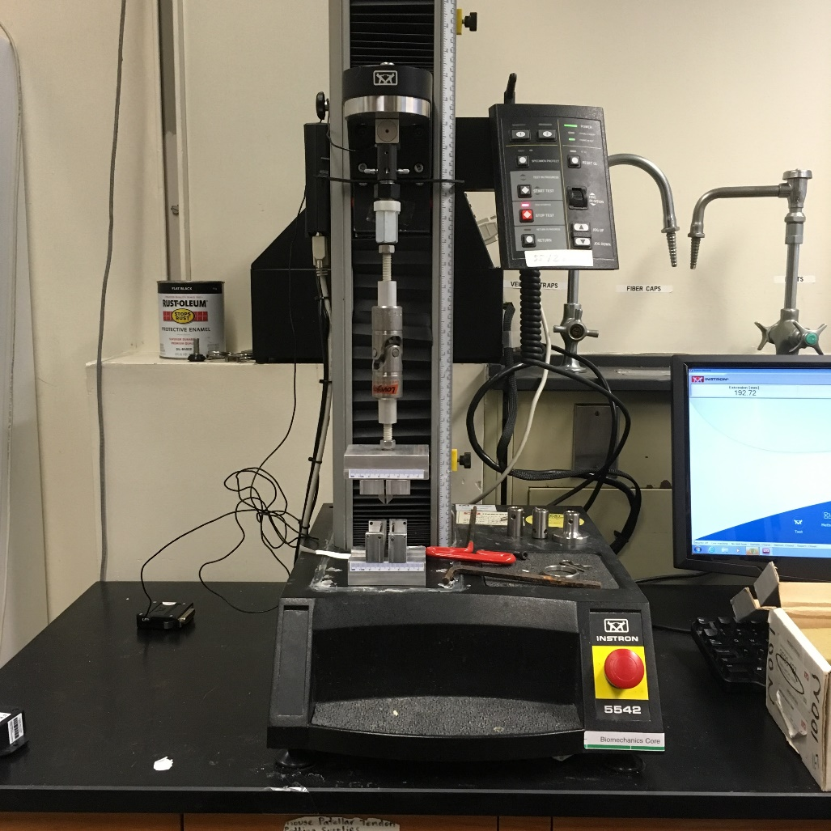
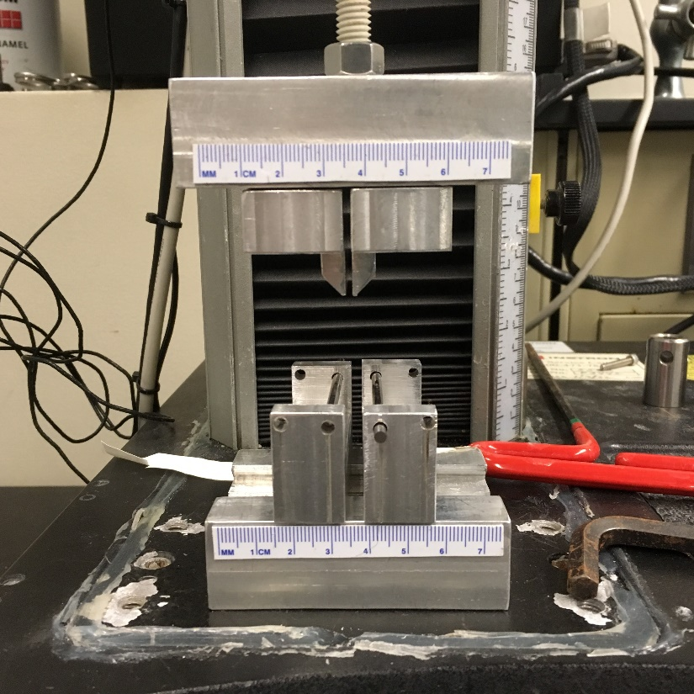
Example
4-point bend setup

Slide 19
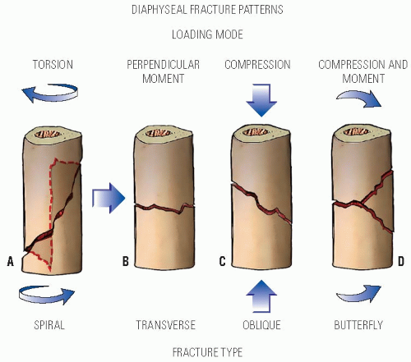
Failure modes in bone

Slide 20
When to use torsion tests?
3-pt or 4-pt bend tests work well for intact specimens
Fractured samples
  3-pt test will cause significant stress concentrations at the contact point
    Usually that is where the fracture/callus is
    Definitely not recommended
  4-pt test loading points should span the healing site
    Difficult to achieve on mouse femora/tibiae
    Cannot control size and location of fracture callus
  Torsion
    Usually have unobstructed access to epiphysis
    Only test that evaluates the entire free length of the bone
    Does need 6-dof fixation at the termini
    Takes longer for prep and setup
Load (F)
Load

Slide 21
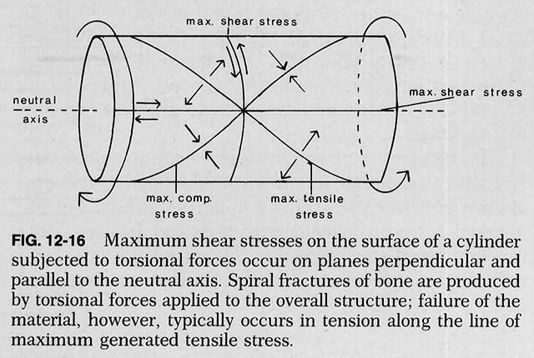
Torsion testing

Slide 22
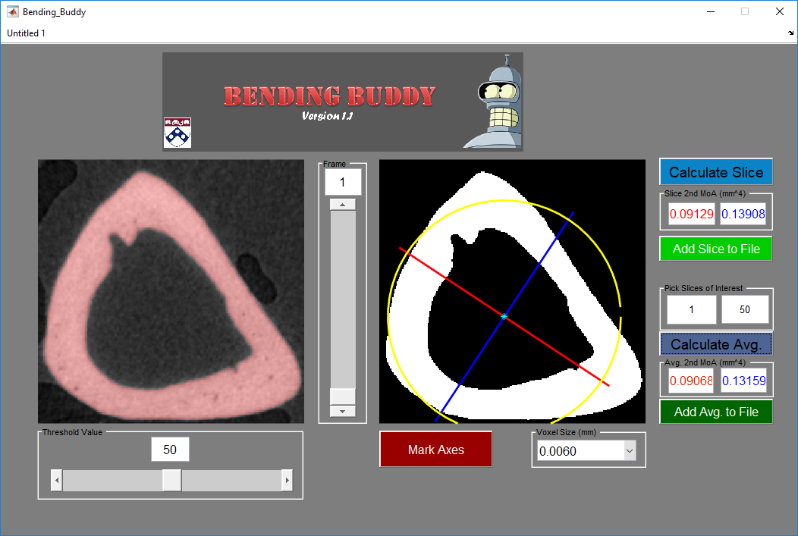
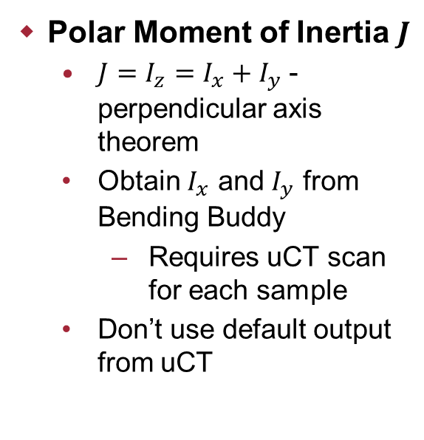
Torsion Parameters
Polar Moment of Inertia $J$
  $J=I_{z}=I_{x}+I_{y}$ - perpendicular axis theorem
  Obtain $I_{x}$ and $I_{y}$ from Bending Buddy
    Requires uCT scan for each sample
  Don’t use default output from uCT

Slide 23
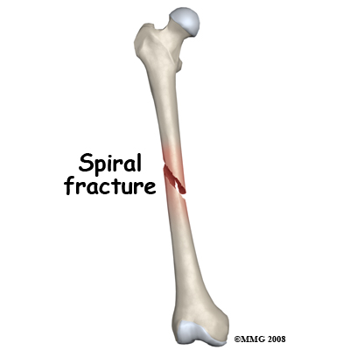
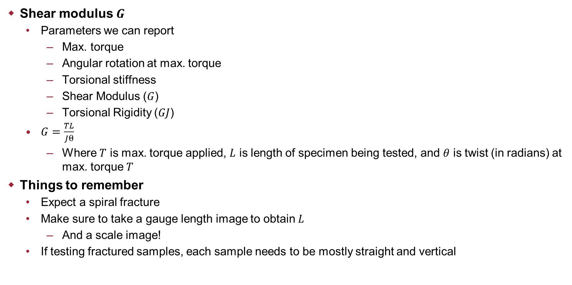
Polar moment of inertia $J$
Shear modulus $G$
  Parameters we can report
    Max. torque
    Angular rotation at max. torque
    Torsional stiffness
    Shear Modulus ($G$)
    Torsional Rigidity ($GJ$)
  $G=\frac{TL}{Jθ}$
    Where $T$ is max. torque applied, $L$ is length of specimen being tested, and $θ$ is twist (in radians) at max. torque $T$
Things to remember
  Expect a spiral fracture
  Make sure to take a gauge length image to obtain $L$
    And a scale image!
  If testing fractured samples, each sample needs to be mostly straight and vertical

Slide 24
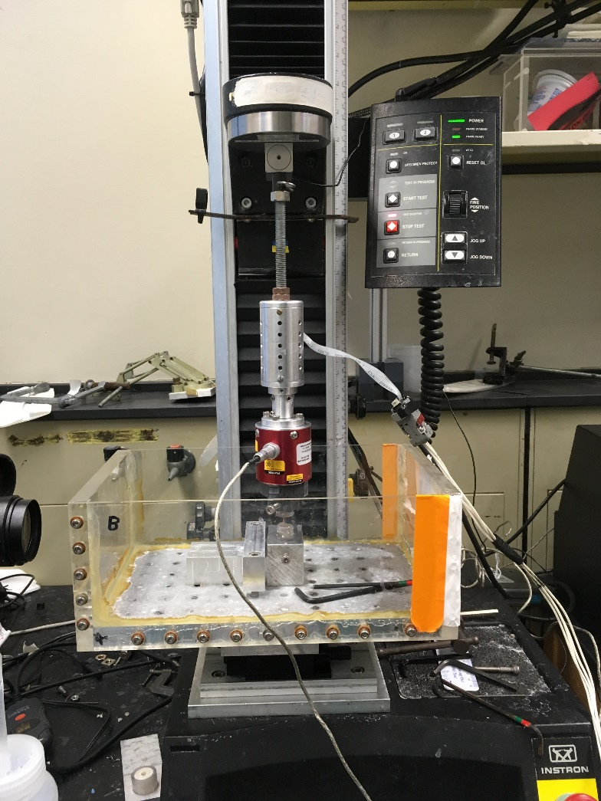
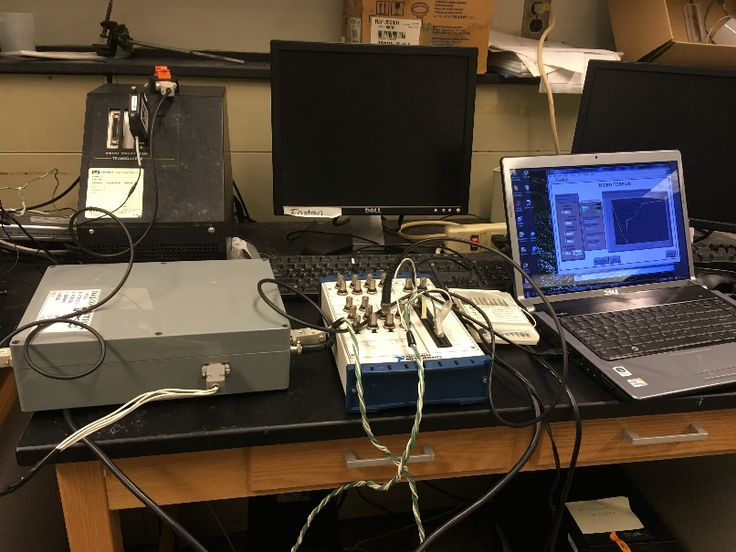
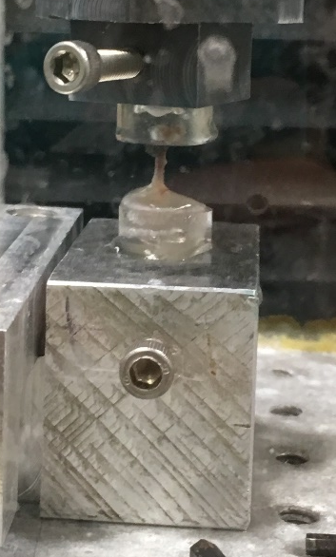
Torsion Testing

