Slide 1

Acyanotic CHD
Jennifer Tingo, MD

Slide 2
Congenital Heart Disease Basics
0.8/1000 live births
Most common congenital heart lesion in childhood:
  VSD→actually probably BAV
  PS, ASD, PDA
Most common cyanotic heart disease in childhood: tetralogy of Fallot
  Most common cyanotic heart disease in a newborn→
    Transposition of the Great Arteries

Slide 3
Case 1
12 year old male
  Healthy, no recent illnesses. Feels well.
  Presents for abnormal ECG during school sports screening exam.

Slide 4
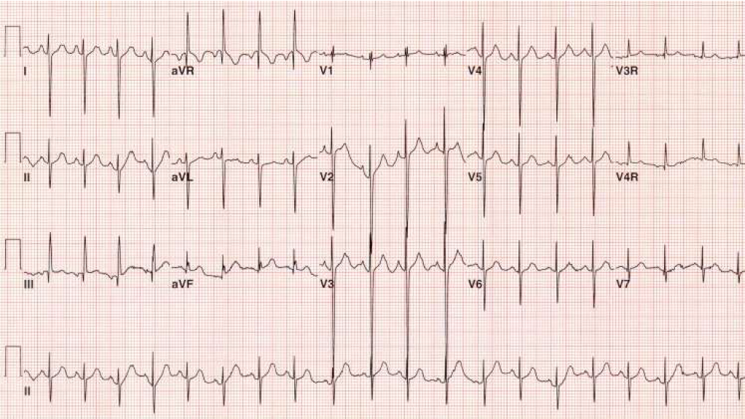
Notes:
RAD
RVH (upright T wave n V1, deep S wave in V6)

Slide 5
What physical exam finding is most likely in this patient?
II/VI Systolic ejection murmur at the RUSB that sounds louder upon standing than supine.
Fixed split S2
III/VI blowing, holosystolic murmur most prominent at the apex.
S3 gallop
Notes:
Fixed split S2

Slide 6
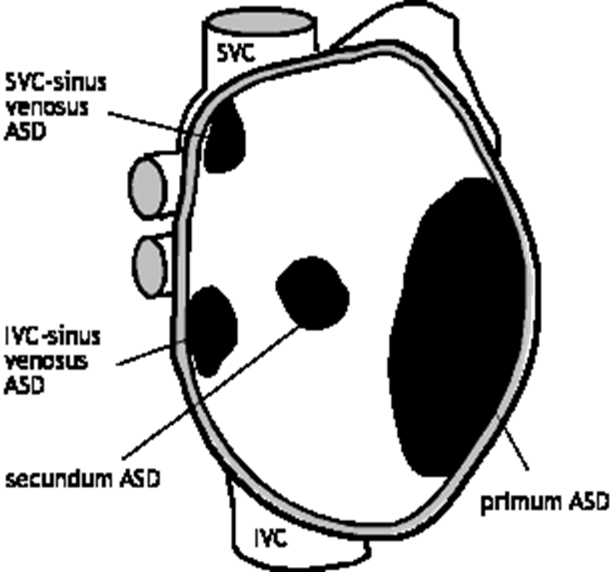
Atrial Septal Defects
10% of Congenital heart disease
Female predominance
Syndrome associations: Holt Oram
4 Types
  Secundum most common
Notes:
Holt Oram. AD, abnormally developed bones in the upper limbs (wrists/hands) and heart problems (ASD). TBX5 gene.

Slide 7
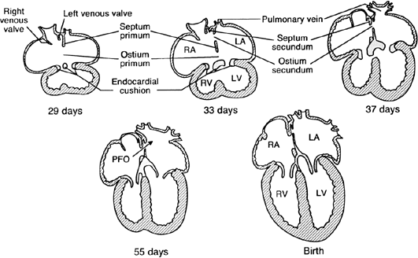
Notes:
Septum primum forms from top.
--Supposed to meet bottom- if not, ostium primum.
--Cell death ant/sup portion of septum primum=>ostium secundum
--To the R of septum primum, septum secundum forms.
-- Septum secundum- limbus of fossa, septum primum is valve

Slide 8
A large atrial level shunt should cause….
Dilation of the right ventricle
Dilation of the left ventricle
Right ventricular hypertrophy
Left ventricular hypertrophy
Notes:
A

Slide 9
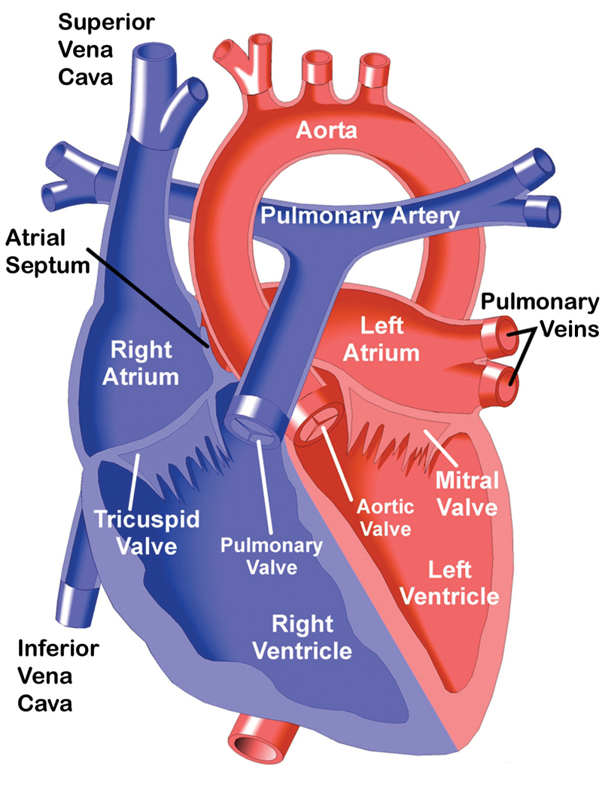
Physiology
Left to right shunt at the atrial level
  Occurs during diastole
  Dependent upon ventricular compliance
Right atrial, Right ventricular and PA enlargement
Increased pulmonary blood flow

Slide 10
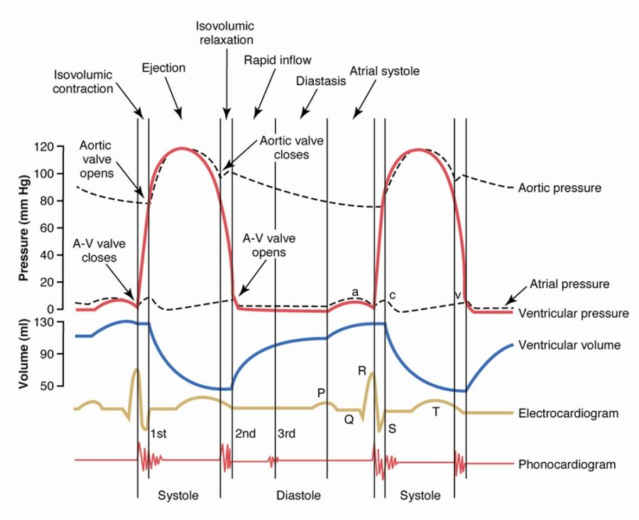

Slide 11
Course
Often asymptomatic
  Rare to see growth failure
Presentation is usually murmur or EKG abnormality
Older children and adults may have dyspnea on exertion
Long term consequences
  Heart failure, arrhythmias, pulmonary hypertension
  Extremely rare before the 4th and 5th decade

Slide 12
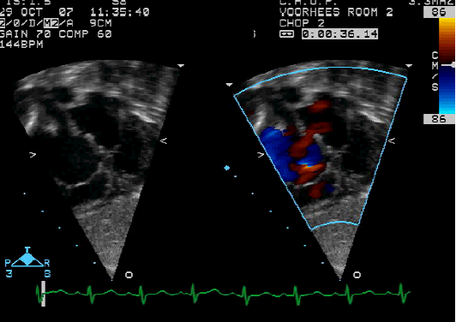
Diagnosis
Physical exam:
  RV systolic lift at LSB
  Widely split (may not be fixed) S2
  Pulmonary flow murmur
    2-3/6 systolic ejection murmur at LUSB radiating to back
  Short, rumbling mid- diastolic murmur at LLSB (subtle)
    Increased flow across the tricuspid valve
EKG
  Right axis deviation, right ventricular conduction delay (rSR’), RVH
  Not in primum defects!!
Echocardiogram makes the diagnosis

Slide 13
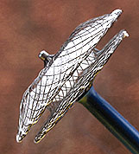
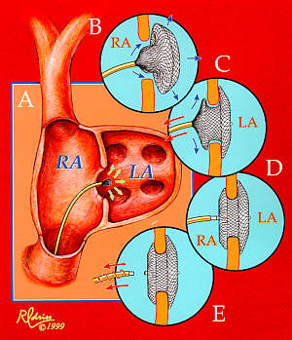
Management
Secundum defects do decrease in size and may close
  Dependent upon size of defect
  If over 6-8mm in size, much less likely to close spontaneously
  Small defects (<3mm) without a significant volume overload on right heart no indication for intervention
Usually elective repair at school age
  No advantage in delaying much beyond this age but no change in outcome if repaired in early childhood versus late.
Surgical
  0.4% mortality (1998 study, 2471 patients 1984-1995). 6 of the 9 deaths were infants
Cardiac cath
  Device occlusion (Amplatzer, Cardioform)
  Erosion risk (0.03-0.05%).
Results after surgical or device closure are excellent, with rapid resolution of symptoms, normalization of EKG and decrease of heart size to normal

Slide 14
6 week old male presents to your office with tiring to feed x 2 weeks and poor weight gain (~10gm/day over the last 4 weeks). Physical exam reveals normal vital signs but you note mild increased work of breathing with subcostal retractions, liver edge palpable 2cm below the RCM and a III/VI holosystolic murmur loudest at the LLSB. The next most appropriate intervention is…

Slide 15
A. Referral for surgical intervention
B. Referral for cardiac cath and possible intervention
C. Increase the caloric density of the feeds
D. Start Digoxin and increase the caloric density of the feeds
E. Start furosemide and increase the caloric density of the feeds
Notes:
E

Slide 16
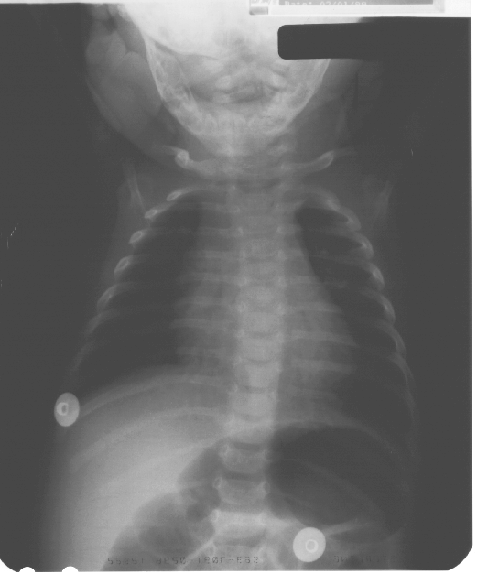
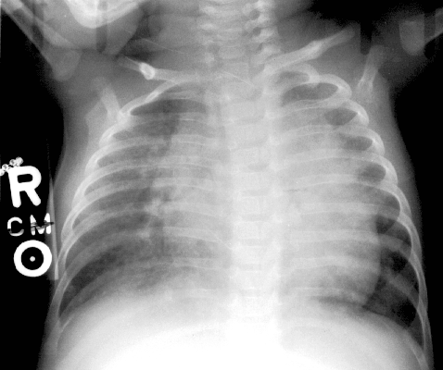
Normal Case 1

Slide 17
Ventricular Septal Defect (VSD)
Most common CHD lesion (excluding bicuspid AoV)
20% of congenital heart disease
  Slight female predominance
Most common lesion in a child with a chromosomal abnormality
  However, >95% of patients with VSD have normal chromosomes
Subtypes:
  Membranous/Conoventricular (80%)
    After 1 year
  Muscular (5-20%)
    Most common In a newborn but majority close spontaneously <1 yr of age
  Outlet (5-7%)
  Inlet (5-8%)
    AV canal type

Slide 18
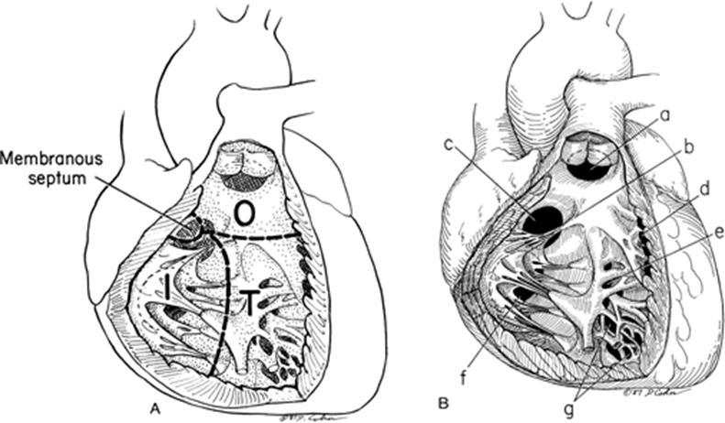

Slide 19

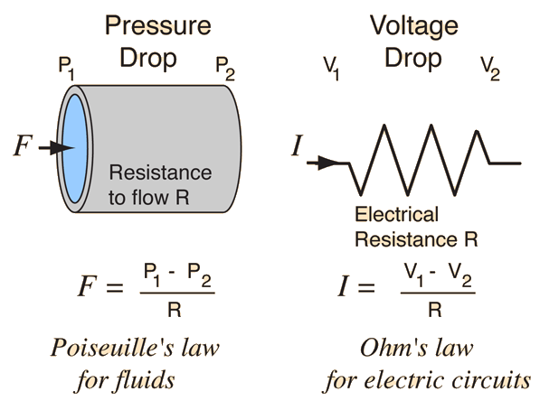
Physiology
Left to right shunt at the ventricular level
What determines flow across a hole?
Change in pressure = Flow (Velocity) x Resistance
  OR
Flow= ΔPressure/Resistance
Notes:
Ohms Law is Voltage= current x resistance

Slide 20
What causes blood to flow from LV to RV in an infant with a large VSD?
A. Difference in pressure between the ventricle
B. Difference in size between the two chambers
C. Difference in resistance between the pulmonary vasculature and systemic vasculature
D. Blood flow is low velocity and bidirectional when you have a large VSD
Notes:
C

Slide 21
Physiology
  Flow= ΔPressure/Resistance
Small size
  Large pressure difference between ventricles (no change in RV pressure)
  Increased velocity of flow across defect (turbulence)—>Loud murmur
  Small amount of flow
Moderate size
  Smaller pressure difference between ventricles (>20 mmHg)
  Decent amount of flow but some resistance still resistance
Large size
  Equal systemic pressure in both ventricles
  Flow determined by PVR/SVR
  Large difference in resistance = Large shunt
    Slower rate of drop of PVR. PVR normally declines to adult levels by 7-10days but with large VSDs, this rate of decline is slower→ protective- prevents early massive shunting through the VSD
Notes:
How do you calculate resistance to flow; Poiseuille’s Equation: Basically three factors are related: Vessel diameter (or radius), Vessel length, and viscosity of blood. Most important is diameter…

Slide 22
Physiology
Increased volume load on the left ventricle and pulmonary vasculature:
  Dilation of LA/LV
  Pulmonary HTN
  PA dilation
  Pulmonary edema, Pulmonary venous congestion
  Heart Failure
The amount of shunt increases as PVR falls over first 6-8 weeks of life.
Development of pulmonary edema is dependent upon how much systemic pressure is transmitted to the pulmonary capillary bed**
Notes:
Important concept. Why ASD’s NEVER get pulmonary edema.
Starling equation: the role of hydrostatic and oncotic forces in the movement of fluid across capillary membranes

Slide 23
Clinical signs and symptoms
Small VSD:
  Asymptomatic
  High frequency, holosystolic murmur
  Normal P2
  Close < 2y/o
Large VSD
  Dyspnea; Feeding difficulties; FTT; sweaty
  Recurrent respiratory infections. Nml height.
  40-50% will need Surgery
  Physical exam:
    Prominent left precordium (LV heave)
    Palpable thrill
    Grade 2-4/6 harsh, holosystolic at lower left sternal border to apex
    Loud P2
    Mid-diastolic rumble at apex (mitral valve)
      Qp/Qs>2

Slide 24
Diagnosis
EKG
  Large defects: LVH and/or biventricular hypertrophy (later)
Chest Xray
  Cardiomegaly
  Increased pulmonary vascular markings, possible edema
Small defects will have normal ECG and CXR.

Slide 25
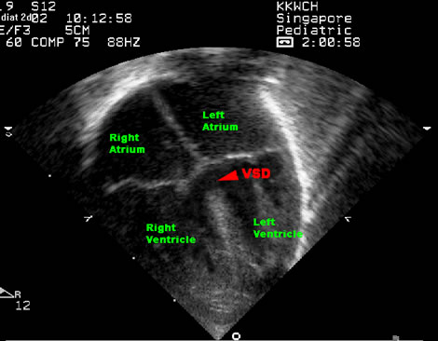
Notes:
Diagnostic

Slide 26
Management
Muscular and Perimembranous/Conoventricular
  Treat for symptoms and growth failure
  Increase calories
  Medical therapy:
    Diuretics
    Second line: debated→ACEi and/or Digoxin
  Continuing to have growth failure→Surgical Closure
Inlet and Outlet VSDs rarely close spontaneously
  Outlet VSDs may cause aortic valve prolapse and regurgitation
Other indications for closure in smaller defects
  Recurrent endocarditis
  Evidence of LV volume overload
  Recurrent respiratory infections

Slide 27
Long term
Unrestrictive shunts have increased risk of development of irreversible pulmonary hypertension
Repair large defects “electively” after 6 months of age
  Before 12 months
Surgical mortality 1-2%
  Risk of heart block ~3%
  No endocarditis prophylaxis before or after repair unless there is a residual shunt

Slide 28
Case 3
6 month old, thriving
  Referred for murmur
Physical exam with a III/VI continuous murmur, loudest just below the left clavicle
Bounding pulses throughout

Slide 29
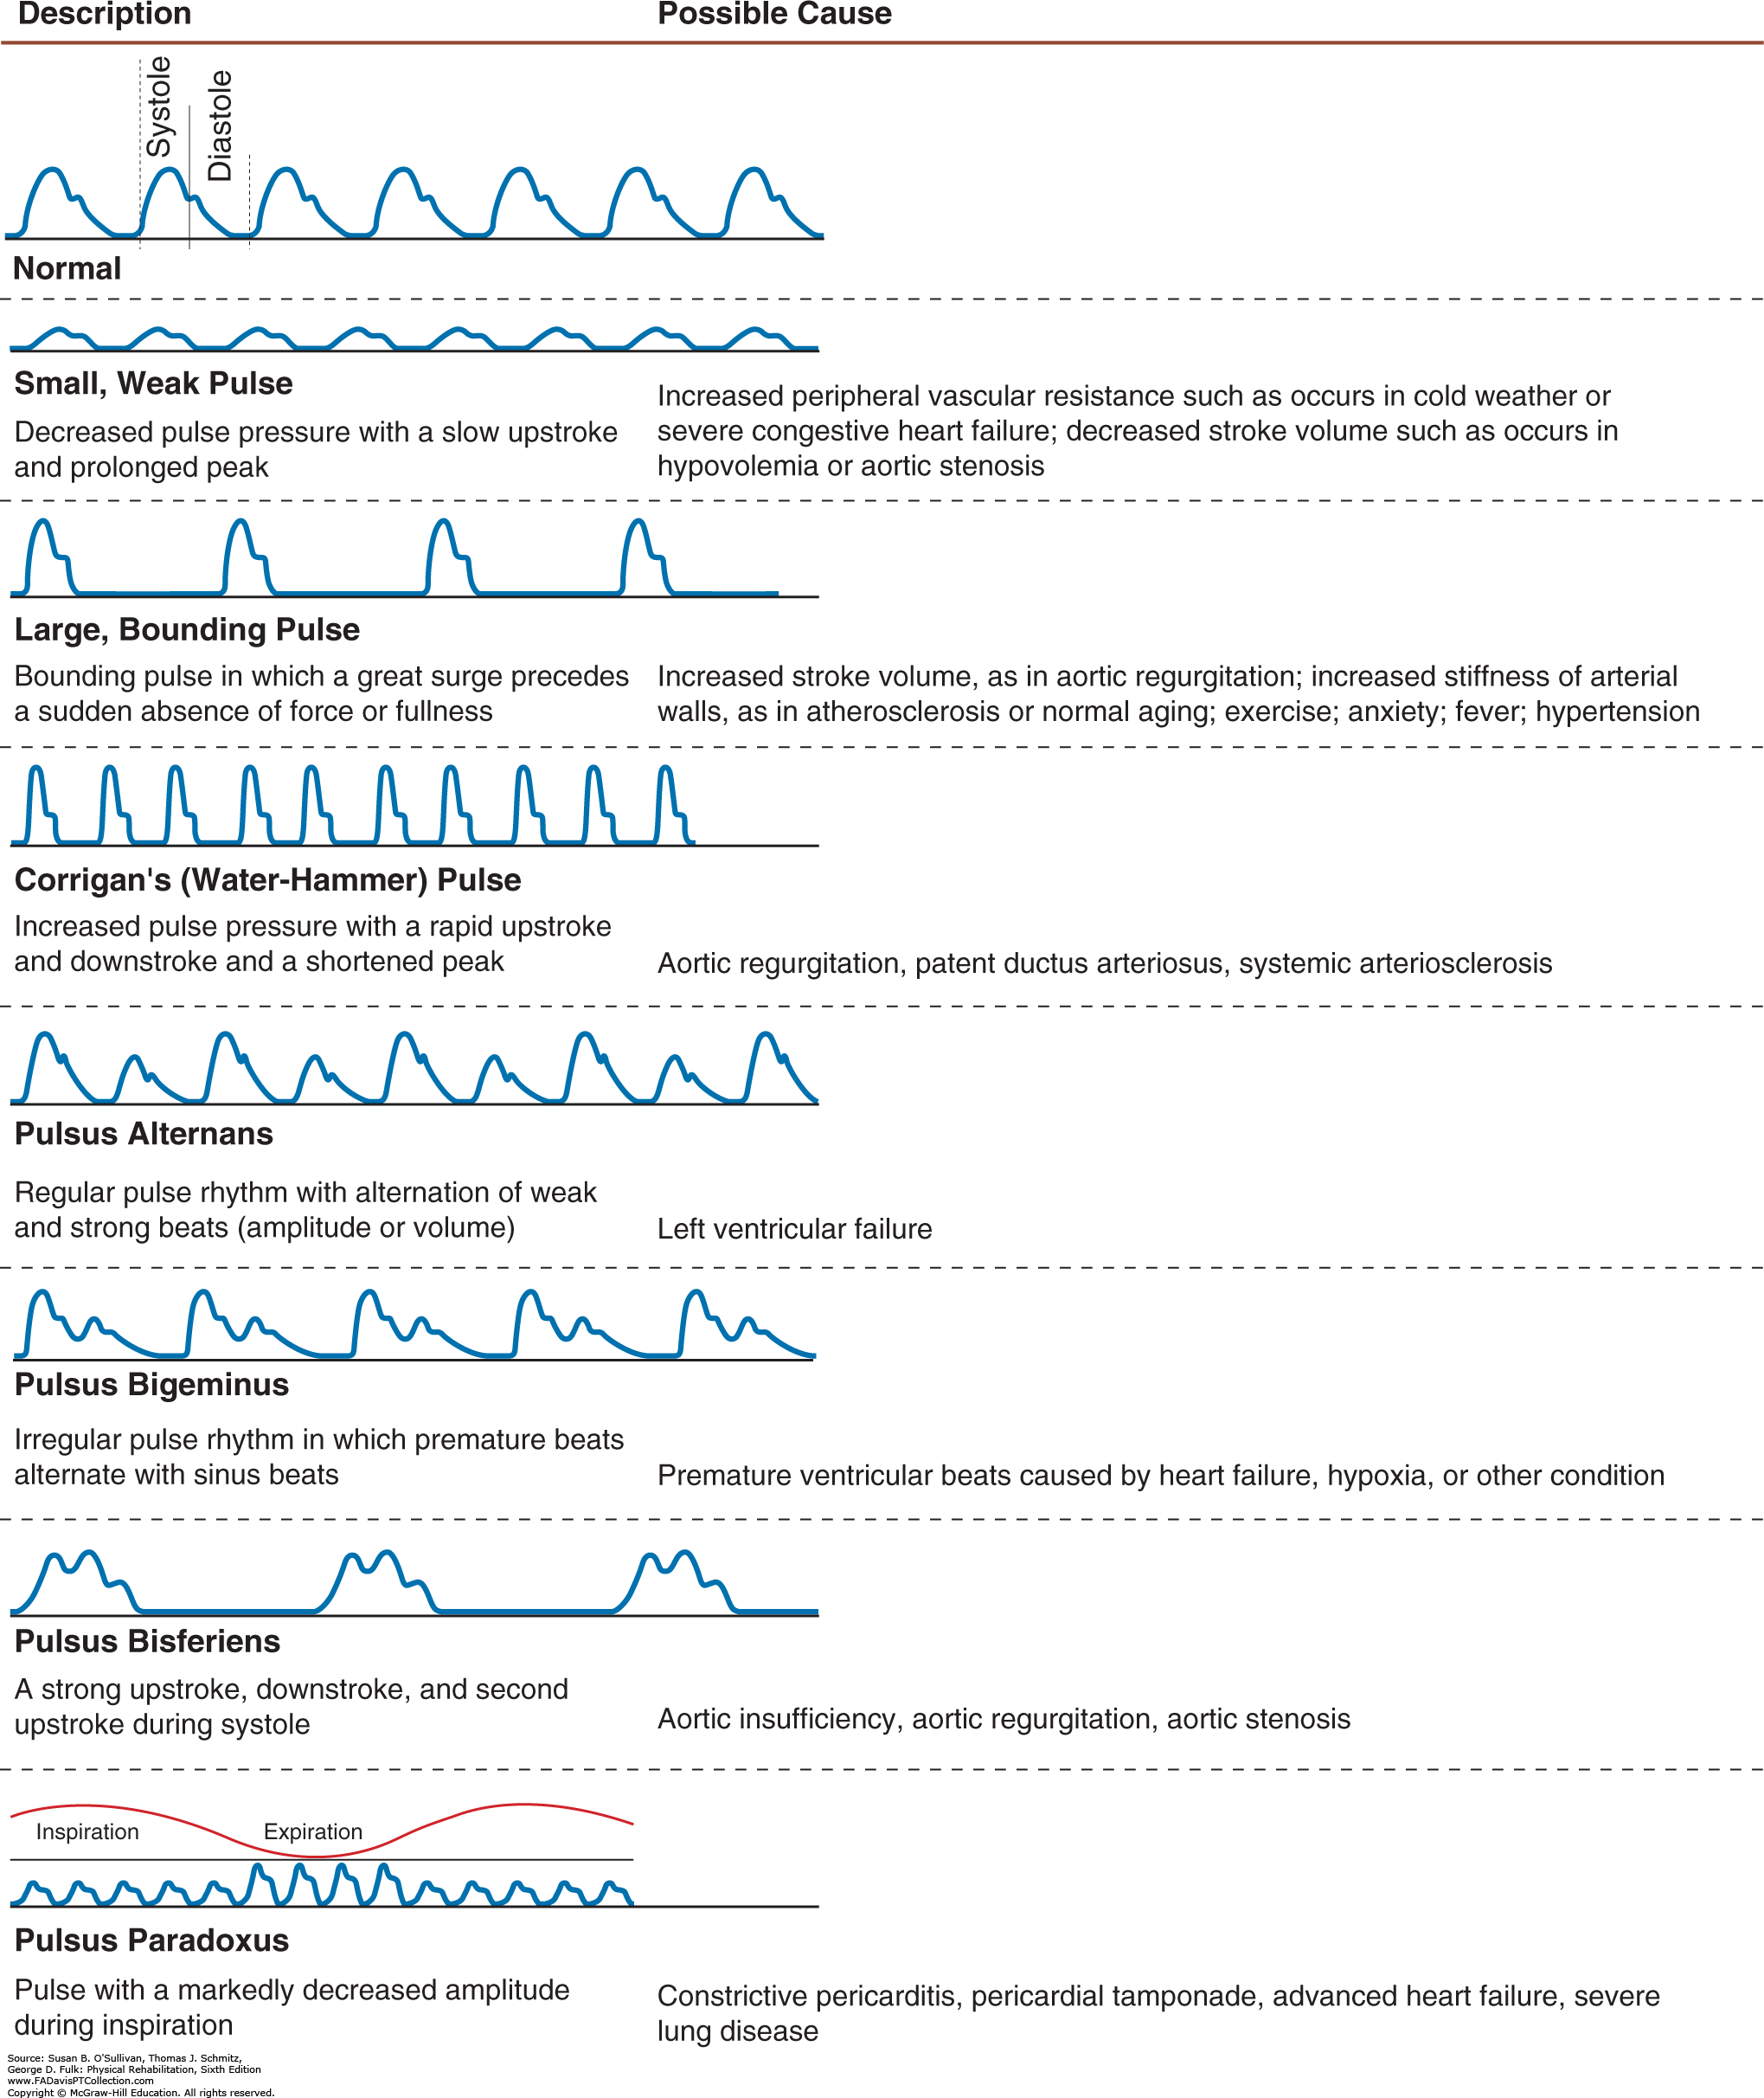

Slide 30
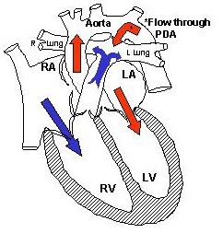
Patent Ductus Arteriosus
5-10% of all congenital heart disease
Persistent remnant of fetal circulation
  Pulmonary vasculature bypass (lungs see ~10% of CO fetally)
  Kept open in fetus by vasodilatory effects of low O2 tension and endogenously produced prostaglandin
At birth drop in PVR and increasing O2 tension cause circular smooth muscle in PDA to constrict, closing in the first few days of life
Very common in premature infants
  <1.2 kg 80%, <1.75 kg 45%

Slide 31
A longstanding large PDA will cause?
A. Dilation of the descending aorta
B. Right atrial enlargement
C. Right ventricular hypertrophy
D. Left atrial enlargement
E. Left ventricular hypertrophy
Notes:
D

Slide 32
Physiology
Increasing left to right shunt as pulmonary vascular resistance falls
Size of shunt dependent on size of ductus and pressure gradient
Increased volume load on left ventricle
  LA and LV dilation
  Heart failure
Increased pressure load on pulmonary vasculature:
  Pulmonary HTN
  Pulmonary vascular congestion

Slide 33
Clinical Signs and Symptoms
Small PDA--Usually asymptomatic
Large PDA– FTT/ Heart failure
Physical Exam
  Bounding peripheral pulses
  Prominent apical impulse
  Thrill at 2nd L interspace, radiating to clavicle
  Machinery-like continuous murmur at left infra-clavicular area radiating to back in older children, variable in preemies
    Diastolic portion of murmur may be absent with increased pulmonary vascular resistance.
  Mid-diastolic rumble at left lower sternal border

Slide 34
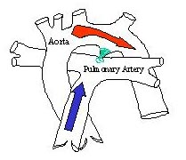
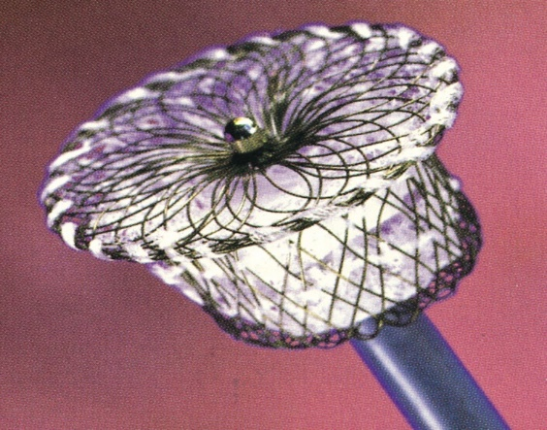
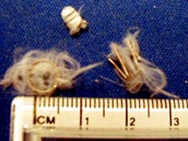
Management
Premies
  Fluid restriction
  Diuretics
  Closure by indomethacin/ibuprofen/acetaminophen or surgery when contributing to respiratory disease or nutritional limitation
Non-preemies
  All audible PDA’s should be closed, for prevention of SBE/Arteritis (after 1 year of age).
  Hemodynamically significant PDA’s should be closed for symptom management or prevention of PAH upon diagnosis
    Transcatheter device
    Surgical ligation

Slide 35
A teenager with coarcation of the aorta may present with what?
A. Headaches
B. Pain in the calves when running
C. Hypertension
D. All of the above
Notes:
D

Slide 36
What is the classic CXR finding is consistent with aortic coarctation?
A. Snowman sign
B. Boot shaped heart
C. Rib notching
D. Sail sign
E. Egg on a string
Notes:
C

Slide 37
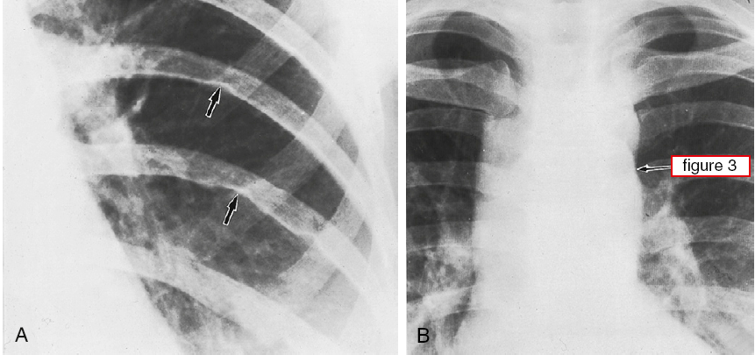
Aortic Coarctation
Notes:
Rib notching
Figure 3 sign

Slide 38
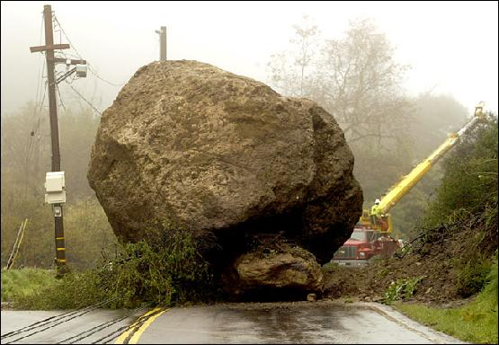
Obstructive lesions
Increased ventricular systolic pressure
Severity depends upon degree of obstruction
Complications
  Myocardial hypertrophy
    →Diastolic dysfunction→Systolic dysfuntion
  Heart Failure
Aim of treatment is to alleviate obstruction prior to irreversible myocardial damage
Exam is characterized by “Systolic Ejection Murmurs”
  Crescendo-Decrescendo

Slide 39
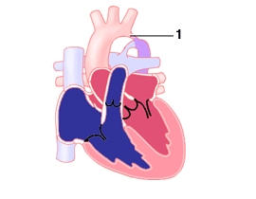
Aortic Coarctation
4/10,000 (0.04%) live births
Narrowing of the aorta
  Varying degrees of severity
98% of cases occur at origin of ductus arteriosus (juxtaductal coarctation)
Common feature in Turner’s Syndrome
“Flow to Grow”
  Thought to be initiated in fetal life by cardiac abnormality that results in decreased anterograde flow through the aortic valve
  Evidence: Associated with bicuspid aortic valve in 70% of cases

Slide 40
Physiology
Increased pressure load on LV
  LVH
  Myocardial Dysfunction
  CHF
Severe coarcts can behave as a cyanotic heart defect
  Ductal dependent
  Shunting of blood right to left across PDA

Slide 41
Clinical Presentation
Neonatal
  CHF
  Cardiogenic shock
Childhood/Adolescence/Adulthood
  Often Asymptomatic
  Pain + weakness in legs with exercise (claudication)
  Hypertension
Physical Exam:
  Upper extremity hypertension
    Upper ext systolic BP higher than lower ext BP
  Differential upper/lower extremity pulses
  Late onset systolic ejection murmur heard in RUSB and back (to the right of the left scapula)
  May have continuous murmurs (collateral vessels)
  Highly associated with bicuspid aortic valve
    Click

Slide 42
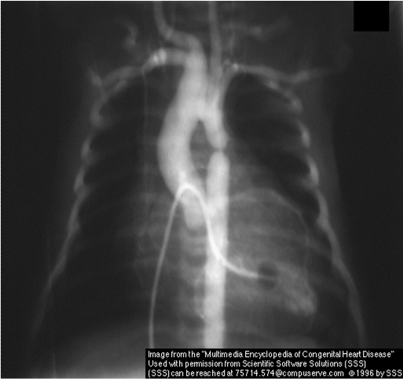

Slide 43

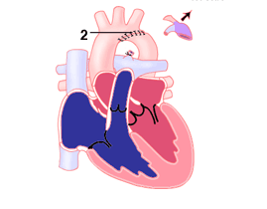
Management
Newborns
  Surgical correction
    Risk of restenosis
Older children/adolescents
  Transcatheter Stent as primary intervention
Complications
  Significant portion of those operated on prior to 1 yr will require revision
  Rebound HTN is common following correction→Most patients need anti-hypertensive medications for a period of time
  Post Coarctectomy Syndrome
    Post-Op mesenteric arteritis→can cause bowel necrosis
    HTN, abdominal pain
    Treated with anti-hypertensive meds, surgical resection of necrotic bowel

Slide 44
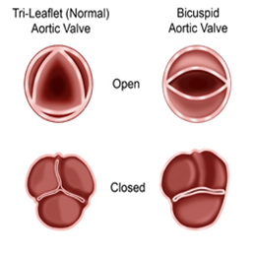
Bicuspid Aortic Valve
Most common CHD (0.5-2% of population)
  Runs in families
    Occurrence of BAV in 9% of first degree relatives of affected individuals
  Only 2% of those with BAV have significant stenosis or regurgitation in childhood.
    A high percentage though will develop valve dysfunction and may require intervention in adult life

Slide 45
50% of children with congenital bicuspid aortic valves will develop…
A. Aortic root dilation
B. Aortic Coarctation
C. Hypertrophic cardiomyopathy
Notes:
A

Slide 46
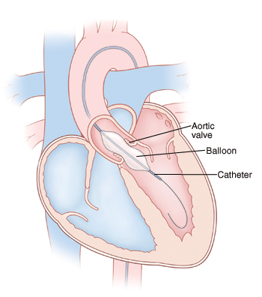
Aortic Stenosis
Can occur at the Subvalvar, Valvar and Supravalvar level
  Valvar AS
    >85% associated with Bicuspid aortic valve
LV outflow obstruction
LVH, myocardial dysfunction, CHF
Harsh systolic ejection (crescendo-decrescendo) murmur at RUSB
  Radiates to suprasternal notch and neck
  May have systolic ejection click
“Critical AS”→ So severe, LV is unable to maintain CO and perfusion (ductal dependent)
  Cardiogenic shock, systolic murmur
  Decreased pulses and BP everywhere
  Marked cardiomegaly/pulmonary edema
Treatment
  Valvar AS
    Balloon valvuloplasty
    Surgical valve repair or replacement
  Surgical resection/repair for supra/sub AS
Supravalvar AS→ William’s Syndrome

Slide 47
What physical exam finding would you expect in moderate-severe valvar pulmonary stenosis?
A. Loud pulmonic component of S2
B. III/VI systolic crescendo/decrescendo murmur at the RUSB
C. II/VI early, decrescendo, diastolic murmur at the LUSB
D. Mid systolic click
E. Soft pulmonic component of S2
Notes:
E

Slide 49
A neonate with “critical pulmonary stenosis” has…
A. A ductal dependent lesion and will present with cardiogenic shock
B. A ductal dependent lesion and will present with cyanosis
C. A high likelihood at developing heart failure symptoms around 6-8 weeks of life
D. Will likely present with an incidental murmur found in the nursery or at the first outpatient visit

Slide 50
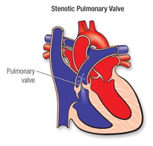
Pulmonary Stenosis
2nd most common congenital heart disease (10%)
  Vast majority are valvar (90%). Also includes Sub or supravalvar PS.
Abnormality of the valve leaflets
RVH develops, rarely RV failure
Presentation:
  SEM in the LUSB, radiates to the back
    +Systolic ejection click along the left sternum
    Soft P2
  ECG: RAE, RAD, RVH
  CXR: RV prominence, MPA enlargement, normal pulmonary vascular markings
  Patient may have decreased exercise tolerance
Course:
  Severe requires intervention
    Balloon valvuloplasty
  Mild tend to not progress and rarely require treatment
  Moderate (>1/2 systemic) can progress over time and may require intervention
Syndrome associations
  Noonans
  Alagille , Williams, Ehlers-Danlos (peripheral pulmonic stenosis)

Slide 51
Next case… Read the Newborn’s ECG

Slide 52
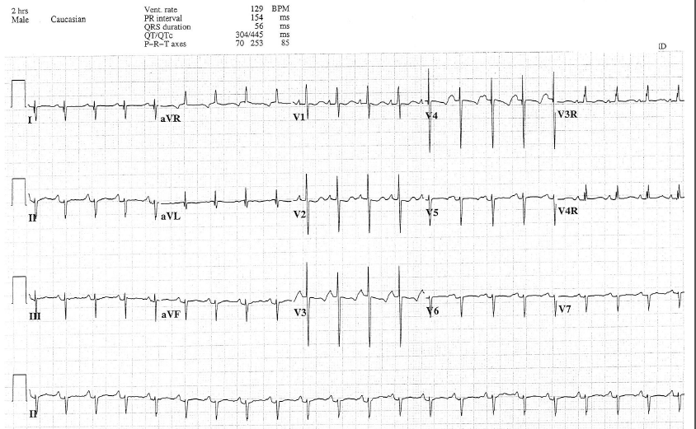
Notes:
2 hour old with dysmorphic features, extreme left/right axis deviation, RVH

Slide 53
AV Canal Defects
Consist of contiguous atrial and ventricular septal defects with abnormal AV valves
Anatomic Variants:
  Complete
    ASD + VSD + Common A-V Valve
  Transitional
    ASD +/- VSD + Common A-V Valve
  Partial
    ASD +/- VSD + Separate A-V Valves

Slide 54
AVC basics
9% of CHD
  CAVC
    75% are “balanced”
      Unbalanced→RV dominant most common
  2/3 of AVC diagnoses associated with Down Syndrome
  7.5% of TOF patients have CAVC (almost always assoc. with Down Syndrome)

Slide 55
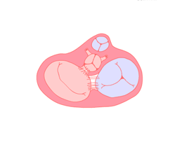
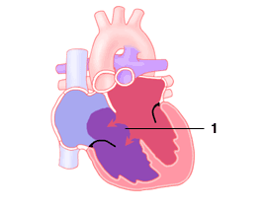
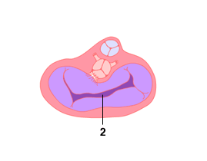

Slide 56
Physiology
Dependent upon size of defects
  Atrial defect
  Ventricular defect
  Large complete defect
    Volume load on both ventricles
    Pressure load on the right ventricle and pulmonary vasculature
  **AV valve regurgitation**
    Additional volume load upon the ventricles

Slide 57
Presentation
May be asymptomatic (ostium primum defects)
Large shunts and/or significant valve regurgitation
  CHF (tends to present earlier)
  Failure to thrive
Physical Exam (CAVC)
  Systolic thrill at LLSB
  Low-pitched mid-diastolic rumbling murmur at LLSB (MV)
  Pulmonary systolic ejection murmur at LUSB
  Harsh apical holosystolic murmur of mitral insufficiency may also be present

Slide 58
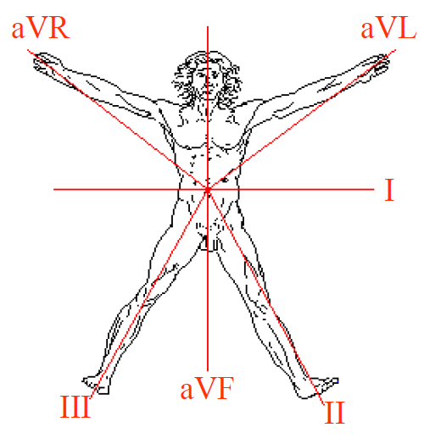
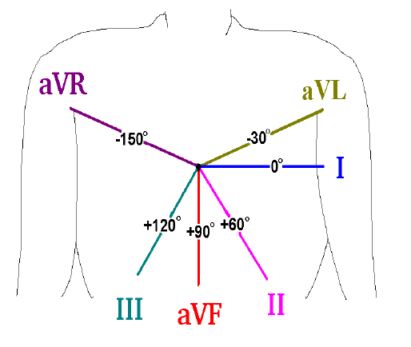
Presentation
EKG
  LAD/Northwest axis (-90-180)
    **For boards** In newborn with LAD
      If patient cyanotic→tricuspid atresia
      If Down Syndrome→AVC defect
  RVH
Chest Xray
  Reflects degree of shunt
  Cardiomegaly
  Increased pulmonary vascular markings/edema
Echocardiogram is diagnostic

Slide 59
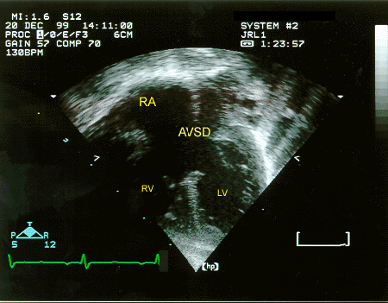

Slide 60
Management
Complete AVC
  Surgical correction ~2-6 months of age (earlier if signs of failure to thrive)
  Patients with Trisomy 21 can have early development of pulmonary vascular disease
Primary atrial shunts are managed similar to ASD’s (“elective” surgical repair in school age).
AV valve regurgitation can frequently complicate need/timing of surgery

Slide 61
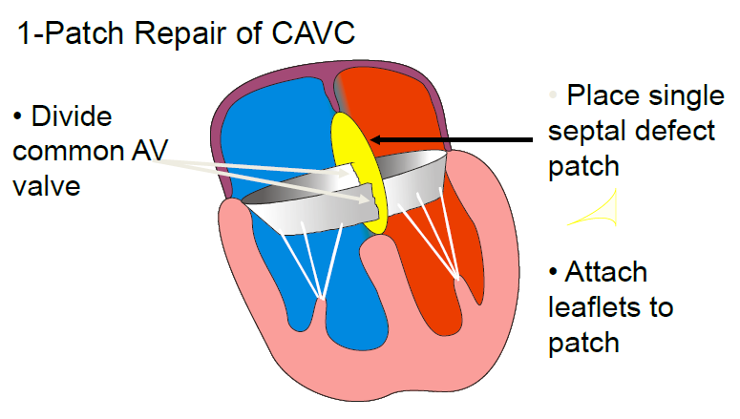
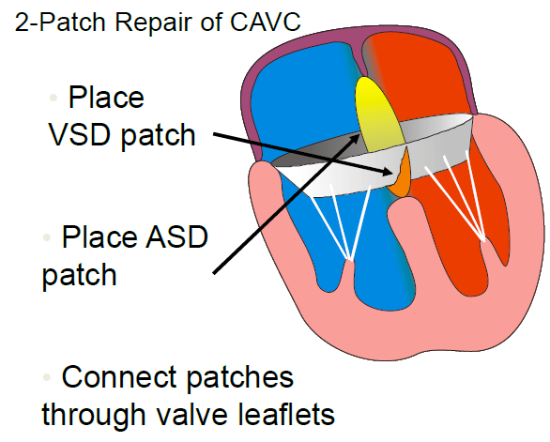
All techniques with good results
  Operative mortality <3%
Complications:
  TR/MR, LVOT obstruction (SubAS), Complete heart block, LV-RA shunt
  ~20% chance of needing a reoperation

Slide 62
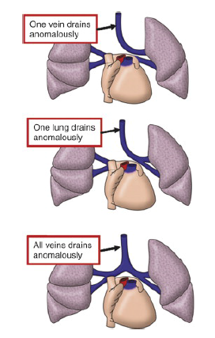
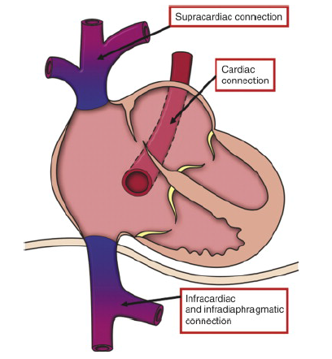
Anomalous pulmonary veins

Slide 63
Anomalous pulmonary venous connection
TAPVC→Cyanotic lesion… to be talked about in congenital heart disease 201
  Rare, 1.5% of congenital heart disease
PAPVC
  Uncertain incidence but much more common
  Can include any number of veins to drain to any number of sites/combinations

Slide 64
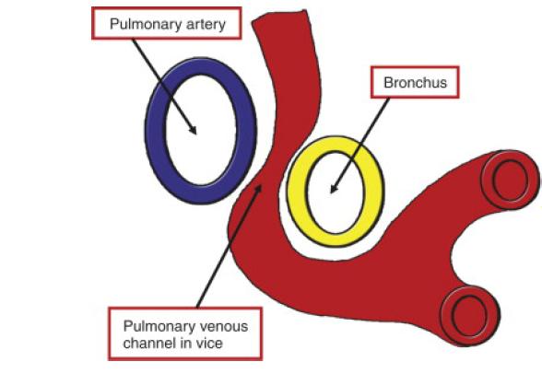
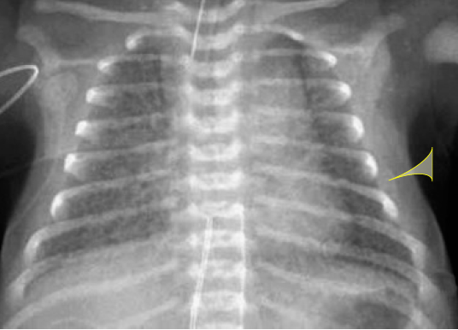
Physiology
PAPVC
  Obligate left to right shunt
    RA and RV volume overload, similar to ASD
  Veins are rarely obstructed
  Depends upon number of veins draining abnormally
TAPVC
  Total mixing lesion
  Atrial shunt MUST be right to left
  Varying degrees of pulmonary venous obstruction
    Severe→Respiratory distress and cyanosis in immediate newborn period
    Snowman Sign

Slide 65
Presentation: PAPVC
Similar to ASD presentation, depending upon degree of shunt
  Typically asymptomatic
Physical Exam
  Widely split S2
  Pulmonary flow murmur
  RV heave
EKG: RAD, RAE, RVH, right ventricular conduction delay
Echocardiogram:
  Signs of right heart enlargement without an atrial communication
  Occasionally can be difficult to visualize all pulmonary venous connections on TTE→TEE or MRA can be useful

Slide 66
Management
Individualized approach
  Based upon number of involved veins, degree of shunt, feasibility of surgical repair.
Surgical intervention
  Long term out comes are good

Slide 67
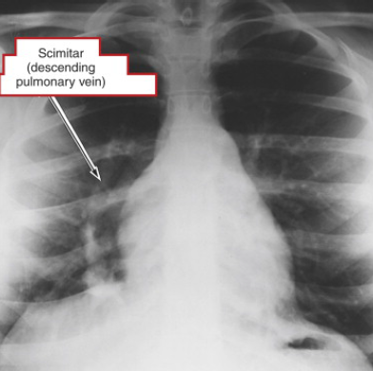

Slide 68
Scimitar Syndrome
Right lung hypoplasia
Dextro-position of the heart
Anomalous drainage of the right pulmonary veins to the IVC-RA junction
Pulmonary sequestration
  Sub-diaphragmatic anomalous pulmonary arterial connections

Slide 69
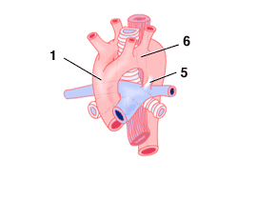
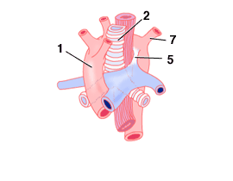
Vascular rings
Congenital anomalies of aortic arch and its branches results in varying degrees of compression of trachea and esophagus
Most common anatomy
  Double aortic arch
  Right arch with left ligamentum arteriosum
Presentation
  Chronic wheezing or stridor
  Chronic vomiting with feeds
Treatment
  Surgical correction

Slide 70
Thank You

