Slide 1
Non-infectious Causes of Prolonged or Recurrent Fevers

Slide 2
Case #1
5 year old female with fever for 8 days
On day 2 of illness, developed bilateral eye redness and swelling of the left neck
On day 6 of illness, developed maculopapular rash of chest and abdomen
Parents noticed that she's also been having chapped lips and she is very irritable

Slide 3
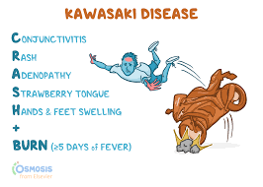
Kawasaki Disease
Inflammatory vasculitis
Affects mostly medium-vessel arteries

Slide 4
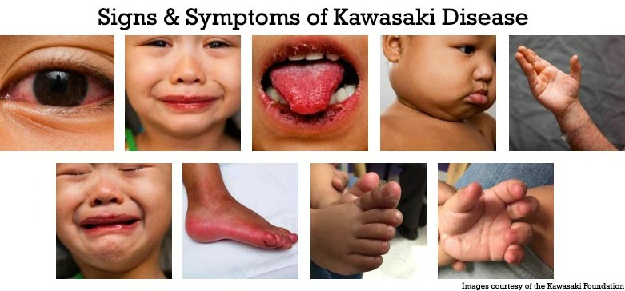
Source

Slide 5
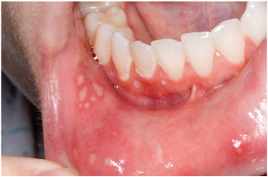
Case #2
2 year old male with recurrent episodes of fever
Associated with mouth sores and neck swelling

Slide 6
PFAPA: Periodic Fever with Aphthous Stomatitis, Pharyngitis, Adenitis
Must have at least 1 of the three symptoms
No associated neutropenia
  Would consider cyclic neutropenia if neutropenic with the typical PFAPA symptoms

Slide 7
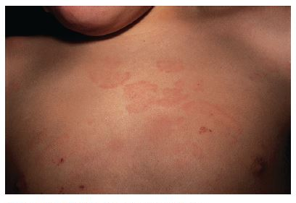
Case #3
8 year old with fever, rash, and knee and hip pain
Recently diagnosed with viral illness with symptoms of fever and sore throat

Slide 8
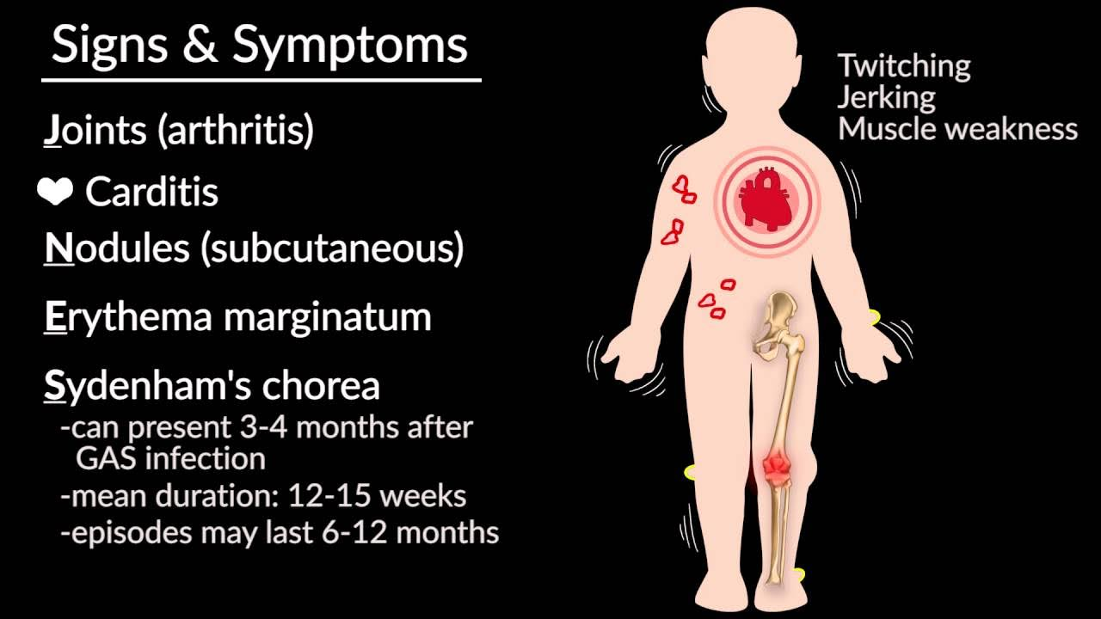
Rheumatic Fever

Slide 9
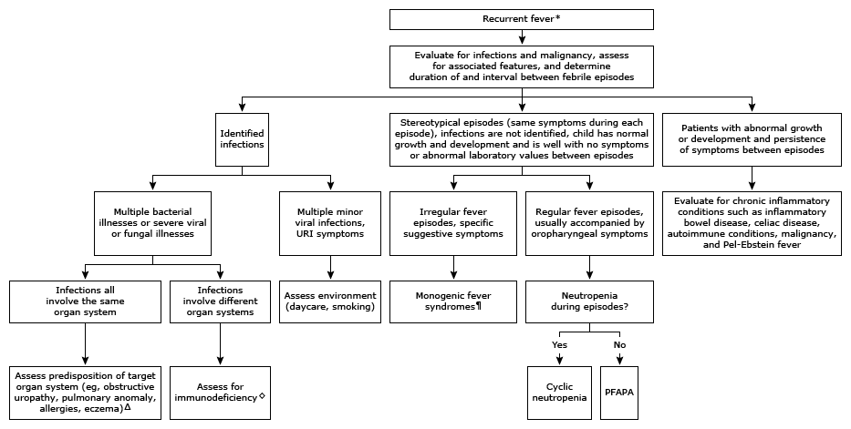
Up-To-Date Recurrent Fever Algorithm

Slide 10
Case #4
10 year old with history of recurrent fevers
Gets a rash when febrile
Has frequent joint swelling
What is the differential?

Slide 11
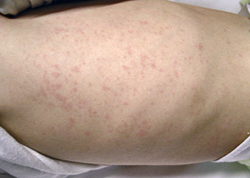
DDx: recurrent fever, rash, and joint pain
Juvenile Idiopathic Arthritis
  Associated symptoms
    evanescent rash
    Arthritis (typically involves multiple joints)
    Uveitis
  Macrophage Activating Syndrome
    Life-threatening
    Associated with inflammation (very elevated ferritin)
    Hepatitis
    Abrupt pancytopenia

Slide 12
DDx: recurrent fever, rash, and joint pain
Systemic Lupus Erythematosus
HARRIET LANE CHAPTER

