Slide 1

Murmurs: when to worry or reassure
Jennifer Tingo, MD
Attending, Pediatric Cardiology
The Children’s Hospital of Philadelphia

Slide 2
Learning objectives
Describe the normal heart sounds during cardiac auscultation
Recite the common types of systolic and diastolic murmurs and their relation to congenital heart disease
Review the characteristics of innocent murmurs

Slide 3
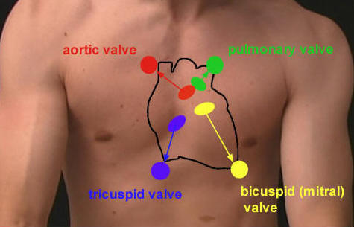
Murmurs
Even before the invention of auscultation, physicians utilized palpation to detect cardiac abnormalities

Slide 4

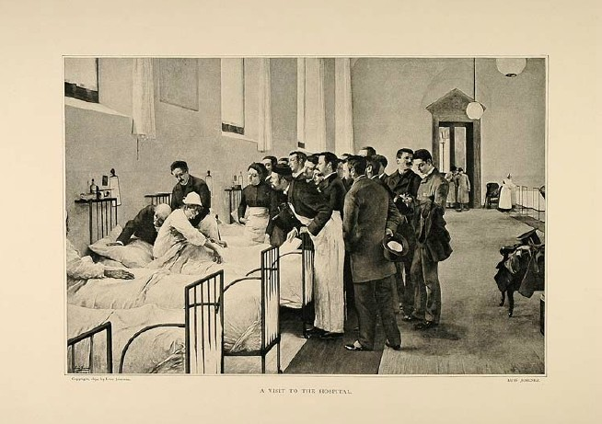
Auscultation of murmurs
In 1816 Rene Laennec created a paper acoustic device as a stethoscope

Slide 5

Auscultation of murmurs
Luckily for us…

Slide 6
Murmurs: overview
Murmurs are audible turbulent sound waves in the range of 20 to 2000 Hz produced by the heart and vascular system
Cardiac murmurs are a common finding in children and represent the most frequent reason for referral to a cardiologist
The majority of murmurs are normal
  Occur in almost 50% of all school aged children
Auscultation, thorough history and appropriate physical exam can help guide the pediatrician toward distinguishing pathologic from benign etiologies

Slide 7


Slide 8

Cardiac Examination
Precordium
    Fully apply the entire palm of the hand to the chest wall to maximize the ability to detect thrills or heaves
    Use the fingertips to localize the apical impulse which should be confined to one intercostal interspace
    Thrills should be sought in the precordial and suprasternal areas utilizing the palmar surface of first two fingers

Slide 9
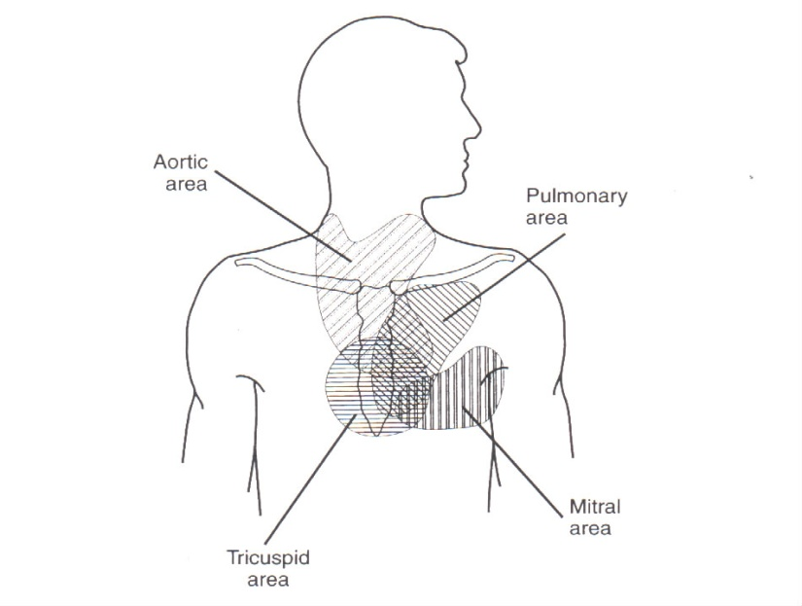
Physical Examination
  Auscultation
    Should be performed under optimal conditions in the supine, sitting and standing positions
    Listen systematically to all aspects of the cardiac cycle in each area utilizing the diaphragm and repeating with the bell
Bell vs. Diaphragm??
Bell allows auscultation of low frequency sounds (ie diastolic rumble, gallop) while the diaphragm is better for high frequency sounds

Slide 10
Classification of Murmurs
Timing
  The relative position within the cardiac cycle and relation to S1/S2 (systole or diastole, early, mid, late)
Intensity
  Grade 1: Heard only with intense concentration
  Grade 2: Faint, but heard immediately
  Grade 3: Easily heard, of intermediate intensity
  Grade 4: Easily heard and associated with a thrill
  Grade 5: Very loud, with thrill and audible with only edge of stethoscope on chest wall
  Grade 6: Audible with stethoscope off the chest wall

Slide 11
Classification of Murmurs
Location on the chest wall with regard to
  The area of maximal intensity
  The extent of radiation
Duration
  The length of time of the murmur
Configuration
  The dynamic shape of the murmur
Pitch
  The frequency range of the murmur
Quality
  The presence of harmonics and overtones

Slide 12
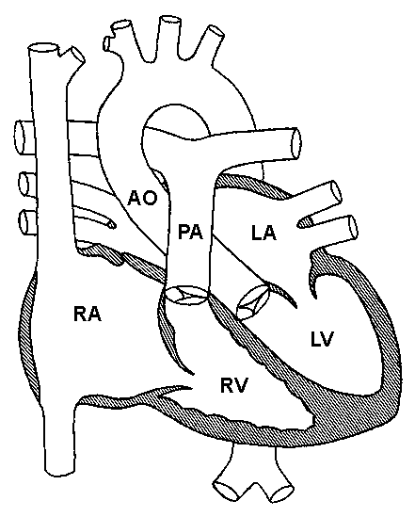
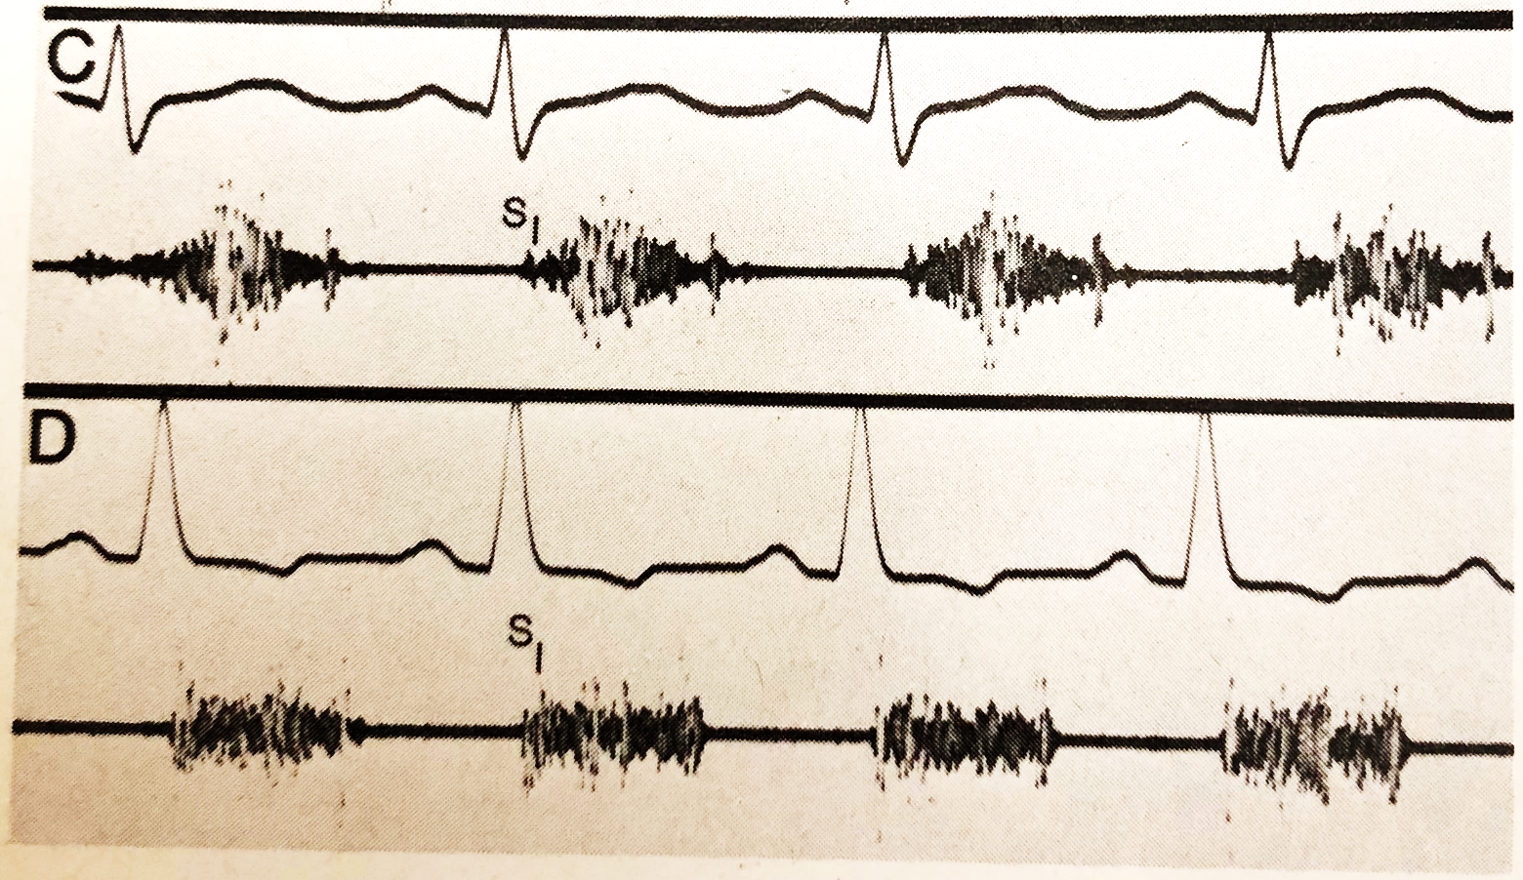

Systolic murmurs
Notes:
C is PS, D is VSD
In systole:
Semilunar valves are open to allow for ventricular ejection
AV valves are closed
Systolic Ejection (Mid Systolic) Murmur
Semilunar valve or outflow obstruction
AS, PS, Coarctation, SubAS, hypertrophic cardiomyopathy
Increased blood flow across the semilunar valves
Hyperkinetic states, anemia
Significant AI/PI
ASD, VSD cause increased flow across the pulmonic valve
Holosystolic
Ventricular septal defect, mitral regurgitation, tricuspid regurgitation

Slide 13
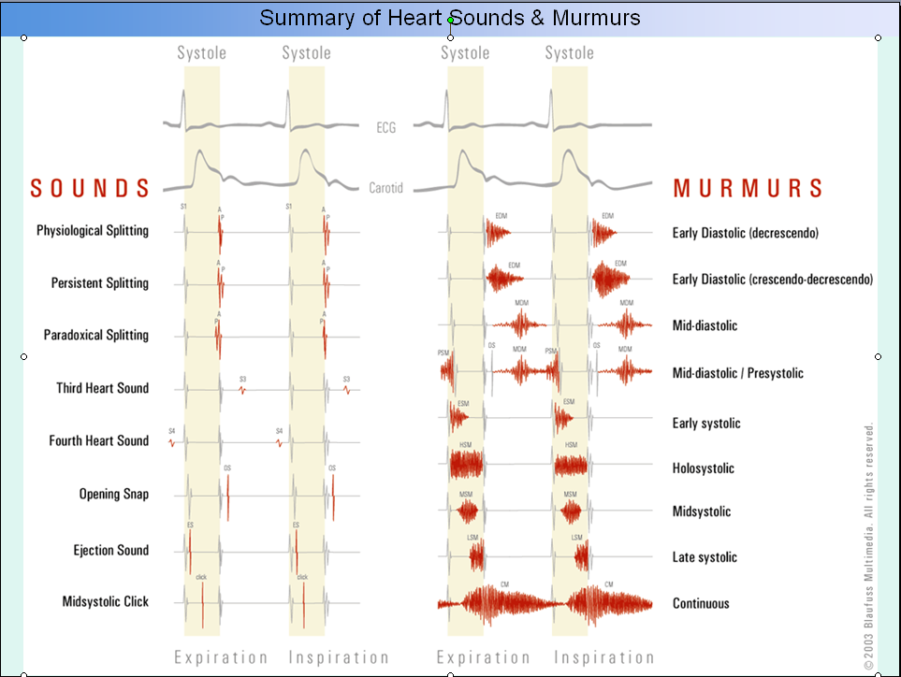
Diastolic murmurs
Notes:
A: PI
B: rumble from significant PI
C: Mild MS
In diastole:
AV valves are open to allow for ventricular filling
Semilunar valves are closed
Early diastolic
Regurgitation, after semilunar valve closure
Aortic regurgitation, Pulmonary regurgitation
High pitched, decrescendo
\
Mid diastolic
Stenosis of an AV valve
Mitral/Tricuspid stenosis, Cor triatriatum
Increased blood flow across nonstenotic mitral valve
Mitral/Tricuspid regurgitation, VSD or PDA (relative MS), ASD or Partial veins (relative TS)

Slide 14
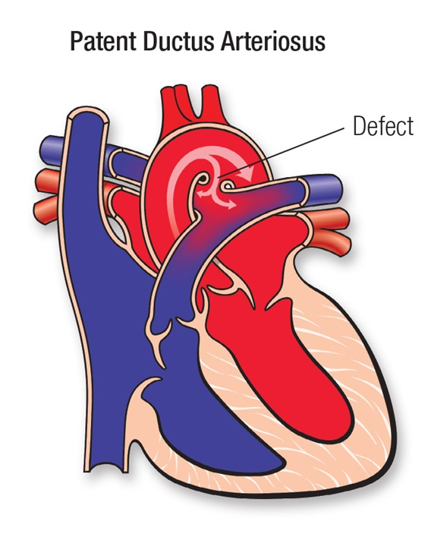
Murmurs by timing
Continuous Murmurs
  Occur as a result of flow through vessels distal to the aortic/pulmonary valves and therefore not confined to systole and diastole
  May be heard through part or all of diastole
  Generally pathologic except Venous Hum

Slide 15
https://www.youtube.com/watch?v=KBVNJtayzbA

Slide 16
When should we worry?
When should we reassure???

Slide 17
Perspective on Index of Suspicion
Diagnosis of CHD is made in:
  46.0% by one week
  88.3% by one year
  98.8% by four years
Pretest probability (physical exam) goes down as age goes up
Older children with murmurs – less likely to have CHD

Slide 18
Index of suspicion continued
Prevalence of innocent murmurs during infancy may be as high as 60%
School-age children – 75-90%
Overall numbers….
  Prevalence of CHD at birth is 8/1000 (not including BAV, PFO)
  School-age children – 3.7-3.9/1000

Slide 19
Pediatric murmurs
Innocent
  Systolic
  Ejection
  Soft or vibratory
  Grade < 3
  Normal S1 and S2
  No extra sounds
  Louder supine
Pathologic
  Diastolic (AR, MS)
  Holosystolic (MR,VSD)
  Harsh
  Grade > 3
  Abnormal S1 and S2
  Extra sounds (click)
  Louder with standing

Slide 20

Case: describe what you hear
14 year old soccer player
Sports physical
MURMUR!!!!!!
What do you do?
Timing: Systolic
Intensity: I-II/VI
Location: LLSB – louder supine
Duration: Early systolic
Pitch: Vibratory/musical/low frequency

Slide 21
WHAT do I not want to miss??
Atrial Septal Defect
  Pulmonary flow murmur
  Fixed split S2
  RA dilation, RAD, RVH, RBBB on EKG
Hypertrophic Cardiomyopathy
  AS murmur, increases with standing, Valsava
  LVH or T wave abnormalities on EKG
https://www.youtube.com/watch?v=Bq5TTgLgZIM
Notes:
First sound→split S2
Youtube clip→S2 nml sounding, not softer like in AS/PS

Slide 22
What should worry you…..
Symptoms
Abnormal vital signs
Loud – grade III or higher
Harsh (subjective)
Additional sounds: Click/Gallop
LUSB or radiating to the back
Diastolic

Slide 23
Characteristics of An Innocent Murmur
Short (early to mid-systolic, except for the venous hum)
Low to medium pitch systolic murmur
Musical/Vibratory
Normal physiological splitting of S2
Commonly found in children & early teen year

Slide 24
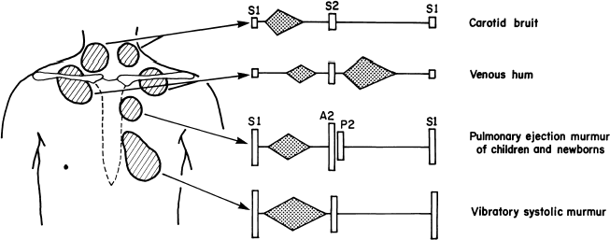

Innocent Murmurs of Childhood

Slide 25
Still’s murmur
Originally described by George F. Still
Very common in childhood
Heard at the LLSB and Apex
Low pitched
Musical, twanging string, vibratory
Mid systolic
Decreases intensity with standing up or Valsalva
  Distinguishes from HCM or small VSD
Accentuated by fever, anemia, exercise

Slide 26
Innocent pulmonary murmur
15% of all innocent murmurs of childhood (Middle/late childhood and adolescence)
LUSB, may transmit to axilla or back
Blowing, medium pitched
Mid-systolic
Variable intensity, softens with standing
Peripheral Pulmonary Stenosis of the newborn
  Short, mid systolic ejection murmur located at high left/right sternal border and radiates to the back and axillae bilaterally
  Occurs exclusively in young infants (Birth to several months of age)
  Relative hypoplasia of PA branches in a newborn, may cause turbulence at the branch points

Slide 27
Venous hum
Continuous murmur
Soft, blowing, low-medium pitched
Most prominent at the high right sternal/infraclavicular area
Accentuated when sitting with neck extended
Disappears with supine position, neck flexion or compression over the jugular vein
  Turbulent flow at the connection between the jugular vein and SVC is thought to cause a venous hum

Slide 28

Good Luck!!!
If there is ever any question, refer!

Slide 29
Thank You!
Questions? tingoj@chop.edu

