Slide 1
Collection of Pat’s Pics: TORCH Infections

Slide 2

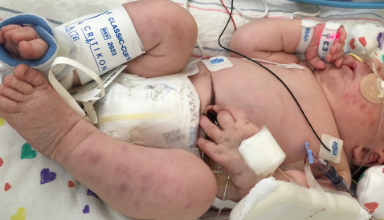
Case 1: A full-term infant born by planned C/S to a mother with gestational diabetes but otherwise uncomplicated pregnancy was noted to have this rash at birth.

Slide 3
Case 1- This infant has a “blueberry muffin” rash and was transferred to the CHOP NICU for further evaluation.
Questions for the clerkship students:
Explain what is meant by a “blueberry muffin” rash and why these skin lesions occur.
Discuss the differential diagnosis for neonatal “blueberry muffin” rash.

Slide 4
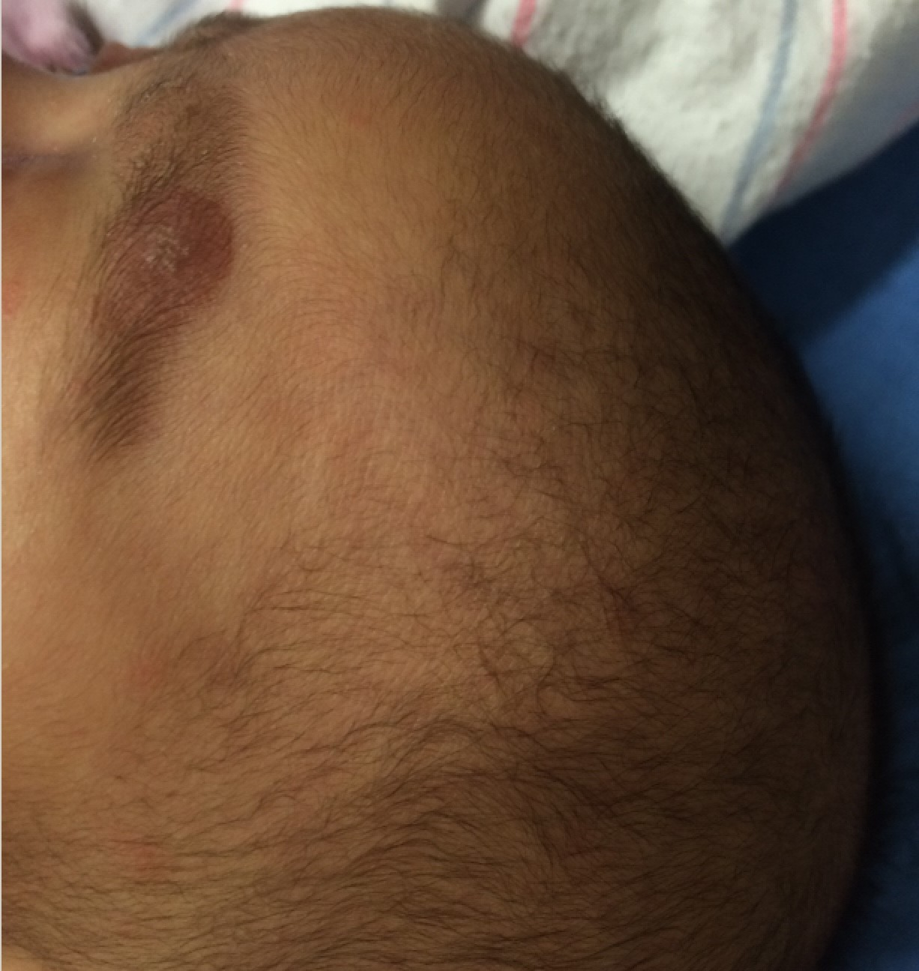
Case 2: 8-week-old presents with a rash
Rash present for 1 month. It was first noted as a circular lesion over her left eyebrow
Aside from the rash, she has been well appearing except for some rhinorrhea and cough for the past 2 weeks
No fever
Normal PO intake

Slide 5
Case 2 continued...
Patient was admitted overnight. The etiology of the lesion remained unclear, so a punch biopsy was performed.
She was stable and so discharged home with scheduled dermatology follow up.

Slide 6
Case 2 Continued...
One week later, the punch biopsy resulted, and the patient's family was instructed to return to CHOP for treatment
Of note, Mom has a dry rash on the palms of her hands and soles of her feet since her 8 month of pregnancy
No history of STIs
She reports that no one else in the household, including the father or the 3-year-old sibling has similar skin lesions

Slide 7
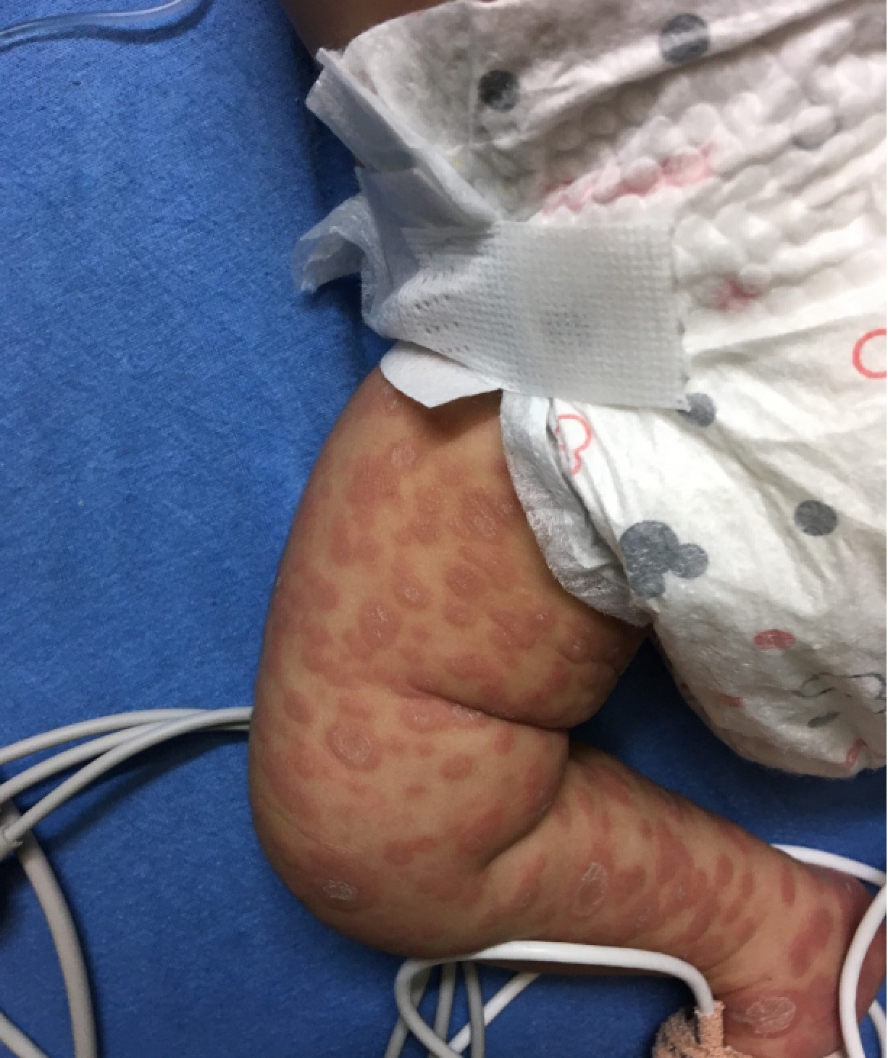
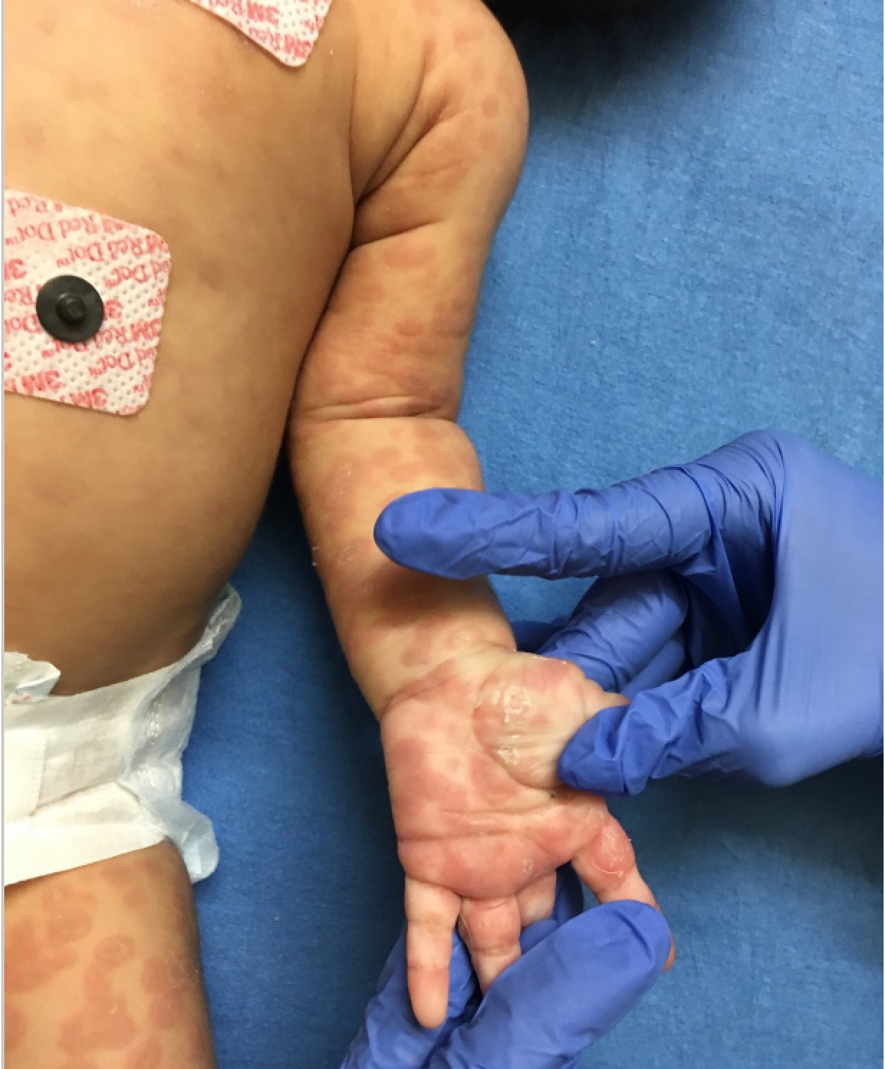
Case 2: Rash on 2nd presentation

Slide 8
Case 2:The punch biopsy was positive for spirochetes confirming a diagnosis of syphilis
Questions for the clerkship students...
What are the early and late clinical manifestations of congenital syphilis?
What tests do we use to screen and confirm congenital syphilis?
How do you treat congenital syphilis?
Name the TORCH infections? How do they present?

Slide 9
Case 3:
Baby girl born by vaginal delivery at 37 1/7 weeks. Pregnancy complicated by intrauterine growth restriction but otherwise normal.
At birth,
  Weight 1.9 kg (0.03%)
  Length 45 cm (1.3%)
  HC 29 cm (<<0.01%)

Slide 10
Case 3:
Given her severe microcephaly and low birthweight, she underwent evaluation for TORCH infections, among other etiologies.
Question for the clerkship students:
What are the TORCH infections?
Discuss some key clinical features of each

Slide 11
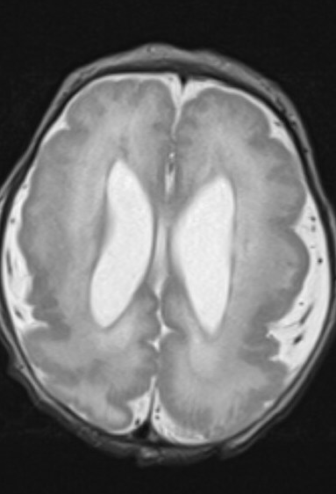
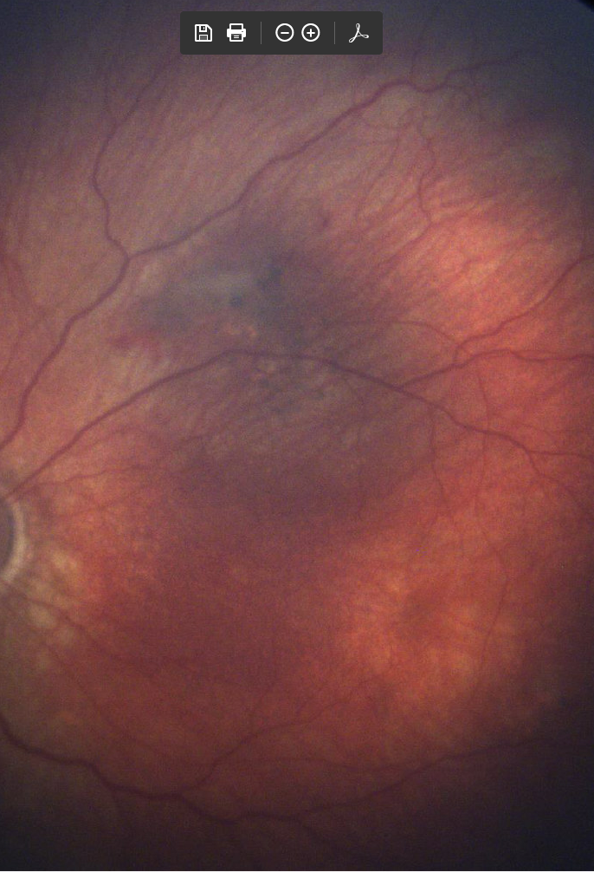
Case 3:
The baby was positive for CMV
Further evaluation revealed CMV retinitis and a brain MRI showed extensive malformation of cortical development characterized by an abnormally underdeveloped sulcation pattern and diffuse polymicrogyria as well as mild enlargement of the lateral ventricles

Slide 12
Case 1:
This baby later developed seizures and was found to have hearing loss related to her congenital CMV
Questions for the clerkship students:
What are the most common long-term sequelae of congenital CMV?
What can be done to prevent congenital CMV?
Discuss potential treatment options for infants with CMV

Slide 13
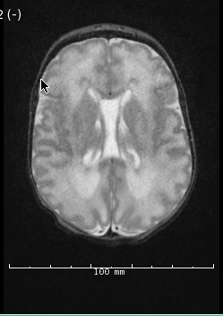
Case 4: A late preterm infant with a history of IUGR is born with hepatosplenomegaly and thrombocytopenia. A brain MRI is performed.
Brain MRI: Periventricular white matter signal abnormality.

Slide 14
Case 4: The patient is diagnosed with congenital CMV.
Questions for the clerkship students…..
What are the characteristic signs and symptoms of congenital CMV infection?
What are the TORCH infections and name 2-3 characteristic signs and symptoms of each.
What should be followed in patients with congenital CMV?

