Slide 1
The Salt Balance
Understanding IV Fluids and Sodium Management in Pediatrics

Slide 2
Case
A 3 year old, 15 kg, patient comes into the emergency room. On exam she looks tired and sleepy with sunken eyes. Her vital signs reveal tachycardia but she does not have a fever.

Slide 3
Case
A 3 year old, 15 kg, patient comes into the emergency room. On exam she looks tired and sleepy with sunken eyes. Her vitals signs reveal tachycardia but she does not have a fever.
What information do you want to know next?
Notes:
Options for additional history: how long has this gone on for? Any vomiting or diarrhea? Anyone known sick contacts? Pertinent past medical or family history?

Slide 4
Additional History
3 days ago her brother caught a "GI bug" at school
Last night she threw up 2 times
Today she has thrown up 3 more times and is unable to keep anything down
The emesis does not contain blood and is not bilious
She last ate dinner last night.
She had 4 episodes of non-bloody diarrhea today. Difficult to track urine output given diarrhea, last void without stool was yesterday evening.
She is healthy with no chronic conditions. There is no cardiac history in the family.

Slide 5
What do you want to do next? What are you most worried about?
Notes:
Obtain vital signs and labs
Worried about extreme dehydration and down-stream effects from that: poor perfusion, low blood sugar, electrolyte abnormalities from dehydration --> seizures, acidosis from vomiting up acid --> metabolic alkalosis

Slide 6
You obtain Vital Signs and get a POC BG
HR 184, BP 84/43
POC BG 72
BMP: Na 157, K 4.7, Cl 100, BUN 25, Cr 0.99

Slide 7
Vital Sign and Labs
HR 184, BP 84/43
POC BG 72
BMP: Na 157, K 4.7, Cl 100, BUN 25, Cr 0.99
She appears fluid down based on exam and BP. You decide to give her a fluid bolus. How much fluid and what type do you want to give? Show your work!

Slide 8
Fluid Management: Fluid Bolus
For fluid boluses to correct losses, consider 10 mL/kg or 20 mL/kg volume
This patient does not have a cardiac history and appears quite fluid down, so we chose 20 mL/kg
We will use isotonic fluid like Normal Saline or Lactated Ringer's, we do not bolus with D5-NS
If she was hypoglycemic, we could consider D-10 bolus to fix the sugar, although this would not address the fluid deficit
Plan to give 20 mL/kg x 15 kg = 300 mL bolus NS

Slide 9
Assess Response to Fluid
You get a repeat set of vital signs after the bolus is in
HR 184, BP 84/43 --> HR 125, BP 96/58
Both HR and BP have trended in the right direction
Now you want to start her on maintenance fluids
What fluid do you choose and what rate should it run at? Show your work!

Slide 10
Fluid Management: Maintenance Fluids
We use the 4-2-1 rule for maintenance fluid rate in kids
Hourly fluid rate =
4 x (first 10 kg of patient weight) +
2 x (next 10kg of patient weight) +
1 x (remainder of patient weight)
For our 15kg child this is: (4x10) + (2x5) = 40 + 10 = 50 mL/hr of D5-NS
When would you want to use something other than D5-NS?

Slide 11
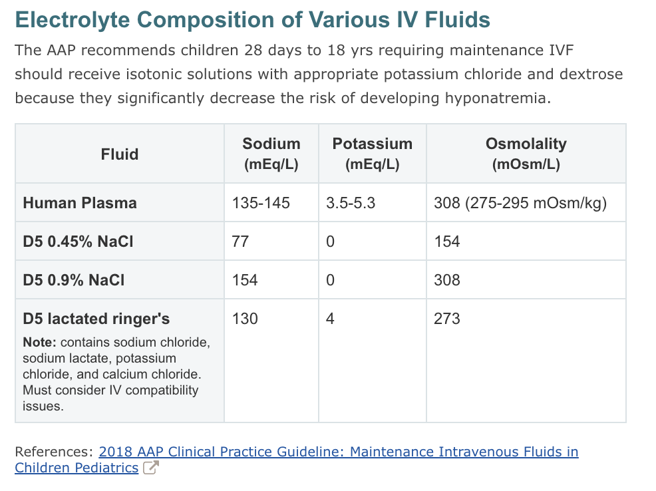
Notes:
-You can choose D5-LR when the patient is acidotic (our patient was alkalotic) OR if you wanted to help with hypokalemia (we also sometimes add K to fluids of D5-NS)
-You can use 1/2NS if the Na was very high or if the patient was a tiny baby

Slide 12
What to make of her sodium?
If you recall the BMP showed a Na of 157 – very high!
How do you approach hypernatremia?
What is your first step in work-up?

Slide 13
What to make of her sodium?
If you recall the BMP showed a Na of 157 – very high!
How do you approach hypernatremia?
What is your first step in work-up?
3 big buckets:
Not enough water in
Too much water out
Increase in salt in
Notes:
Work-up 1) confirm lab is real 2) assess fluid status 3) assess other electrolytes, urine osmolality + electrolytes can be helpful in distinguishing etiology

Slide 14
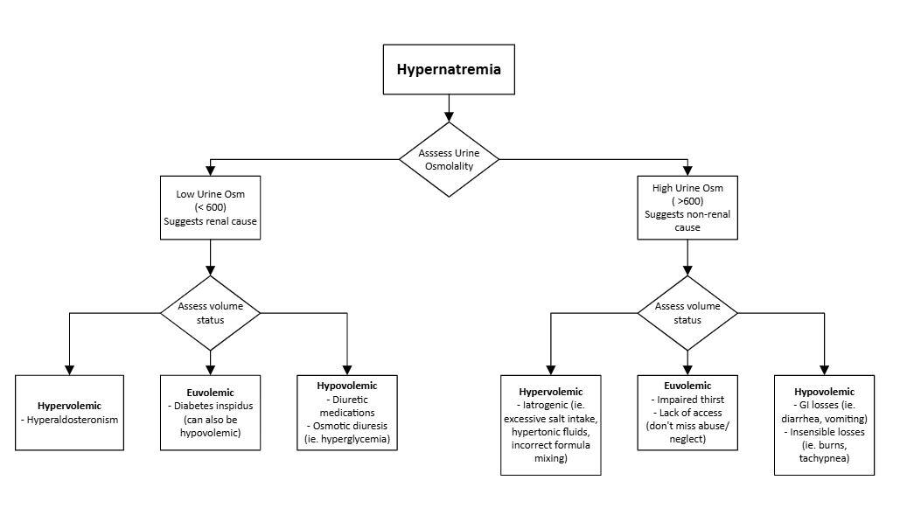

Slide 15
Sodium Correction
We would classify this as Hypovolemic Hypernatremia
The best way to treat this is to slowly correct her fluid status
Abnormal Sodium levels are usually associated with water balance
Can calculate free water deficit (ie. MD Calc) and replace gradually with IV fluids to slowly correct hypernatremia (max decrease Na by 12 mEq/L in a day, or 0.5 mEq/L per hour). If correct too rapidly, risk cerebral edema.
Also be mindful of monitoring and replacing ongoing GI losses

