Slide 1
Hematology

Slide 2
Rashes and Skin Findings
Abnormal Bleeding
Anemia
Blood Smears
Physical Exam finidngs
Fun Facts
$200
$200
$200
$200
$200
$200
$400
$400
$400
$400
$400
$400
$600
$600
$600
$600
$600
$600
$800
$800
$800
$800
$800
$800
$1000
$1000
$1000
$1000
$1000
$1000

Slide 3
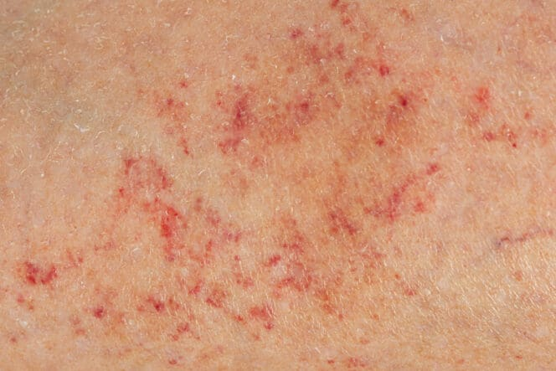
These pinpoint spots are caused by small blood vessels bleeding under the skin.
Rashes/Skin Findings · $200
Notes:
Image: Petechiae: Causes, Treatment & When to See a Doctor | MyVision.org

Slide 4
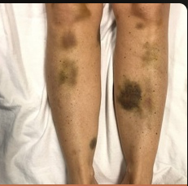
Low platelets can cause this skin finding, which you may also see when you get a black eye. Ouch!
Rashes/Skin Findings · $400
Notes:
Image: Thrombotic thrombocytopenic purpura (TTP) | STROKE MANUAL

Slide 5
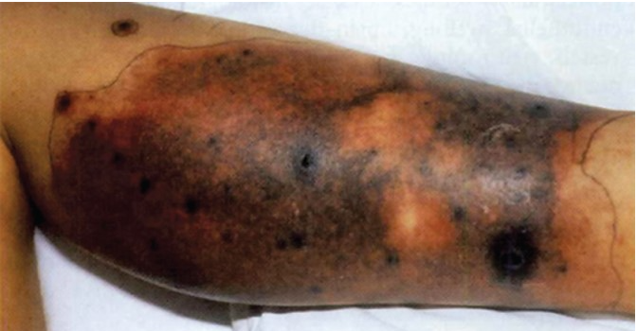
This skin finding can be seen in Disseminated Intravascular Coagulation (DIC).
Rashes/Skin Findings · $600
Notes:
Image: Purpura Diagnosis | AccessMedicine Network

Slide 6
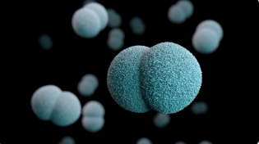
This bacteria can cause meningitis with petechial or purpuric rashes.
Rashes/Skin Findings · $800
Notes:
Image: Meningococcal Disease | Meningococcal | CDC

Slide 7
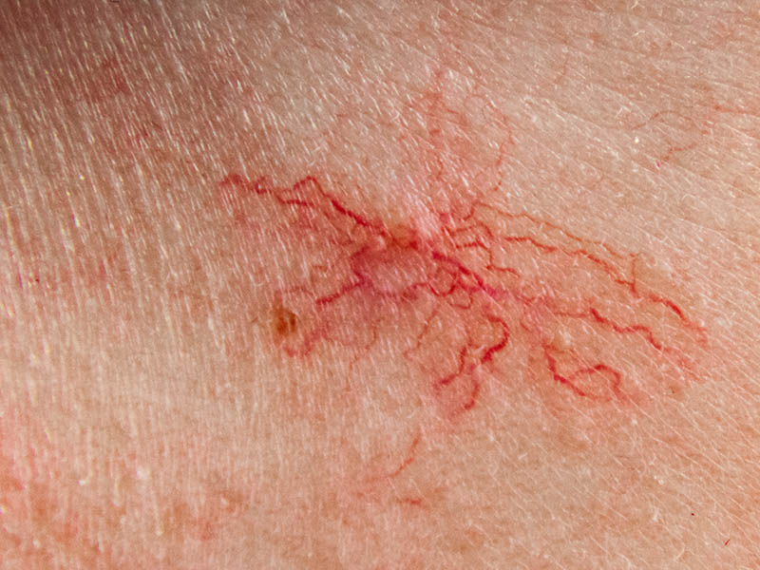
These dilated blood vessels are sometimes mistake for petechiae.
Rashes/Skin Findings · $1000
Notes:
Image: Spot Check | Telangiectasia (broken capillaries)

Slide 8
This vitamin, which is crucial for clotting, is also known as one half of the newborn baby’s “eyes and thighs”.
Abnormal bleeding · $200

Slide 9
These three “pathways” make up the coagulation cascade.
Abnormal bleeding · $400

Slide 10
This inheritance pattern is common to both Hemophlia A and B.
Abnormal bleeding · $600

Slide 11
This disease, named after a Finnish doctor, is the most common inherited clotting disorder in humans.
Abnormal bleeding · $800

Slide 12
While the majority of clotting factors are produced by the liver, this factor is made by the vascular endothelium.
Abnormal bleeding · $1000

Slide 13
Children who are heavy cow’s milk drinkers may have decreased absorption of this element, which is crucial for the production of hemoglobin.
Anemia · $200

Slide 14
Lack of this vitamin, a major component in prenatal supplements, causes a macrocytic anemia.
Anemia · $400

Slide 15
While some kids may find these “chips” sweet and tasty, they can cause a microcytic anemia (among many other problems).
Anemia · $600

Slide 16
This lab test can show if the bone marrow is appropriately responding to decreased levels of hemoglobin.
Anemia · $800

Slide 17
This common inherited blood disorder causes a microcytic anemia that does not singificantly improve with iron supplementation.
Anemia · $1000

Slide 18
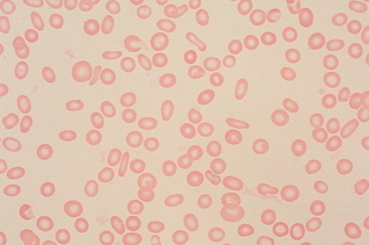
Red blood cells with increased pallor are described as having this characteristic.
Blood Smears · $200
Notes:
Image: Hematopathology

Slide 19
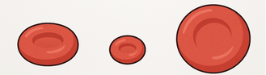
This measure of red blood cell size can help you differentiate between tyes of anemia.
Blood Smears · $400
Notes:
Image: Mean corpuscular volume - Wikipedia

Slide 20
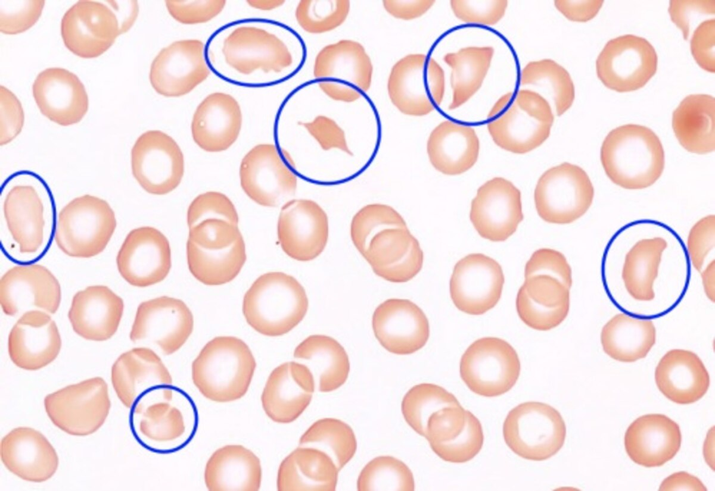
These fragmented red cells are caused by damaged endothelium, such as in TTP or HUS.
Blood Smears · $600
Notes:
Image: Schistocyte - Wikipedia

Slide 21
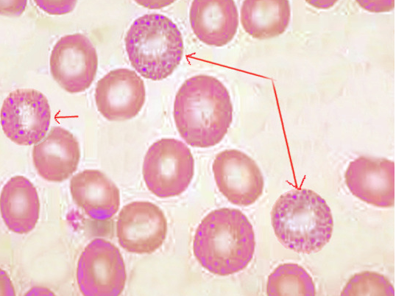
This red blood cell finding can be seen with lead ingestion.
Blood Smears · $800
Notes:
Image: Histology, Basophilic Stippling - StatPearls - NCBI Bookshelf

Slide 22
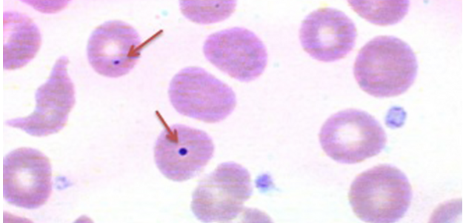
These DNA remnants can be seen in the red blood cells of those with an absent or poorly functioning spleen.
CATEGORY 4 · $1000
Notes:
Image: What is the Howell-Jolly body? | Stanford Medicine 25 | Stanford Medicine

Slide 23
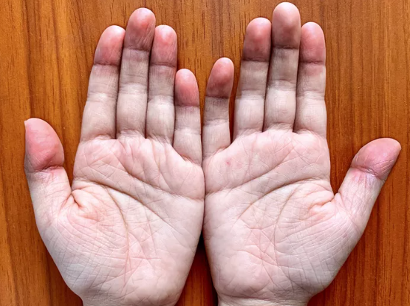
This exam finding can be seen with anemia.
Physical Exam Findings · $200
Notes:
Image: Pallor (Paleness): Types, Symptoms, Causes, & Treatment

Slide 24
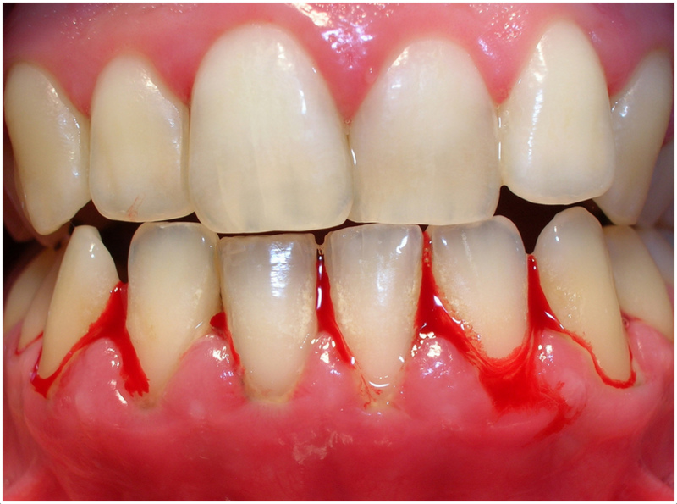
Very low levels of this blood cell can cause this oral exam finding.
Physical Exam Findings · $400
Notes:
Image: Bleeding gums. What does it mean???

Slide 25
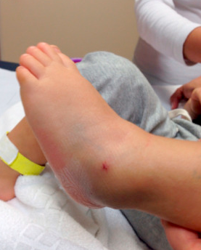
This term refers to bleeding into a joint space.
Physical Exam Findings · $600
Notes:
Image: Hemarthrosis subtalar, a rare diagnosis - ScienceDirect

Slide 26
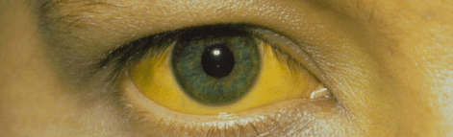
This occular finding can be found with increased hemolysis.
Physical Exam Findings · $800
Notes:
Image: Episode 17: Why does bilirubin deposit in the eyes? – The Curious Clinicians

Slide 27
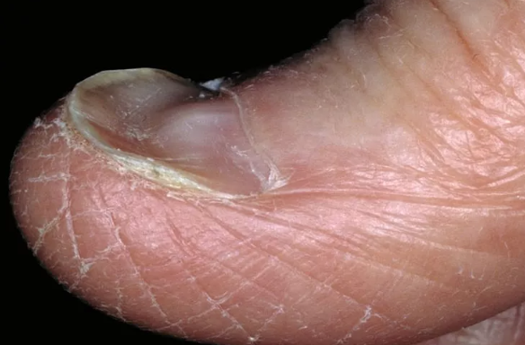
Iron deficiency can cause these types of nails. Though I don’t recommend using them to slurp your soup!
Physical Exam Findings · $1000
Notes:
Image: Anemia Nails: How They Look, Causes, and Treatments

Slide 28
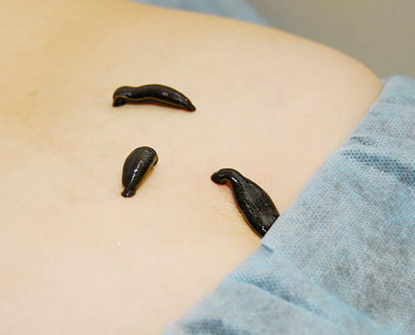
These little creatures are sometimes used to help relieve post-op venous congestion.
Fun Facts · $200
Notes:
Image: How Leeches Can Save Lives And Limbs for Some Patients | University Hospitals

Slide 29
This Dracula-esque spa treatment involves microneedling platelet rich plasma (PRP), and has been linked to at least one HIV outbreak.
Fun Facts · $400

Slide 30
This year marked the discovery of the A, B, and O blood groups.
Fun Facts · $600

Slide 31
If you were a student of the ancient physician Galen, you’d consider blood a part of this funny quartet (along with phlegm, black bile, and yellow bile).
Fun Facts · $800

Slide 32
This coagulation factor may just be the jolliest of them all. Ho ho ho!
Fun Facts · $1000

Slide 33
Answer Key
Rashes/Skin Findings
Abnormal Bleeding
Blood Smears
Physical Exam Findings
Anemia
Fun Facts
Petechiae
Vitamin K
Iron
Hypochromia
Palmar Pallor
Leeches
Ecchymosis aka bruising
Intrinsic, Extrinsic, and Common Pathways
Folate
MCV
Platelets
Vampire Facials
Purpura
X-linked Recessive
Lead Paint Chips
Hemarthrosis
1901
Schistocyte
Neisseria meningitides
VWD
Reticulocyte Count
Basophilic Stippling
The Four Humors
Scleral Icterus
Factor VIII
Howell Jolly Bodies
Spoon Nails aka Koilonychia
Factor IX aka Christmas Factor
Telangiectasias
Thalassemia

