Slide 1
Penn Mental Health AIDS Research Center
Core E: Laboratory Biomarkers, Quantitative Pharmacology, Neuroimaging, and Neurobehavioral Characterization Core
Core Director: Steven D. Douglas, M.D.
Co-Director: Ruben C. Gur, Ph.D.
Co-Director: Athena Zuppa, M.D., M.S.C.E.
January 29th, 2015

Slide 2
Core E: Specific Aims Laboratory Biomarkers
Aim 1
The Core Immunology-Virology Laboratory performs assays of body fluids including plasma and CSF markers related to AIDS and leukocyte markers related to HIV/AIDS, psychiatric disease, and co-morbidities.
Aim 2
The Core maintains a specimen repository, which includes plasma, serum, cells, and DNA.

Slide 3
Core E: Specific Aims (continued) Quantitative Pharmacology
Aim 3
The Quantitative Pharmacology Laboratory utilizes and develops bioanalytical methodology to detect drug and biomarker exposure in various biologic media. Biological assays are performed on cells, plasma, serum, urine, and CSF
The Core provides metabolomic and metabonomic support to identify potential novel biomarkers of drug activity, subject characteristics which correlate with responsiveness to therapy and time-dependent markers of disease progression
The Core performs In Silico and ADME screens in order to examine the interaction between psychotropic drugs and anti-viral drugs
The Core provides pharmacokinetics, pharmacodynamics, and pharmacometric (PK/PD and PM) support to facilitate drug selection, target dosing, and dosing recommendations in all relevant Pilot Projects and interacts with the other Cores.

Slide 4
Core E: Specific Aims (continued) Neuroimaging and Neurobehavioral Characterization
Aim 4
The Center for Neuroimaging in Psychiatry and the Brain Behavior Laboratory performs state of the art assessment of regional brain function in normative and clinical populations.

Slide 5
Core E: Services
Labs by System
Immune/Inflamm |  | Immune | Inflamm | Stress | Coag | Neurodamage | Cardio | General
Fractalkine | MIP-1α | IFNγ | hsCRP | Cortisol | D-dimer | NFH | Fractalkine | CBC
IFN-γ | sCD14 | CD4/CD8 | LPS |  |  | NFL | sICAM | Glucose
IL-1β | sCD163 |  | Neopterin |  |  |  | sVCAM | β-hCG
IL-6 | sICAM |  | sCD163 |  |  |  |  | Viral load
IL-8 | sVCAM |  |  |  |  |  |  | Genomic DNA
IL-10 | TNFα
MCP-1 | TNFα-R1
Monocyte and NK flow cytometry panels are available, as appropriate, for Pilot Projects.

Slide 6
Core E: Services
Labs by Comorbidities
Cardiac | Renal/Liver | Psychiatric
Creatine Kinase | Creatinine | Cortisol
Na | Na | IL-6
K | K | TNFα
AST | Cl | hsCRP
HDL | Ca | IFN-γ
LDL | BUN | CD4/CD8
Triglycerides | Total bilirubin
Cholesterol | Direct bilirubin
Glucose | Total protein
 | ALP
 | AST
 | ALT
 | CO2
 | Albumin

Slide 7
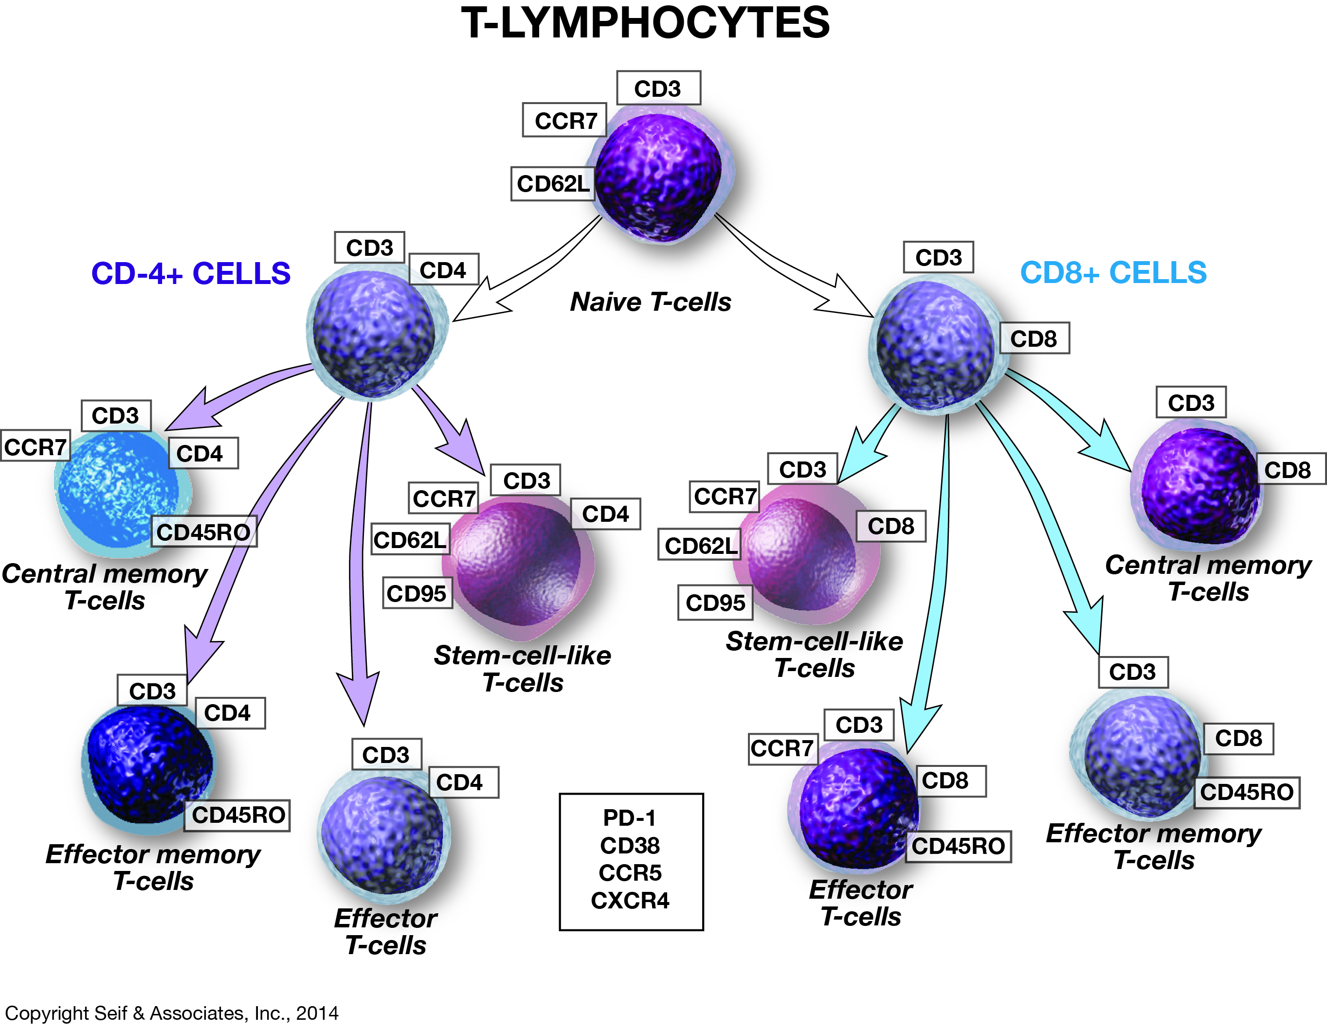

Slide 8
Core E: Services Peripheral Blood Leukocyte Cell Phenotypes T cell phenotypes:
Naïve T cells:
CD3+
CD4+ or CD8+
CCR7+
CD45RO-
CD62L+
CD95-
Central memory T cells:
CD3+
CD4+ or CD8+
CCR7+
CD45RO+
Effector memory T cells:
CD3+
CD4+ or CD8+
CCR7-
CD45RO+
Effector T cells:
CD3+
CD4+ or CD8+
CCR7-
CD45RO-
Stem cell-like T cells:
CD3+
CD4+ or CD8+
CCR7+
CD45RO-
CD62L+
CD95+

Slide 9
Core E: Services Peripheral Blood Leukocyte Cell Phenotypes Monocyte and NK Cell phenotypes
Classical monocytes:
CD14 high
CD16 low
Intermediate monocytes:
CD14 high
CD16 positive
Non-conventional monocytes:
CD14 low
CD16 high
Typical NK cells, ~90% (mainly cytotoxic):
CD56dim
CD16 high
NK cells precursor-like ~10% (more specialized on cytokine production):
CD56 bright
CD16 low

